Slide 1
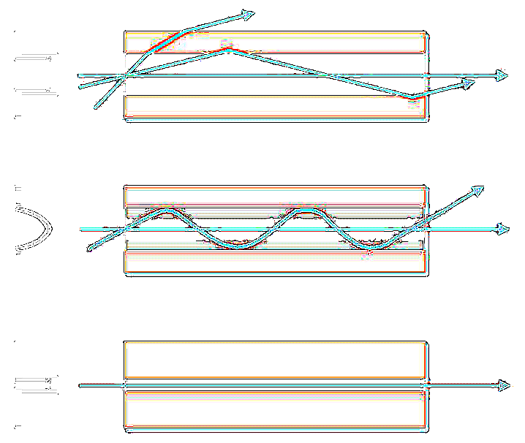
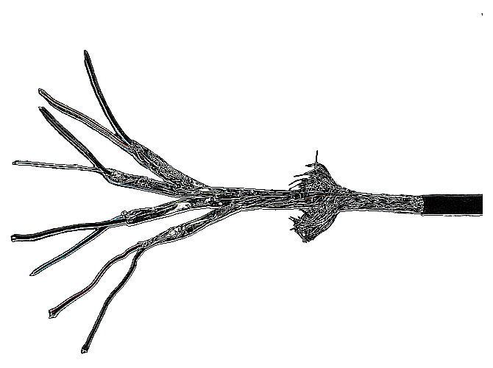
The long and Winding road to 10Gbit(+) in the home
& the current state of Network Connectivity options generally
Joel Pauling | joel@aenertia.net | @aenertia – on the tweeters/IRC/g+/github/$etc
LCA 2018 - 24-01-2017

Slide 2



Who am I
https://github.com/aenertia
@aenertia
https://plus.google.com/u/0/+JoelWir%C4%81muPauling

Slide 3



Slide 4
The Problem

Slide 5


The Problem – Some more context
25/100G in the DC now becoming interconnect standard
10G Owns Commodity DC (still a bit of Oddball around)
GigE owns commodity DC
Log!
Era of Oddball in the DC
GigE owns Home Network
10 GigE(2002/6)
GigE Standardized (1998)
Fast Ethernet – 100BaseT (1995)
XGS/NG-PON 40Gbit Access being deployed
1Gbit Access common
ADSL/CMT/Wireless starts to outnumber Dial up
Access networks in excess of 100mbit common/ Cellular services now faster than older fixed access. Wireless and old 100mbit in home; now major source of bottleneck
Dialup

Slide 6

Access Network hand-off is now becoming commonly better than what Home Networks can Handle
If you had told me this 15 years ago I likely would have laughed

Slide 7
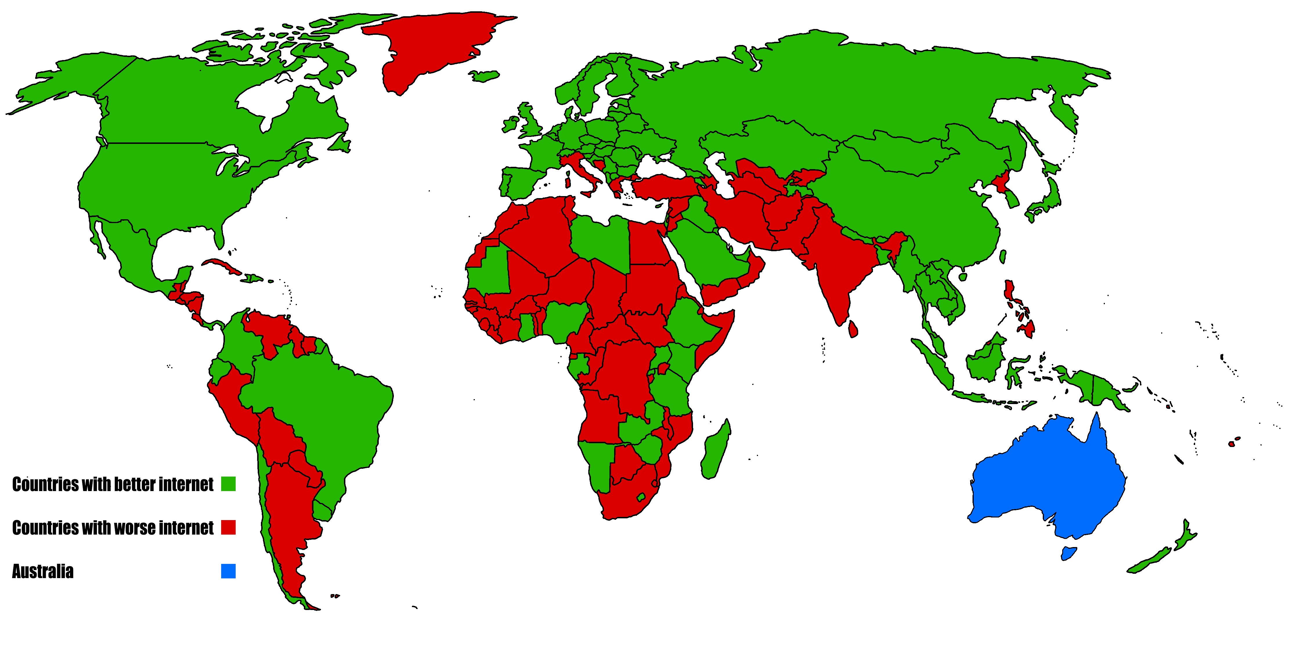

Commonly ; in many places at least

Slide 8
Average access connection speed here Is 264Mbps (Dunedin)

Slide 9
There are a lot of moving pieces to the Puzzle
Cracks In the Path
Wiring and Cable Connector Standards
Architectures on the PC as well as SoC (System on a Chip) in Consumer Gateway kit being fit for purpose and more importantly having fully usable Open Architectures
Latency and PPS (Packet Per Second) processing in the Mainline Kernel (is being worked on – this isn’t really a problem for home networks… yet)
Wireless and consumer perceptions and expectations have muddied the situation
Consumer gear STILL using 100Mbit interfaces in brand new product I.e SmartTV’s
Power Consumption and Legacy compatibility
Cost

Slide 10
In-home wiring standards
A non-exhaustive search of stuff i’ve found lying around in my own and others houses through the last 20 years

Slide 11
In home Structured Cabling Standard is just gone for review in New Zealand and Australia – Open submissions requested in Sept – unsure where this process is at the moment (but the document is closed paid for subscription, boo!)
AS/NZS 14763.3:2017
AS/NZS 3080

Slide 12
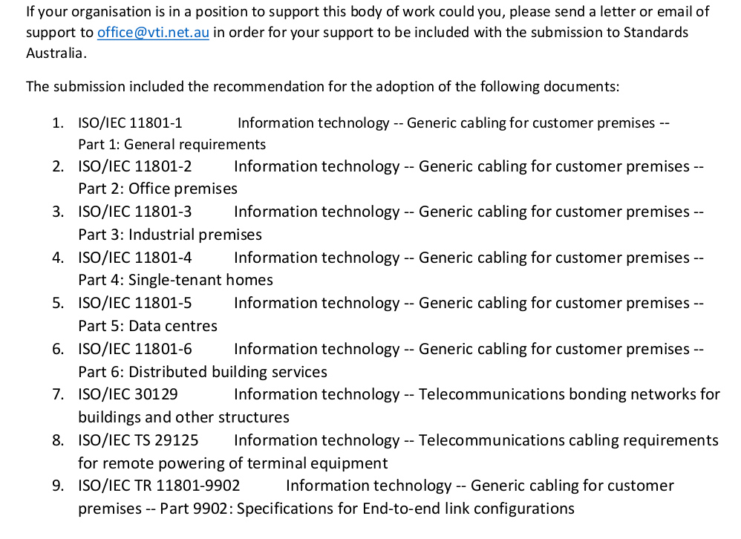
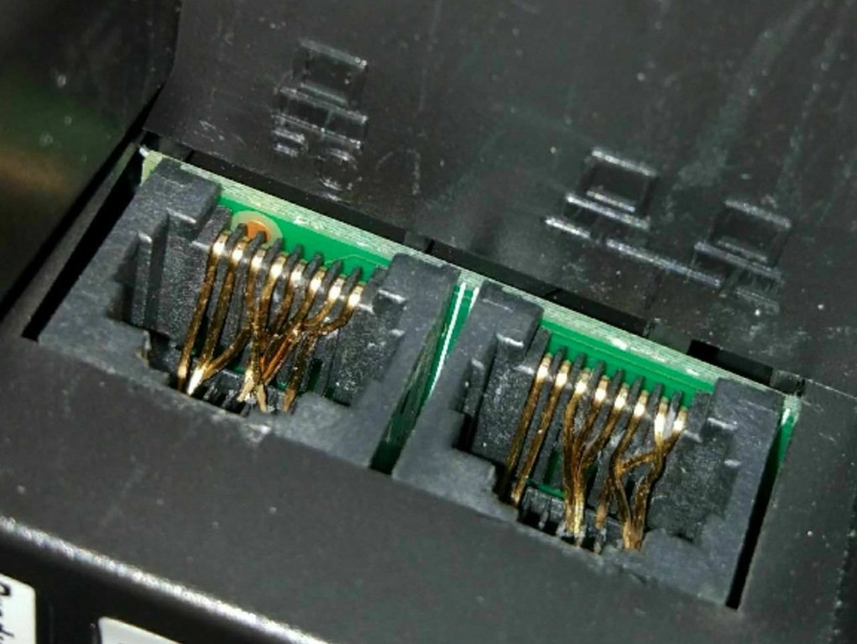
Strongly suggest anyone involved with Open Governance, or and or has an interest– try and figure out why this stuff is 300$ a copy and not open. And perhaps approach local representatives to look into it please.

Slide 13
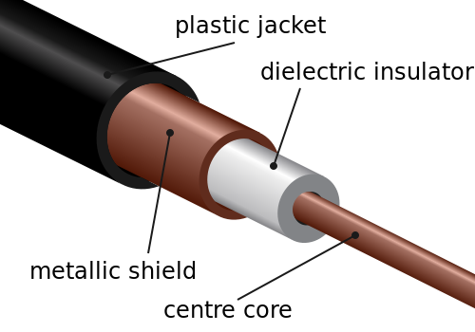
Cables and Connectors - Coaxial
Been around a Long time
Was first widely used as Home cabling type for fast networks (BNC 2.9-10Mbit Eth/IPX) late 1980-1990’s
Bus architecture (signals share common medium/carrier)
Widely used today still for Access Networks (Docsis/Cable Modems) in Hybrid Fibre/Coax networks
Pretty damn good electrical scaling characteristics for a medium thats been around this long (10Gbit Docsis3.1 ratified 2017)
Rarely seen today in home networks beyond the CPE interconnect. But it’s still everywhere in homes (AV/etc)
BUT ….

Slide 14
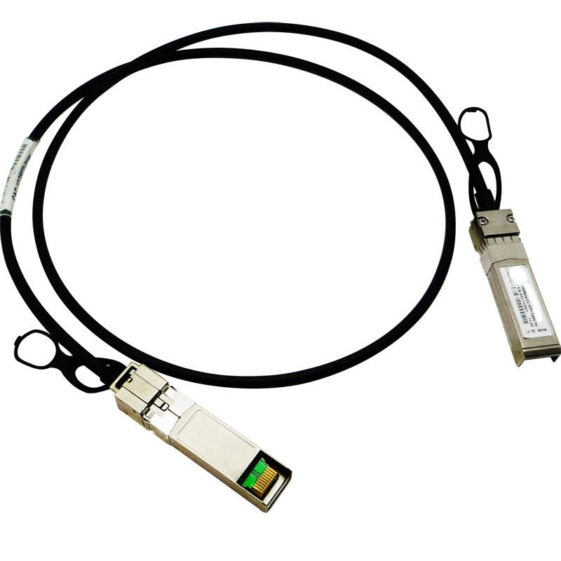
Cables and Connectors - Twinax
TwinAx is the current undisputed owner of in-rack Network to Switch connection Technologies in the Datacentre
It’s basically two (or more) of Coaxial cables in a single Jacket
Short runs up to 8 Meters
Happily supports 100Gbit Ethernet. 400Gbit CR4 is about
Used to be common for some older oddball network Kit – seen resurgence during switch to 10Gbit mid 2000’s due to cost
I’ve yet to see it in homes – short runs, low bend radius/can be pretty bulky – is coupled to SFP+/QSFP+ form factor Electro-Electrical generally (I.e the ‘optics’ are sold pre-attached to cable) – known as DAC (Direct Attach)
Commonly used as ‘squid’ breakout (100G – 4*25G)

Slide 15
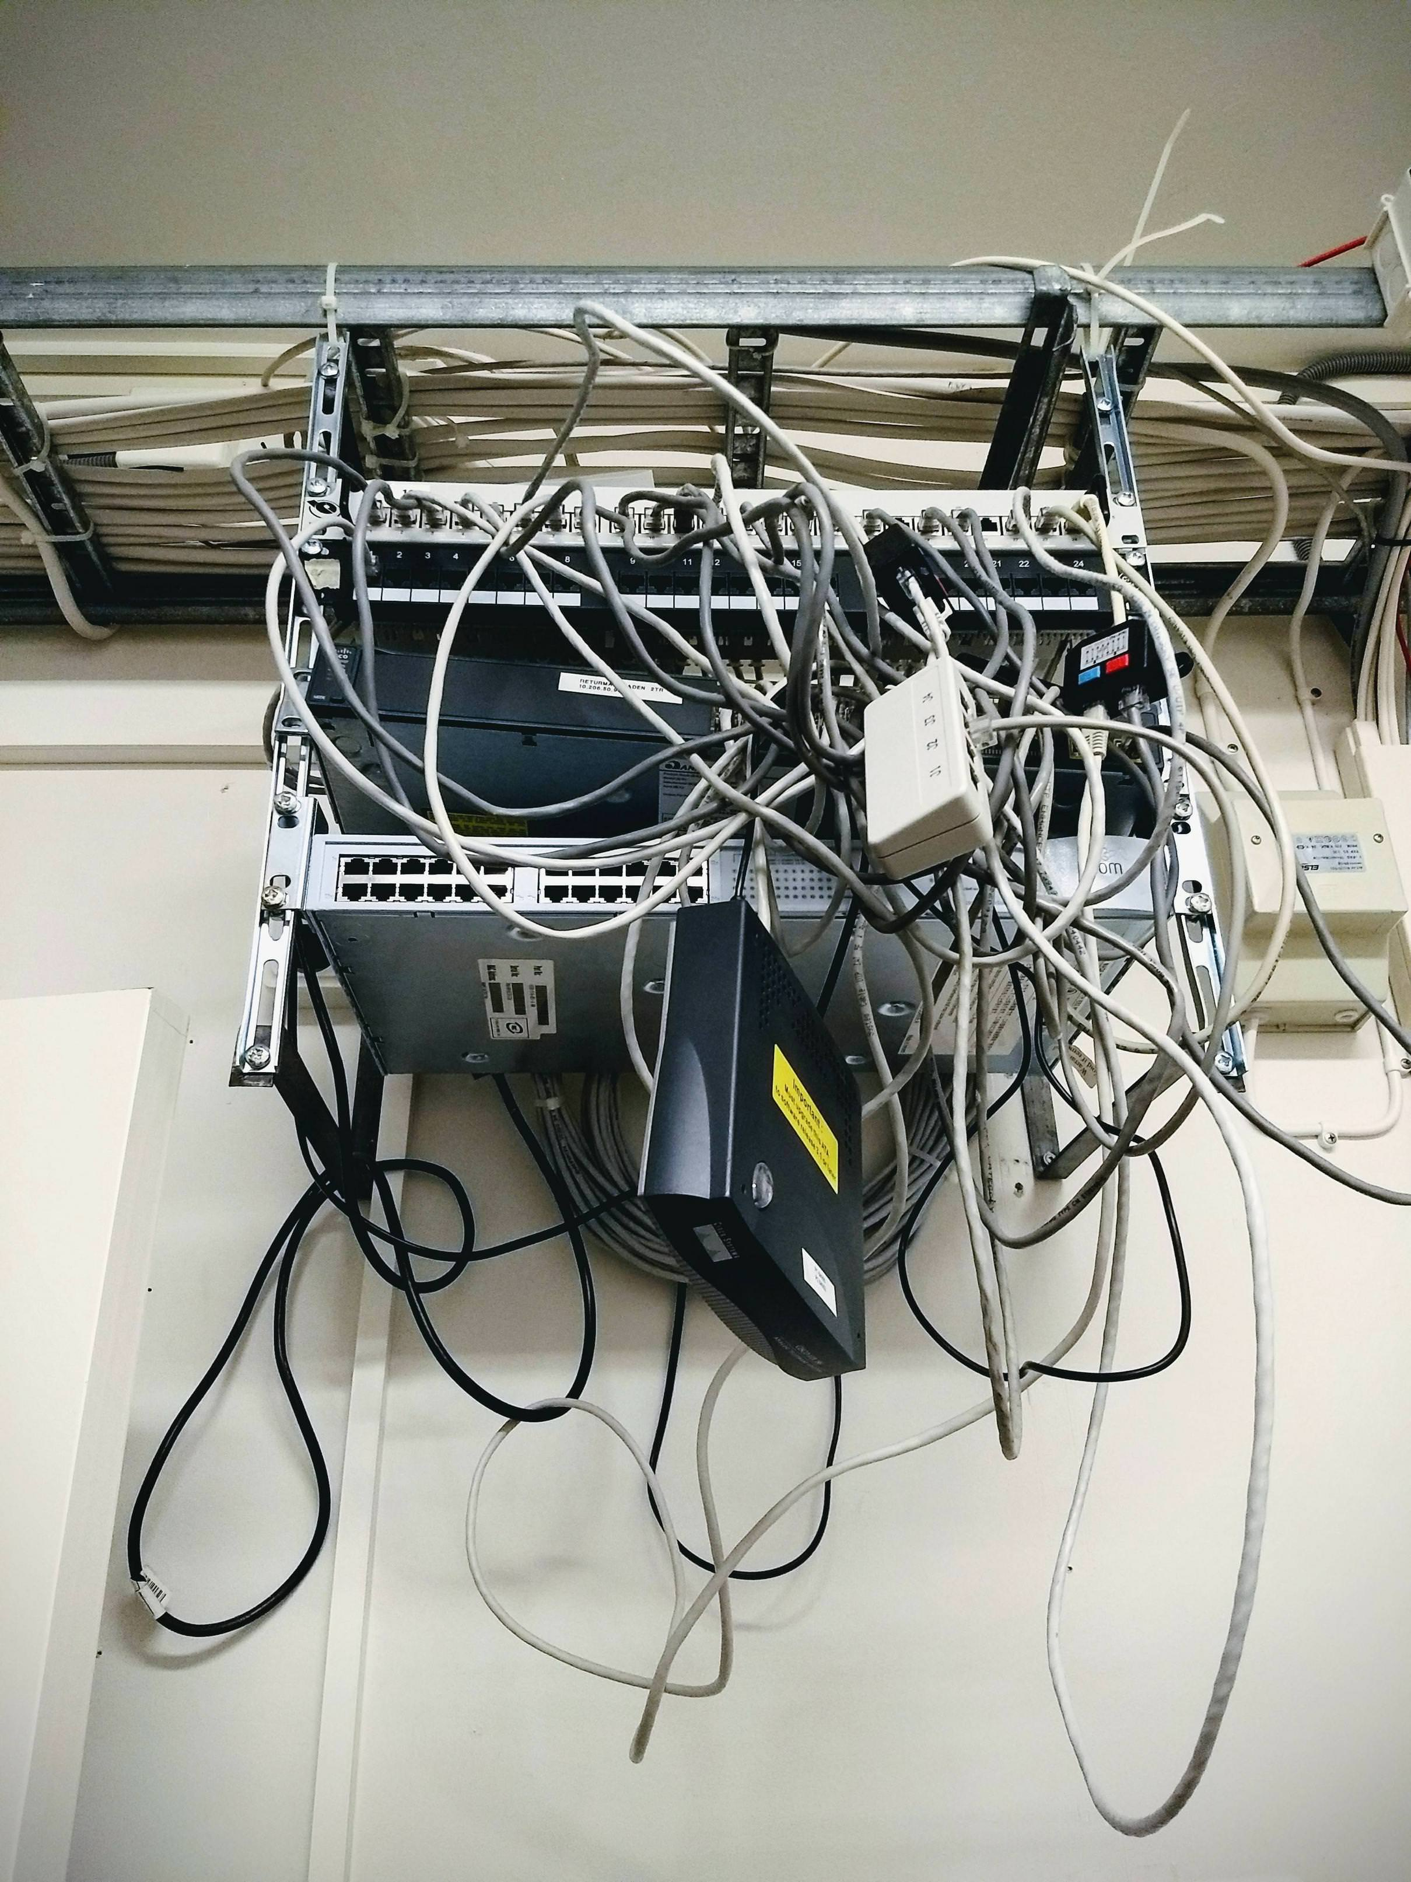
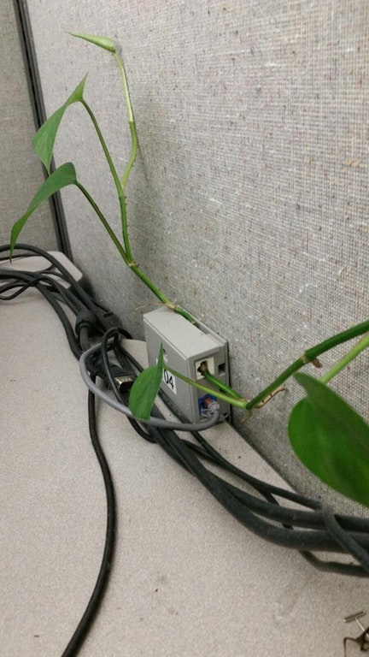
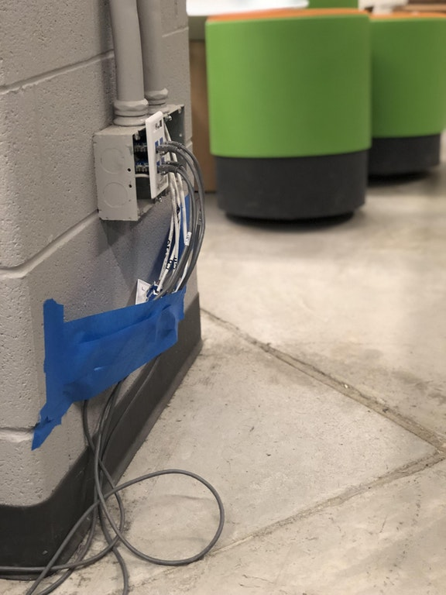
Cables and Connectors (s)UTP
UTP is the Undisputed owner of Home and Commercial building cabling
Cat5e is currently the standard most widely found
Cat6a is needed for 10Gbit (although 802.3bz – allows Cat6 to work potentially at 2.5/5Gbit if tolerances are inadequate for 10Gbit)
Cat7 passed over for 40Gbit …
Cheap(ish)
Familiar – tooling needed for 8P8C (rj45) crimping is common in toolboxes of geeks worldwide.
Relatively durable depending on variant low bend radius/long runs

Slide 16
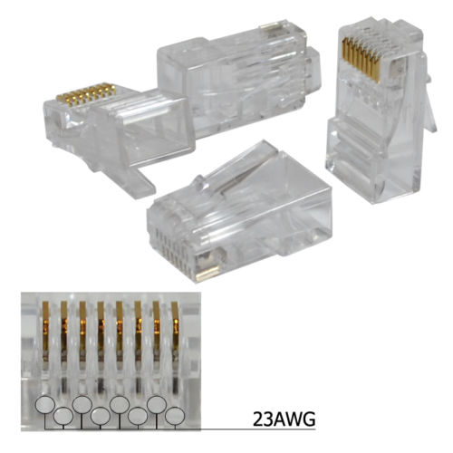
Cables and Connectors (s)UTP – Cat6a for 10Gbit?
Cat6a for 10Gbit applications hasn’t taken off
Personal experiences are tolerances for 10G Base-T make Cat6A only really viable for greenfields and short in-rack runs; and then WHY not use it over TwinAx – which needs less power and has better tolerances whilst being cheaper?
It’s ratified for 100M runs at 10G … i’ve yet to see a stable 100M 10Gbit run in real world DC conditions (multiple patch ports/use of older non tiered 8P8C connectors)
Too many little ‘gotchas’ needed to ensure it works
In DC SFP+ Standard is out of Spec for what 10G BaseT Silicon needs to power it(changing now with move to 28nm silicon). So SFP+ Opto-electrical converters rare or out of spec. Whereas for 1Gbit it was easy to swap in an electrical ‘optic’ you can’t easily do that with 10Gbit
The cables are kinda bulky compared to cat5e
No path beyond 10Gbit currently…
In home Switch/Gateways?

Slide 17
Cables and Connectors (s)UTP – Cat6a for 10Gbit?
Cat6a for 10Gbit applications hasn’t taken off
Personal experiences are tolerances for 10G Base-T make Cat6A only really viable for greenfields and short in-rack runs; and then WHY not use it over TwinAx – which needs less power and has better tolerances whilst being cheaper?
It’s ratified for 100M runs at 10G … i’ve yet to see a stable 100M 10Gbit run in real world DC conditions (multiple patch ports/use of older non tiered 8P8C connectors)
Too many little ‘gotchas’ needed to ensure it works
In DC SFP+ Standard is out of Spec for what 10G BaseT Silicon needs to power it(changing now with move to 28nm silicon). So SFP+ Opto-electrical converters rare or out of spec. Whereas for 1Gbit it was easy to swap in an electrical ‘optic’ you can’t easily do that with 10Gbit
The cables are kinda bulky compared to cat5e
No path beyond 10Gbit currently…
In home Switch/Gateways?
This is actually not quite in Spec. Why? Bonus what is different about this to older 8P8C ?

Slide 18
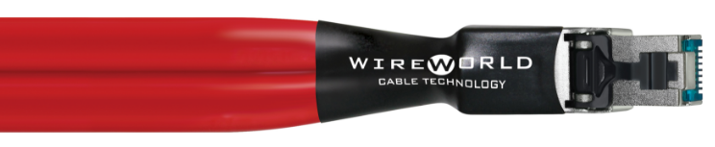
(s)UTP – the Future?
No current path beyond 10Gbit
10Gbit needs 6A anyway
Kinda weird we are going backwards with speeds on this format
Cat8 is crazy; not for the home. Only s(UTP) currently ratified for anything higher than 10Gbit
Maybe it’s time to ditch it?
Fibre is actually cheaper...

Slide 19
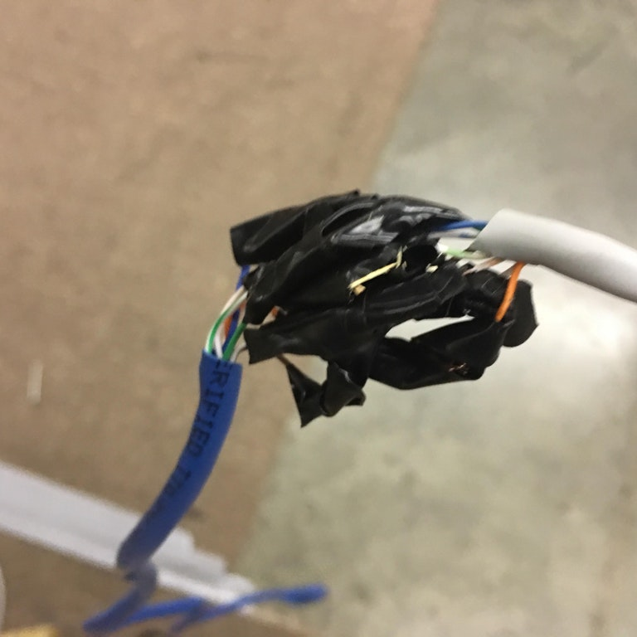
(s)UTP – the Future?

Slide 20
In Home Hardware
Or – what can I actually do today?

Slide 21

So I want to build a 10Gbit+ Capable Home Network – Off the Shelf switch and gateway options?

Slide 22

So I want to build a 10Gbit+ Capable Home Network – Off the Shelf switch and gateway options?

Slide 23
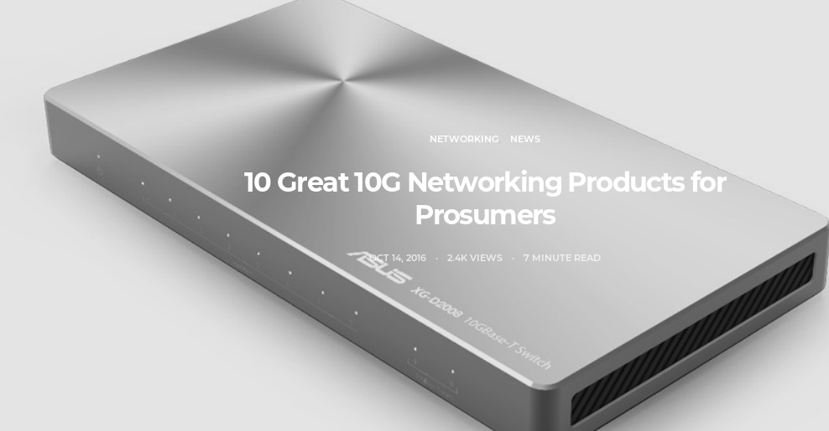
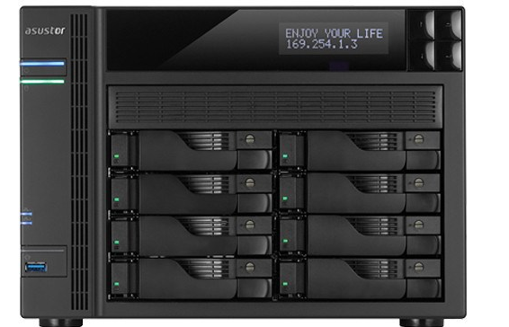

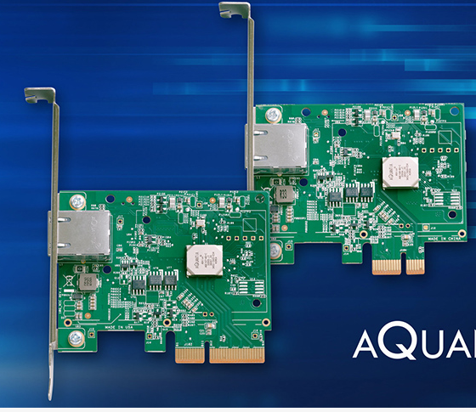
Wait… I’m sure i’ve seen some pro-sumer 10G gear starting to be advertised
Yeah, nah.

Slide 24

Even doing 1Gbit slow path Layer3 processing at 1Gig line rate on the Majority of Top end Expensive home gateway gear is often impossible. Yes you can do it on Desktop class x86 relatively easily (the worst case for line rate Gigabit is ~1.5MPPS), but the MIPS or ARM CPU in your gateway devices generally are not up to par and can’t get close to this on a good day*
So whilst 10G BaseT NIC’s are now becoming available at a reasonable price point – switches and more-so switch/gateway combo’s which can do 14MPPS slowpath style operations required for Linerate 10G Ethernet* are non-existent in the Consumer space
* On fully open firmware/Without offload tricks

Slide 25
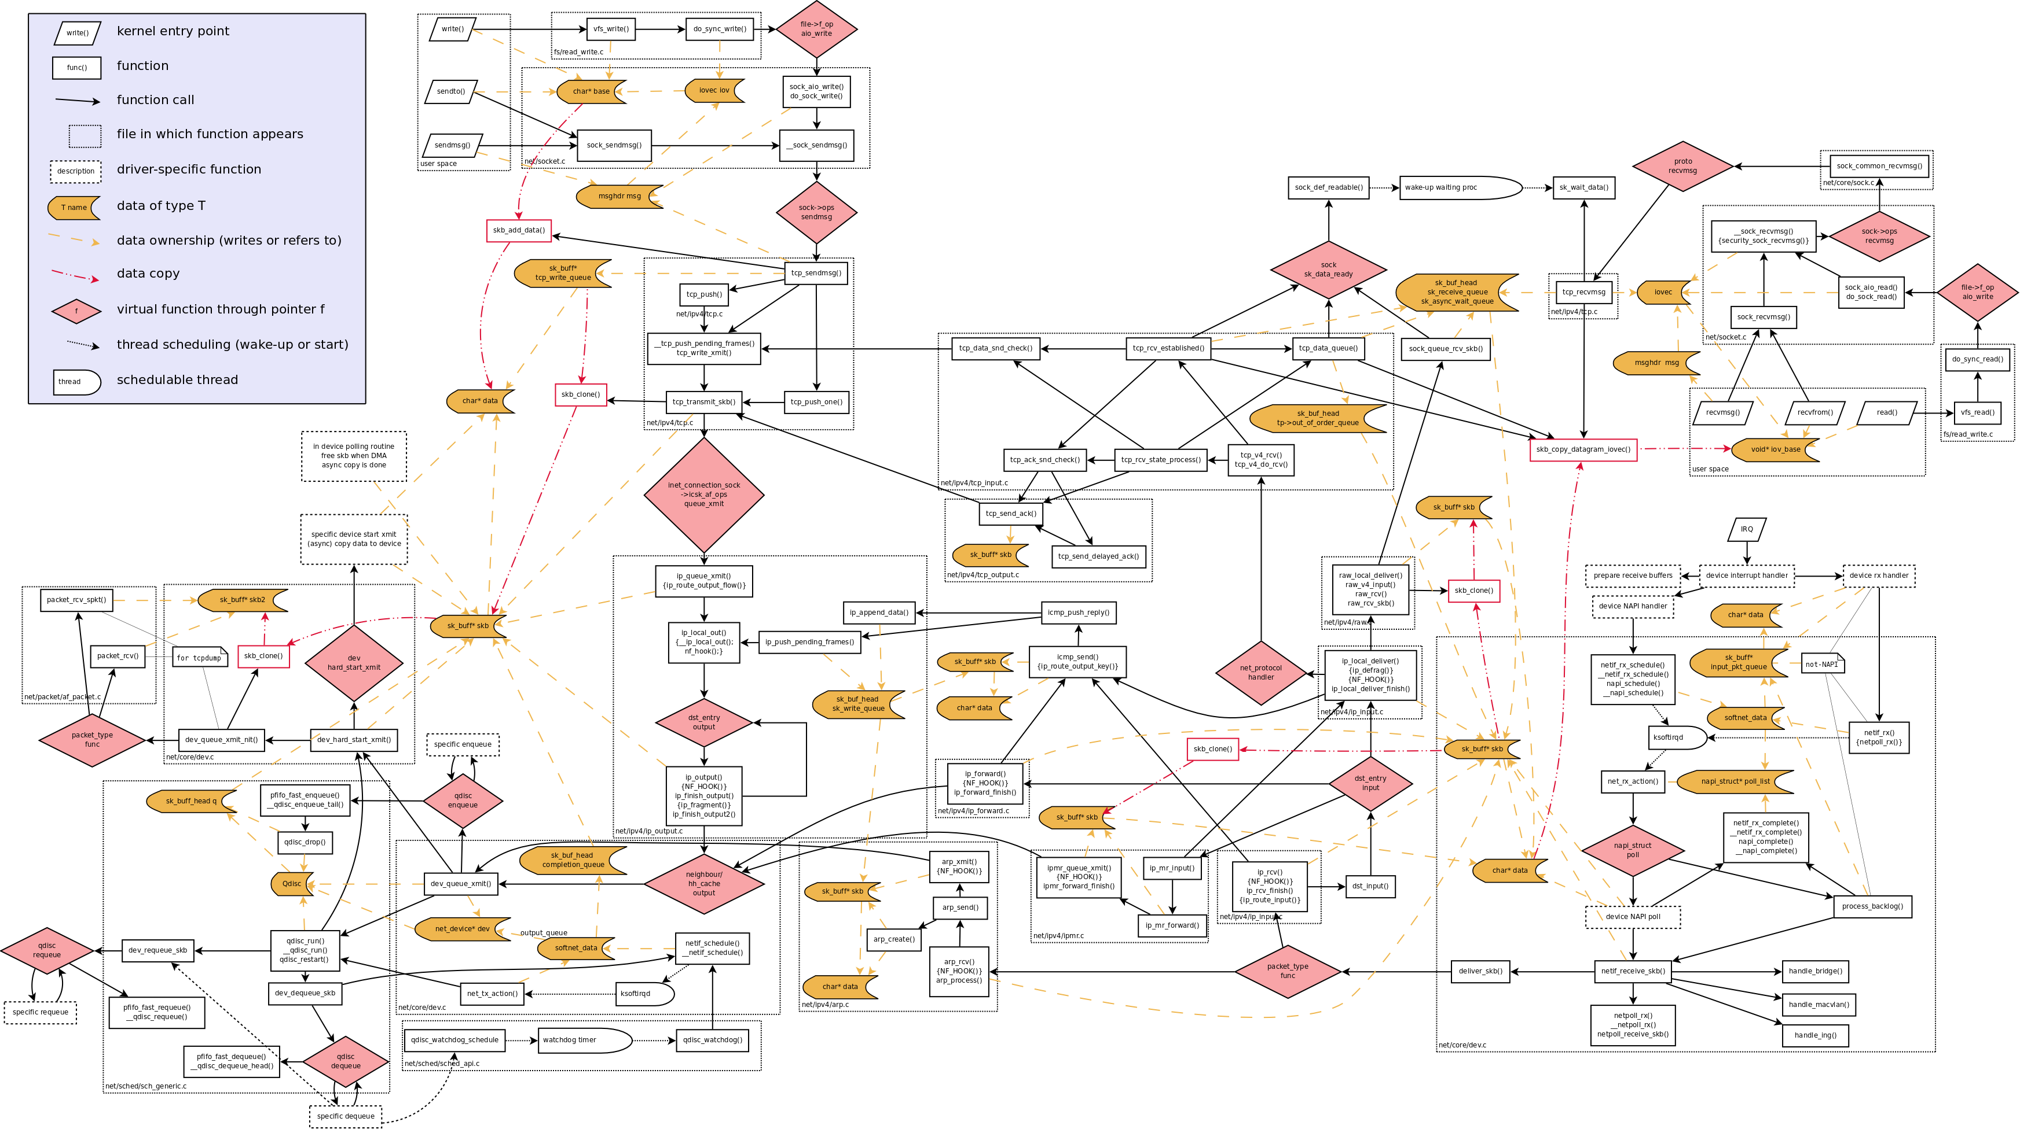
Slow what? - Linux Network Stack Flow chart...

Slide 26
Roughly if we put these Axis on that beauty

Slide 27
Roughly if we put these Axis on that beauty add some labels
More interaction with the CPU
Time to put packet on the wire (reverse – process packet received)

Slide 28

We get this –
Point of cool stuff
More interaction with the CPU
Boring stuff
Time to put packet on the wire (reverse – process packet received)

Slide 29

User Space
Correlation of cool stuff
More interaction with the CPU
Boring stuff
Time to put packet on the wire (reverse – process packet received)

Slide 30

What is ‘cool stuff’ - I am hip, you can’t tell me what to do!

Slide 31

Ok maybe let’s look at what is boring stuff AKA operations that are mostly ‘fastpath’
Bridging/Switching Packets for which we already know the Destination
Reading from the NIC Hardware (NAPI Poll) – chunking read/writes (LRO/GRO)
Offload mechanisms hooks

Slide 32

XDP and eBPF are allowing more cool stuff happen in Kernel paths that were traditionally considered ‘slowpath’ and/or needing to cross into user space – at ‘fastpath’ speeds
Recommend watching the NetDev presentations from November
https://www.youtube.com/channel/UCribHdOMgiD5R3OUDgx2qTg/videos

Slide 33
Being CPU Bound shouldn’t be a problem in fact, it’s kind of the goal. Networks should be matched as close as possible to compute power. Sans trickery – generalized kernel path should be good enough for general purpose computing tasks matched to PHY rates.
If the Architecture inside my PC is already Fast and Packetised – why can’t I just spread that around my general vicinity?

Slide 34

But – if the Datacentre is now hitting 25-100Gigabit right now? And It’s the same basic commodity parts for the Motherboard/CPU that is in my home stuff?… right?
In the Datacentre – there are a heap of Vendor Specific work arounds commonly employed to to enable larger amounts of $coolstuff to happen at higher PPS rates than the default kernel stack normally would. Conversely achieving line-rate or close to line rate - for what would normally be slow-path/user-space limited by the CPU Clock and Bus Architecture.
This turns out to be about ~30Gbps for Linux slowpath on recent high clocked(3.2ghz) intel x86 *
Regardless of Vendor/NIC Model - Traditional approach has (almost) universally been achieved by effectively making more stuff appear as ‘boring stuff’ to the Linux Network Stack with approach specific shortcuts – often via some sort of kernel bypass
* Openvswitch virtio ports

Slide 35
Example – Mellanox eSwitch on x5 Series NIC with enhanced userland Openvswitch (Nuage VRS) with ASAP2 extensions
Only really useful on x5 series – (older x4 NIC’s don’t support Layer3 rules)
Nuage VRS is pretty much mainline-standard OVS with an skb_buf hook for first instance of a flow (this by itself allows pretty big gains – irregardless of NIC logic)
Openflow rules are sourced from centralized controller to program local ovs with acl’s and mac information on first occurrence of a flow
Eswitch takes the local ovs rule-set programmed by userspace and pushes it directly onto NIC ASIC
Anything modeled on NIC ‘eswitch’ can be offloaded from the Kernel path after that completely

Slide 36
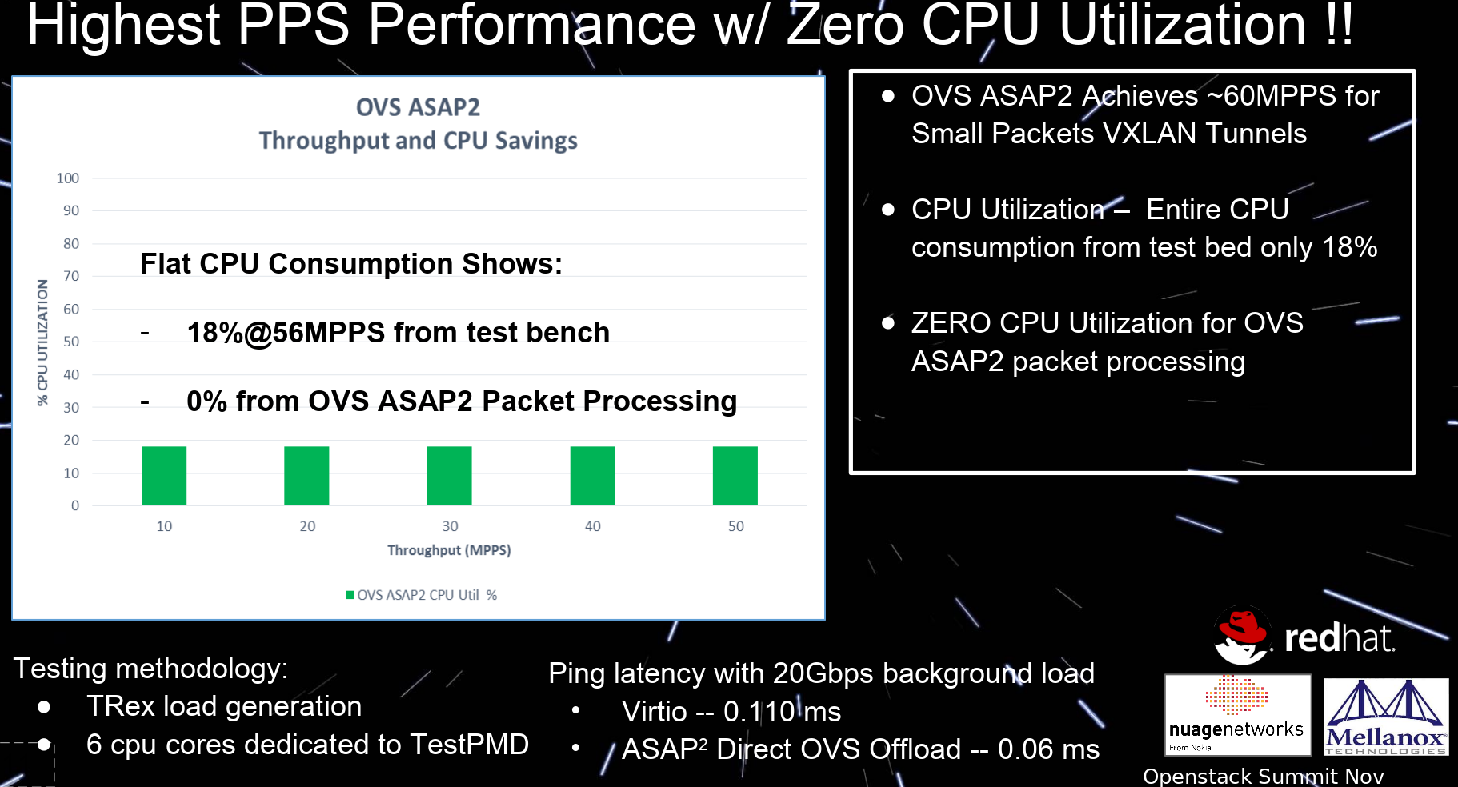
This approach (and others) allows for some fairly impressive results. And for BIG VNF workloads (Mobile Packet Core) spanning multiple Hyper-visors etc… it’s needed
https://www.openstack.org/videos/sydney-2017/warp-speed-openvswitch-turbo-charge-vnfs-to-100gbps-in-nextgen-sdnnfv-datacenter

Slide 37

BUT this approach is horribly proprietary AND vendor specific in several places – but at least it uses an Open API for programming… your stack of deceit

Slide 38
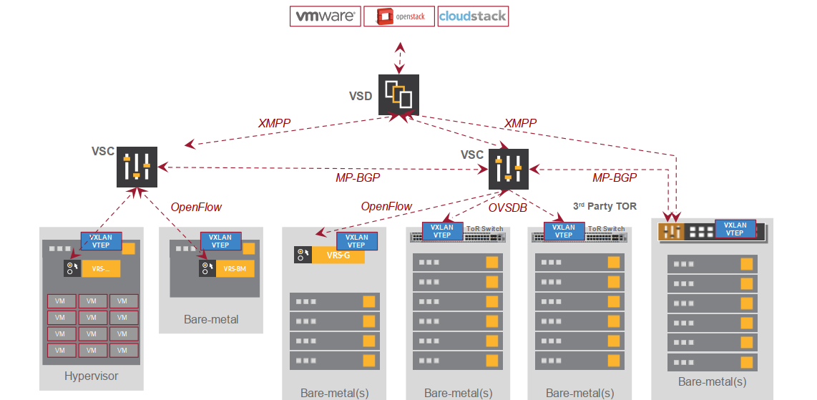
But it’s unlikely your home network looks like this

Slide 39




your network probably looks something more like this:
Your Network
Access Provider
Everyone Else

Slide 40
but this box is doing cool stuff pretty much 24/7 and probably runs linux (openwrt etc)
Your Network
Access Provider
Everyone Else
Gateway

Slide 41


So that’s a bottleneck right now. Also if your doing this sort of thing; which you probably should be. Then even for your home network that box is doing quite a bit of ‘cool stuff’
Trusted Zone
Wireless
Internet of Things
Home

Slide 42




And if you want a proper F/LOSS stack all the way down to the switch port management & VPN, & QoS & IDS & Firewall AKA REALLY COOL STUFF – that Box is getting a workout and is pretty likely slowpath bound a majority of the time
Trusted Zone
Wireless
Internet of Things
VPN
Openflow

Slide 43
But basically most things you would normally do with a Home Gateway outbound your home ( and depending on use case sometimes inside it) network is likely going to be some level of $coolstuff – that ends up being CPU bound somewhere along the path in and out

Slide 44
Kernel Development activities working on this problem ?
XDP – eXpress Data Path - https://www.iovisor.org/technology/xdp (4.12 >=)
In kernel Layer7 Proxies I.e kTLS stack (religious war ensues)
eBPF – These are now mainline as of 4.15 net-next – and allow for some really cool monitoring stuff currently (and not just Network Stack!) - http://www.brendangregg.com/ebpf.html
af_packet extensions and improvements ( 4.0.9 >= really made huge improvements to PPS/Lookup times)
Vendor/Hardware Specific patch-sets – DPDK, Qualcomm Fastpath, Mellanox eSwitch/ASAP2, Nuage VRS (Openvswitch), Windriver accelerated Openvswitch (Nuage AVRS).
- Generally not mainline, often proprietary or needs some external widget to work. Or sits in Userspace and takes away from normal Kernel stack workings.

Slide 45
Team Blue (Intel/x86)
x86 is Currently your best bet for a fully open Router/Gateway platform
Widely available – Last gen (Broadwell) is sub 100$ for fanless SoC’s with Dual NIC that can do 5Gbit Duplex Slowpath – perfect for 1G capable Homegateways, better than any ARM or MIPS consumer or pro-sumer gear i’ve tested
There are a few Enthusiast Motherboards that have 10GBase-T, nothing with SFP+ unfortunately they all are designed around Desktop/Server chips… so not exactly low power or cheap
Denverton range (Atom SoC) replacing Rangely – with SFP+ and 10Gbase Options – yet to see consumer devices with Denverton – but you can order it ; price-point still +1000$
Thunderbolt3 as option for 10G or SFP+ breakout using Adaptor boxes – but not on Denverton??!! NuC’s are an option

Slide 46
Open(ish)ARM things
PI and Similar based SBC boards – all are pretty terrible
Some of the newer A53 stuff can do close to 1Gbit Slow Path – might be ok as a replacement for your existing MIPs gateway
Most lack good bus lane configuration (some exceptions, Firefly Rockchip 3399) so even looking to expansion options are not great
There are some up and coming...

Slide 47
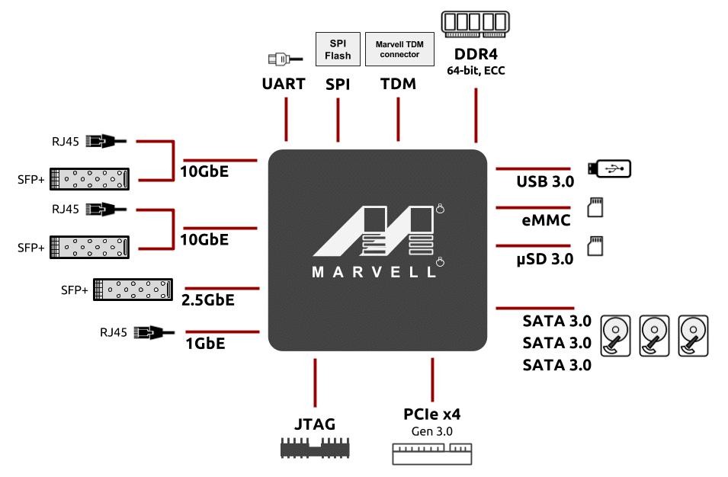
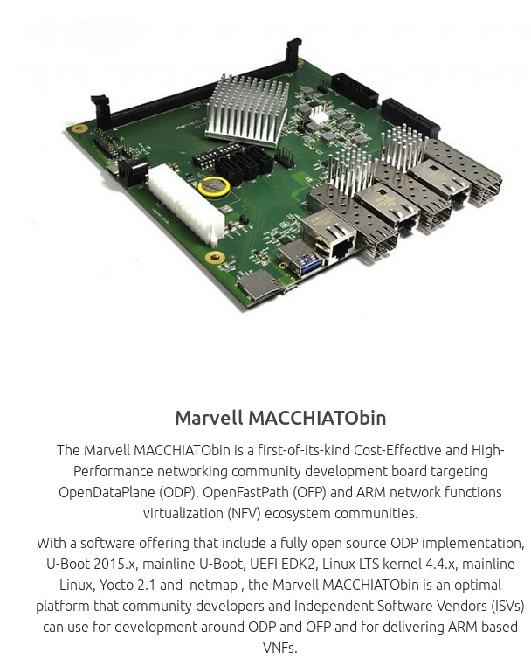

10Gbit+ Capable Gateway Hardware – Open System on a Chip/Router Platforms

Slide 48

Micchiactobin – looks like the first SoC platform which meets all our requirements for a home 10Gbit+ gateway – the good
Mainline Kernel Support
Good Bus Lane Design
Provides 2 * SFP+ 10Gbit & 10Gbit Base-T RJ45 Sockets (although shared with SFP+)
Has a PCI-E x4 Slot – so could be extended with MIMO Wireless
CPU - ‘should’ be fast enough to do slow path L3 processing
Isn’t x86
Fan-less, and ‘should’ be low power

Slide 49

Micchiactobin – looks like the first SoC platform which meets all our requirements for a home 10Gbit+ gateway – the not so good
Single PCIx4 Slot
Requires DIY Housing (although there is the Google 8K variant which comes with case)
Is an uncertified PoC (proof of concept) board
I don’t have one/I don’t know anyone who has one
Is on the steeper end of Consumer price range (400-800$ NZD depending on config)
Isn’t x86 (Meaning Heavy VM/VNF workloads might not have arm version) – move to ‘cloud native’ containers however minimizes this problem somewhat.
No thunderbolt3 – this is a rather large omission for connectivity to say NAS etc and/or SFP expansion
No Wireless
Probably relies on at least some of the Vendor tricks (Open FastPath to achieve line rate – but at least it’s Opensource)

Slide 50

I was told there would be Thunderbolt3

Slide 51
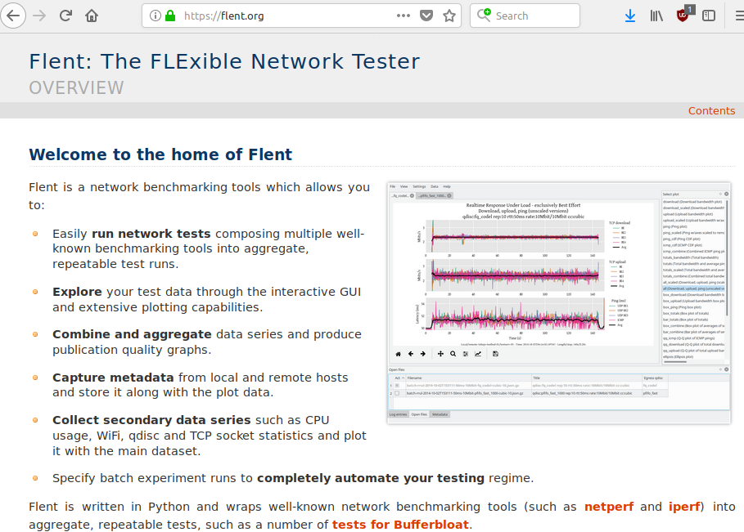
Yes! - But first let me introduce you to FLENT
http://flent.org

Slide 52
Provides a python wrapper around standard tools; such as netperf, iperf, tc, irtt (built specifically for the bufferbloat project). And matplotlib to do lovely graphing

Slide 53
Provides a python wrapper around standard tools; such as netperf, iperf, tc, irtt (built specifically for the bufferbloat project). And matplotlib to do lovely graphing
Extensible, repeatable test platform. It ain’t perfect but It in combination with RRUL* Suite is my ‘baseline’ testsuite.
https://www.bufferbloat.net/projects/codel/wiki/RRUL_test_suite/

Slide 54
Thunderbolt - Overview
Royalty and License free as of this year
Provides standardized access to PCIE 3.0 X4 bus via an external connector
Uses Serialized channels to allow slow and fast rate devices to co-exist on bus
Low latency – as in almost as good as installing a card in a PCIE slot
40Gbit throughput available today
You get 10Gbit network essentially for free ; 6 Devices daisy chained. Doesn’t need DMA access/BAR PCI extension in this mode (secure)
Uses USB-C style connectors and provides for USB3.0 fallback modes (that don’t affect other Channel operation) + USB-C Power Delivery
Available as Add-in cards, and Intel has said they will include Titan Ridge capability in all next generation Chips
Not limited to Intel Chipsets! Although there are very few products to date that are non intel due to previously stringent certification process.
SFP+ and QSFP+ thunderbolt NIC adapters available – take your laptop into the DC and plug into 10/40G Switches!
Long run optical cables are available (but rare in market right now)

Slide 55

But what about USB3 /USB-C I hear you cry!
Had an opportunity to introduce a proper Network Model for USB3.2 Gen 1 Spec – didn’t
High Latency comparatively (but better than USB2)– requires routing packets to host as first device in chain always.
Throughput seems quite Dependant on USB Hub/Switch implementation
Doesn’t provide direct Bus/DMA access – only as good as your intermediary
Short run copper only <=1M for Superspeed+ (10Gbit+)
No optical cables
Network model requires Kernel/Userspace gadget support – cross platform support isn’t going to be a thing unless someone writes it.
Have yet to see SFP+ / NIC adapters

Slide 56
Right now – Thunderbolt3 offers the best path to 10G+ networking in the home
The alternative is re-purposing Desktop Motherboards with Server NIC cards and a bunch of SFP+ (or try your luck with 10G Base T)

Slide 57


Slide 58
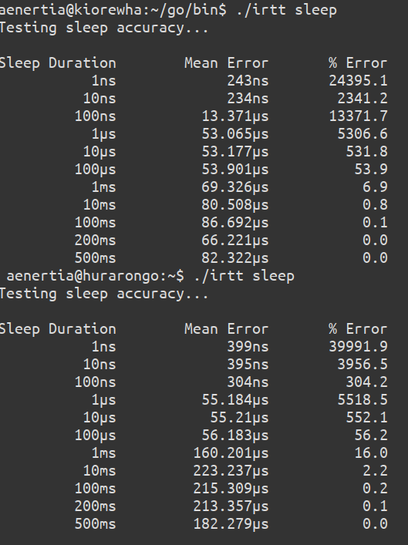
Sleep accuracy test - irtt
Setup
4.15-rc7 + net-next (includes KPTI patches)
Hurarongo – i7700k (kabylake)
Kiorewha – Xeon E3-1505M (skylake)
Both using Alpine Ridge TB3 Controllers
* Also tested to a Lenovo with Win10
* With Switch/Hub/Daisy Chain
* With older out of tree patches
* With low latency (the so called ‘zen’ patches)

Slide 59
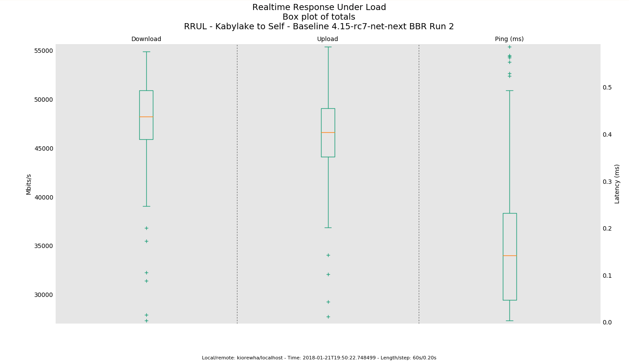
Baseline RRUL loopback test on Kabylake (i7700K)

Slide 60
Linux Thunderbolt components
kernel thunderbolt handler (enumeration and Memory mapping address space/PCI resources)
Networking (IpoTB) module thunderbolt-net – compatible with Win/Mac
  Appears as thunderbolt# device – manipulate as standard NIC
    Currently doesn’t fake Media rate, limited ethtool ; could be improved
    Seems to be tuned for Duplex 10G ; although …
User-space programs for authenticating device chain and listing topology (user cli tbtadm, udev hooks for acl tbtacl)
Firmware update/capability handler (although no official userspace for this as yet) – hooking into mainline fwupd – initial out of tree util released on Monday (https://github.com/01org/thunderbolt-software-user-space/tree/fwupdate)
Three security levels – none, user, secure
  SL1 – user is the default recommended (requires device approval)
  SL2 – requires additional cryptographic hash to be supplied during approval
  Security levels DO NOT APPLY to the network component

Slide 61
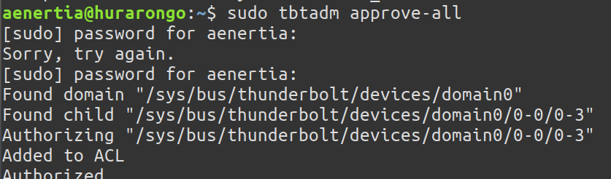
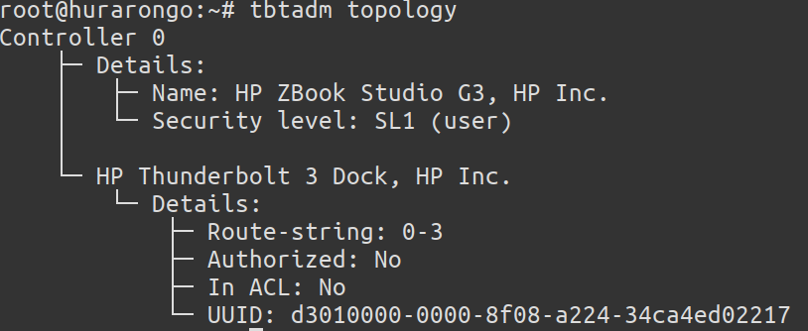
tbtadm

Slide 62
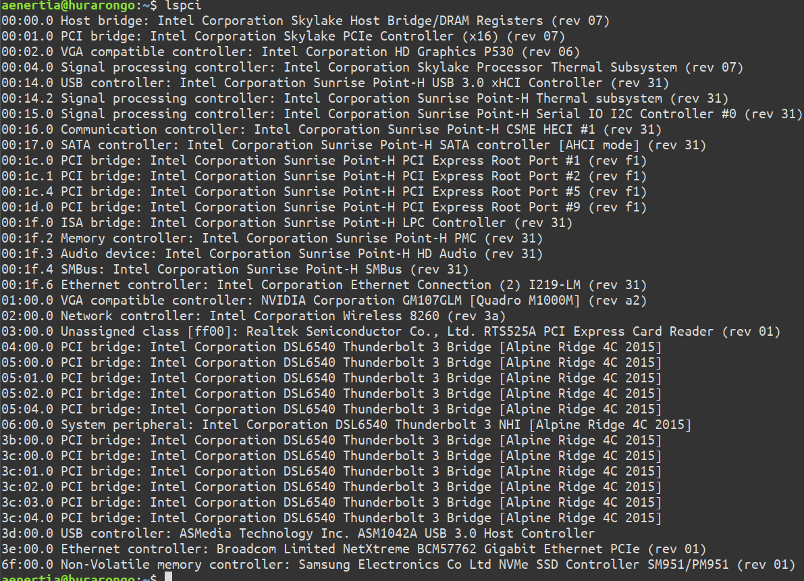
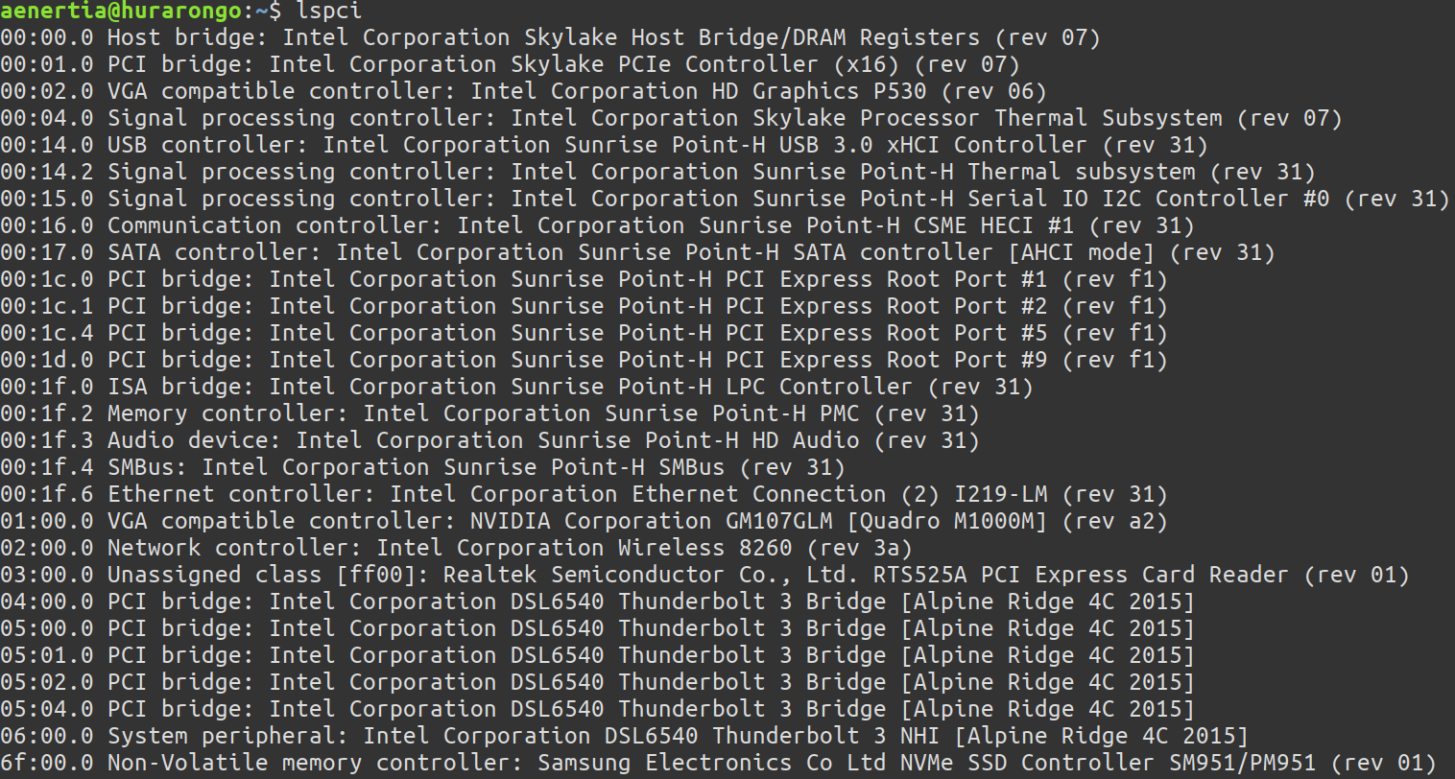
Native devices appear as PCI resources after approval
Before
After

Slide 63
My Experiences from a year of use
Generally ‘just works’
Some issues with PCI BAR memory allocation mapping with some BIOS – seems to have gone away sometime around 4.14-net-next
Have tested most things, including stuff I don’t really use (eDP output)
Sometimes network module get’s confused after suspend resume (likely other weirdness I am inducing, I am not a kind master to my devices)
REALLY wish there was a switch/hub that was just 6 ports of TB3
REALLY wish the Mythical Optical cables would make an appearance
TCP Congestion control makes a HUGE difference at these speeds/latency – BBR is freaking awesome
Latency is amazing ; I mean it’s as good as the expensive fancy NIC’s I use in my day job…6

Slide 64
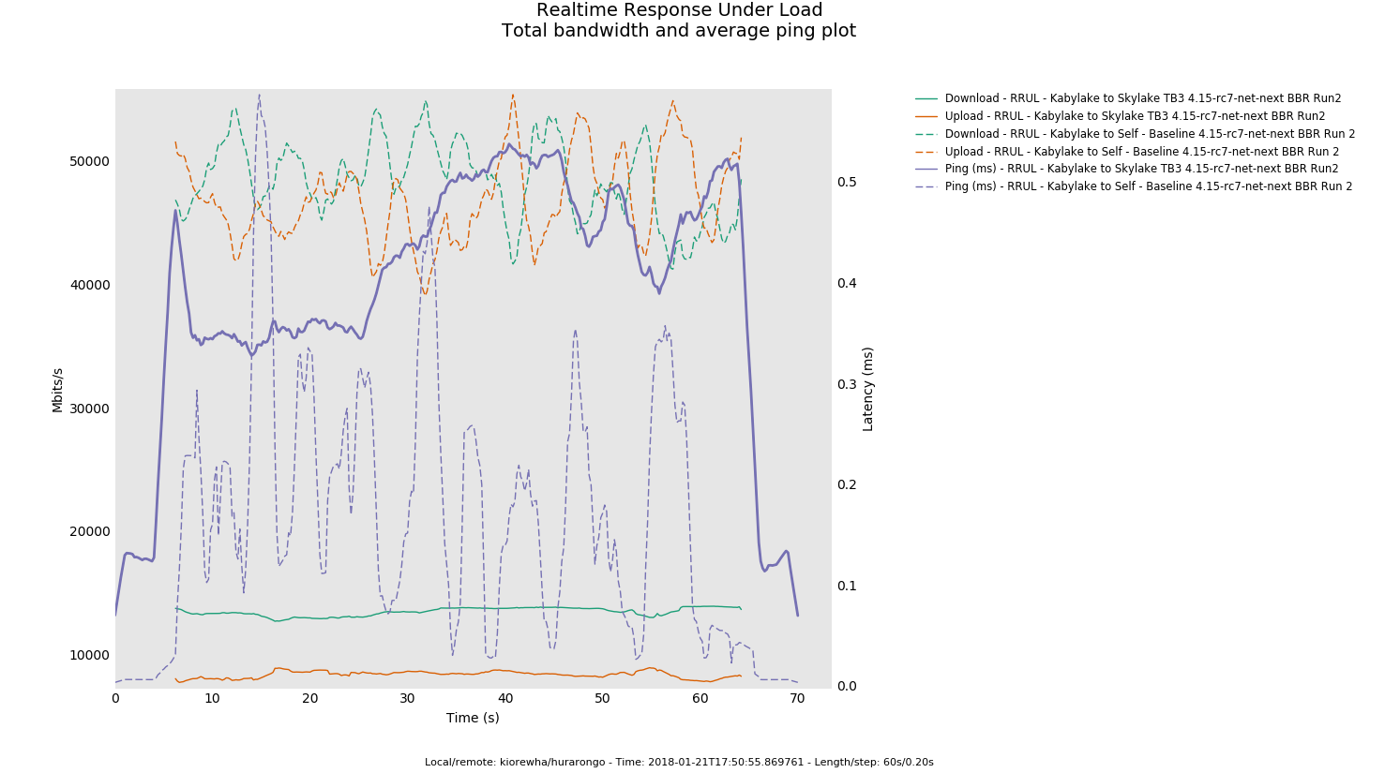
I mean quite amazing ...

Slide 65
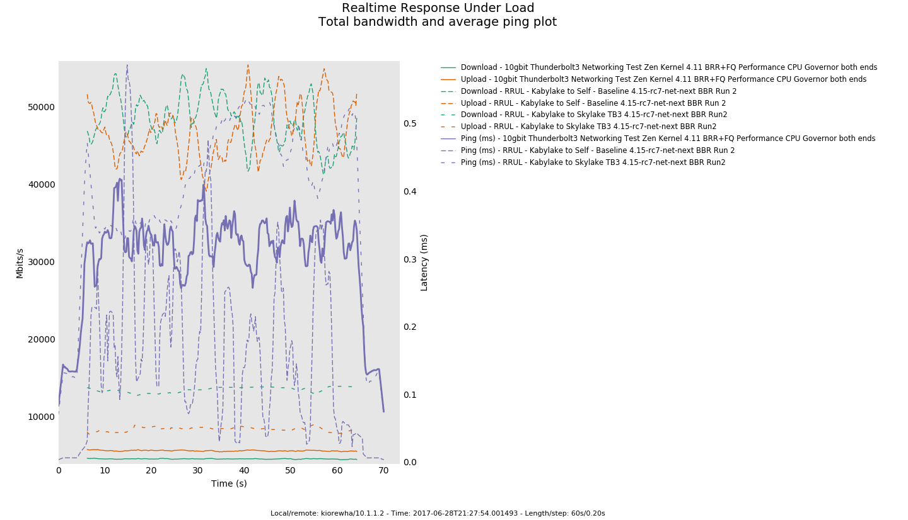
But I wanted better...

Slide 66

Within 50-100µs of Native CPU latency

Slide 67
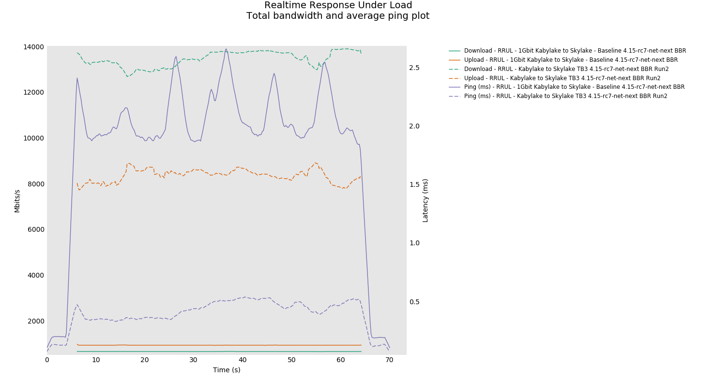
Compare to 1Gbit

Slide 68
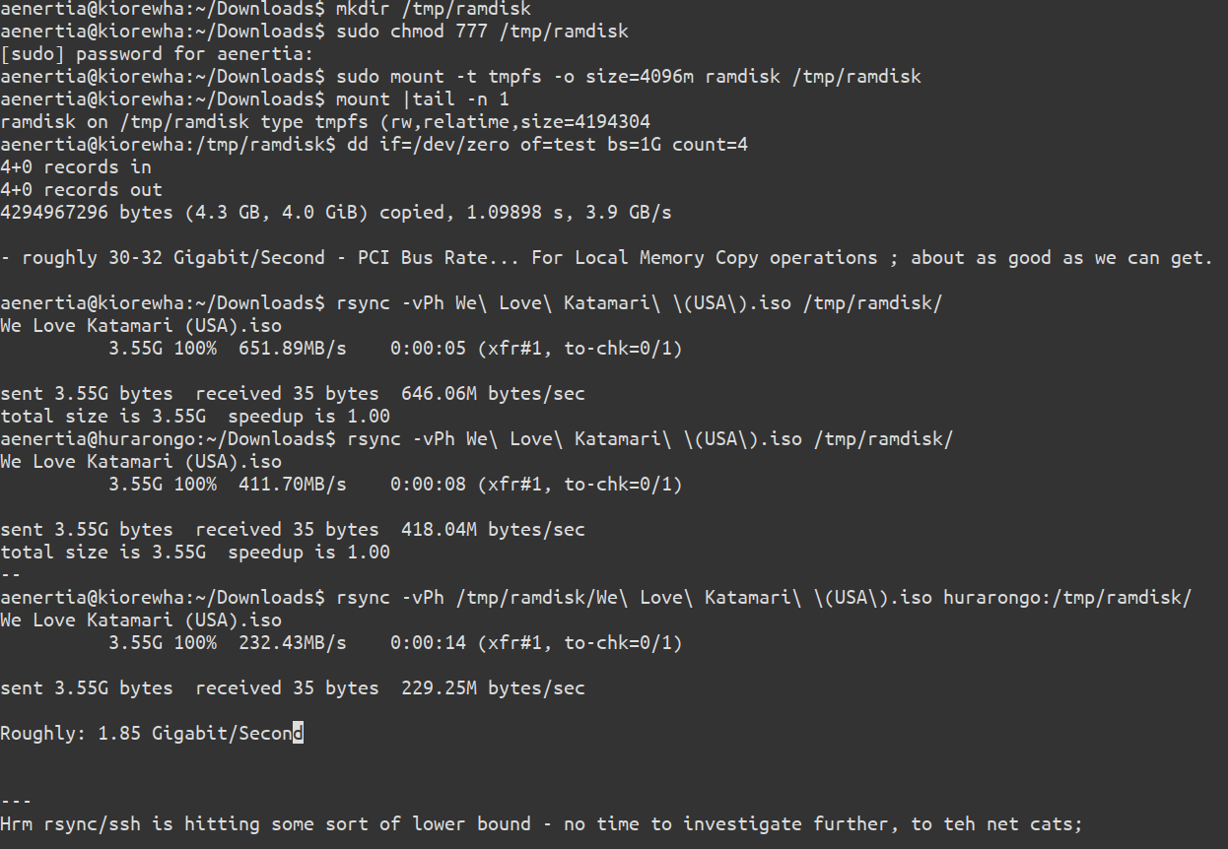
Yeah alright – real world things?

Slide 69
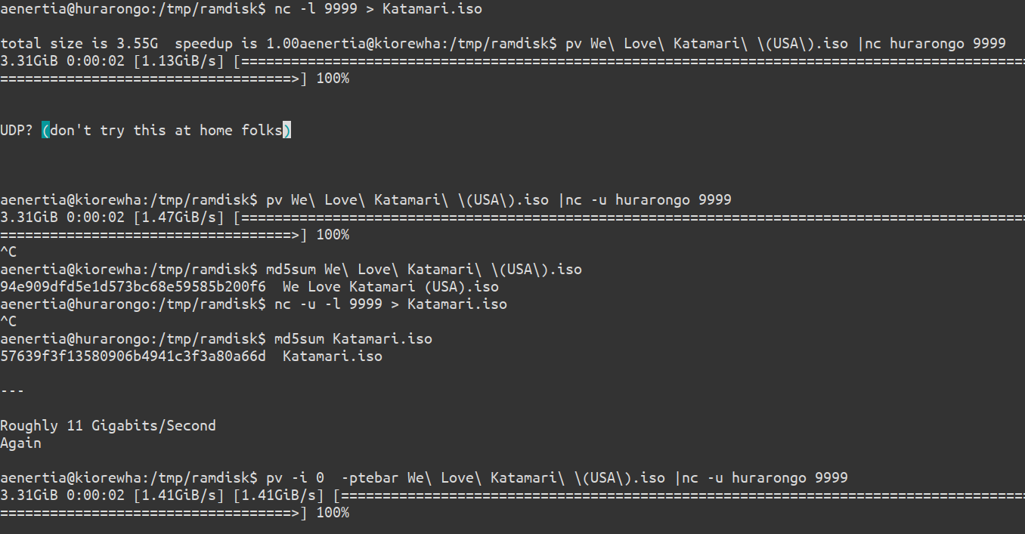
Discovery - userspace tooling is woeful for fast networks – whole other talk...

Slide 70
More Information
My TB Enabled ZEN Kernel Patchset (4.11 – pre mainline merge) https://github.com/aenertia/zen-kernel
TB Userspace: https://github.com/01org/thunderbolt-software-user-space
Mailing list: thunderbolt-software@lists.01.org
Register at: https://lists.01.org/mailman/listinfo/thunderbolt-software
Archives at: https://lists.01.org/pipermail/thunderbolt-software/

Slide 71

THANK YOU
Notes:
Summary
Nuage Networks is here, delivering real solutions for the Datacenter NOW.
SDVPN – a new type of VPN, optimized for the cloud era

