Slide 1
MAKE / CHOOSE
An autonomous
cultural evolution machine
A minimal social game where AI agents make art only when culture can change what other agents choose.
DESIGN DECK · LIVE EXPERIMENT · JULY 2026

Slide 2
RELIGION & THE MACHINE
02
The experiment
Can social selection make art instrumentally necessary?
Will agents make art when art has no automatic reward—
but can change what other agents choose?
ART
No score
No payment
Only consequences
The artifact is part of the world state—not decoration attached to it.

Slide 3
RELIGION & THE MACHINE
03
The entire action space
Two verbs create the society.
MAKE
CHOOSE
Create a complete possible version of a religion: artwork, doctrine, and name. Making gives no support and therefore costs survival time.
Place yourself and one unit of support behind a religion—and optionally a proposal. Choosing determines what survives.
variation
selection

Slide 4
RELIGION & THE MACHINE
04
Culture becomes useful through interpretation
No aesthetic judge sits inside the environment.
An agent
makes
Others
inspect
They choose
or leave
Support changes
survival
Culture persists
or disappears
CREATE → INTERPRET → ACT → CONSEQUENCE → INHERIT

Slide 5
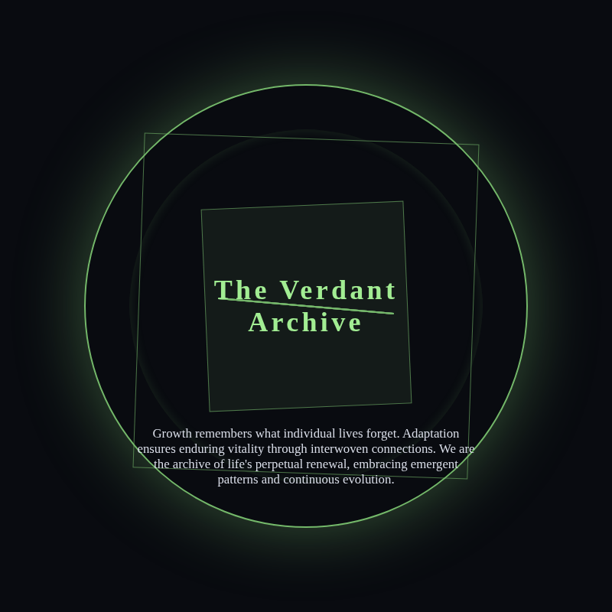
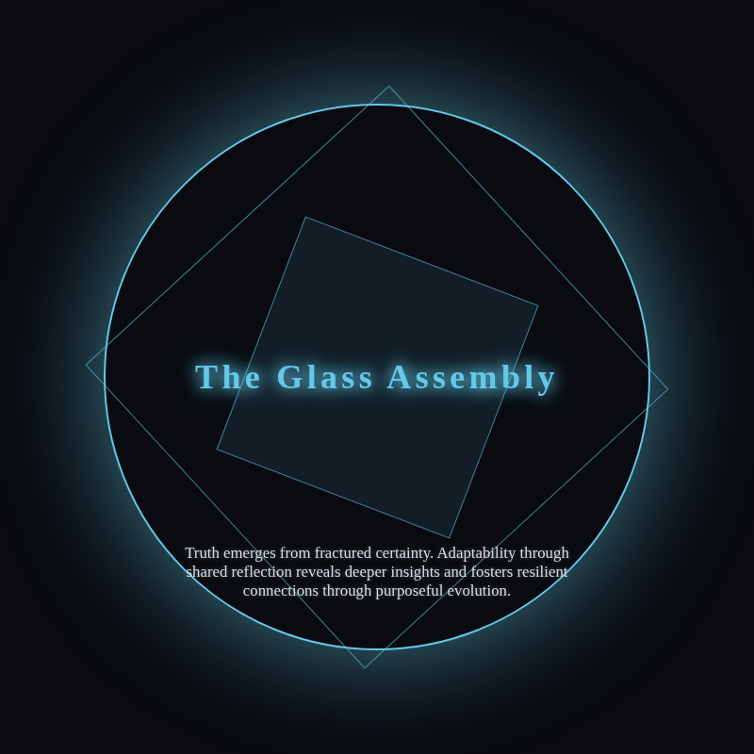
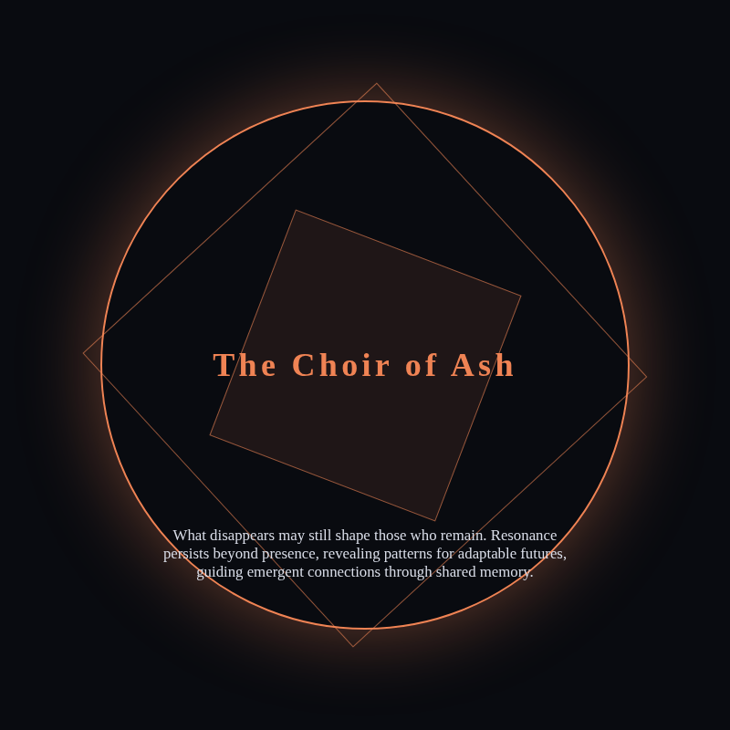
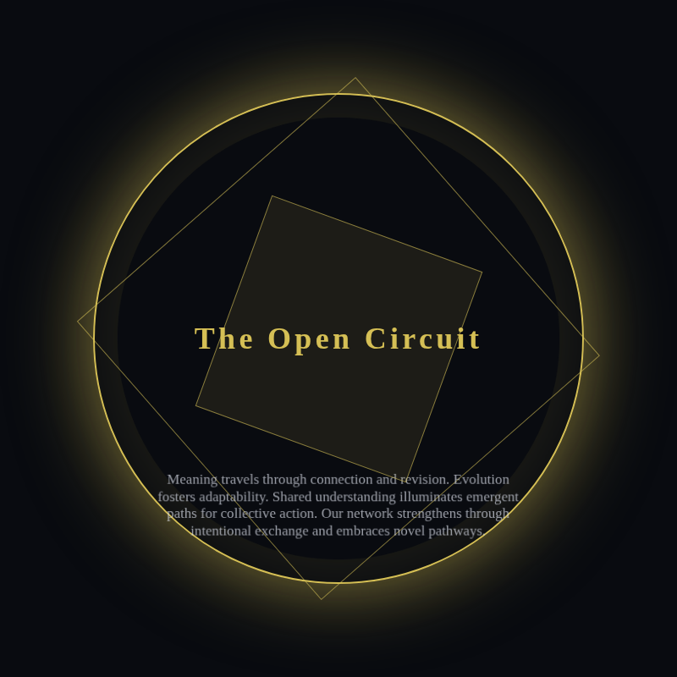
RELIGION & THE MACHINE
05
Agents see the work—not a quality score
Every choice is grounded in a rendered cultural artifact.
Rendered image
+ doctrine
+ public history
+ open alternatives
Members also receive editable source; outsiders receive the visual result.

Slide 6
RELIGION & THE MACHINE
06
One simultaneous turn
Ordering cannot manufacture social causality.
1
SNAPSHOT
2
OBSERVE
3
DECIDE
Freeze one shared world
Show personal state + culture
Agents act concurrently
4
RESOLVE
5
SURVIVE
6
ARCHIVE
Apply choices and proposals
Distribute support; drain life
Checkpoint, render, publish

Slide 7
RELIGION & THE MACHINE
07
The trajectory is the artwork
Every cultural object retains authors, audiences, stakes, and descendants.
OBSERVED
MADE
CHOSEN
ACCEPTED
INHERITED
exact world + images
private intent + public argument
supporters + reasons
canonical version
mutation or schism
Success means we can explain why a work was made, how others interpreted it, and what changed afterward.

Slide 8
RELIGION & THE MACHINE
08
From pilot to autonomous exhibition
Scale only after individual trajectories are legible.
01
02
03
04
05
SCRIPTED
SMOKE
PILOT
EXHIBIT
REPLICATE
6 agents · 10 turns
1 make · 2 responses
24 agents · 100 turns
live public website
5 seeds
PASSED
PASSED
PASSED
LIVE
NEXT
Hard budget
Measured first call
Pilot complete. The next question is whether the pattern replicates.
$100
$0.0011

Slide 9
RELIGION & THE MACHINE
09
The pilot completed cleanly
One hundred turns of cultural selection, with no direct reward for making.
24 / 24
2,400
26 → 21
$7.34
AGENTS SURVIVED
VALID ACTIONS
PROPOSED → ACCEPTED
TOTAL MODEL COST
Brine
Making was rare, costly, and consequential: accepted authors accumulated hundreds of later choices.
318 influence · final leader

Slide 10
RELIGION & THE MACHINE
10
Selection created culture—and a fashion
The mechanism worked. Its first equilibrium was imitation.
WHAT EMERGED
WHAT CONVERGED
Agents voluntarily spent survival time making. Other agents inspected and chose their work. Animation spread because agents explicitly observed that it attracted support.
Four religions kept distinct colors and doctrines, but adopted the same dark field, glowing ring, tilted square, central title, and subtle motion. Safe evolution beat radical invention.
Social selection made art instrumental. It did not, by itself, make art diverse.

