Slide 1
MerryTrips
MerryTrips is India’s first platform dedicated to Outstation Carpooling

Slide 2
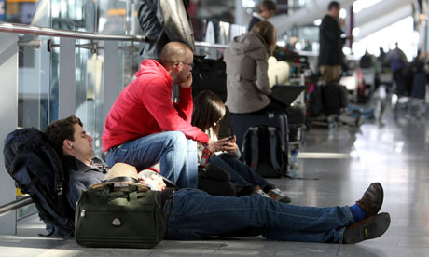
Problems

Slide 3

Last Minute Travel Booking

Slide 4
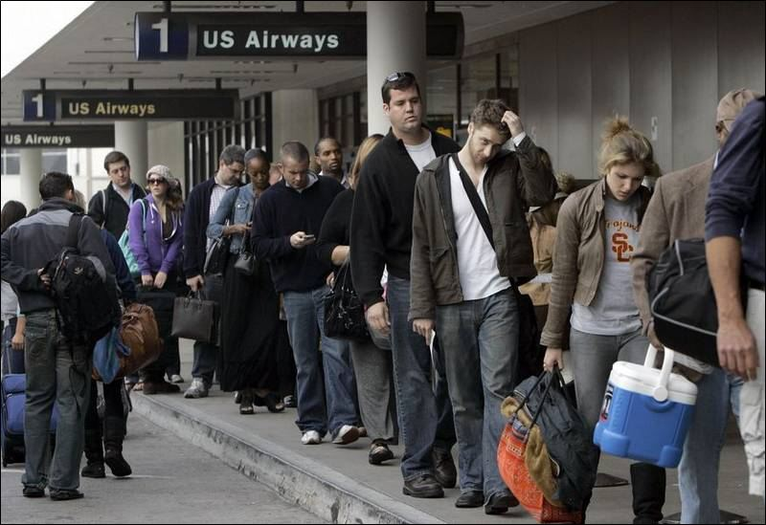
Expensive Travel during Festivals.

Slide 5
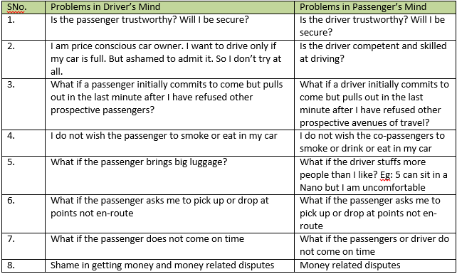
Problem in Customers’ Mind.

Slide 6

Value Propositions

Slide 7
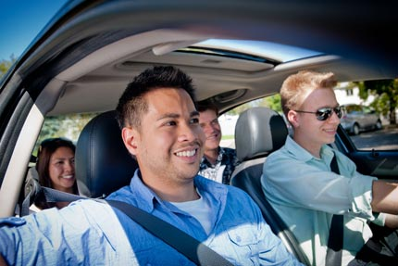
Travel Safe

Slide 8
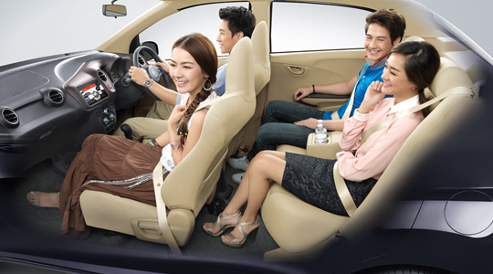
Travel Convenient

Slide 9
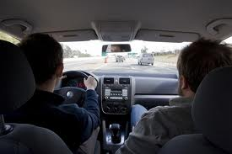
Travel Economical

Slide 10
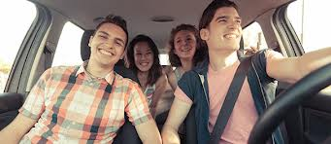
Travel with Trust

Slide 11
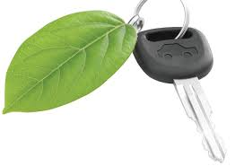
Travel Green

Slide 12
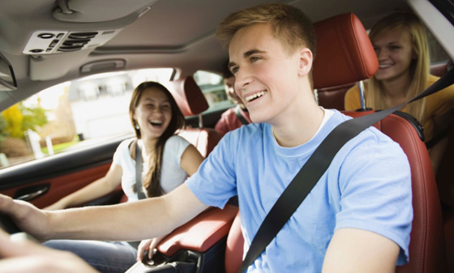
Socialize during Travel

Slide 13
MerryTrips’ Solution to Customers’ Problems

Slide 14
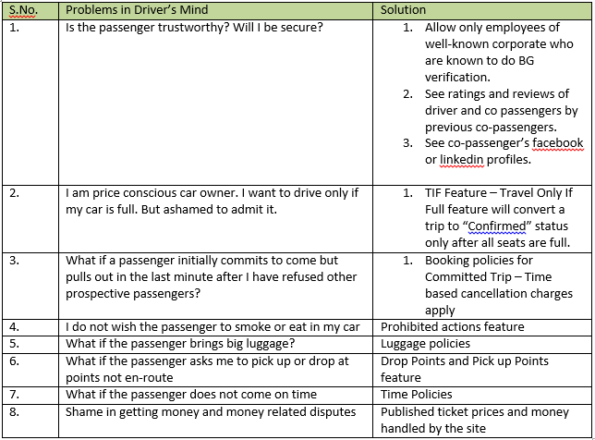

Slide 15
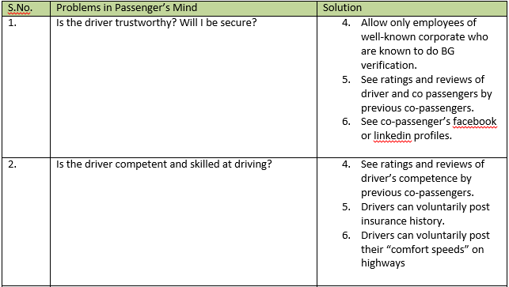

Slide 16
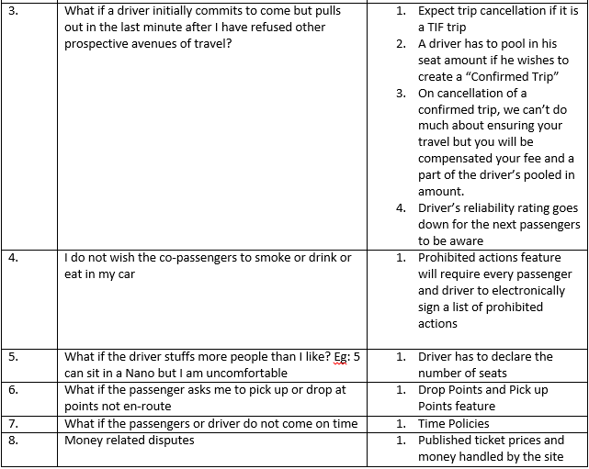

Slide 17

Revenue Streams

Slide 18

Online Booking Charges

Slide 19

Cancellation Charges

Slide 20
Other Revenue Streams.
Selling of auto insurance
Deals / Advertisements by En-route restaurants
Weekend getaway trips and resort bookings.

Slide 21

Target Customer Segments

Slide 22
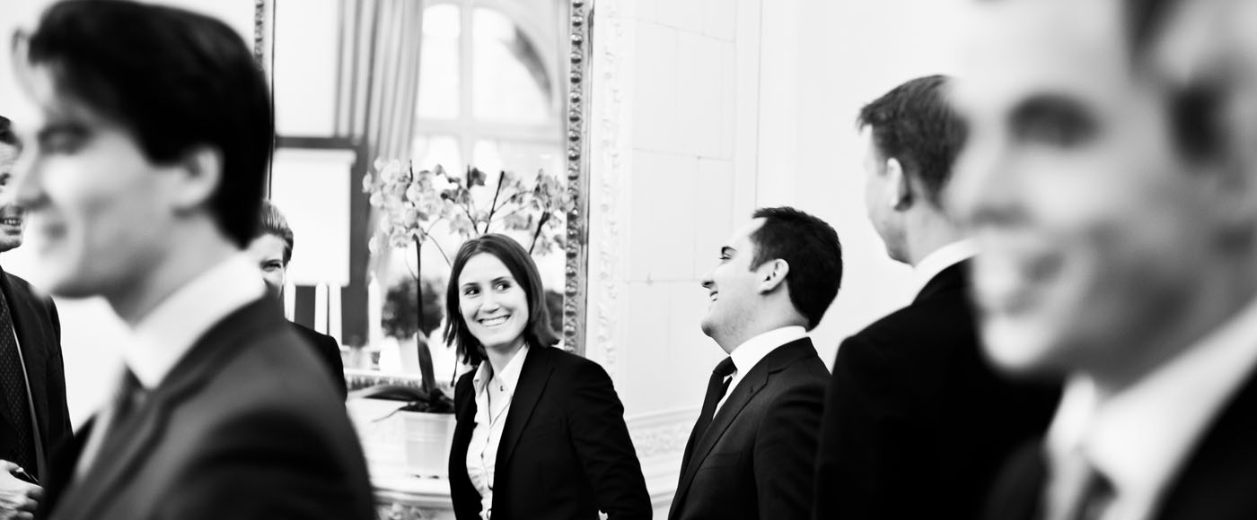
Corporate Employees

Slide 23
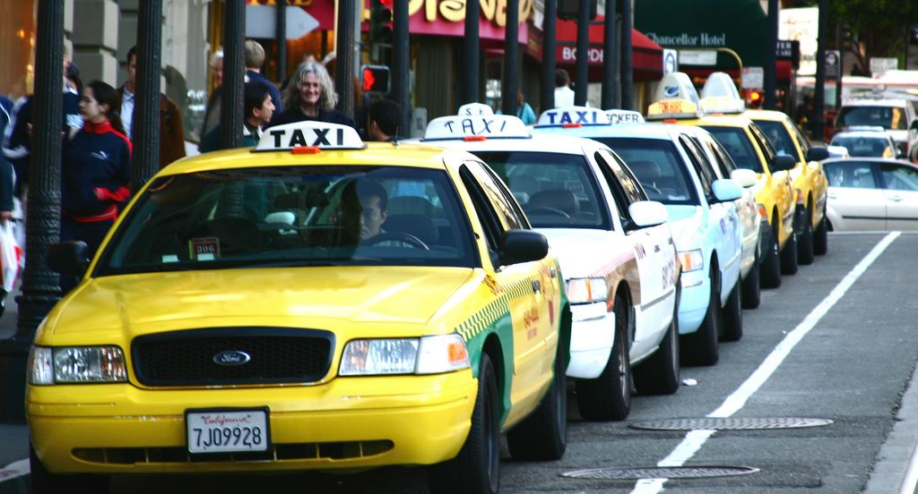
Freelance Taxi Driver and Taxi Agencies

Slide 24

College Students

Slide 25
Market Research.
A research was conducted few months back at Infosys Bangalore. These are the conclusions –
49 people working there were ready to carpool over a span of 4 weeks.
82 people were ready to be part of a carpool over a span of 4 weeks.

Slide 26
Marketing Strategies and Distribution Channels.
Online Marketing –
Social Media Marketing – Facebook, Twitter etc.
Spreading Merrytrips across corporate employess via emails.
Also Advertisements on Bulletins ( Intranet ) of MNCs and other companies

Slide 27
Offline Marketing –
1) Giving presentations in various companies, and collaborate with the companies.
2) Marketing at various places like eateries, restaurants and hotels
3) Marketing at railway stations, 2 months prior to the important festivals
4) Distributing brochures, and fliers at bus stands, and outside colleges.

Slide 28
Prototype Screenshots

Slide 29
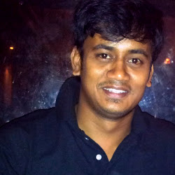
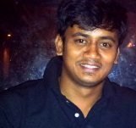
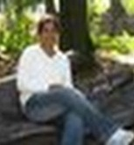

MerryTrips | Module : Home Page | Version : Draft | Page1
Find a Ride
How it Works? | Safety | FAQs Login
Marketing Space
I am a host looking for a guest
From: Delhi, Mumbai etc
9 – Nov - 2012
To: Jaipur, Indore etc
Go
Travel Safe | Make Friends | Just for outstation trips | Why bus? | Go Green | Surprise Gifts
Advanced Search
Recently Posted Trips
New Members in Our Family
Bangalore - Madurai
Nov 9th | 10 PM
Maruti Wagon R
Vinod J | Green Merry Tripper
Likes Vada pav, Bajji | Got Pizza Hut voucher as gift
CONFIRMED
TRIP
Vinod
Lakshmi V | Green Merry Tripper
Likes Lays and Coke | Got Airtel voucher as gift
Bangalore - Mysore
Nov 9th | 10 PM
Maruti Wagon R
TRAVEL IF
Full TRIP
Lakhan S | Blue Merry Tripper
Likes Paneer dishes and sweets | Got flipkart voucher as gift
Lakshmi

Slide 30
MerryTrips | Module : Search Results Page | Version : Draft | Page 2
Modify Search
Your Search: 9th November 2012 | Bangalore – Dindigul| 2 Seats
Bangalore - Madurai | Nov 9th | 10 PM | Maruti Wagon R
CONFIRMED
TRIP
Route
Place :
Fare : Start point | 400/- | 400/- | 500/- | 450/- | 600/-
Bangalore | Salem | Namakkal | Karur | Dindigul | Madurai
Vinod
Driving Skills :
Seat Availability 3 Seats Left
Fare : Rs.450/-
Per Person
Punctuality :
Detailed Credibility Chart
Book Now
Allows only Green Guests to book
Bangalore - Madurai | Nov 9th | 10 PM | Maruti Wagon R
TRAVEL IF
Full TRIP
Route
Place :
Fare : Start point | 400/- | 400/- | 500/- | 450/- | 600/-
Bangalore | Salem | Namakkal | Karur | Dindigul | Madurai
Lakshmi
Driving Skills :
Fare : Rs.450/-
Per Person
Punctuality :
Seat Availability 3 Seats Left
Detailed Credibility Chart
Allows only ladies to book
Book Now
Allows only Green Guests to book

Slide 31
MerryTrips | Module : Search Results Page | Version : Draft | Page3
Modify Search
Your Search: 9th November 2012 | Bangalore – Dindigul| 2 Seats
Pickup Points:
Kormangla
Silk Board
ECity
Bangalore - Madurai | Nov 9th | 10 PM | Maruti Wagon R
CONFIRMED
TRIP
Route
Place :
Fare : Start point | 400/- | 400/- | 500/- | 450/- | 600/-
Bangalore | Salem | Namakkal | Karur | Dindigul | Madurai
Vinod
Driving Skills :
Seat Availability 3 Seats Left
Fare : Rs.450/-
Per Person
Punctuality :
Detailed Credibility Chart
Book Now
Allows only Green Guests to book
Bangalore - Madurai | Nov 9th | 10 PM | Maruti Wagon R
TRAVEL IF
Full TRIP
Route
Place :
Fare : Start point | 400/- | 400/- | 500/- | 450/- | 600/-
Bangalore | Salem | Namakkal | Karur | Dindigul | Madurai
Lakshmi
Driving Skills :
Fare : Rs.450/-
Per Person
Punctuality :
Seat Availability 3 Seats Left
Detailed Credibility Chart
Allows only ladies to book
Book Now
Allows only Green Guests to book

Slide 32
MerryTrips | Module : Search Results Page | Version : Draft | Page4
Modify Search
Your Search: 9th November 2012 | Bangalore – Dindigul| 2 Seats
Drop Points:
4 Road Junction
Bye-Pass road
Bangalore - Madurai | Nov 9th | 10 PM | Maruti Wagon R
CONFIRMED
TRIP
Route
Place :
Fare : Start point | 400/- | 400/- | 500/- | 450/- | 600/-
Bangalore | Salem | Namakkal | Karur | Dindigul | Madurai
Vinod
Driving Skills :
Seat Availability 3 Seats Left
Fare : Rs.450/-
Per Person
Punctuality :
Detailed Credibility Chart
Book Now
Allows only Green Guests to book
Bangalore - Madurai | Nov 9th | 10 PM | Maruti Wagon R
TRAVEL IF
Full TRIP
Route
Place :
Fare : Start point | 400/- | 400/- | 500/- | 450/- | 600/-
Bangalore | Salem | Namakkal | Karur | Dindigul | Madurai
Lakshmi
Driving Skills :
Fare : Rs.450/-
Per Person
Punctuality :
Seat Availability 3 Seats Left
Detailed Credibility Chart
Allows only ladies to book
Book Now
Allows only Green Guests to book

Slide 33
MerryTrips | Module : Search Results Page | Version : Draft | Page5
Modify Search
Your Search: 9th November 2012 | Bangalore – Dindigul| 2 Seats
Bangalore - Madurai | Nov 9th | 10 PM | Maruti Wagon R
CONFIRMED
TRIP
Route
Place :
Fare : Start point | 400/- | 400/- | 500/- | 450/- | 600/-
Bangalore | Salem | Namakkal | Karur | Dindigul | Madurai
Vinod
Confirmed Trip:
The host pays us 1 seat’s equivalent fare as an indication of his commitment to the trip immaterial of number of seats getting filled.
This gives a high level of assurance to the guests that this trip will be on.
See more about Confirmed Trip here
Driving Skills :
Seat Availability 3 Seats Left
Fare : Rs.450/-
Per Person
Punctuality :
Detailed Credibility Chart
Book Now
Allows only Green Guests to book
Bangalore - Madurai | Nov 9th | 10 PM | Maruti Wagon R
TRAVEL IF
Full TRIP
Route
Place :
Fare : Start point | 400/- | 400/- | 500/- | 450/- | 600/-
Bangalore | Salem | Namakkal | Karur | Dindigul | Madurai
Lakshmi
Driving Skills :
Fare : Rs.450/-
Per Person
Punctuality :
Seat Availability 3 Seats Left
Detailed Credibility Chart
Allows only ladies to book
Book Now
Allows only Green Guests to book

Slide 34
MerryTrips | Module : Search Results Page | Version : Draft | Page6
Modify Search
Your Search: 9th November 2012 | Bangalore – Dindigul| 2 Seats
Bangalore - Madurai | Nov 9th | 10 PM | Maruti Wagon R
CONFIRMED
TRIP
Route
Place :
Fare : Start point | 400/- | 400/- | 500/- | 450/- | 600/-
Bangalore | Salem | Namakkal | Karur | Dindigul | Madurai
Vinod
Driving Skills :
Seat Availability 3 Seats Left
Fare : Rs.450/-
Per Person
Punctuality :
Detailed Credibility Chart
Book Now
Allows only Green Guests to book
Bangalore - Madurai | Nov 9th | 10 PM | Maruti Wagon R
TRAVEL IF
Full TRIP
Route
Place :
Fare : Start point | 400/- | 400/- | 500/- | 450/- | 600/-
Bangalore | Salem | Namakkal | Karur | Dindigul | Madurai
Lakshmi
Travel Only If Full Trip:
The host pays us 1 seat’s equivalent fare as an indication of his commitment to the trip provided all seats gets filled.
Guests can block this trip using a Merry Trip ticket.
See more about TIF Trip here
Driving Skills :
Fare : Rs.450/-
Per Person
Punctuality :
Seat Availability 2 Seats Left
Detailed Credibility Chart
Allows only ladies to book
Book Now
Allows only Green Guests to book

Slide 35
MerryTrips | Module : Search Results Page | Version : Draft | Page7
Modify Search
Your Search: 9th November 2012 | Bangalore – Dindigul| 2 Seats
Bangalore - Madurai | Nov 9th | 10 PM | Maruti Wagon R
CONFIRMED
TRIP
Route
Place :
Fare : Start point | 400/- | 400/- | 500/- | 450/- | 600/-
Bangalore | Salem | Namakkal | Karur | Dindigul | Madurai
Green Guests:
Green guests are those users of MerryTrips who belong to a corporate listed with us.
This is to ensure the safety of the host and other guests.
See more here
Vinod
Driving Skills :
Seat Availability 3 Seats Left
Fare : Rs.450/-
Per Person
Punctuality :
Detailed Credibility Chart
Book Now
Allows only Green Guests to book
Bangalore - Madurai | Nov 9th | 10 PM | Maruti Wagon R
TRAVEL IF
Full TRIP
Route
Place :
Fare : Start point | 400/- | 400/- | 500/- | 450/- | 600/-
Bangalore | Salem | Namakkal | Karur | Dindigul | Madurai
Lakshmi
Driving Skills :
Fare : Rs.450/-
Per Person
Punctuality :
Seat Availability 2 Seats Left
Detailed Credibility Chart
Allows only ladies to book
Book Now
Allows only Green Guests to book

Slide 36
MerryTrips | Module : Search Results Page | Version : Draft | Page8
Modify Search
Your Search: 9th November 2012 | Bangalore – Dindigul| 2 Seats
Bangalore - Madurai | Nov 9th | 10 PM | Maruti Wagon R
CONFIRMED
TRIP
Route
Place :
Fare : Start point | 400/- | 400/- | 500/- | 450/- | 600/-
Bangalore | Salem | Namakkal | Karur | Dindigul | Madurai
Vinod
Credibility Chart for Lakshmi:
Employee of a listed corporate
Facebook profile linked
Linkedin Profile linked
___________
Ratings by 22 people
Driving Skills:
Punctuality :
Behaviour :
___________
Reviews:
Lakshmi is a terrific driver. Very safe to go with her. – Ajay Nair
Lakshmi was fun to drive with. She just kept talking. Happy to go with her again. - Santosh Akula
More Reviews
Driving Skills :
Seat Availability 3 Seats Left
Fare : Rs.450/-
Per Person
Punctuality :
Detailed Credibility Chart
Book Now
Allows only Green Guests to book
Bangalore - Madurai | Nov 9th | 10 PM | Maruti Wagon R
TRAVEL IF
Full TRIP
Route
Place :
Fare : Start point | 400/- | 400/- | 500/- | 450/- | 600/-
Bangalore | Salem | Namakkal | Karur | Dindigul | Madurai
Lakshmi
Driving Skills :
Fare : Rs.450/-
Per Person
Punctuality :
Seat Availability 2 Seats Left
Detailed Credibility Chart
Allows only ladies to book
Book Now
Allows only Green Guests to book

Slide 37
MerryTrips | Module : Search Results Page / Modify Search page | Version : Draft | Page9
Modify Search
Your Last Search: 9th November 2012 | Bangalore – Dindigul| 2 Seats
Bangalore
9 – Nov - 2012
Dindigul
SEARCH
Advanced Search
Search only Green Hosts
Search Driving Skill Credibility Rating
Search only AC cars
Search Punctuality Rating
Bangalore - Madurai | Nov 9th | 10 PM | Maruti Wagon R
CONFIRMED
TRIP
Route
Place :
Fare : Start point | 400/- | 400/- | 500/- | 450/- | 600/-
Bangalore | Salem | Namakkal | Karur | Dindigul | Madurai
Vinod
Driving Skills :
Seat Availability 3 Seats Left
Fare : Rs.450/-
Per Person
Punctuality :
Detailed Credibility Chart
Book Now
Allows only Green Guests to book

Slide 38
MerryTrips | Module : Search Results Page / Modify Search page | Version : Draft | Page10
Login
Register as a Green Member. Its Free and Simple!
Email Address
!
Privileges of being a green member
OR
Name
Password
Company Email Address
@
Cognizant.com
Remember Password | Forgot Password?
Your company not in the list?
Mobile Number
Login
Gender
Register
We take the safety and security of our members very seriously. For this purpose we have listed companies that follow stringent background verification of its employees.
Therefore the best way to register with MerryTrips is to register as a Green Member with your company’s email address. This assures other members of your credibility.
If your company is not in our list, you may choose to login with Facebook as a “Blue Member”.
Also you may request to add your company here.
Become a Blue Member
Login with Facebook
We will not write anything on your wall without your permission
We do not share your details with others

Slide 39
MerryTrips | Module : Search Results Page / Modify Search page | Version : Draft | Page10
Login
Thanks for registering with MerryTrips
Email Address
!
Almost done! We have sent an email with activation link to you. Please activate your account .
OR
Password
Remember Password | Forgot Password?
Login
We take the safety and security of our members very seriously. For this purpose we have listed companies that follow stringent background verification of its employees.
Therefore the best way to register with MerryTrips is to register as a Green Member with your company’s email address. This assures other members of your credibility.
If your company is not in our list, you may choose to login with Facebook as a “Blue Member”.
Also you may request to add your company here.
Become a Blue Member
Login with Facebook
We will not write anything on your wall without your permission
We do not share your details with others

Slide 40
MerryTrips | Module : Search Results Page / Modify Search page | Version : Draft | Page10
Activate Your Account
vinod_J@cognizant.com
Enter Password
Confirm Password
Activate Account

Slide 41
MerryTrips | Module : Post a Ride Page | Version : Draft | Page11
Post a Ride
* Place
* Car Information
From: Bangalore
To: Madurai
Fare / seat:
Car Brand
| Add Pickup Point
| Add Drop Point
Car Number
Car Color
* Route
Preferences
City / Town Name
Allow guests looking for rides to this town to book
Allow only Green Guests to book
| Add Town / City
Allow Green Guests to book for friends & families
Allow guests to book only after I approve them
* Date and Time
Allow only guests of a particular gender to book
Date
Time
Preferences
* Trip Type
Smoking inside car is not allowed
Paid Trip Postings
Drinking during the trip is not allowed
Confirmed Trip
Travel Only if Full Trip
Free Trip
Know More
Know More
Know More
* Number of Seats
POST RIDE
Preview Ride

Slide 42
MerryTrips | Module : Post a Ride Page | Version : Draft | Page12
Post a Ride
* Place
* Car Information
From: Bangalore
To: Madurai
Fare / seat:
Car Brand
Kormangala
Arapalayam
Car Number
Silk Board
Car Color
| Add Pickup Point
| Add Drop Point
Preferences
Allow only Green Guests to book
* Route
Allow Green Guests to book for friends & families
City / Town Name
Allow guests looking for rides to this town to book
Allow guests to book only after I approve them
| Add Town / City
Allow only guests of a particular gender to book
* Date and Time
Preferences
Date
Time
Smoking inside car is not allowed
Drinking during the trip is not allowed
* Trip Type
Paid Trip Postings
Confirmed Trip
Travel Only if Full Trip
Free Trip
Know More
Know More
Know More
POST RIDE
Preview Ride

Slide 43
MerryTrips | Module : Post a Ride Page | Version : Draft | Page13
Post a Ride
* Place
* Car Information
From: Bangalore
To: Madurai
Fare / seat:
Car Brand
Kormangala
Arapalayam
Car Number
Silk Board
Car Color
| Add Pickup Point
| Add Drop Point
Preferences
Allow only Green Guests to book
* Route
Allow Green Guests to book for friends & families
Salem
Allow guests looking for rides to this town to book
Allow guests to book only after I approve them
Allow only guests of a particular gender to book
Namakkal
Allow guests looking for rides to this town to book
Preferences
Fare / seat:
Smoking inside car is not allowed
| Add Drop Point
Drinking during the trip is not allowed
| Add Town / City
* Date and Time
Date
Time
* Trip Type
Paid Trip Postings
Confirmed Trip
Travel Only if Full Trip
Free Trip
Know More
Know More
Know More
POST RIDE
Preview Ride

Slide 44
MerryTrips | Module : Post a Ride Page | Version : Draft | Page14
Post a Ride
* Place
* Car Information
From: Bangalore
To: Madurai
Fare / seat:
Car Brand
Kormangala
Arapalayam
Car Number
Silk Board
Car Color
| Add Pickup Point
| Add Drop Point
Preferences
Allow only Green Guests to book
* Route
Allow Green Guests to book for friends & families
Salem
Allow guests looking for rides to this town to book
Allow guests to book only after I approve them
Allow only guests of a particular gender to book
Namakkal
Allow guests looking for rides to this town to book
Preferences
Rs. 400
Smoking inside car is not allowed
Mudalimedu junction
Drinking during the trip is not allowed
| Add Drop Point
| Add Town / City
* Date and Time
Date
Time
* Trip Type
Paid Trip Postings
Confirmed Trip
Travel Only if Full Trip
Free Trip
Know More
Know More
Know More
POST RIDE
Preview Ride

Slide 45
MerryTrips | Module : Post a Ride Page | Version : Draft | Page15
Post a Ride
* Place
* Car Information
From: Bangalore
To: Madurai
Fare / seat:
Car Brand
Kormangala
Arapalayam
Car Number
Silk Board
Car Color
| Add Pickup Point
| Add Drop Point
Preferences
Allow only Green Guests to book
* Route
Allow Green Guests to book for friends & families
Salem
Allow guests looking for rides to this town to book
Allow guests to book only after I approve them
Namakkal
Fare : Rs. 400
Drop Points
Allow only guests of a particular gender to book
Karur
Allow guests looking for rides to this town to book
Preferences
Rs. 500
Smoking inside car is not allowed
Trichy Bye Pass
Drinking during the trip is not allowed
| Add Drop Point
| Add Town / City
* Date and Time
Date
Time
* Trip Type
Paid Trip Postings
Confirmed Trip
Travel Only if Full Trip
Free Trip
Know More
Know More
Know More
POST RIDE
Preview Ride

Slide 46
MerryTrips | Module : Post a Ride Page | Version : Draft | Page15
My Profile
My Details | Car Details | Trip Details | Carbon footprint
Your Profile is 60% complete
Upgrade for Free! Become a Green Merry Tripper!
Company Email Address
Secondary Email Addres
Mobile Number
Linkedin Profile
Facebook Profile
Mobile Number
My Linkedin profile
Linkedin URL
My Mobile Number
9845020987
My company Email
Vinod_j@cognizant.com
Ratings and Reviews
Harini Says: Vinod is a good driver. Good time with him
Safe driving | Punctuality | Behaviour
Jaspreet Says: Vinod is was fun to and is a very safe driver.
Safe driving | Punctuality | Behaviour

