Slide 1

Analyze Boston
Michael Rose
Factors :
I looked at the data from the city of Boston.
Here are it’s stories.
Factors :
State Employee Salaries
Economic Indicators
Name
Department Name
Title
Regular
Overtime
Extra Pay
Total Earnings
Injured
Year
Month
Logan Passengers
Logan International Flights
Hotel Occupancy Rate
Hotel Average Daily Rate
Unemployment Rate
Labor Force Participation Rate
Pipeline Units
Pipeline Total Development Cost
Pipeline Square Feet
Pipeline Construction Jobs
Foreclosure Petitions
Foreclosure Deeds
Median Housing Price
Housing Sales Volume
New Housing Construction Permits
New Affordable Housing Permits
First, a Data Overview:
State Employee Salaries
Crime
Incident Number
Offense Code
Offense Code Group
Offense Description
District
Reporting Area
Shooting (Y/N)
Occurred on Date
Year
Month
Crime
Gun Recovery
Economic Indicators
Gun Recovery
Collection Date
Crime Guns Recovered
Guns Surrendered Safeguarded
Buyback Guns Recovered
Year
Month
`
Notes:
<number>

Slide 2

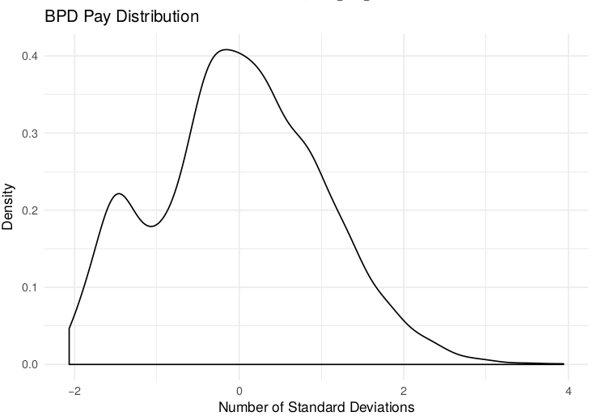
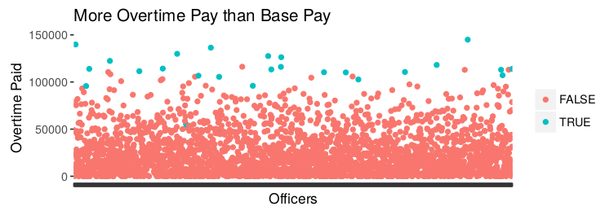
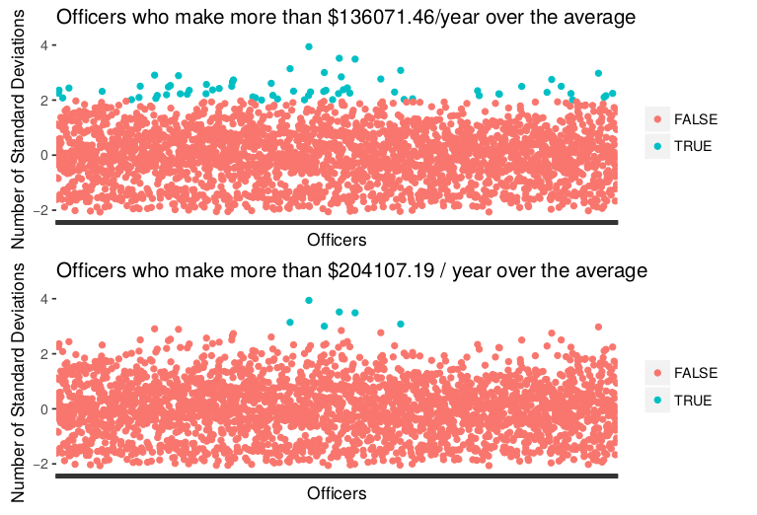
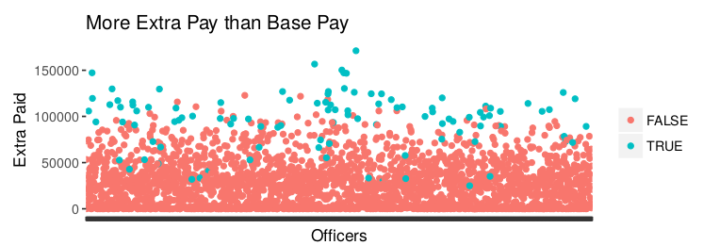
Police Pay
In what critics call an extreme example of a systemic problem, Lee Waiman bolstered his wages thanks to police union contracts that require that officers who work detail shifts or testify in court be paid a minimum of four hours, even if the assignment lasts only 30 minutes.
Last year, Lee earned $58,600 by working more than 1,100 hours of overtime, according to a Globe review of police payroll records. Records show that Lee did not work 674 of those hours - more than 16 40-hour weeks - yet received time-and-a-half pay.
Most of Lee’s overtime pay stemmed from court appearances that typically lasted no more than an hour, the Globe found. He was also paid for 2,771 hours for detail shifts, including 861 unworked hours. That allowed him to make close to $130,000, a sum that did not include his overtime pay. [1]
Boston Police Overtime Pay Last Year was $66,900,000 [3]
Hosein - 203 violations that include 80 counts of inaccurate reporting on a detail card, 16 counts of receiving details outside the system, 24 counts of accepting a detail scheduled during his regular patrol shifts, and 1 count of breaking the law and conduct unbecoming an officer.
Kervin - 191 violations that include 68 counts of inaccurate reporting on a detail card, 46 counts of receiving details outside the system, 6 counts of accepting a detail scheduled during his regular patrol shifts, and 1 count each of breaking the law and conduct unbecoming of an officer.
Frangie - 84 violations that include 34 counts of inaccurate reporting on a detail card, 10 counts of accepting a detail scheduled during his regular patrol shifts, 3 counts of receiving details outside the system, and 2 counts of conduct unbecoming an officer. [2]
[1]
www.bostonglobe.com/metro/2017/06/20/for-some-boston-police-officers-extra-money-comes-easy/oS47lc7OuYyVZbTPBv1zQL/story.html
[2]
archive.boston.com/news/local/articles/2007/08/23/3_police_lieutenants_are_cited_for_alleged_detail_abuses/
[3]
www.bostonglobe.com/metro/2018/02/16/bpd-captain-was-city-top-earner/iI4G1pnC7MOUODxo0XR4aO/story.html

Slide 3

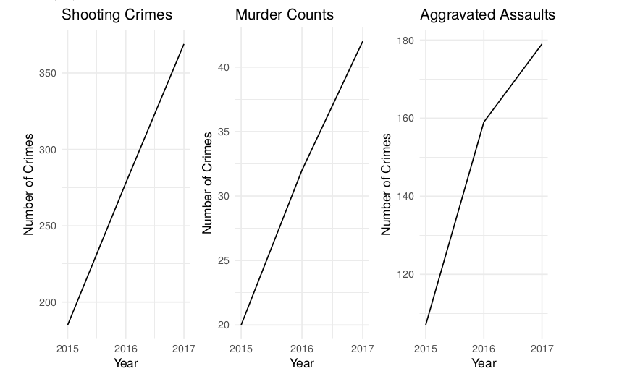
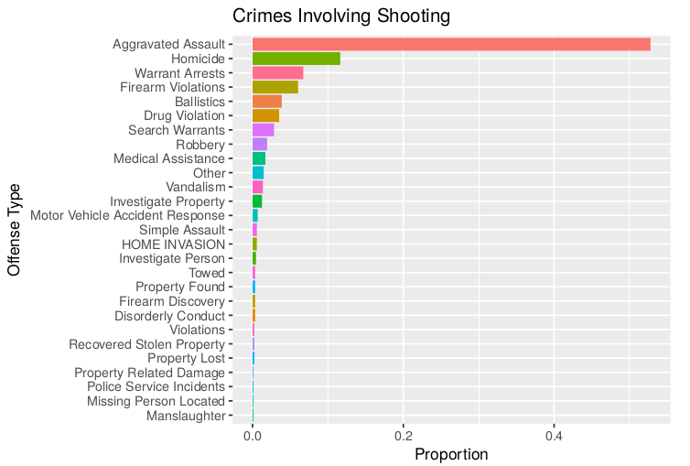
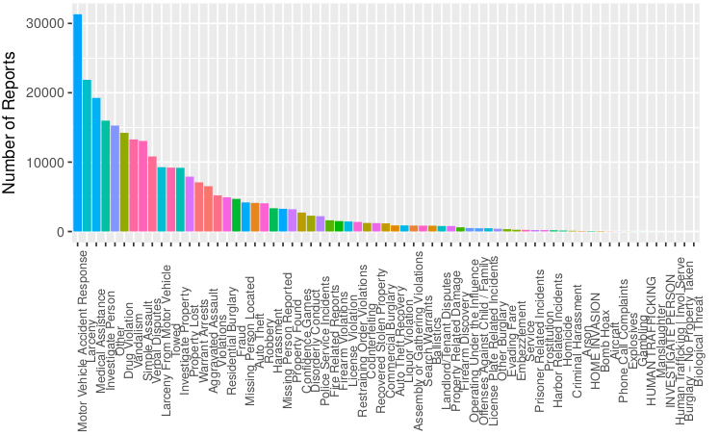
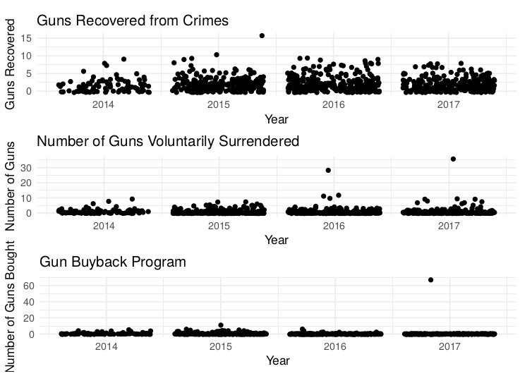
Crime
Takeaways
Majority of reports are car accidents
>50% of crimes involving a gun were aggravated assault
Aggravated Assaults increase, but rate is decreasing
Shooting crimes increase by about 80 per year
Murders increase by about 10 per year
Guns retrieved from crimes increased
2014 – 2015
Guns surrendered is relatively consistent except for outliers.
The gun buyback program has consistent returns, except where someone sold 60+ guns

Slide 4

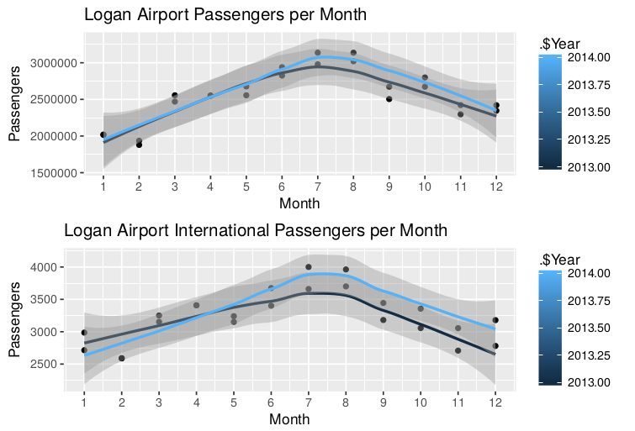
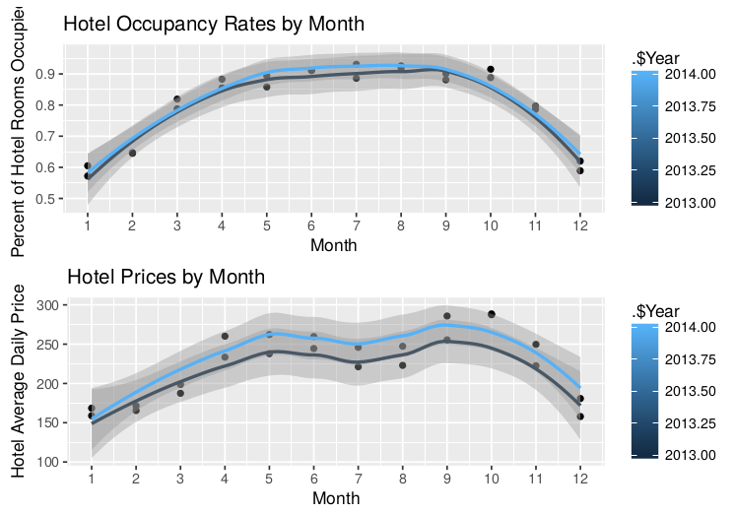
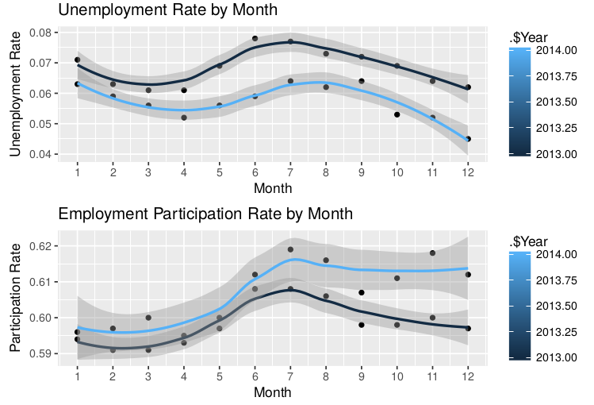
Flights
Hotels
Unemployment
2014 was a slightly better year for tourism
Flight volume jumps about 50% in the summer
There are approximately 1000 times as many domestic passengers as there are international passengers
2014 had similar occupancy rates to ‘13
Average Hotel Price increased 13 → 14
Price increases with occupancy
Not many people spend Christmas in Boston
2013 had a higher unemployment rate
Unemployment dropped 1-2% in 2014 dependent on month
Unemployment ~ 6-8%
Market Participation ~ 60%

Slide 5

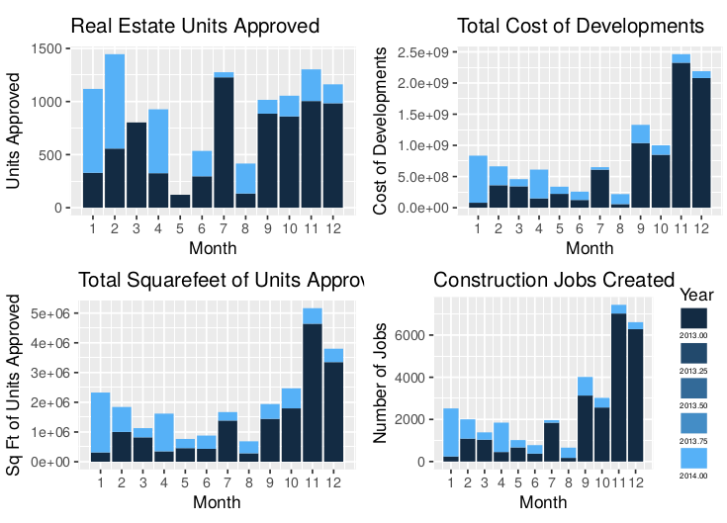
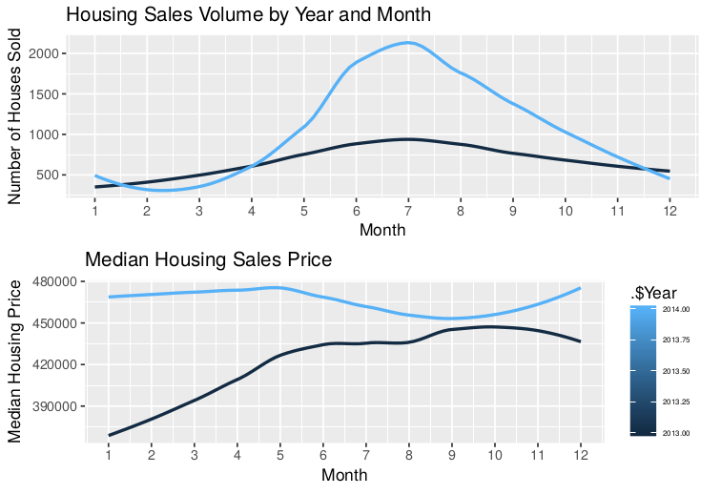
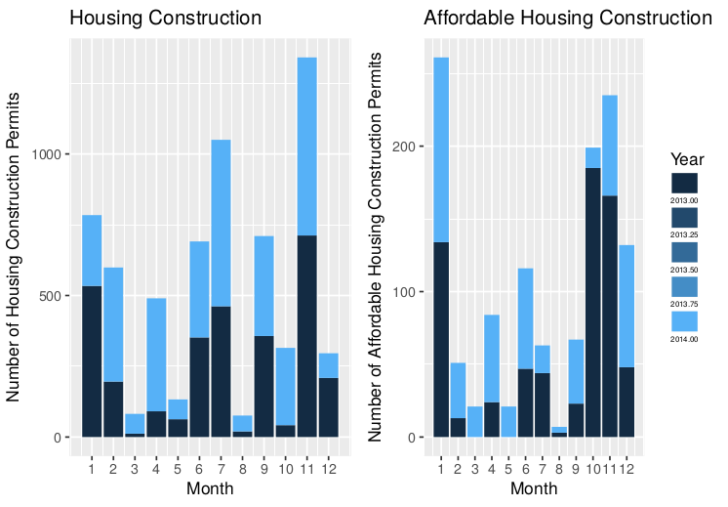
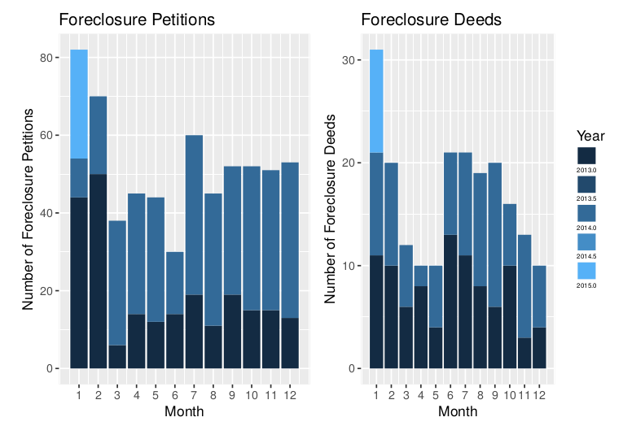
Real Estate and Development
Real Estate Board Development Projects
2014 had significantly more development than 2013
Booms in development lead to creation of construction jobs
New units took up considerably more space
Housing Sales
Summer is a good season for Realtors
More than 2x as many sales in 2014 than 2013
Prices were roughly uniform over 2014
Housing Construction
2014 had a large increase in construction of new houses
November was a popular month to approve new projects
More affordable housing dwellings were approved in 2014 than 2013
Foreclosures
Foreclosures rose in 2014
Notices of Foreclosure in 2015 were mainly in January
Less foreclosures in 2015 than 2014 and 2013

