Slide 1
Analyze Boston

Slide 2

Introduction
data.boston.gov
Employee Earnings, Economic Indicators
Crime, Gun Recovery

Slide 3
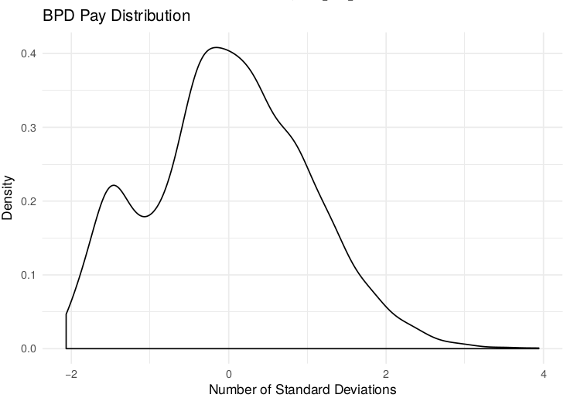
Police Pay

Slide 4
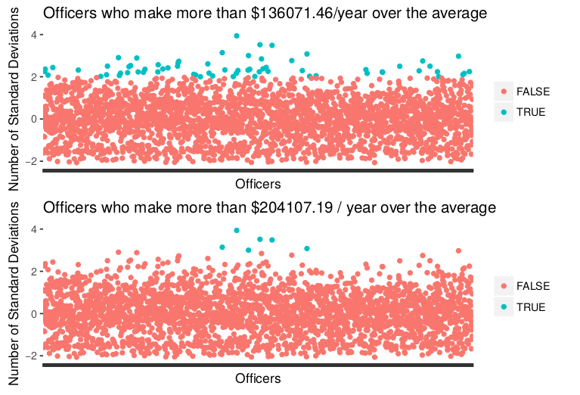
Standard Deviations

Slide 5
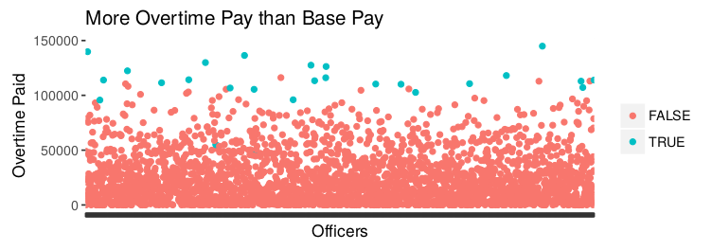

Slide 6
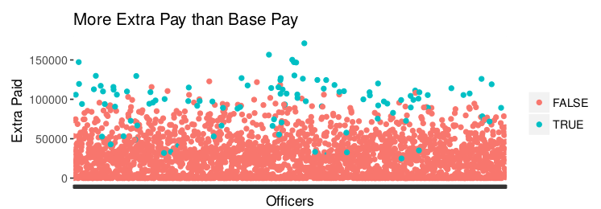

Slide 7
www.bostonglobe.com/metro/2017/06/20/for-some-boston-police-officers-extra-money-comes-easy/oS47lc7OuYyVZbTPBv1zQL/story.html
In what critics call an extreme example of a systemic problem, Lee Waiman bolstered his wages thanks to police union contracts that require that officers who work detail shifts or testify in court be paid a minimum of four hours, even if the assignment lasts only 30 minutes.
Last year, Lee earned $58,600 by working more than 1,100 hours of overtime, according to a Globe review of police payroll records. Records show that Lee did not work 674 of those hours - more than 16 40-hour weeks - yet received time-and-a-half pay.
Most of Lee’s overtime pay stemmed from court appearances that typically lasted no more than an hour, the Globe found. He was also paid for 2,771 hours for detail shifts, including 861 unworked hours. That allowed him to make close to $130,000, a sum that did not include his overtime pay.

Slide 8
archive.boston.com/news/local/articles/2007/08/23/3_police_lieutenants_are_cited_for_alleged_detail_abuses/
Kervin - 191 violations that include 68 counts of inaccurate reporting on a detail card, 46 counts of receiving details outside the system, 6 counts of accepting a detail scheduled during his regular patrol shifts, and 1 count each of breaking the law and conduct unbecoming of an officer.
Frangie - 84 violations that include 34 counts of inaccurate reporting on a detail card, 10 counts of accepting a detail scheduled during his regular patrol shifts, 3 counts of receiving details outside the system, and 2 counts of conduct unbecoming an officer.

Slide 9
www.bostonglobe.com/metro/2018/02/16/bpd-captain-was-city-top-earner/iI4G1pnC7MOUODxo0XR4aO/story.html
Boston Police Overtime Pay Last Year was $66,900,000

