Slide 1
ShiftScope
Compare two groups of single cells. Measure the shift, find the drivers, and decide what to test next.
Energy distance + optimal transport, differential expression, and grounded Claude prioritization. Built with Claude: Life Sciences.
Notes:
This is ShiftScope. You give it two groups of cells, and it measures how they differ, shows where, finds the genes that drive it, and tells you what to test next.

Slide 2
The problem
Comparing two cell populations is the most common question in single-cell work, and today it is mostly done by hand.
Two things stay hard:
1. Is the difference real, and how big? A UMAP cannot say, and a table of per-gene p-values does not give you one number for effect size.
2. Of hundreds of screen hits, which deserve a month at the bench? Ranking by effect size alone points you at genes everyone already knows.
Notes:
Comparing two groups of cells is the most common question in the field, and it is done by hand. Two things stay hard. Is the difference real and how big, and which of many hits is actually worth testing.

Slide 3
How it works
Load .h5ad
Shared PCA
Distances
Localize
Drivers
Interpret
Measuring the shift
Where, and what drives it
Everything runs in one PCA space fit on the pooled cells, so the two groups are comparable. The headline metric is the scPerturb energy distance (E-distance), with a label-permutation E-test for significance. MMD (RBF kernel) and Sinkhorn optimal transport (POT) are reported as geometry-aware cross-checks.
Leiden clusters the shared latent; a per-cluster Fisher exact test with Benjamini-Hochberg correction flags the clusters that gained or lost query cells. Wilcoxon rank-sum DE inside those clusters gives the driver genes, ranked by the Wilcoxon score among significant hits.
Notes:
One PCA space for both groups. The main metric is the scPerturb energy distance with a permutation test, plus MMD and optimal transport as cross-checks. Leiden clustering with a Fisher test shows where the shift is, and Wilcoxon DE gives the driver genes.

Slide 4
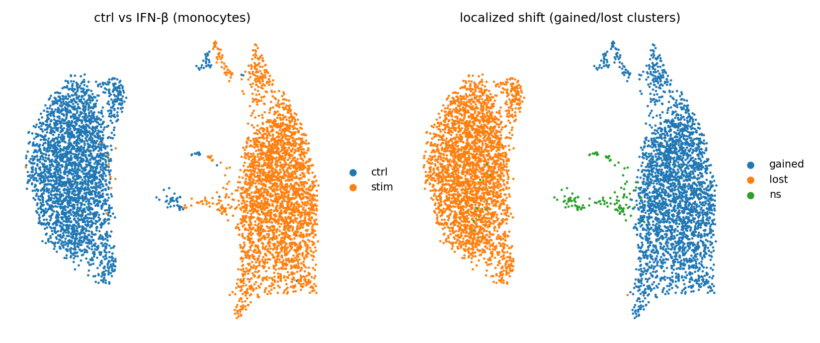
One example, end to end
Control vs IFN-β, CD14+ monocytes (Kang 2018).
• E-distance 216, permutation p = 0.001. MMD and Sinkhorn agree.
• Leiden + Fisher/BH: the stimulated cells form their own clusters (log2 enrichment up to +9).
• Wilcoxon drivers: ISG15, MX1, IFIT1/3, OAS1, the type-I interferon program.
• Claude writes a short rationale, and every claim cites one of these numbers. The exact prompt and evidence are logged.
Notes:
End to end on real data. Control versus interferon. E-distance 216, p 0.001. The stimulated cells form their own clusters, the drivers are the known interferon genes, and Claude explains it with every claim tied to a number.

Slide 5
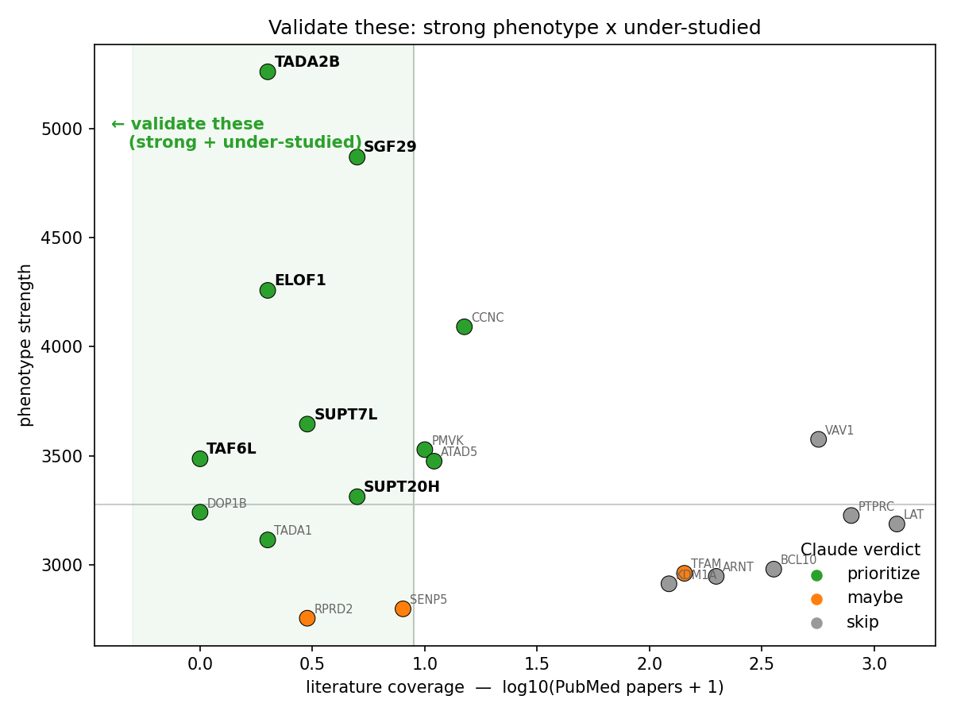
From metric to decision: what to test next
On Marson's genome-scale CD4+ T-cell CRISPR screen (~11k knockouts):
• Phenotype strength = number of downstream DE genes per knockout.
• Novelty is grounded, not guessed: a live NCBI PubMed count (E-utilities) of papers on each gene in an immune context. Cached and rate-limited.
• Claude scores novelty 1–5 and gives a keep/skip verdict with that real count in front of it. Prompt + evidence logged for every call.
• VAV1, CD45 (hundreds of papers) drop. Strong but obscure SAGA-complex genes (TADA2B, SGF29, ELOF1; 0–4 papers) rise to the top.
Notes:
The part we think matters most. On Marson's T-cell CRISPR screen, we rank hits by how strong they are and how little they have been studied. Novelty comes from a live PubMed count, and Claude gives a keep or skip call using that real number. Famous genes drop, strong and under-studied genes rise.

Slide 6
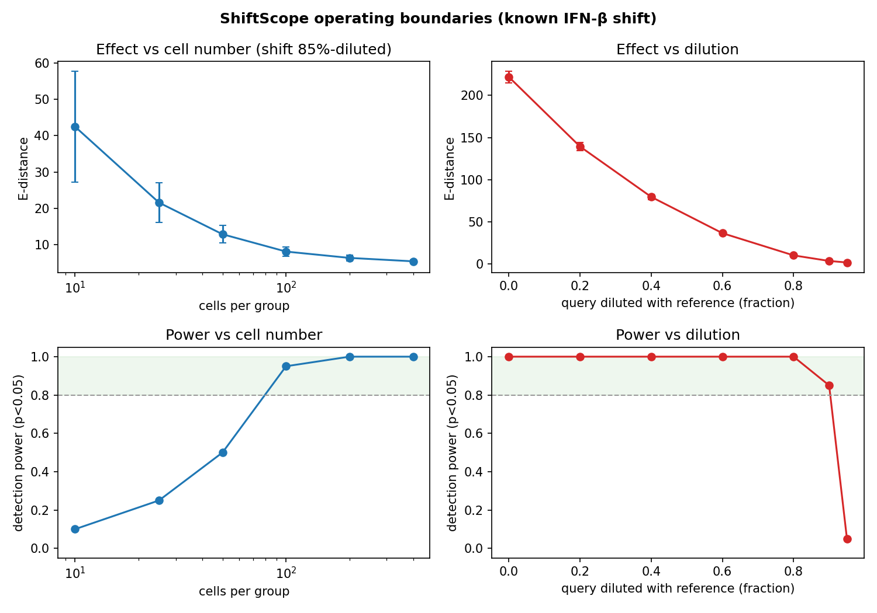
Does it hold up?
We measured where it breaks.
• Detection power over many random draws, not one lucky p-value.
• Needs about 100 cells per group for a subtle shift; detects a shift until it is diluted below ~10% of its true size.
• Validated across four domains (immune, infection, development, cell type) and two real CRISPR screens (Marson, Shifrut), correct distinct biology each time.
• Distances follow the scPerturb standard (Peidli et al., Nat. Methods 2024).
Notes:
We are clear about limits. We measured detection power by cell number and effect size, over many draws. It is validated across four domains and two real screens, and the distance math follows the scPerturb standard.

Slide 7
Turn “these look different” into “test this gene next.”
Any two cell populations. Python, scanpy, POT, NCBI E-utilities, Claude (Anthropic SDK). Runs in Colab. MIT.
github.com/aenorhabditis6/claude_science_hackathon
Notes:
ShiftScope turns 'these look different' into 'test this gene next.' Any two cell populations, open source, runs in Colab. Thanks for watching.

