Slide 1
Perimenopause · everyday health support
Demo · synthetic data
Common, long-lasting, and mostly unseen
Hot flashes and night sweats in perimenopause
up to 80%
7+ years
80%+
of women get hot flashes or night sweats
for half of the women who get them often
of midlife women didn't seek care
During the menopause transition · The Menopause Society
SWAN study · JAMA Internal Medicine, 2015
For menopause symptoms · Mayo Clinic survey of ~5,000 women, 2025
Lisa, 46, is one of them
She wakes up hot at 3 AM. At the doctor, all she can say is “I just feel off.”
Sources: The Menopause Society, menopause.org · Avis et al., JAMA Intern Med 2015 · Mayo Clinic Proceedings, Oct 2025
Notes:
Up to 80 percent of women in perimenopause get hot flashes or night sweats, often for years, and most never see a doctor about it. Lisa, 46, wakes up hot at 3 AM. At the doctor, all she can say is: I just feel off.

Slide 2

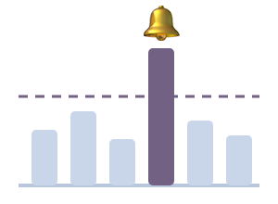
Perimenopause · everyday health support
Demo · synthetic data
Why Claude: it reads the mess
Mixed, messy, personal data is exactly what Claude is good at
Claude reads
Our code decides
Claude writes
Emails in any format and receipt photos become clean events
Lines up her evenings and nights; speaks only if p < 0.05
Turns our numbers into plain words for Lisa and her doctor
Opus 5.5 · structured JSON · vision
Asks at most 2 one-tap questions a week
Uses only our numbers · never diagnoses
Claude never does the math
It reads the inputs and explains the outputs. The statistics are plain code you can check.
Notes:
Why Claude? The hard part is messy input: emails in every format, and photos of receipts. Claude turns them into clean events. Our code does the statistics and decides when to speak. Claude explains the result, using only our numbers.

Slide 3





Perimenopause · everyday health support
Demo · synthetic data
Would you let an agent read your inbox?
Only if personal mail never leaves the phone. She picks the mode.
Manual
Filtered (default)
Full
Only the receipts she snaps
A tiny on-device model screens every email first
Every source except personal mail
GPS and metadata removed first
Only useful emails go to Claude: 75 of 134
Places and card: only restaurants, bars, liquor stores, pharmacy
In our synthetic tests
0 personal emails left the phone · 76 of 76 useful emails got through · fastText model, 363 KB, on the phone
Notes:
Would you let an agent read your inbox? Only if personal mail never leaves the phone. A tiny on-device model screens every email first, Lisa picks how much it reads, and in our synthetic tests no personal email left the phone, and every useful one got through.

Slide 4
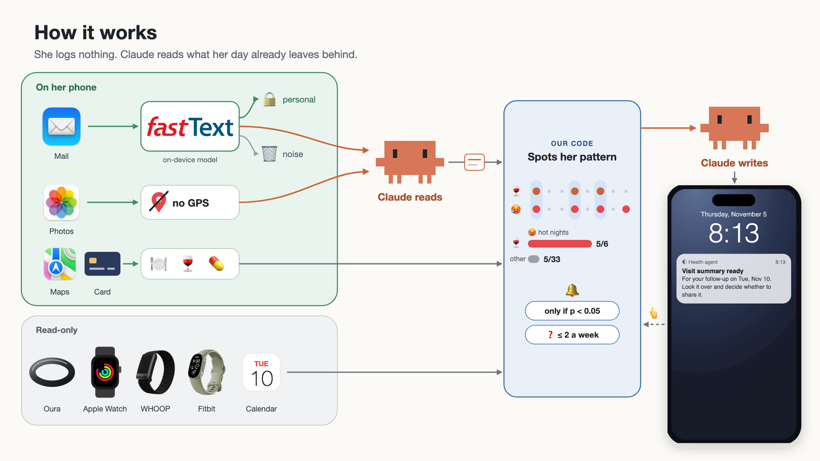
Notes:
Her phone decides what may leave. Claude reads it, our code finds the pattern, and Claude writes it up. Her one-tap answers feed back in.

Slide 5
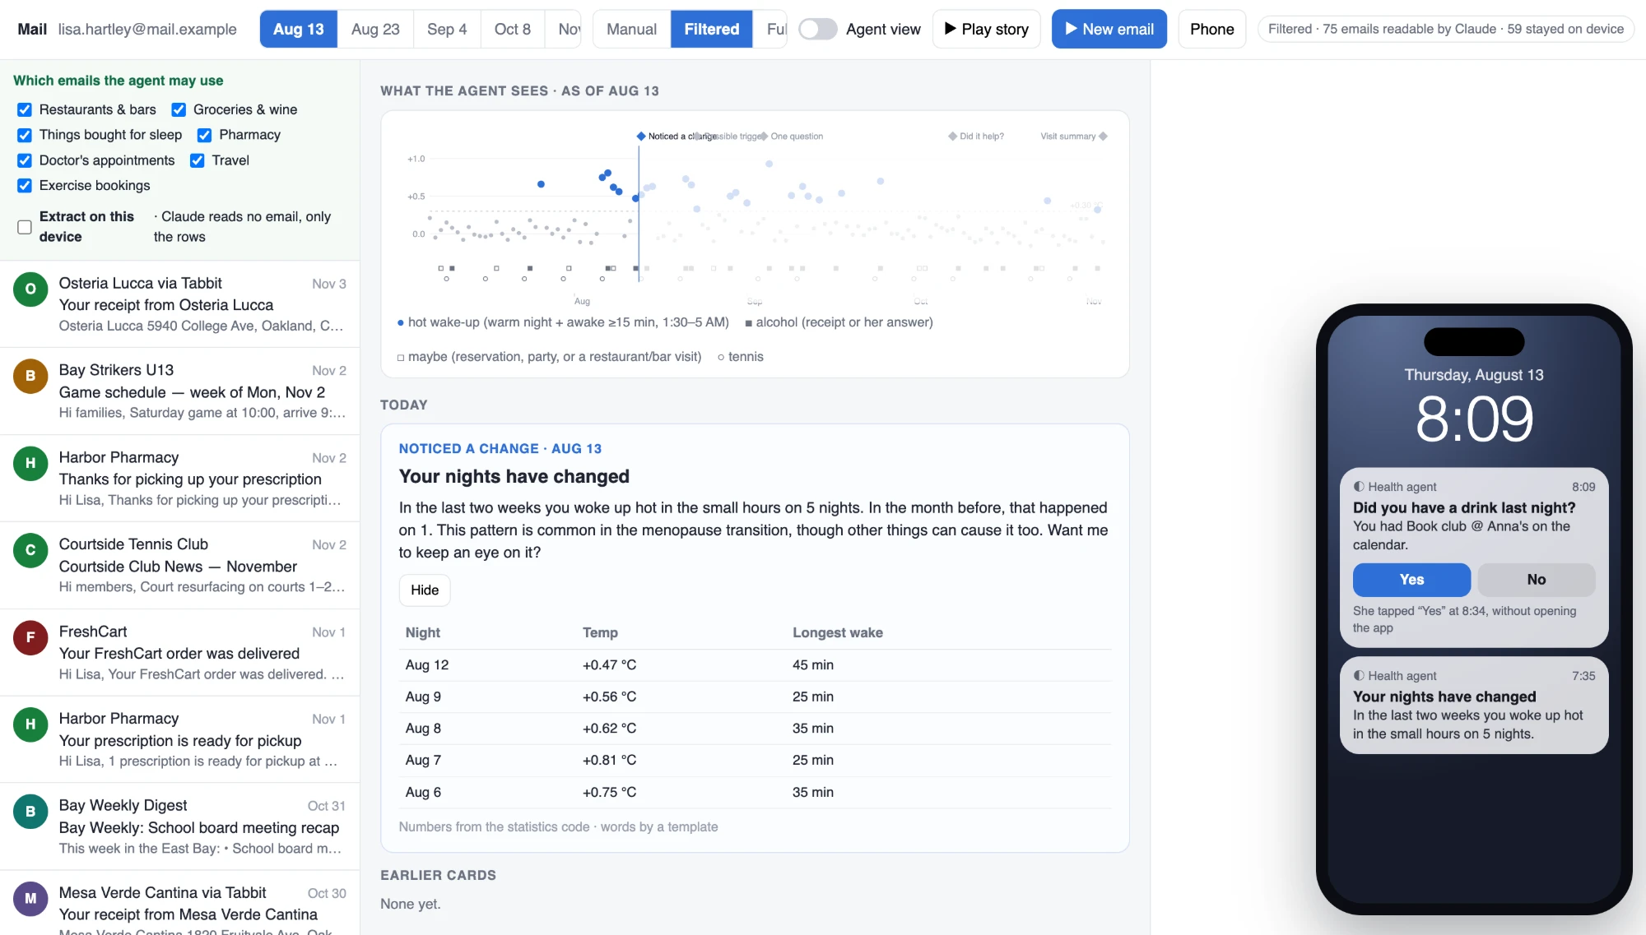
Notes:
August: five hot nights in two weeks, against one the month before. One card, one question: a drink last night? She taps yes.

Slide 6
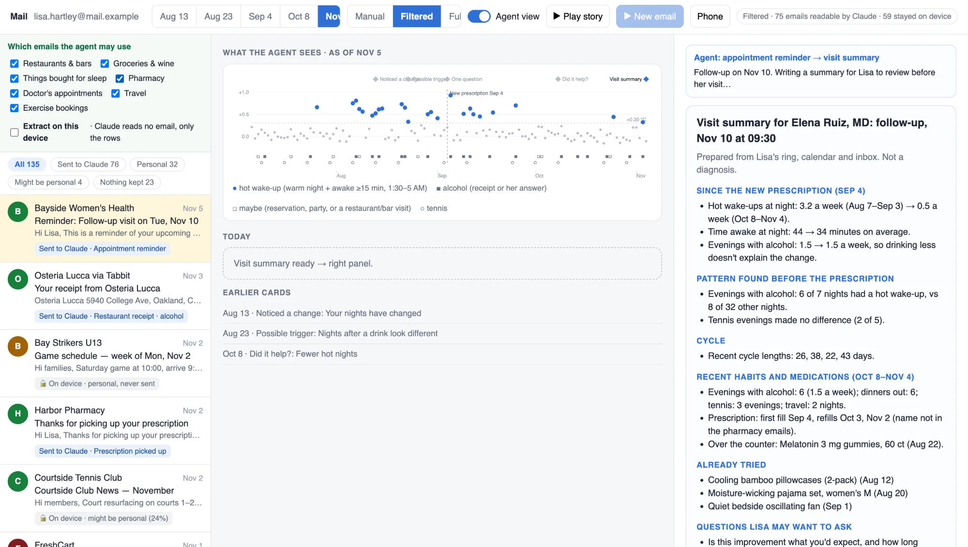
Notes:
November: her clinic's reminder arrives, and the agent writes a one-page summary. Since her new prescription, hot wake-ups fell from 3.2 to 0.5 a week, and her drinking didn't change. It's not a diagnosis.

Slide 7
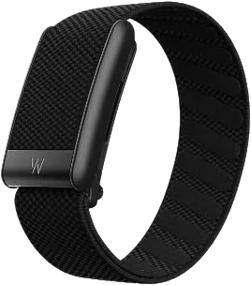
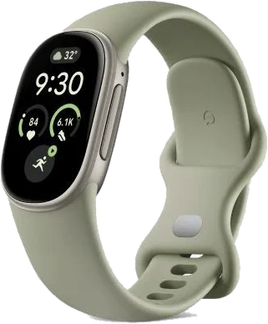

Perimenopause · everyday health support
Demo · synthetic data
Next: more clues, better patterns
Every new sensor adds a clue. Clues that agree are more reliable.
Real inboxes
More devices
Clinic pilot
Gmail and Outlook, read-only, same on-device screen first
WHOOP, Fitbit, any ring or watch that reads temperature
Visit summaries with a menopause clinic
Then on-device extraction, so useful emails can stay put too
Apple Watch has read wrist temperature only since 2022
Does one page help the visit?
It gets better without asking more of her
Lisa still logs nothing. The agent just has more to read.
Notes:
Next: real inboxes, more devices, and a clinic pilot. Apple Watch only started reading temperature in 2022. Every new sensor adds a clue, and clues that agree make patterns more reliable.

Slide 8
Perimenopause · everyday health support
Demo · synthetic data
She logged nothing. The agent did the rest.
17 weeks: from a first warning in August to one page for her doctor
0
13
0
manual logs
times it spoke up
personal emails left the phone
No questionnaires, no tags
9 questions · 3 cards · 1 summary
75 of 134 emails went to Claude
Hackathon demo: synthetic data only
Lisa is fictional. These numbers show the pipeline works, not real-inbox accuracy or health outcomes.
All numbers come from our statistics code, not from the model (as of Nov 5). The visit summary is not a diagnosis.
Notes:
Lisa logged nothing. The agent spoke up 13 times in 17 weeks, and she walked in with three months on one page.

