Slide 1
Mobile Ordering System
Brainstorm Consulting

Slide 2
Problem Scope
The purpose of the Mobile Ordering System created for The Best Seng company is to increase their online presence and provide customers with a streamlined way to order online. The system must offer customers assistance with selecting the paint via a questionnaire and allow customers to use items from previous orders to save time in creating new orders.
Notes:
Oleg

Slide 3
Presentation Outline
1.Database design
2. UI overview
3.UI walkthrough
INCOMPLETE
Notes:
oleg

Slide 4
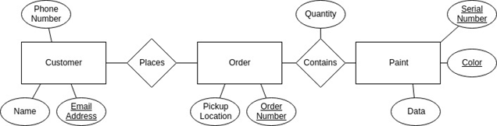
Database Design
The system database stores customer information, orders and a list of paints.
The ER diagram displays the relationships between the entities
Notes:
Oleg

Slide 5
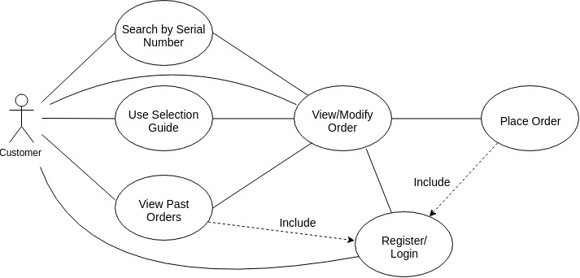
Application UI Overview
Register/login
Search by serial number
Search by selection guide
Search by past orders
View modify cart
Place order
Mobile Ordering System Use Case Diagram
Notes:
Emily/Oleg?

Slide 6
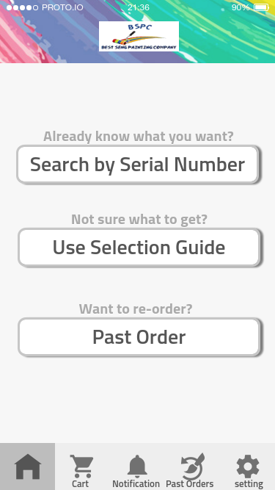
Landing Screen
The landing screen has options to use either of the paint selection methods, as well as settings and carts
Notes:
Emily

Slide 7
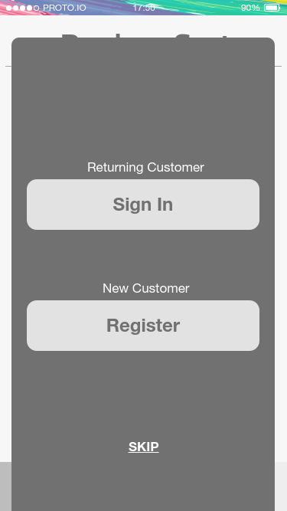
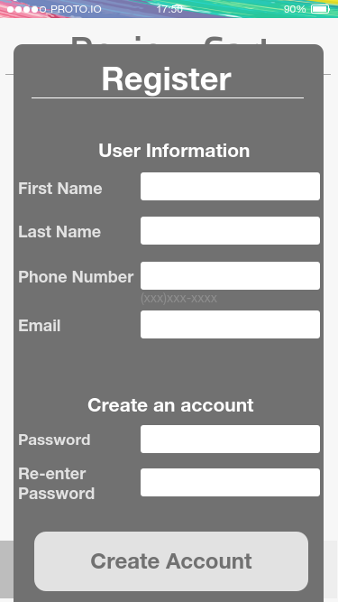
Register/Login
1. Customer selects register button
2. Customer is redirected to new customer form
3. Customer fills out new customer form
4. Customer returns to the previous page they
were on, and now the customer can include
View Past Orders and Place Order use case.
Notes:
Emily

Slide 8
Register/Login
1. Customer selects register button
2. Customer is redirected to new customer form
3. Customer fills out new customer form
4. Customer returns to the previous page they
were on, and now the customer can include
View Past Orders and Place Order use case.

Slide 9
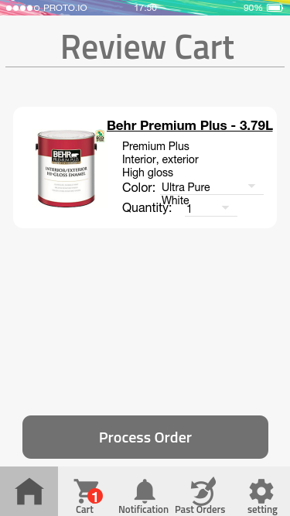
Register/Login
1. Customer selects register button
2. Customer is redirected to new customer form
3. Customer fills out new customer form
4. Customer returns to the previous page they
were on, and now the customer can include
View Past Orders and Place Order use case.
Notes:
Emily

Slide 10
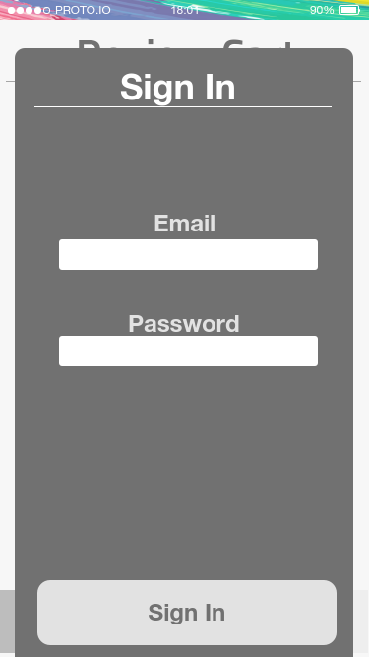
Register/Login
1. Customer selects Sign In button
2. Customer is redirected to Sign In form
3. Customer fills out Sign In form
4. Customer returns to the previous page they
were on.
Notes:
Emily

Slide 11
Register/Login
1. Customer selects Sign In button
2. Customer is redirected to Sign In form
3. Customer fills out Sign In form
4. Customer returns to the previous page they
were on.
Notes:
Emily

Slide 12
Register/Login
1. Customer selects Sign In button
2. Customer is redirected to Sign In form
3. Customer fills out Sign In form
4. Customer returns to the previous page they
were on.
Notes:
Emily

Slide 13
Search by Serial Number
Customer selects Search by Serial Number button from the landing screen
Customer enters serial number
Customer views the paint information
Customer may view paint specification
Customer may select the colour and quantity of the paint

Slide 14
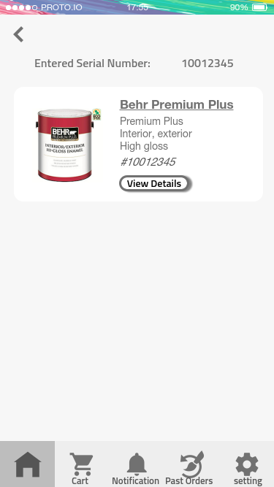
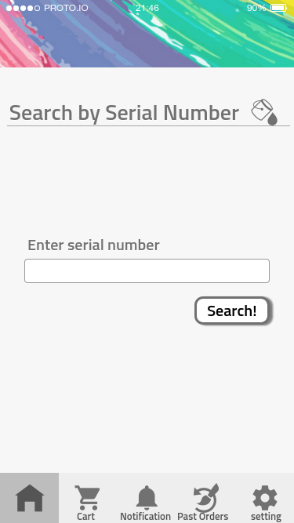
Search by Serial Number
Customer selects Search by Serial Number button from the landing screen
Customer enters serial number
Customer views the paint information
Customer may view paint specification
Customer may select the colour and quantity of the paint

Slide 15
Search by Serial Number
Customer selects Search by Serial Number button from the landing screen
Customer enters serial number
Customer views the paint information
Customer may view paint specification
Customer may select the colour and quantity of the paint

Slide 16
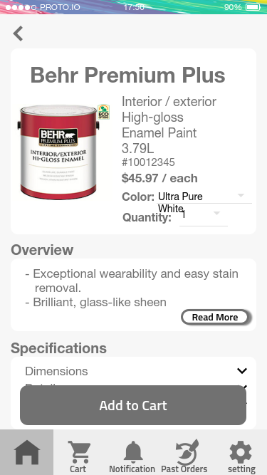
Search by Serial Number
Customer selects Search by Serial Number button from the landing screen
Customer enters serial number
Customer views the paint information
Customer may view paint specification
Customer may select the colour and quantity of the paint

Slide 17
Selection Guide
Customer selects the Selection Guide from the landing screen.
Selection Guide asks the customer a series of questions before offering suggestions.
Customer answers a minimum set the questions that the system proposes to them.
Selection Guide provides suggestions on paints for the user according to the answer(s) given to the Selection Guide

Slide 18
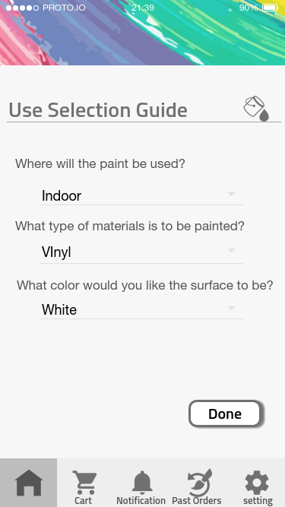
Selection Guide
Customer selects the Selection Guide from the landing screen.
Selection Guide asks the customer a series of questions before offering suggestions.
Customer answers a minimum set the questions that the system proposes to them.
Selection Guide provides suggestions on paints for the user according to the answer(s) given to the Selection Guide

Slide 19
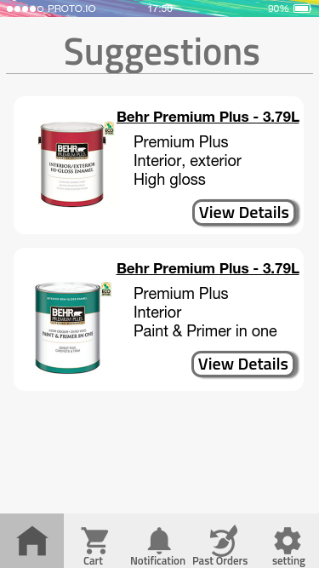
Selection Guide
Customer selects the Selection Guide from the landing screen.
Selection Guide asks the customer a series of questions before offering suggestions.
Customer answers a minimum set the questions that the system proposes to them.
Selection Guide provides at suggestions on paints for the user according to the answer(s) given to the Selection Guide

Slide 20
View Past Orders
Customer selects Past Order from the landing screen
Customer’s list of past orders is displayed
Customer clicks a specific past order
Screen displays list of items from the selected order
Customer adds desired items to the new cart
Customer selects quantity and colour

Slide 21
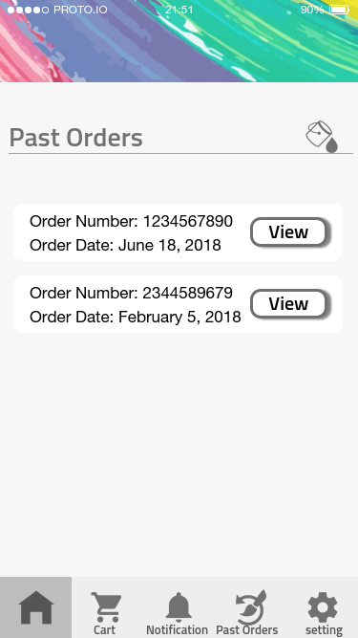
View Past Orders
Customer selects Past Order from the landing screen
Customer’s list of past orders is displayed
Customer clicks a specific past order
Screen displays list of items from the selected order
Customer adds desired items to the new cart
Customer selects quantity and colour

Slide 22
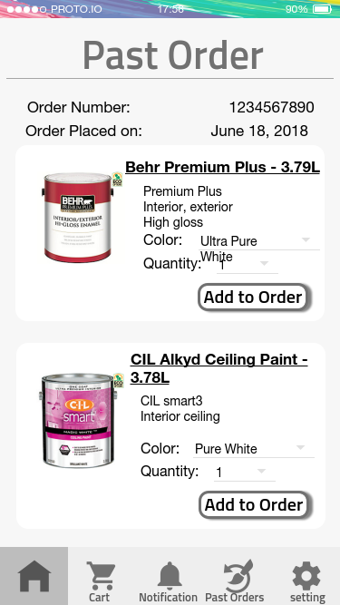
View Past Orders
Customer selects Past Order from the landing screen
Customer’s list of past orders is displayed
Customer clicks a specific past order
Screen displays list of items from the selected order
Customer adds desired items to the new cart
Customer selects quantity and colour

Slide 23
View Past Orders
Customer selects Past Order from the landing screen
Customer’s list of past orders is displayed
Customer clicks a specific past order
Screen displays list of items from the selected order
Customer adds desired items to the new cart
Customer selects quantity and colour

Slide 24
Place Order
Customer selects process order.
List of stores is shown with addresses and contact information.
Customer selects store.
Pick up date is displayed.
Customer selects place order.
Order number, order date and store contact information are provided in case of follow up query or order cancelation.
Printer at selected location prints the pick slip.

Slide 25
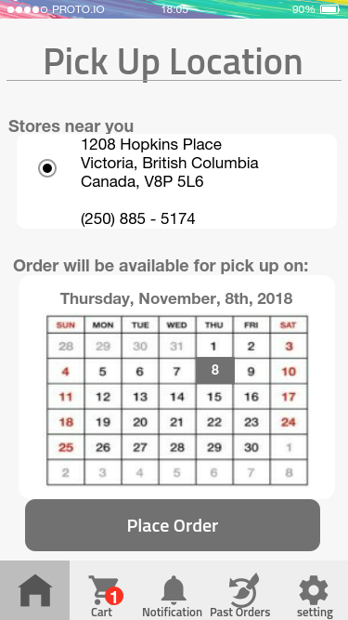
Place Order
Customer selects process order.
List of stores is shown with addresses and contact information.
Customer selects store.
Pick up date is displayed.
Customer selects place order.
Order number, order date and store contact information are provided in case of follow up query or order cancelation.
Printer at selected location prints the pick slip.

Slide 26
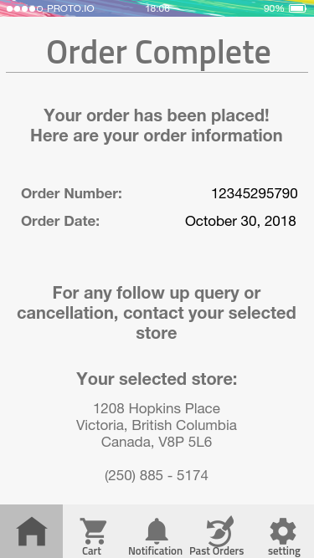
Place Order
Customer selects process order.
List of stores is shown with addresses and contact information.
Customer selects store.
Pick up date is displayed.
Customer selects place order.
Order number, order date and store contact information are provided in case of follow up query or order cancelation.
Printer at selected location prints the pick slip.

Slide 27
Prototype Demo
Selection Guide, Register, Place Order
2. Serial Number, Sign In
3. Past Order
1. https://pr.to/I8D27J/
2. https://pr.to/4TXGSZ/
3. https://pr.to/RXTLJT/

