Slide 1
Aeolus www.aeolusproject.org
An open source community-based cloud management software
Richard Su
rwsu@redhat.com
Red Hat, Inc
Notes:
- Me:
- sys mgmt
- puppet/augeas
- now Deltacloud
- No puppet contrib anymore
- Wanted to give overview of all RH cloud
- Aeolus RH's take on IaaS cloud + future
- Relevant to devops

Slide 2
What is it?
Not a Hypervisor or a Cloud
It is a set of tools and applications that is used to build a portable cloud infrastructure
Works with Amazon EC2, RHEV, VMWare vSphere, and more under development

Slide 3
Some Use Cases
Compute Farm
  Increase throughput by offloading work to a public cloud
Seasonality and Cost Savings
  Quickly bring up resources when needed
  Pay for resources only when used
Notes:
- nebolous
- every man for themselves
- no vision for landscape

Slide 4
An Abstraction Layer
Don't need to know each cloud provider's API
Aeolus provides a way to
  Create images that can be deployed to multiple cloud providers
  Manage VMs across multiple cloud providers

Slide 5
Unlocks your cloud environment from any particular cloud vendor
Notes:
- Users with oodles of internal virt installations

Slide 6
Installation
For Fedora, add aeolus repo to yum
Install “aeolus-all” meta-package
Run aeolus-configure. It uses puppet to configure the server and to bring up services and applications.

Slide 7
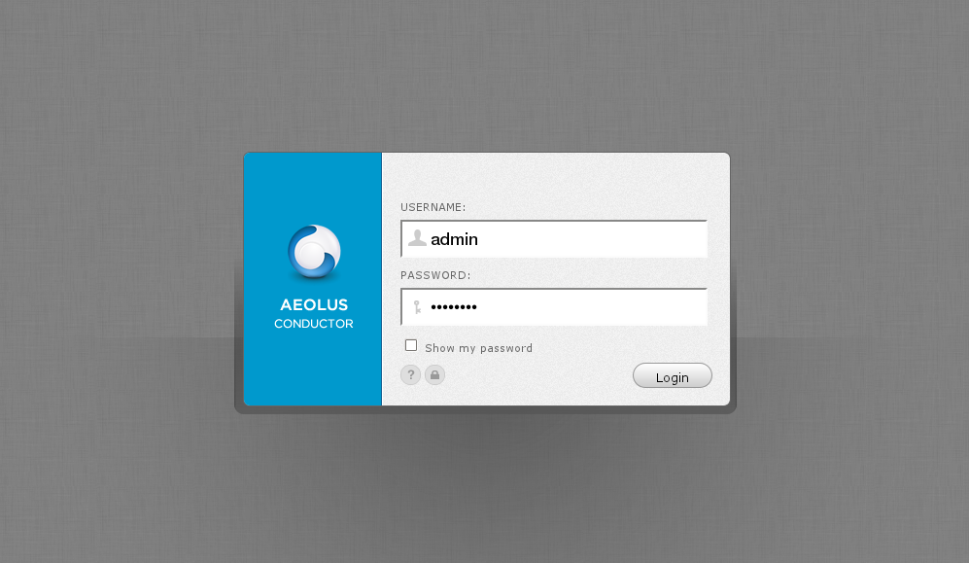

Slide 8
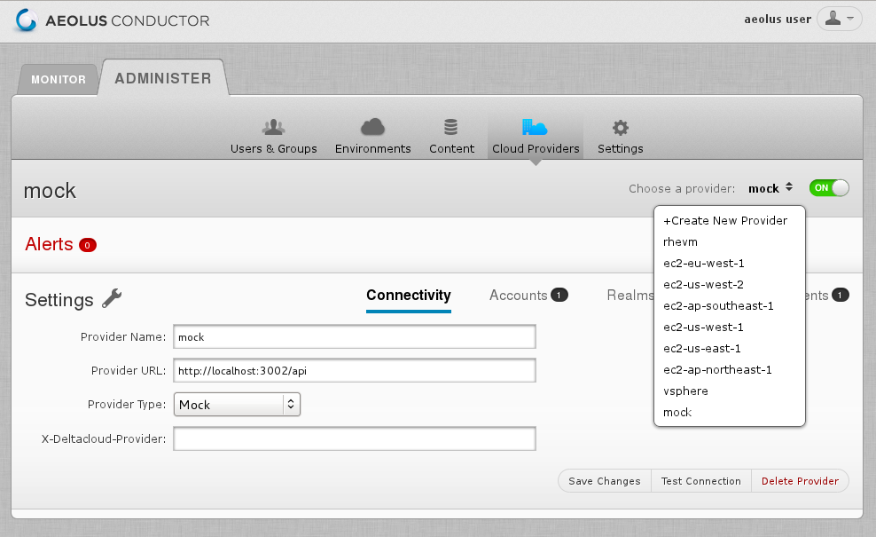

Slide 9
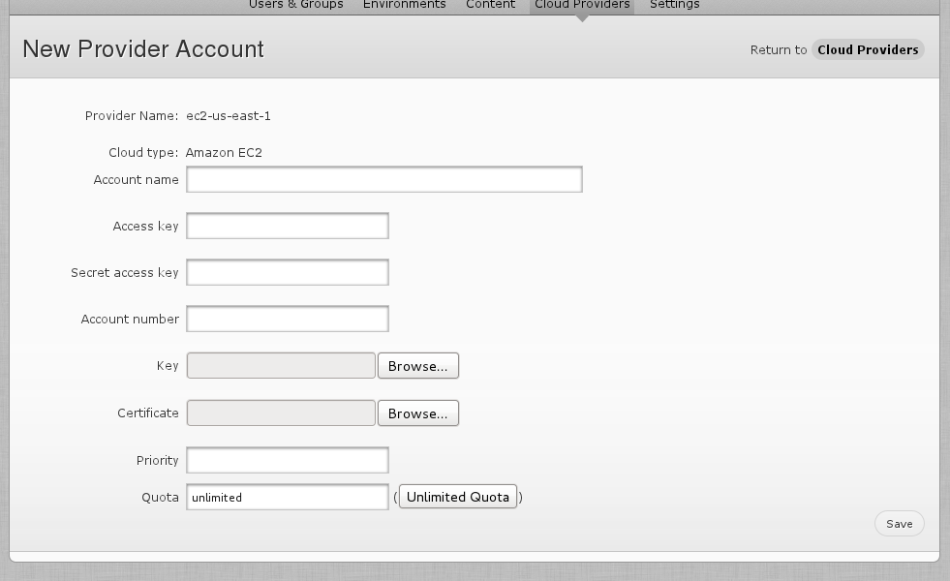

Slide 10
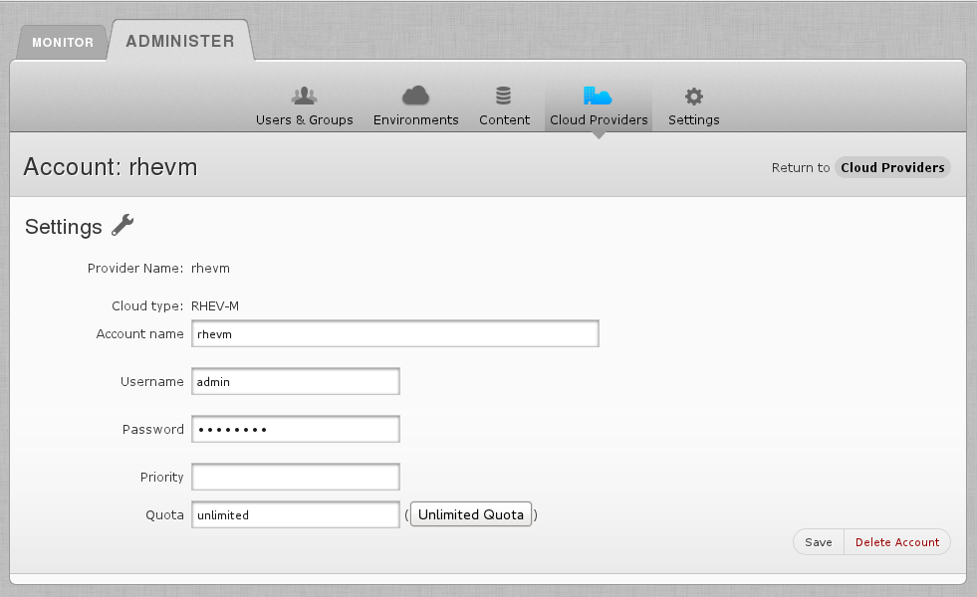

Slide 11
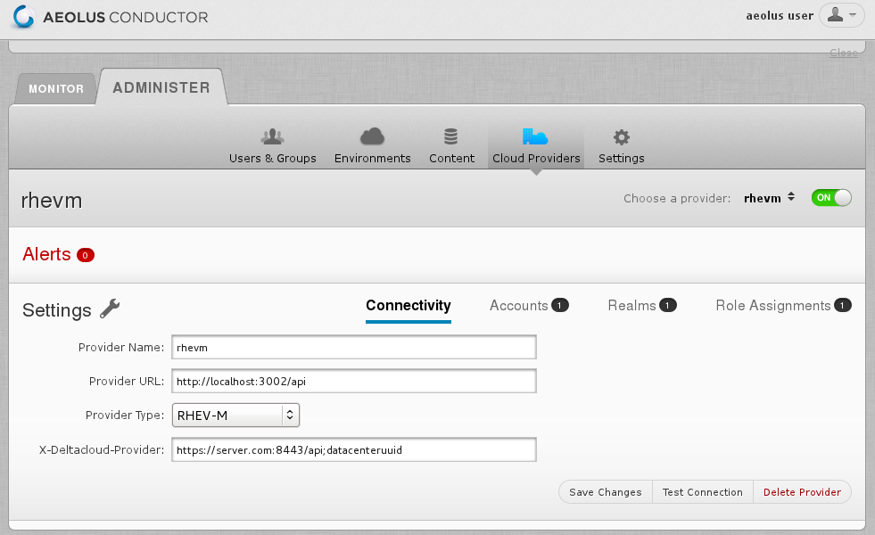

Slide 12
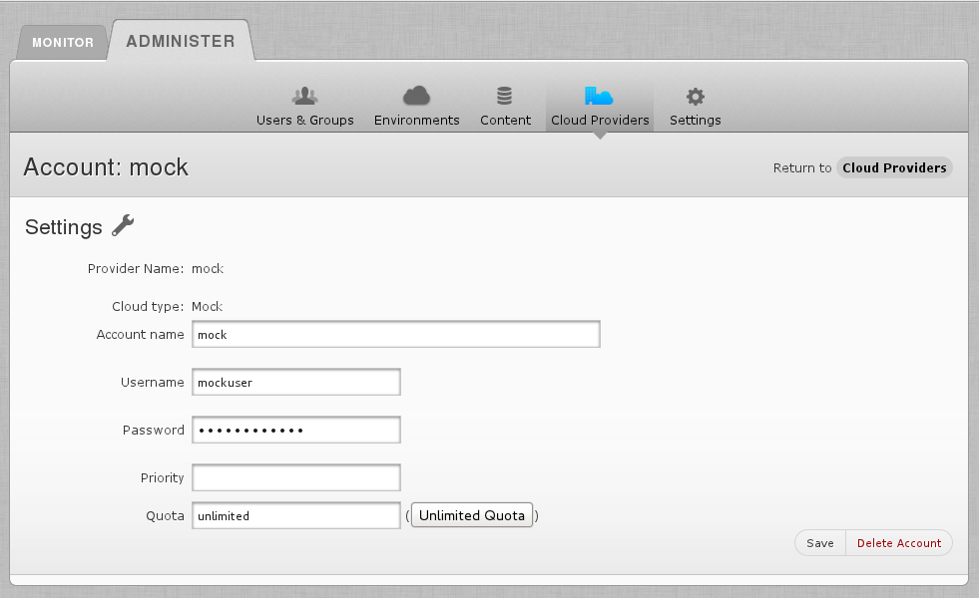

Slide 13
Images Can Be Built For
Red Hat Enterprise Linux
Fedora
OpenSuse
Debian
Ubuntu
Windows
ScientificLinux
and more
http://aeolusproject.org/oz.html

Slide 14
Template
<template>
<name>tmpl1</name>
<description>foo</description>
<os>
<name>Fedora</name>
<version>15</version>
<arch>x86_64</arch>
<install type="url">
<url>http://download.fedoraproject.org/pub/fedora/linux/releases/15/Fedora/x86_64/os/</url>
</install>
<rootpw>changeme</rootpw>
</os>
<packages>
<package name='aeolus-all'/>
</packages>
<repositories>
<repository name="custom">
<url>http://repos.fedorapeople.org/repos/aeolus/conductor/testing/fedora-15/x86_64/</url>
<signed>false</signed>
</repository>
</repositories>
</template>

Slide 15
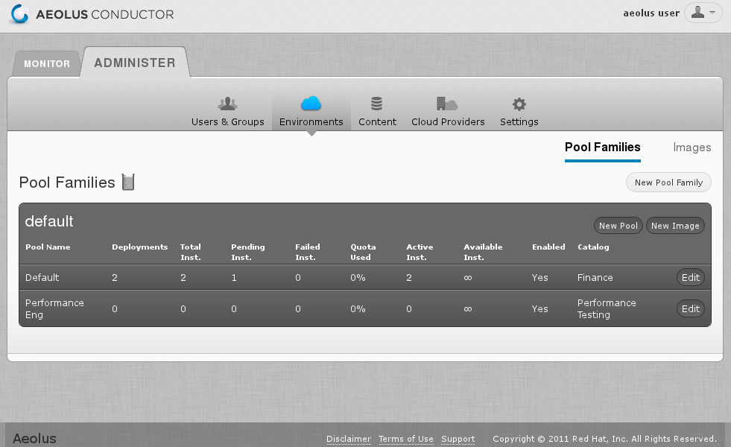

Slide 16
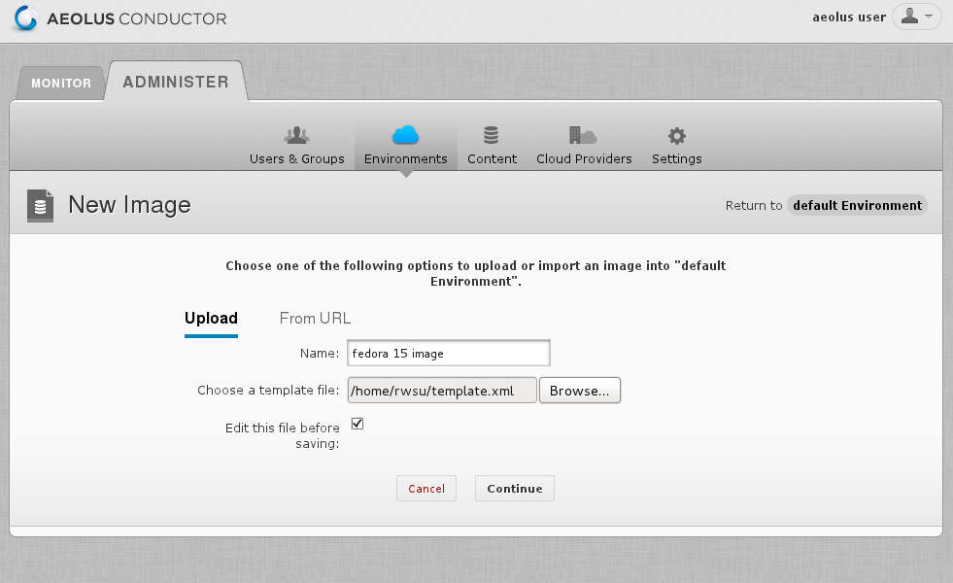

Slide 17
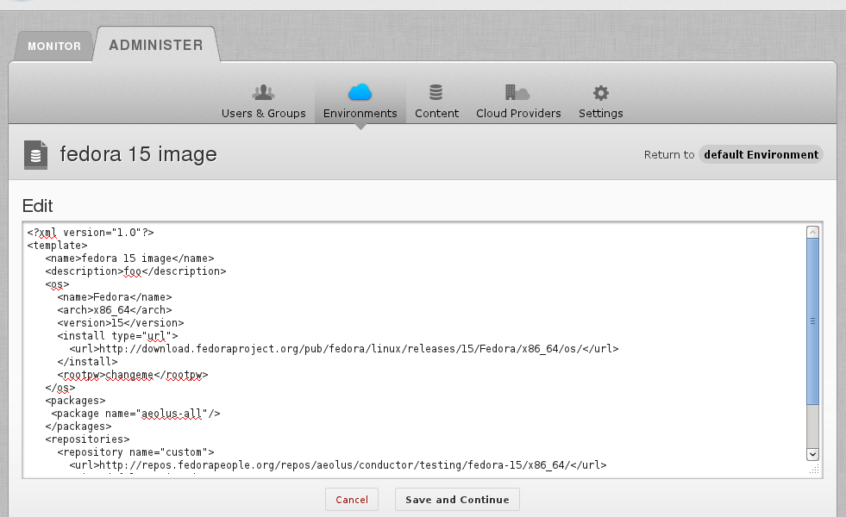

Slide 18
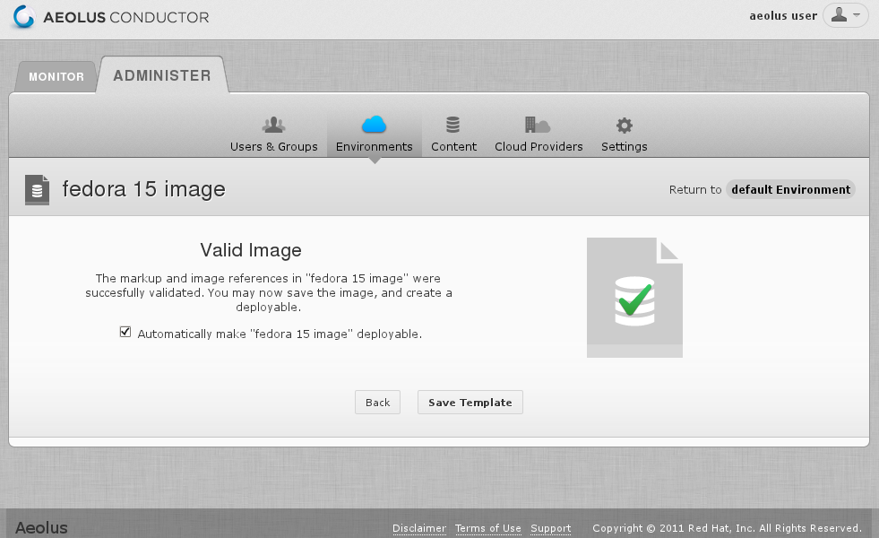

Slide 19
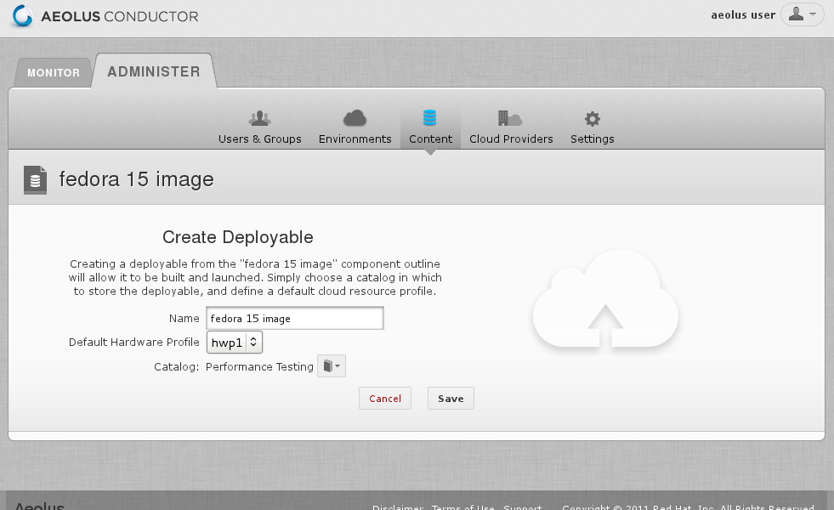

Slide 20
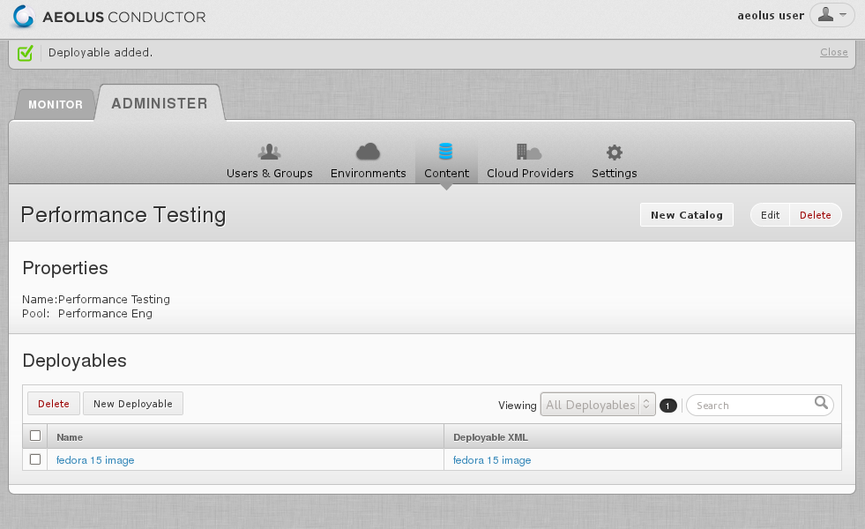

Slide 21
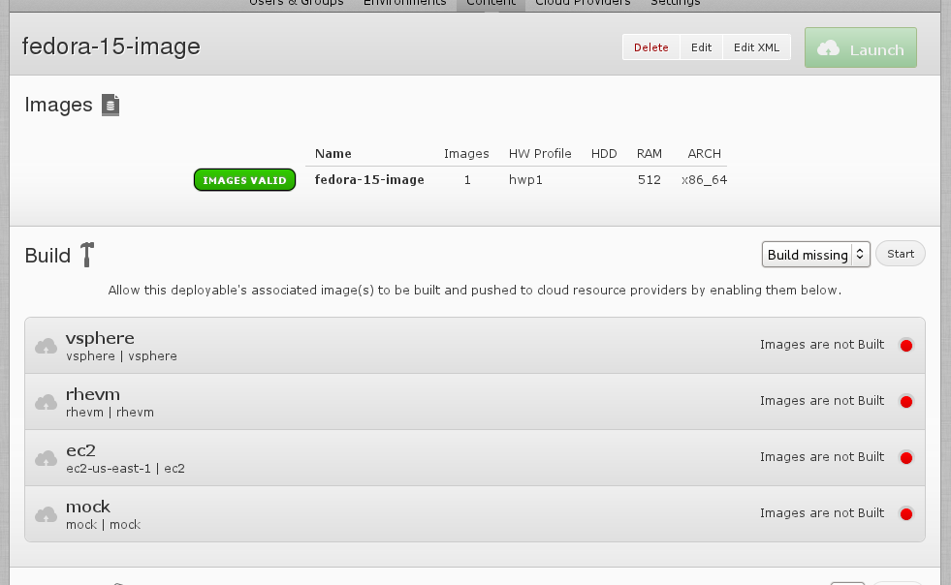

Slide 22
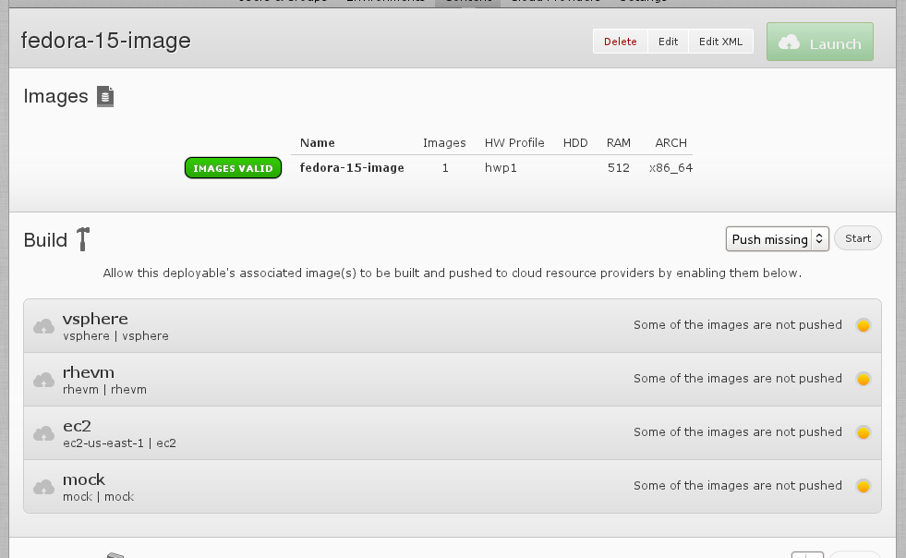

Slide 23
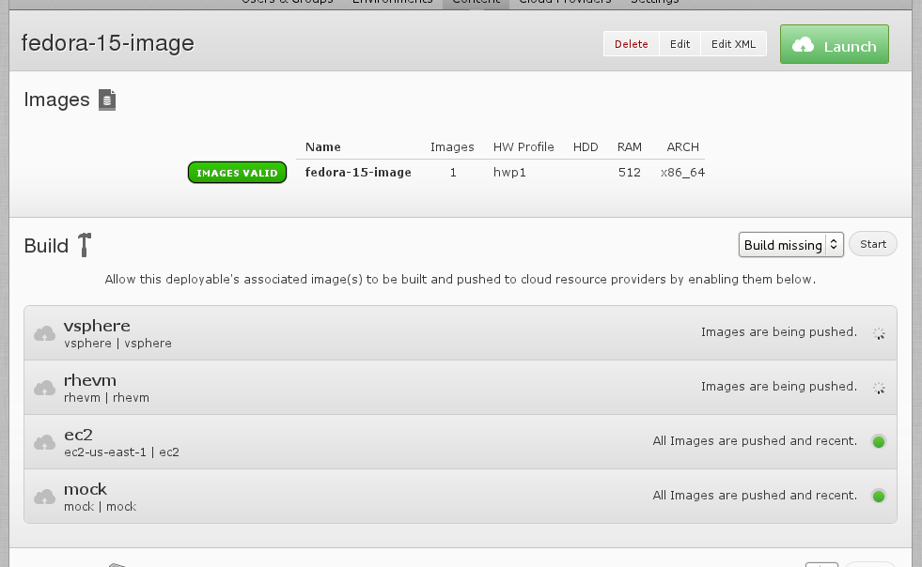

Slide 24
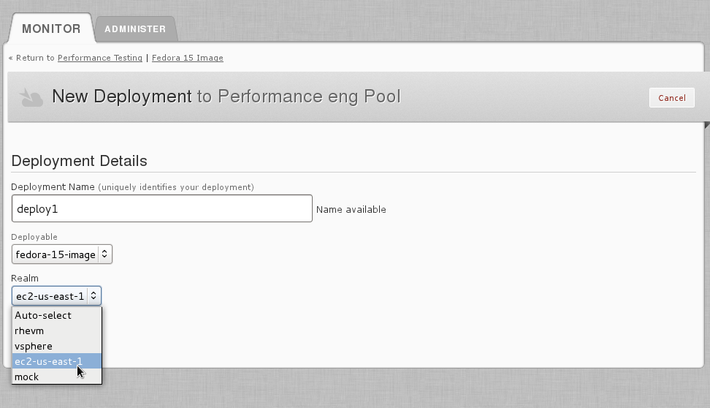

Slide 25
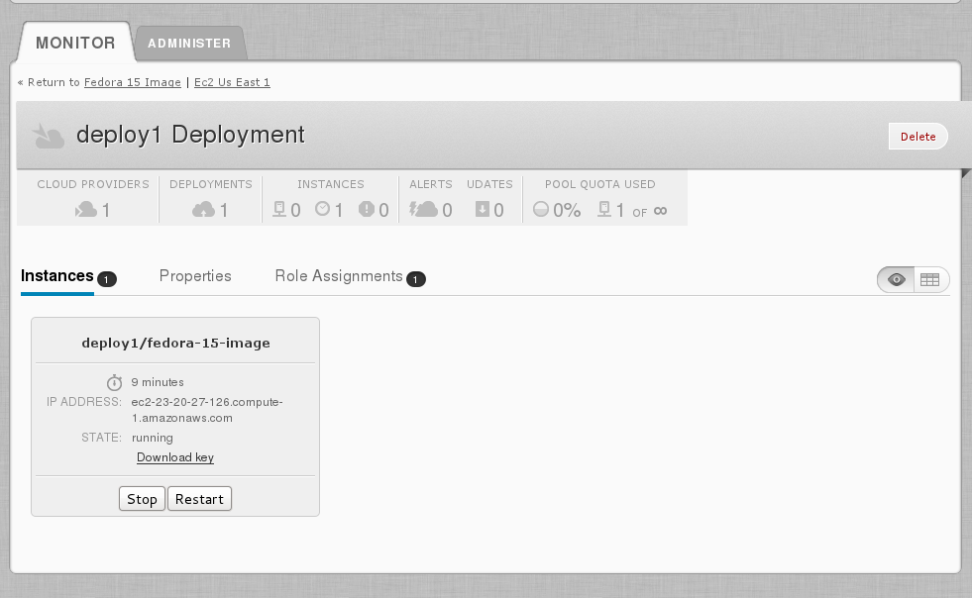

Slide 26
Deltacloud
Cloud abstraction API
REST based, language independent
Supports most major infrastructure as a service clouds

Slide 27
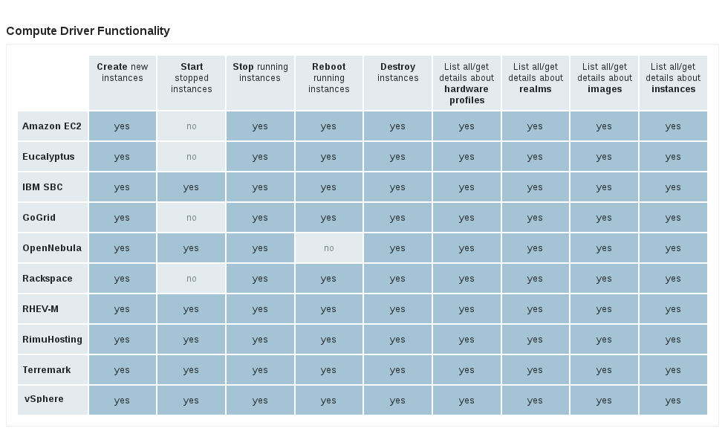

Slide 28
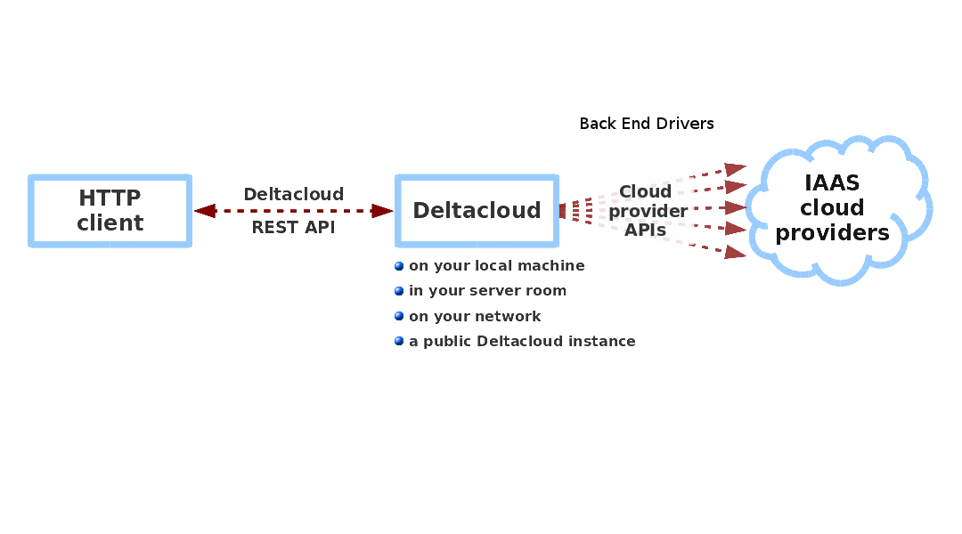

Slide 29
Deltacloud Resources
Images
Instances
Realms
Keys
Storage_volume
Storage_snapshot
Bucket
Blob
Address
Load_balancer
Firewall

Slide 30
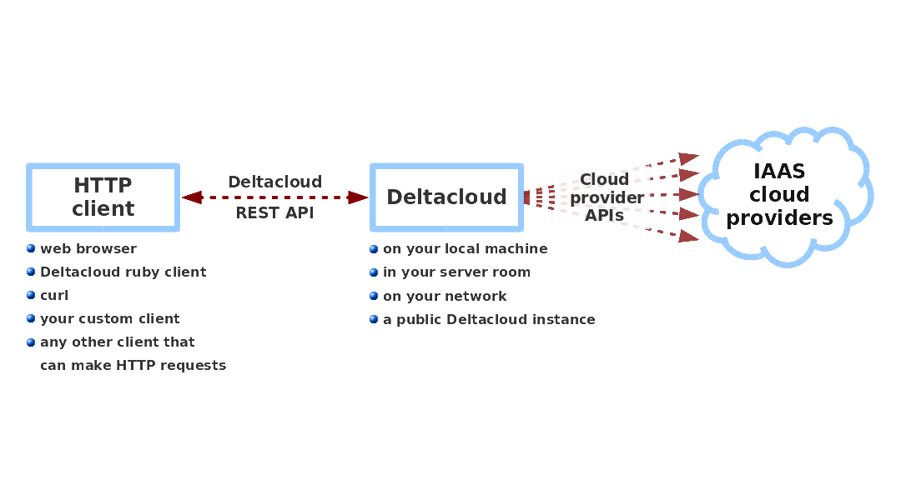

Slide 31
Composer
Imagefactory
  Builds images from a template
Oz
  Automates installs
Image Warehouse
  Stores images locally and transfers them to providers

Slide 32
Imagefactory Builds
Requires
  name of the target cloud provider
  template XML, a description of the image to be built
Can build an image in two ways

Slide 33
Imagefactory
Creates a raw image from scratch, using a boot image, runs the native installer
Applies user customizations, remove and/or add software
Uses Oz to automate the installation

Slide 34
Conversion
Creates a final image that is compatible with target cloud provider
Example
  VMware stream-optimized format
  qcow2 format for RHEV

Slide 35
Snapshot Builds
Available with Amazon EC2
Takes an existing JEOS in S3, makes a copy of it
Boots it and modifies it until template is satisfied
Saves time and bandwidth costs

Slide 36
Image Warehouse
Stores images and their metadata
Responsible for transmitting image to the cloud provider
For Amazon EC2, bundled in S3, and registered in the correct region
For RHEV, to the data center's storage domain

Slide 37
aeolus-image cli tool
[~]# aeolus-image build --target ec2,vsphere,rhevm --template template.xml
[~]# aeolus-image push --account acctname --image image_id
[~]# aeolus-image status --targetimage target_image_id
[~]# aeolus-image list --images,accounts,targets
[~]# aeolus-image import --account my-ec2 --id ami_id
[~]# aeolus-image delete --image image_id

Slide 38
Orchestrator
Construct a multi-tier application that runs on multiple instances and have it self configure when it is deployed
Example
  Web application with MySQL as database, each on its own instance
  Web application should start after the database is up

Slide 39
Deployment XML Recipe
MySQL
  User Param: username, password
  Runtime Param: dbup
Apache
  User Param: username, password
  Dependency to MySQL username, password, and dbup

Slide 40
Audrey
Configuration server placed in a cloud provider
Audrey agent installed in the instance
Conductor starts up instances and sends deployment information to the configuration server

Slide 41
Config Server
1. Instances boot and agents contact the config server
MySQL
agent waits
Apache
agent waits
Config Server
2. Config server sends MySQL Agent its parameter values
MySQL
agent starts
Apache
agent waits
Has all parameters filled
Waits for dbup
parameter

Slide 42
Config Server
3. MySQL instance finishes loading, sets dbup fact to true and notifies config server. Config server sends Apache agent configs.
MySQL
up
Apache
agent starts
Has all parameters filled
Config Server
4. Apache starts up and configuration completes on the instance and agent notifies config server.
MySQL
up
Apache
up
All done!

Slide 43
More info?
www.aeolusproject.org
source: https://github.com/aeolusproject
aeolus-devel@lists.fedorahosted.org
IRC
  Network: Freenode (irc.freenode.net)
  Channel: #aeolus

