Slide 1
Notes:
Abstract: In this session, Steven Hardy will introduce the OpenStack project (http://openstack.org), which provides an open source, community-developed solution for deploying Infrastructure-as-a-Service (IaaS) clouds.
Steven will introduce the openstack project, brief summary of history and then get into the details of the openstack architecture, and top-level overview of each component project
Finally a summary of how to get started with openstack and an overview of the new Heat orchestration project will be provided
Technical difficulty: 2 / 5

Slide 2
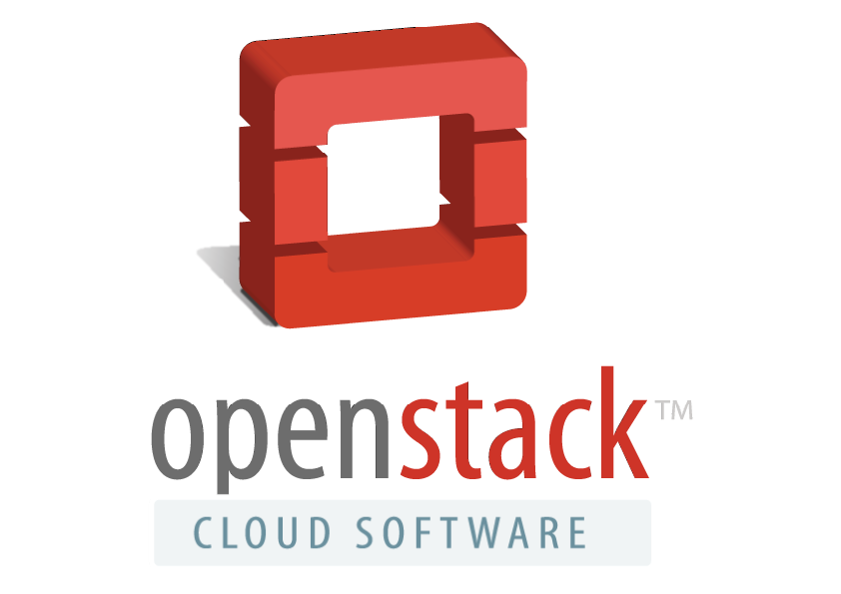
What is this OpenStack thing all about?
Notes:
Large community of developers and companies
Started by Rackspace and NASA a few years ago
Openness: Not just the source code, but the project as a whole.:
Design Summits
open source development methodologies
APIs
Not one big project, but contains a number of core projects/components
Quick evolution and adaptation as the landscape evolves

Slide 3
OpenStack top-level view..
Building blocks for creating public / private clouds
Massive scale
Horizontally scalable services
Illusion of infinite resources
Rapid provisioning / tear down of resources
Modular services with well defined APIs
Being led by the same folks doing the actual coding
Rapid development, evolution, innovation
Notes:
Provides the building blocks/services necessary to construct an IaaS cloud
Provides feature parity in many areas with Amazon AWS services, improving all the time
Design being led by the same folks doing the actual coding, not a standards based “top down” project organisation.
Leads to rapid development and innovation, which generates a lot of buzz/interest and brings even more people to the community/effort
OpenStack (by being open and implementable by all) can help reduce lock in, since the more clouds are implemented with OpenStack the easier it is to move things from Cloud to Cloud

Slide 4
OpenStack Core Services
OpenStack
Web UI
REST API
AMQP
Node
Node
Node
Node
Node
Node
Node
Node
Node
Node
Notes:
So here's what an OpenStack deployment would look like at a high level
Set of core services, each horizontally scalable
Set of nodes that run your hypervisor and virtual machine workloads
Important to note that the services and the user interface are completely separate
Also important to note that each of the services are self contained and provide well defined REST APIs
AMQP (Rabbit/QPID) message bus is used for communication between various parts of the services

Slide 5

CC-BY-SA flicker user r-butler
http://www.flickr.com/photos/r-butler/5092400656/
Notes:
So OpenStack core projects provide building blocks:
- Well defined interfaces and roles
- Can be stacked in many ways, both for scaling and even for some variations in use cases which I'll describe a bit later
- Each project is independent “do one job well”
- openstack-common provides somewhere for common code/reuse between projects

Slide 6
Horizon
Dashboard
Keystone
Identity
Service
Nova
Compute
Node
Glance
Image
Service
Swift
Object
Store
Quantum
Networking
Cinder
Volume
Service
What makes up OpenStack?
Notes:
So let's take a look at each of these core services:
Collection of services providing IaaS
Compute – Nova
Object Storage – Swift
Image Service – Glance
Identity Service – Keystone
Dashboard UI – Horizon
Network – Quantum
Volumes – Cinder
Related Projects
Heat (Orchestration)
Ceilometer (metering/metrics)
Many others but these two are proposed for Incubation

Slide 7
Horizon
Dashboard
Keystone
Identity
Service
Nova
Compute
Node
Nova
Compute
Node
Glance
Image
Service
Swift
Object
Store
Quantum
Networking
Cinder
Volume
Service
Schedules virtual machines to run on a set of nodes
Similar in concept to Amazon EC2
Multiple hypervisor support: KVM, Xen, LXC, VMware
Storage: iSCSI, NetApp, Nexenta, XenSM, SAN
Native OpenStack API + EC2 API Support
Notes:
At the core of OpenStack is Nova, or “Compute”
Composed of a handful of services: scheduler, compute node, api, cert, object store, volume, network
Core purpose is to schedule VMs to run on a set of Hypervisor nodes and to control their lifecycle
In Fedora/RHEL, we're focused on KVM as being the leader in hypervisor tech, but OpenStack is hypervisor neutral which I'll show later
EC2 and OpenStack API support
Network / Volume services being split out into separate services (Quantum/Cinder)

Slide 8
OpenStack Compute (Nova)
REST
API
Compute, Volumes, EC2
API
Compute, Volumes, EC2
API
Compute, Volumes, EC2
AMQP
QPID
Database
Scheduler
Volume
Scheduler
AMQP
AMQP
Scheduler
AMQP
Compute
libvirt
KVM
Compute
libvirt
KVM
Compute
libvirt
KVM
Network
Network
Network
Notes:
Multi-tenant
Highly scalable
Multiple hypervisors
KVM, Xen, VMware, Hyper-V, LXC
Pluggable persistent block storage
ISCSI, NetApp, Nexenta, XenSM, SAN
Native OpenStack and EC2 API support

Slide 9
Horizon
Dashboard
Keystone
Identity
Service
Nova
Compute
Node
Glance
Image
Service
Swift
Object
Store
Quantum
Networking
Cinder
Volume
Service
Glance
Image
Service
Mechanism for storing and retrieving disk images
Backends: Swift, S3, filesystem
Image Types: raw, qcow2, vmdk, vhd, iso, ami/aki, ovf
Public or private images & image sharing
Notes:
Ok, we've got the ability to run VMs, but where do we get the images for these VMs?
Enter Glance, or Image Service
Very simple service, allows VM disk images to be stored and retrieved
Works with a variety of image types
Images can be public, private or shared between groups (called tenants)
Pluggable storage back-ends (e.g swift).

Slide 10
OpenStack Image Service (Glance)
REST
Glance API
Glance API
Glance API
Glance Registry
Glance Database
Notes:
Image registry
List, register, retrieve
Multiple storage backends
Swift, S3, http, filesystem
Multiple image types
raw, qcow2, vmdk, vhd, iso, aki/ari/ami, ovf
API service horizontal scaling and possible caching
Public or private images
Private images can be shared via memberships

Slide 11
Horizon
Dashboard
Keystone
Identity
Service
Nova
Compute
Node
Glance
Image
Service
Swift
Object
Store
Quantum
Networking
Cinder
Volume
Service
Swift
Object
Store
Mechanism for storing arbitrary data
Similar to Amazon S3 (and supports S3 API)
Data replication/redundancy
Commodity Hardware (RAID etc not required)
Linear performance (optimised for scale)
Notes:
Swift is an Object Store. One of the first components in OpenStack and among the most mature in development and usage
Provides storage of arbitrary data/objects, allows you to read/write files (but not mount directories like a fileserver)
Swift is horizontally scalable, and objects are replicated across Swift nodes. The level of replication is configurable.
Swift is an analogue to Amazon S3 storage, and implements the S3 API. But it also implements its own API (Swift API) as well
Can layer Swift underneath Glance, and then the objects you are storing in Swift are VM disk images.

Slide 12
OpenStack Object Storage (Swift)
REST
Swift API
(Proxy Node)
Swift API
(Proxy Node)
Swift API
(Proxy Node)
Storage Node
Storage Node
Storage Node
Replication (rsync based)
Notes:
- Distributed architecture to prevent single-point of failure
- Designed to scale horizontally
- Proxy server accepts request via ReST API
- Uses memcache to improve performance (doesn't cache objects)
- Replication of objects, database and metadata, based on rsync with algorithms to reduce replication workload
- Can also serve data via plain HTTP (e.g images for web-pages)
- Authentication handled by WSGI middleware (usually uses keystone)

Slide 13
Horizon
Dashboard
Keystone
Identity
Service
Horizon
Dashboard
Nova
Compute
Node
Glance
Image
Service
Swift
Object
Store
Quantum
Networking
Cinder
Volume
Service
Self-service web UI for managing openstack services
Modular Django web application
Provides end-user and administrator interface
Plugin architecture (so can support non-core projects)
Notes:
As noted earlier, all of the components have well defined REST APIs to communicate with each other and for user/admin access
But it's also nice to have a graphical way of seeing the state of your deployment and controlling things
Enter Horizon, or Dashboard. It's a self service user portal, to allow you to view and control your resources in OpenStack

Slide 14
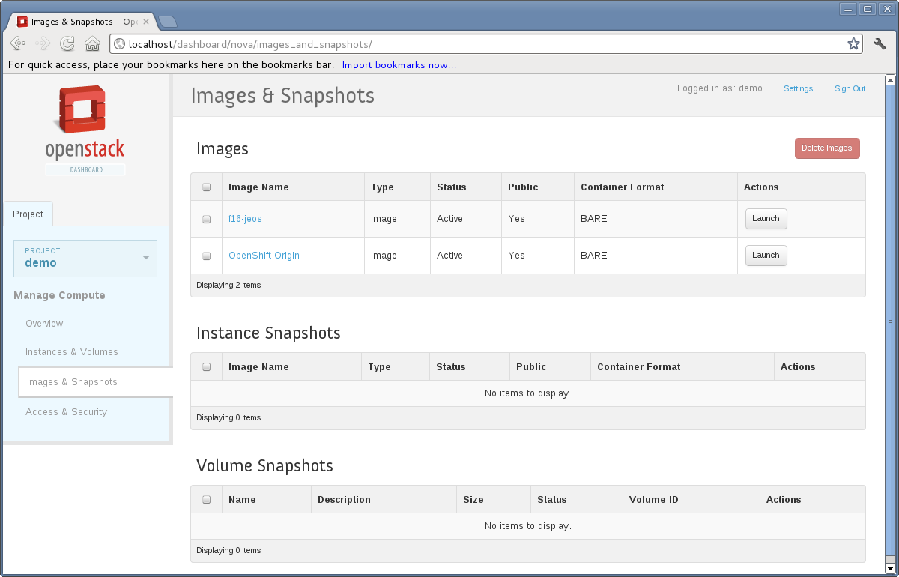
OpenStack Dashboard (Horizon)
Notes:
Here's an example of the Horizon UI
Points to note:

Slide 15
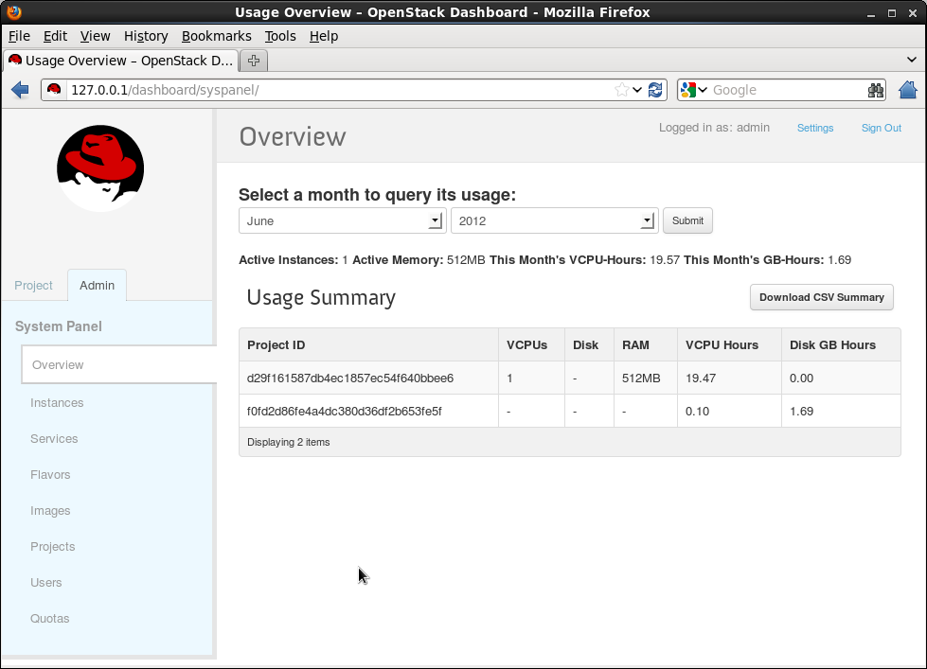

Slide 16
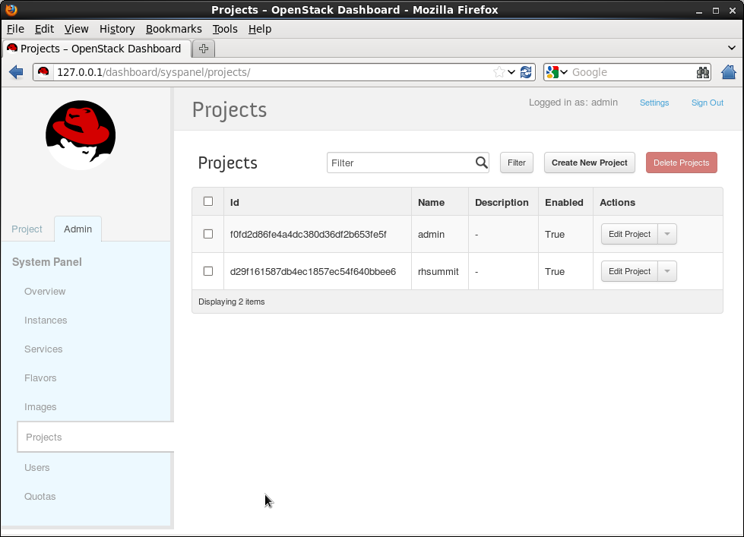

Slide 17
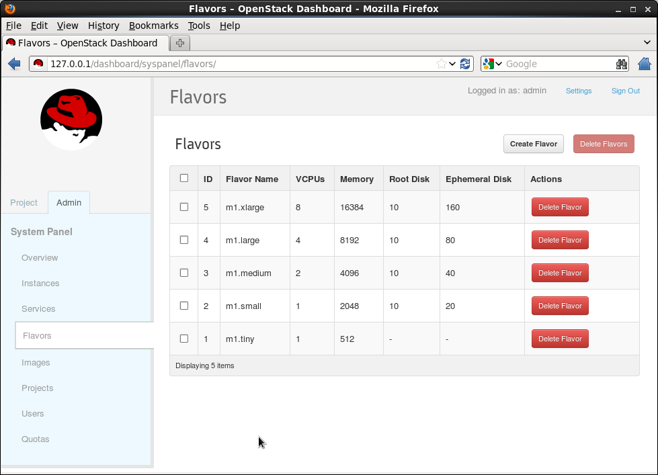

Slide 18
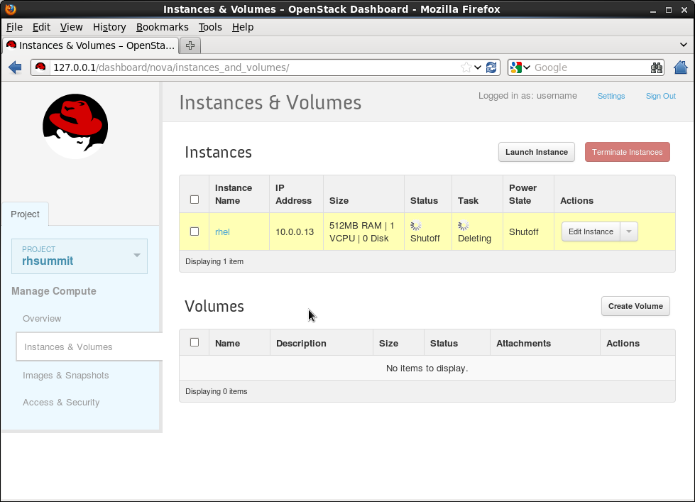

Slide 19
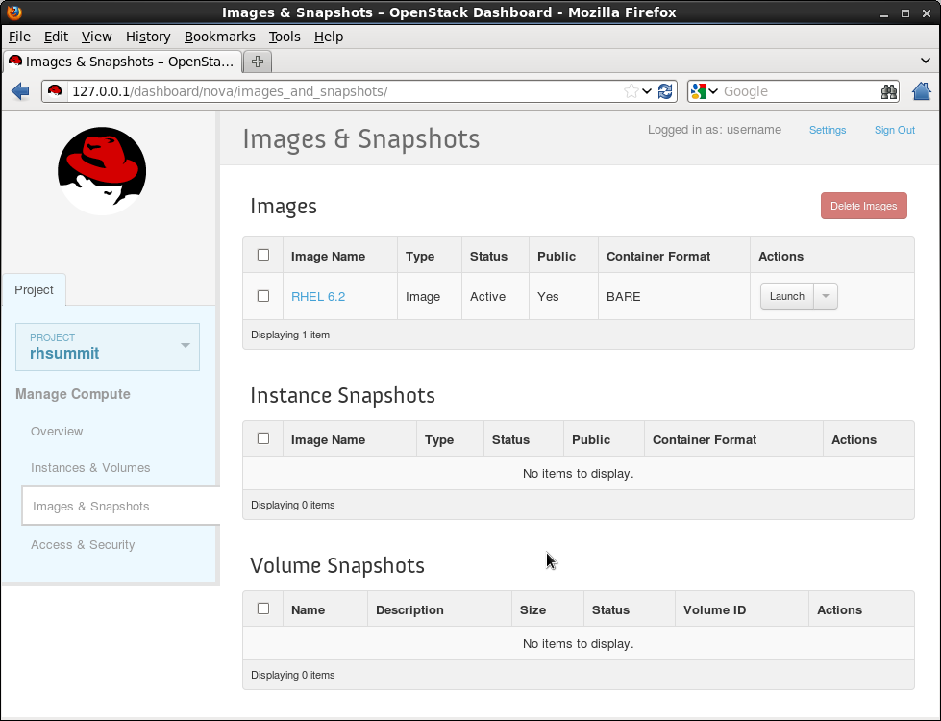

Slide 20
Horizon
Dashboard
Keystone
Identity
Service
Keystone
Identity
Service
Nova
Compute
Node
Glance
Image
Service
Swift
Object
Store
Quantum
Networking
Cinder
Volume
Service
Common authorization framework based on tokens
Manages users, tenants, roles
Provides service catalogs & endpoints
Pluggable backends: SQL, PAM, LDAP, KVS
Notes:
And then to tie everything together from an authorization and authentication perspective there is Keystone or the Identity Service
This is used to authenticate users to the REST APIs, as well as to authenticate services talking to each other
Passes out tokens and validates those tokens when actions are performed
Users, Tenants (think Groups) and Roles
Can be plugged in to a variety of backends: SQL, PAM, LDAP (SQL and LDAP being the most prevalent)

Slide 21
OpenStack Identity Service (Keystone)
REST
Keystone API
Token
Identity
Policy
Catalog
Notes:
Manage user, tenant, roles
Token service
Policy
Service catalog
Pluggable backends
KVS, SQL, PAM, LDAP

Slide 22
Horizon
Dashboard
Keystone
Identity
Service
Nova
Compute
Node
Glance
Image
Service
Swift
Object
Store
Quantum
Networking
Cinder
Volume
Service
Quantum
Networking
Provides networking as a service
Plugin architecture to allow integration with hardware based networking solutions
Implements Software Defined Networks (SDN)
Will replace Nova's Network Service
Notes:
Quantum is a relatively new component. Nova contains a Network service as I mentioned earlier, but this service only supported a very limited set of network topologies: Flat and VLAN
Quantum provides a pluggable networking system, allowing for the creation of Software Defined Networks “"network connectivity as a service"
Plugins exist for some open technologies like linux bridging and openvswitch, as well as some hardware vendor specific technologies, lots of new stuff in-progress :)
The intent is that over time, Quantum will eventually replace the Nova Network service completely

Slide 23
Horizon
Dashboard
Keystone
Identity
Service
Nova
Compute
Node
Glance
Image
Service
Swift
Object
Store
Quantum
Networking
Cinder
Volume
Service
Cinder
Volume
Service
Created from the Nova Volume service
Provides block storage for runtime of instances
Enables ability to do live migration of instances
Similar to Amazon EBS
Notes:
Cinder is also fairly new. It is a recent effort to split out the Nova Volume service into its own project
Cinder and Nova Volume both provide persistent block storage for VMs.
This allows for things like live migration of VMs from one Compute Node to another, although support for this is still somewhat experimental / not heavily tested
Provides a similar service to Amazon EBS
As you can see, a lot of components start out in Nova and then get split out into their own projects as they mature and become independently consumable

Slide 24
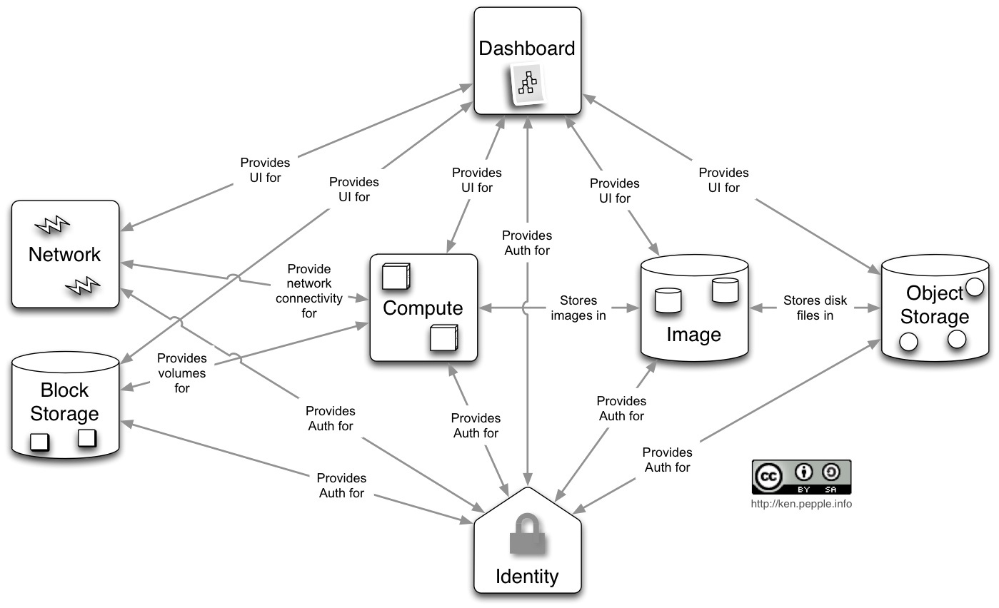
Notes:
This is a high level diagram showing some of the conceptual relationships between the core services: Image, Object, Compute and Identity
The previous diagrams didn't show the relationships between components because with the number of components OpenStack has this sort of diagram can get complex
Key point here is that each of the services is interacting with 1 or more other services using their REST APIs, quite a “flat” topology

Slide 25
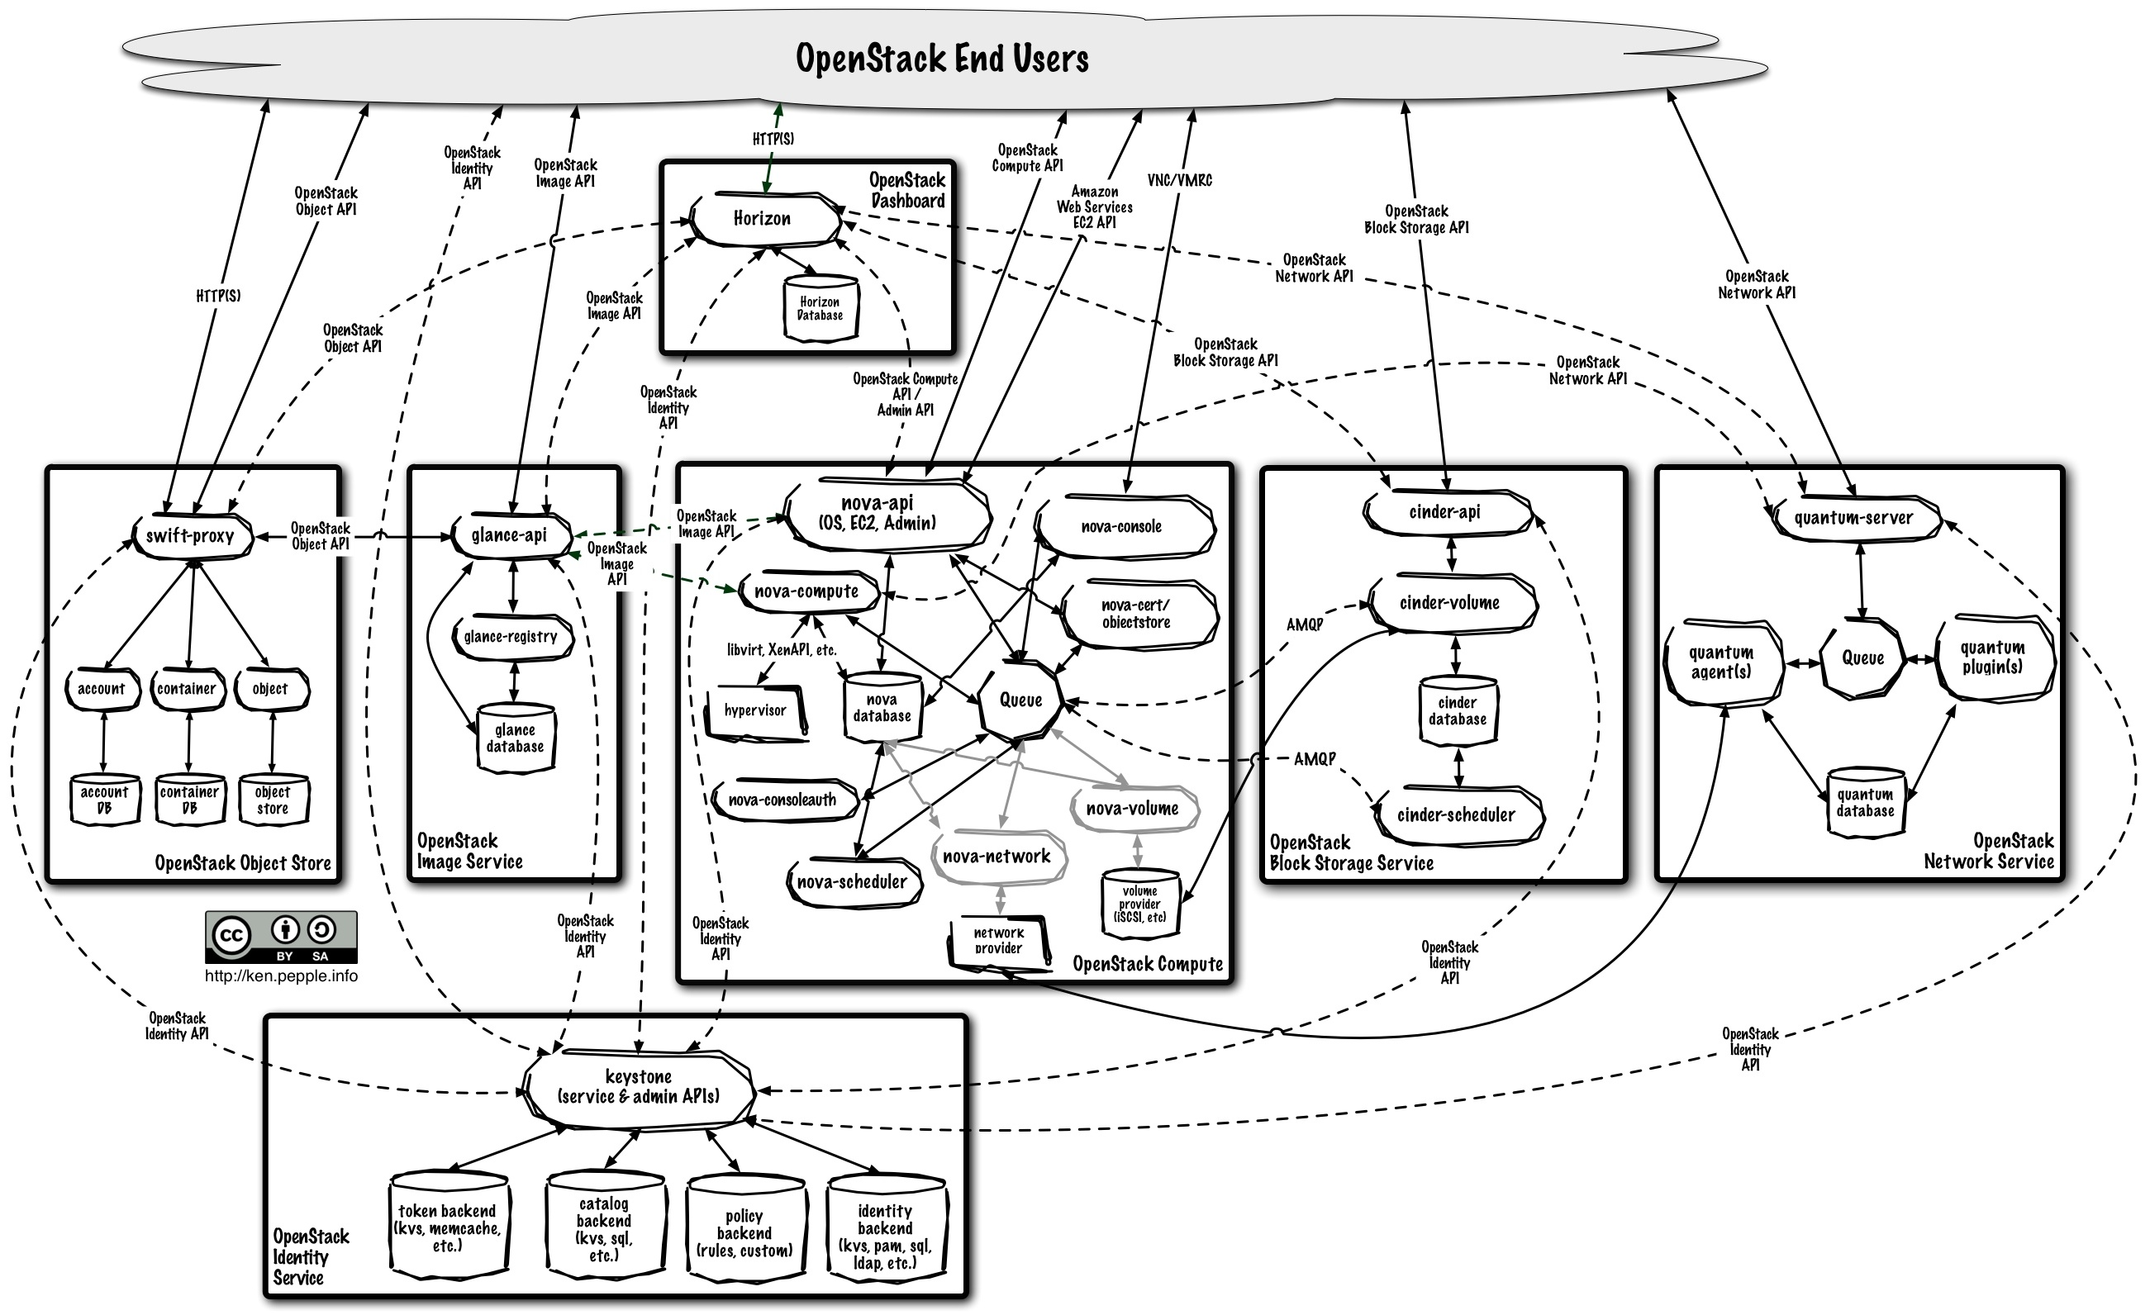
Notes:
Here is a diagram illustrating the logical architecture and information flow between components:
- See what I mean about it getting complex!!
- Also notice the “flat” topology, where many services have relationships and data flow between them – makes this diagram look complex, but aids horizontal scalablilty and deployment flexibility.

Slide 26
OpenStack Releases
Grizzly
2013
Folsom
Oct 2012
Quantum (Networking) full inclusion
Cinder (Volume Service)
Essex
Apr 2012
Initial release: OpenStack Dashboard, OpenStack Identity
New project: Quantum
Diablo
Sep 2011
First “Production Ready” Release
Cactus
Apr 2011
Scaling enhancements
Support: KVM/QEMU, XenServer, Xen, ESX, LXC
Bexar
Feb 2011
OpenStack Compute ready for deployment
Initial release: OpenStack Image Service
Installation & deployment enhancements, documentation
Austin
Oct 2010
Initial Release
OpenStack Object Storage Production Ready
OpenStack Compute in testing
Notes:
Even though OpenStack is comprised of a handful of independent and modular projects, there is a common release schedule that they all track
Current cadence is 6 months between releases, though this could change in the future
Folsom is current release, Grizzly design summit just completed, starting Grizzly development cycle now.
Release names based on cities near to where the relevant Design Summit was held
Release cadence shows how quickly things are progressing. Starting from just 2 years ago, to where we are today.

Slide 27
Openstack deployment
Currently geared towards deployments managed by skilled in-house Dev-ops teams
Red Hat is introducing a fully supported Openstack product – reduces skills required to deploy/maintain
Aiming to make Openstack consumable by a much wider audience
For evaluation/development purposes it is actually really easy to get a simple demo deployment going...

Slide 28

Heat API, introduction
Orchestration of Openstack deployments
Integrates with all Openstack core projects
Converts a JSON template into a cloud application
Implements well known template and API (AWS Cloudformation)
Version your cloud applications like your software
Repeatable deployments, fully automated
Notes:
Introduction to the Heat project, which I am currently working on
- Orchestration of cloud applications deployed on openstack
- Provides functionality similar to AWS Cloudformation
- Supports many AWS resource types, mapped to openstack services internally
- Provides AWS CFN compatible API, and in-progress CloudWatch API
- Also provides an openstack-native API and some openstack-specific additional resources
- Single template deployments mean you can version complex cloud application deployments like code!
- Fully automated deployments, no bespoke scripting!

Slide 29
Horizon
Dashboard
Heat
Orchestration
Keystone
Identity
Service
Nova
Compute
Node
Glance
Image
Service
Swift
Object
Store
Quantum
Networking
Cinder
Volume
Service
Provides AWS Cloudformation and native ReST API
Abstract configuration of services to single-template
Monitoring/HA/Autoscaling features
Aiming for openstack incubation
Notes:
Here we can see the heat orchestration component in the context of the earlier diagram showing core-projects.
Heat integrates with all openstack core components, providing a single point for configuration
Removes (or minimises the need for) bespoke scripting to manage your cloud applications
Can be used with other management tools like chef/puppet (not mutually exclusive!)

Slide 30
Overview of a Nova Instance lifecycle
Base OS image stored in glance
Deployment-time configuration/customization
Flexible
Cloud-init (nova user/metadata)
Puppet/Chef
Potentially complex
All the big users have their own deployment solution
Notes:
Discuss the nova lifecycle, describe existing ways to automate openstack based provisioning, outline complexities and pain-points.
Mention that many big adopters (HP/Rackspace for example) have complex, closed, hard to maintain in-house deployment solutions requiring big dev-ops effort to maintain

Slide 31
Overview of a Nova Instance lifecycle
Heat-jeos
(oz)
REST
Nova
Glance
(Image Store)
REST
Nova-network
/quantum
libvirt
Nova-volume
/cinder
Instance
- cloud-init
Swift

Slide 32
Overview of a Heat Stack lifecycle
Base OS image stored in glance
Deploy instances & configure services based on template contents (resources)
Deployment-time configuration/customization
Very flexible
Cloud-init (nova user/metadata), plus cfn-init
Puppet/Chef can still be used if you want!
Fully integrated, Fully automated

Slide 33
Overview of a Heat Stack lifecycle
Stack
Template
Heat
REST
REST
REST
REST
REST
Heat-jeos
(oz)
Nova
REST
REST
Nova-network
/quantum
libvirt
Glance
(Image Store)
Nova-volume
/cinder
Instance
- cloud-init
- cfn-init
- cfn-hup
-cfn-push-stats
Swift

Slide 34
Why Heat/orchestration?
Orchestration makes things repeatable
Much easier to provide “on demand” infrastructure
Much less scripting, single template system
Leverage the power of openstack without learning fine detail of every service (learn one set of APIs/tools)
Portability/migration
Version/tag/branch your infrastructure like code!
Open community project – aiming to be ubiquitous openstack orchestration solution

Slide 35
Heat API : Key features
Compatibility with AWS Cloudformation
Also superset of OS native resources & ReST API
Fully open community project (come get involved!)
Aiming for openstack incubation/core
Implements HA (service/instance/stack)
Implements Autoscaling
Cloudwatch/Monitoring API
Watch this space!

Slide 36
Heat API : Demo!
Wordpress example
Openshift on Openstack orchestrated by Heat
Wordpress with HA
Autoscaling
Many example templates in our git repo
Notes:
Demo, either live or via recorded screencast the wordpress example, then the HA wordpress will httpd restarts etc, then Autoscaling

Slide 37
What next?
www.heat-api.org
www.github.com/heat-api
www.github.com/heat-api/wiki
#heat on Freenode
Notes:
So hopefully you found this session useful here are some links for you to look at :)

Slide 38
???
Notes:
Any Questions?

Slide 39
Useful Links / Getting Started
http://fedoraproject.org/wiki/OpenStack
http://openstack.org
openstack@lists.launchpad.net
IRC: #openstack @ freenode.net
http://devstack.org - Developer environment
http://heat-api.org/
IRC: #heat @ freenode.net

