Slide 1
Tim
A Rails Engine for Template and Image Management.
Martyn Taylor
Notes:
Good afternoon-enthusiasim

Slide 2
Overview
What is Tim?
Background
  Previous architecture
  Imagefactory v2
Tim
  Responsibilities
  Object Model
Tim - Imagefactory interaction
REST API
Extending Tim
TODOs

Slide 3
What is Tim?
“Tim is a Rails Engine responsible for Cloud image management. It allows clients to create, delete and upload images to a multitude of Cloud providers. Tim builds on top of Imagefactory's cloud abstraction layer.
Adding the ability for clients to store meta-data (used for searching and sorting) as well as versioning and support for access control. Tim wraps all this up in a clean, simply RESTful API.”
Notes:
An engine allows you to share common functionality across applications in the
form of a gem or a plugin..
This functionality could be an authentication system such
In Rails 3, these two are basically interchangeable. One lives in vendor/plugins, the other is installed using gem.
For all intents and purposes, they work in a near-identical manner. Developers should try to use
gems where possible, as they are versioned and easy to upgrade to specific versions, where plugins are not.

Slide 4
Background

Slide 5
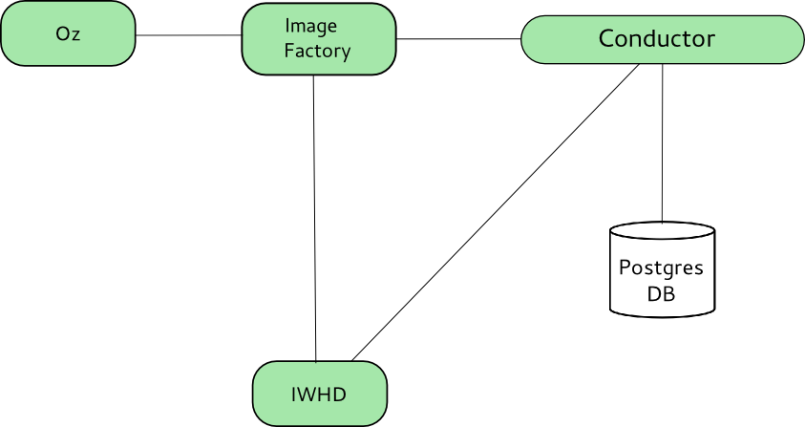
Imagefactory + IWHD

Slide 6
Imagefactory + IWHD
Imagefactory | IWHD
Building | Image Storage
Pushing | Meta data storage
Conductor Container Objects Build | Container objects store
Import | Push + Policy
Templates
ICICLE

Slide 7
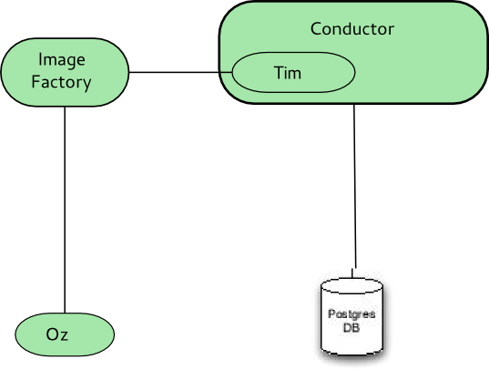
New Architecture

Slide 8
Imagefactory v2
Focus on core responsibilities
  Remove conductor specific concepts
    Build, meta data
  Revised workflow
    Removed placeholder objects
      e.g. BaseImage and TargetImage for SNAPSHOT builds
  No Imports
  No distinct template resource
  No distinct ICICLE resource
New REST API

Slide 9
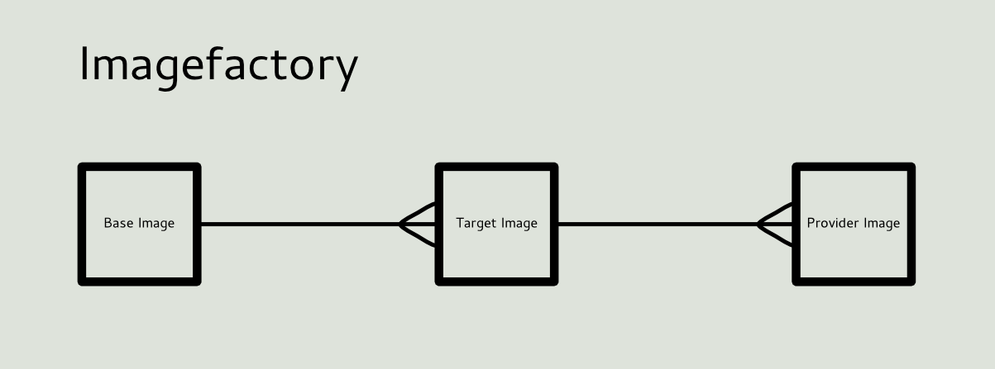
Imagefactory REST API
Flattened Resource Model
Callback support
Immutable Objects

Slide 10
Tim Responsibilities
Template Store
Versioning
Custom Data
Image Imports
Error reporting and status reporting
Meta-data store

Slide 11
Tim Focus
Interoperability
  Consistent Workflow
  Clean REST API
  Clean object model
Stability
  Rails Engine
    Reduced Services
    Share database
    The rails way!
Upstream interest
  Reusable component
Extendability
  Conductor

Slide 12
Inside Tim

Slide 13
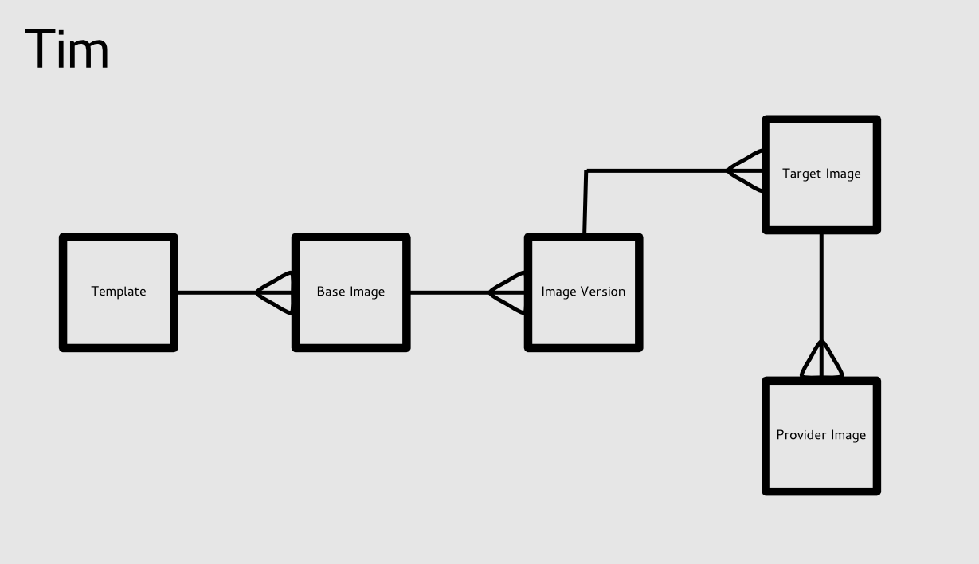
Tim object model

Slide 14
Imagefactory Library
Provider and Target Image support
Factory Client Library
  Support Needed for:
    BaseImage
    Plugins
Separate out into new project
  Contribute to Imagefactory

Slide 15
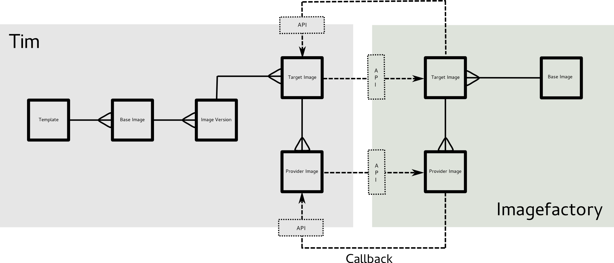
Imagefactory interaction

Slide 16
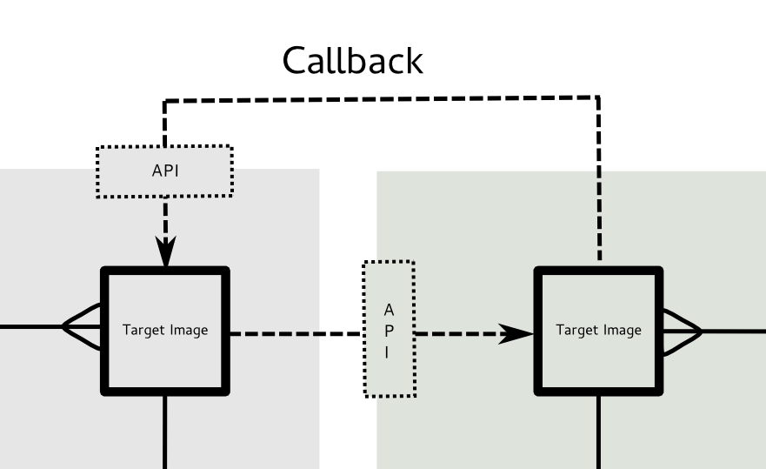

TargetImage
TargetImage
ID=1
ID=123
FactoryID=123
State=Complete
State=Building
State=Building
State=Complete
CallbackUrl=http.../target_images/1

Slide 17
REST API
<api href='http://localhost:3000/tim/'>
<templates href='http://localhost:3000/tim/templates'></templates>
<base_images href='http://localhost:3000/tim/base_images'></base_images>
<image_versions href='http://localhost:3000/tim/image_versions'></image_versions>
<target_images href='http://localhost:3000/tim/target_images'></target_images>
<provider_images href='http://localhost:3000/tim/provider_images'></provider_images>
</api>

Slide 18
Creating Resources
POST http://localhost:3000/tim/templates
<template>
<name>mock</name>
<os>
<name>RHEL-6</name>
<version>1</version>
<arch>x86_64</arch>
<install type=\"iso\">
<iso>http://mockhost/RHELMock1-x86_64-DVD.iso</iso>
</install>
<rootpw>password</rootpw>
</os>
<description>Mock Template</description>
</template>
Standard TDL

Slide 19
Referencing Resources
POST http://localhost:3000/tim/base_images
<base_image>
<name>MyFirstBaseImage</name>
<description>ThisIsABaseImage</description>
<template id="1"></template>
<image_versions type='array'>
<image_version>
<image_version>
<version>1.0</version>
</image_version>
</image_version>
</image_versions>
</base_image>
Template Reference
Nested Image Versions

Slide 20
Nested Resources
POST http://localhost:3000/tim/base_images
<base_image>
<name>MyFirstBaseImage</name>
<description>ThisIsABaseImage</description>
<template>
<name>mock</name>
<os>
<name>RHEL-6</name>
<version>1</version>
<arch>x86_64</arch>
<install type=\"iso\">
<iso>http://mockhost/RHELMock1-x86_64-DVD.iso</iso>
</install>
<rootpw>password</rootpw>
</os>
<description>Mock Template</description>
</template>
<image_versions type='array'>
<image_version>
<target_images type='array'>
<target_image>
<target>MockSphere</target>
</target_image>
</target_images>
</image_version>
</image_versions>
</base_image>

Slide 21
Extending Tim

Slide 22
Model
class AddUserIdToTimImageVersion < ActiveRecord::Migration
def change
add_column :tim_base_images, :user_id, :integer
end
end
class Tim::ImageVersion.class_eval do
belongs_to :user
def list_for_user(user)
user.image_versions
end
end

Slide 23
Controllers
module Tim
class ImageVersionsController < Tim::ApplicationController
def index
@image_versions = Tim::ImageVersion.all unless defined? @image_versions
respond_with @image_versions
end
Tim::ImageVersionsController.class_eval do
before_filter :check_permissions, :only => :index
respond_to :js, :html, :xml
private
def check_permissions
@image_versions = Tim::ImageVersion.list_for_user(current_user)
end
end
Avoid overriding code
Add content type

Slide 24
Views
Override / Add
Custom Content
views/tim/image_versions/index.html
Override Existing View
views/tim/image_versions/index.json
Add New View
- if controller.template_exists?("custom", "tim/image_versions", true)
= render :partial => 'tim/image_versions/custom',
:locals => {:image_version => image_version}
views/tim/image_versions/custom.xml
%user{:id => image_version.user.id, :href => user_url(image_version.user.id) }
<image_version>
...
<user id="1" href="http://localhost:3000/api/users/1"></user>
</image_version>

Slide 25
Responders
module Tim
class CustomResponder < ActionController::Responder
# We want different API Behaviour than in default renderer
def api_behavior(error)
raise error unless resourceful?
status = :ok
begin
if get? then
display resource
elsif post?
status = :created
controller.render :status => status, :action => "show"
elsif put?
controller.render :status => :ok, :action => "show"
else
head :no_content
end
rescue ActionView::MissingTemplate => e
display resource, :status => status
end
end
end
end

Slide 26
TODOs
API Work
  RESTful Gem/Plugin?
Further Imagefactory Integration
  Imagefactory Gem
  BaseImage Mappings
  1 request build/push
UI
Image Imports
Template parsing
Evolving Conductor Requirements
  Imagefactory permissions?

Slide 27
Questions?
Notes:
Good afternoon-enthusiasim

