Slide 1
Upstream Continuous Integration and Patch Testing

Slide 2
Goals
We have an internal continuous integration environment. But we wanted some testing to be publicly visible.
Run spec and cucumber each time code is checked in and flag failures
For upstream, runs in a rpm-free environment and without services like iwhd and deltacloud

Slide 3
Upstream Testing
Upstream developer clones the conductor repo
Bundle install to pickup gems
Bundle exec rake spec
Bundle exec cucumber
Tests should pass without installing any other aeolus component

Slide 4
Upstream Testing
Many spec and cucumber tests were broken upstream
Primarily because some tests were hitting the external services and failed when the services were switched off
Stub out calls to iwhd and deltacloud
Thanks Matt, Jay, and Jiří for fixing them

Slide 5
Where to run upstream tests?
CloudBees
OpenShift
Travis-CI

Slide 6
CloudBees
PaaS provider focusing on Java
Build service – Jenkins with Ruby support

Slide 7
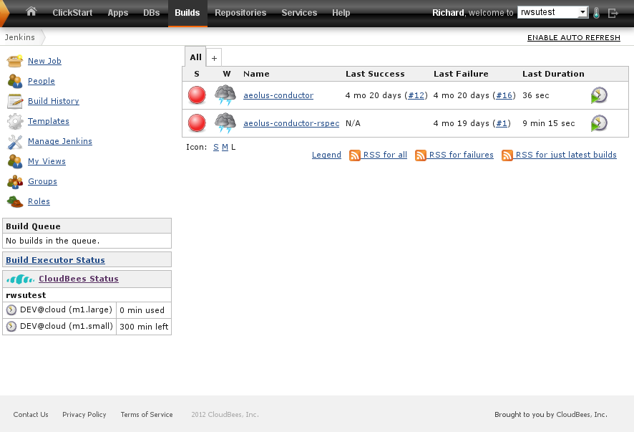
CloudBees
PaaS provider – Jenkins service
https://rwsutest.ci.cloudbees.com/

Slide 8
CloudBees
Runs spec and cucumber
Supports ruby 1.8.7 and ruby 1.9.3
Supports x86_64
Cost? It is free for 300 hours per month on i386 servers. There is a $50 monthly plan for x86_64 servers and more hours.

Slide 9
OpenShift
PaaS offered by Red Hat
Jenkins

Slide 10
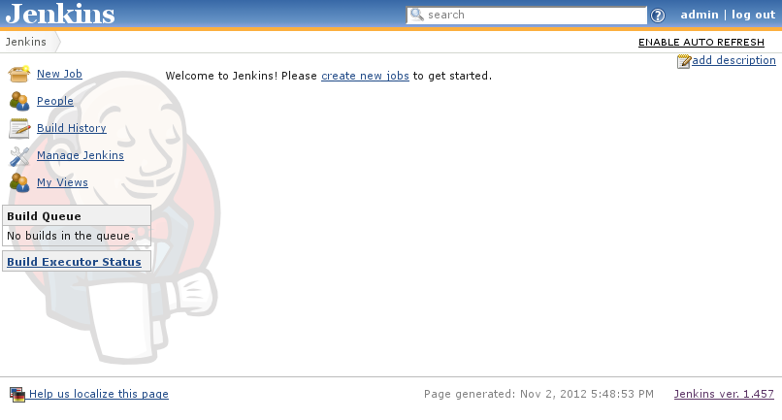
OpenShift
https://jenkins-rwsu.rhcloud.com/

Slide 11
OpenShift
Runs spec and cucumber
Supports ruby 1.8.7. Backend servers used RHEL 6.3. ruby 1.9 support was in progress (June 2012)
Supports x86_64
Cost? Free for 3 gears, small size servers

Slide 12
Travis-CI
Runs spec and cucumber
Supports ruby 1.8.7 and ruby 1.9.3, and many others through rvm.
Supports x86_64
Donation supported service

Slide 13
Travis-CI
Hosted continuous integration service offered to the open source community
Works hand in hand with github. Builds are kicked off for each commit and pull request
Setup is relatively painless. Commit a .travis.yml configuration file in your project root. Create an account on travis-ci.org, and activate the Travis service hook in github.
No Jenkins administration

Slide 14
.travis.yml
rvm:
- 1.8.7
- 1.9.3
gemfile: src/Gemfile
env:
- SUITE=cucumber
- SUITE=spec
before_install:
- sed -i s/'pg'/'sqlite3'/ src/Gemfile
install:
- cd src
- bundle install --path bundle
before_script:
- cp config/database.sqlite config/database.yml
- bundle exec rake dc:oauth_keys
- bundle exec rake db:drop
- bundle exec rake db:create
- bundle exec rake db:migrate
- bundle exec rake db:seed
- bundle exec rake db:test:prepare
script:
- bundle exec rake $SUITE
notifications:
irc:
channels:
- "irc.freenode.org#aeolus"
use_notice: true
skip_join: false
language: ruby
on_success: change
on_failure: change

Slide 15
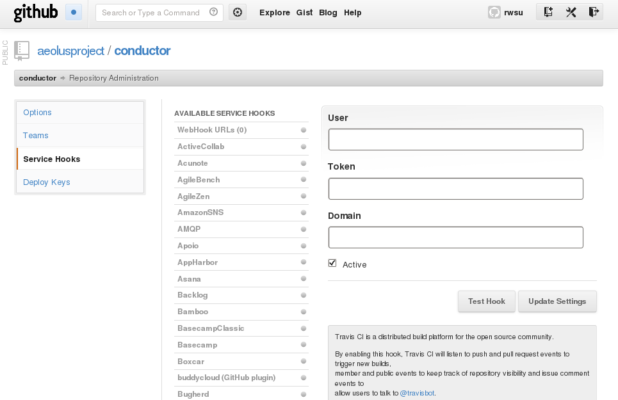

Slide 16
