Slide 1

Image Management in a Federated Cloud Environment
Martyn Taylor,
Senior Software Engineer
Aeolus
Notes:
Good afternoon-enthusiasim

Slide 2
Overview
Background
Current approach
  One Cloud Setup, Federated Clouds
Existing tools
  Boxgrinder, Kiwi, Imagefactory
Imagefactory
  What is it?
  Basic Concepts
  Example application
  Issues and Further Work
  Related tools

Slide 3
Background
IaaS Vendors are on the rise
Differences in APIs restricts switching
DeltaCloud and CIMI are a step closer
Image Management is another problem
  Differing Formats
  Images are tied to provider
  Consistency across clouds
Notes:
We are seeing an increasing number of Cloud IaaS providers popping up all around us. Although having choice is a good thing, often Cloud vendors provide different ways of interacting with their services. We've seen how this can cause problems in which clients writie systems to work with a particular Cloud provider and we seen earlier in Michals talk how that can cause vendor lockin. Essentially, the cost of moving from one Cloud vendor to another outweighs any benefits from the move, or in some extreme cases it may not be possible at all.
There are already efforts underway to help solve this issue, CIMI aims to create a standard for IaaS APIs and tools like DeltaCloud help by add an extra layer between client and service to ease the process of switching vendor.
However, this problem of creating cloud agnosticism becomes a little more difficult when we start thinking about images. Not only do we have the API differences, but we also having differences in required formats as well as keeping images in sync with other. Especially when managing images in multiple cloud providers.=

Slide 4
Image Management
Building
Uploading
Snapshots
Register/Deregister
Deletion

Slide 5
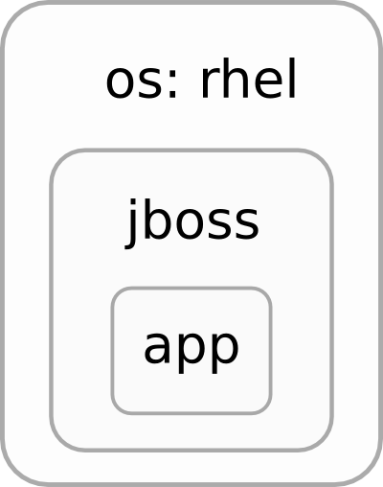






Typical Approach
1
2
3
4
5
EC2
Notes:
Let's take typical user, Joe our Sys Admin, She has some image description that she knows about. She needs to get an image based on that description in OpenStack so she can create deployments.
So the first thing Joe does is take a look at what OS she needs and creates a golden image. This will consist of the base OS and a minimal set of packages.
Once the she's created the golden image, she uploads it OpenStack and register it with Glance.
Once it's in Glance, Joe starts an instance of the golden image. She then connects to the instance via her terminal and does all the customization neccessary, such as package installation, application configuration and so on She then takes a snapshot and registers it with Glance.
This is quite a lot of work for Joe. And not only does this take up her time initially, but there she also has to manually maintain these images. What happens when packages are stale, or she wants to upgrade her OS

Slide 6

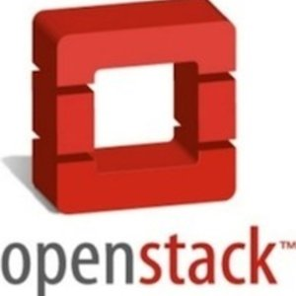

Federated Clouds
RHEV-M
Local Infra

Slide 7
5
5
RHEV-M
5
5
5
5
Notes:
Let's take typical user, Joe our Sys Admin, She has some image description that she knows about. She needs to get an image based on that description in OpenStack so she can create deployments.
So the first thing Joe does is take a look at what OS she needs and creates a golden image. This will consist of the base OS and a minimal set of packages.
Once the she's created the golden image, she uploads it OpenStack and register it with Glance.
Once it's in Glance, Joe starts an instance of the golden image. She then connects to the instance via her terminal and does all the customization neccessary, such as package installation, application configuration and so on She then takes a snapshot and registers it with Glance.
This is quite a lot of work for Joe. And not only does this take up her time initially, but there she also has to manually maintain these images. What happens when packages are stale, or she wants to upgrade her OS

Slide 8

Image Management Tools
RHEV-M

Slide 9


Image Management Tools
`chroot` based building
KIWI
Imagefactory
VM based building

Slide 10
Imagefactory
Python
Oz Based Building
  VM Based, bare OS, Pr-boot configuration
Transformation and Uploading Images
Snapshot builds
Deletion and (De)registration
Consistency across providers
Plug-able Provider and OS support
REST API

Slide 11
TDL
<template>
<name>ApacheWebServer</name>
<description>Apache httpd server, running on Fedora 16</description>
<os>
<name>Fedora</name>
<version>16</version>
<arch>x86_64</arch>
<install type="url">
<url>http://download.fedoraproject.org/pub/fedora/linux/releases/16/Everything/x86_64/os/</url>
</install>
<rootpw>p@ssw0rd</rootpw>
</os>
<packages>
<package name="httpd"/>
<package name="php-gettext"/>
</packages>
<commands>
<command name="enable_httpd_service">systemctl enable httpd.service</command>
</commands>
</template>

Slide 12




TDL
ReST
Oz
Base Image
Target Image
Provider Image
Notes:
So how does it work. Well the first thing it does when it recieves a request is kick off a build using a tool called Oz. Many of you may have used this before and it is indeed how RackSpace build many of its precanned images.
Once Oz is finished building, it can then translate the image into various formats, Amazon Machine Image, GCOW2, basically what ever Cloud provider format you want.
Once this is done it will then upload and register you image with the relevant image service for the provider you are using. You need not know the details Image Factory will handle it for you. If you would like to find out more about Aeolus Image Factory I have included a link in the show notes.

Slide 13
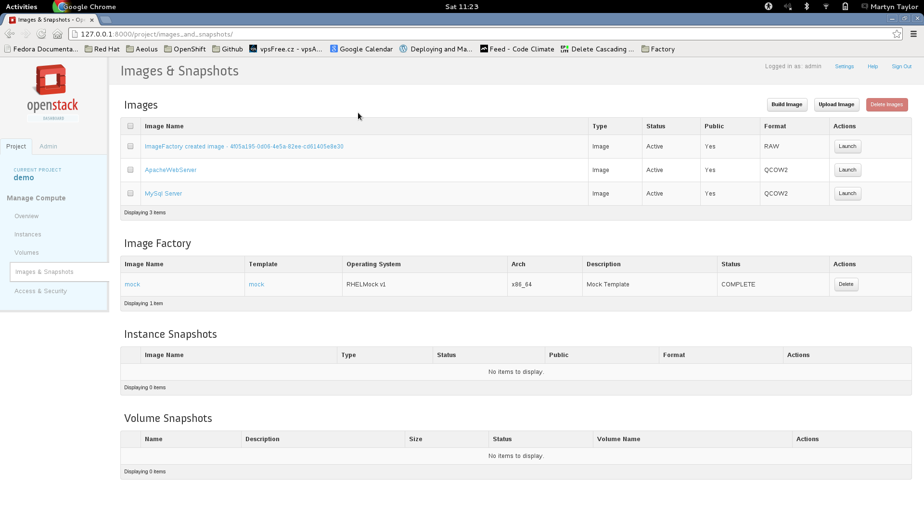

Slide 14
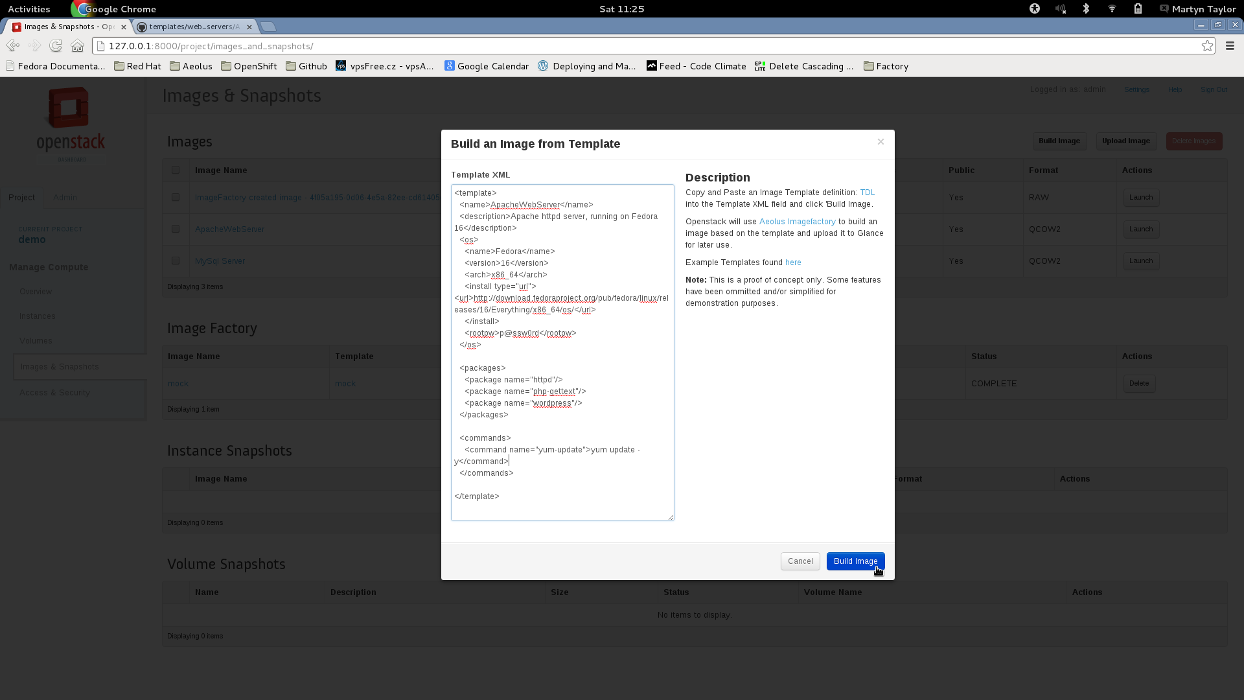

Slide 15
Issues and Future work
Users locked in
  One step back to gain cloud agnosticism
  Migration Toolkit
    Import Existing Base Images
    V2V
      Transform Existing Provider Images
    Create TDL from existing image
Support for Puppet and/or Chef
More off the shelf provider and OS
  DeltaCloud integration
In Cloud Building

Slide 16
Related projects
Tim (Template and Image Management)
  Rails Engine
  REST API, ActiveRecord Model
  https://github.com/aeolus-incubator/tim
  Gem 'tim' , '0.2.0'
Oz
  Automatically install operating systems
  Customization
    Packages
    Configuration
  https://github.com/clalancette/oz/

Slide 17
Want to get involved?
Source: https://github.com/aeolusproject/imagefactory
Websites: www.aeolusproject.org; www.imgfac.org
Contact us:
  mail: aeolus-dev@fedoralists.org
irc: #imagefactory on freenode
OpenStack Integration:
  git@github.com:mtaylor/horizon.git
  Video: http://www.youtube.com/watch?v=MdBM4HA3QUk

Slide 18
Questions?

