Slide 1


















An Introduction to Machine Learning from Time Series
https://aeon-tutorials.github.io/ECLM-2024/
ECML 2024 Workshop
Germain Forestier
Tony Bagnall
Ali Ismail-Fawaz
Matthew Middlehurst
Arik Ermshaus
Antoine Guillaume
Patrick Schäfer
Sebastian Schmidl
Phillip Wenig
Thorsten Papenbrock
David Guijo Rubio

Slide 2












Hands on with the aeon toolkit
Similarity search
classification
clustering
regression
transformations
distances
anomaly detection
aeon
Algorithm research
Scientific research
Industry application
Data science community

Slide 3

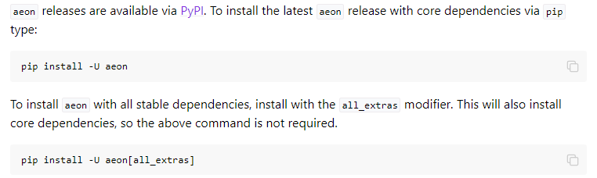
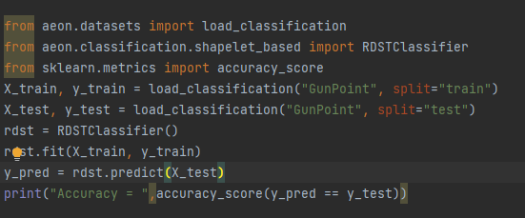
Hands on with the aeon toolkit
KDD 2024 Workshop
https://github.com/aeon-toolkit/aeon
https://www.aeon-toolkit.org/
aeon classifiers and regressors are compatible with sklearn

Slide 4

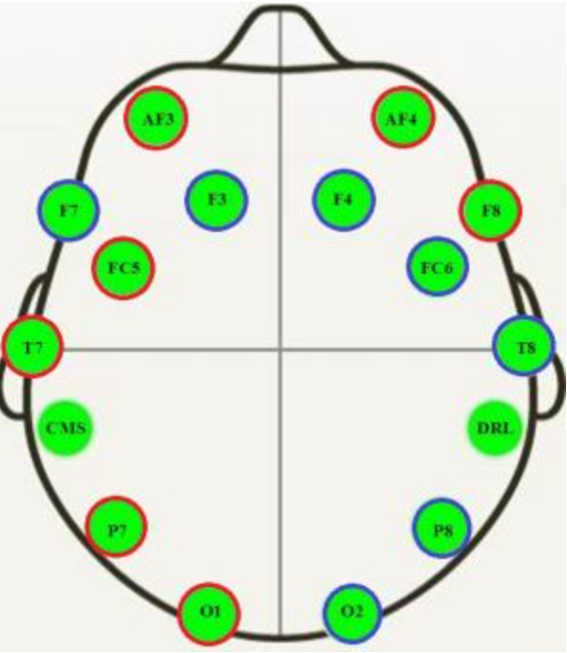
Example EEG datasets
KDD 2024 Workshop
https://github.com/aeon-toolkit/aeon-neuro
aeon-neuro is a fledgling sub project for EEG classification and regression
TSC Data collected by PhD student Aiden Rushbrooke and used by GSoC intern/PhD student Gabriel Riegner
https://github.com/aeon-toolkit/aeon-neuro/blob/main/examples/data_loading.ipynb
TSER Data collected by Southampton post-doc Christoph Tremmel (part of the the wellth lab)
https://www.wellthlab.ac.uk/
Both data sets preprocessed for use as an example. They can be downloaded from the tutorial site or directly with aeon
from aeon.datasets import load_classification from aeon.classification.convolution_based import RocketClassifier from sklearn.metrics import accuracy_score datasets = ["KDD_UTSC", "KDD_MTSC"] r1 = RocketClassifier(rocket_transform="minirocket") for d in datasets: X_train, y_train =load_classification(d, split="TRAIN") print("X shape = ",X_train.shape) X_test, y_test = load_classification(d, split="TEST") print("X shape = ",X_test.shape) r1.fit(X_train, y_train) y_pred = r1.predict(X_test) print("Accuracy miniROCKET = ", accuracy_score(y_pred,y_test))

Slide 5
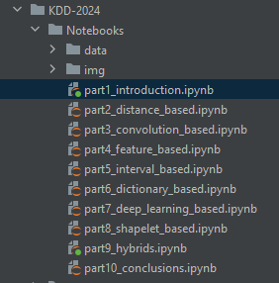
Code Examples
KDD 2024 Workshop
Each section has an associated notebook
The notebook for this section contains information on the datasets
and basic use cases for aeon classifiers and regressors
https://github.com/aeon-toolkit/aeon-tutorials/blob/main/KDD-2024/Notebooks/part1_introduction.ipynb
Join our slack if you want to chat about any element of the code
from aeon.transformations.collection import AutocorrelationFunctionTransformer from sklearn.pipeline import make_pipeline from sklearn.model_selection import GridSearchCV pipe = make_pipeline(AutocorrelationFunctionTransformer(n_lags=25), RocketClassifier (rocket_transform="minirocket")) param_grid = {'rocketclassifier__num_kernels': [5000, 10000, 15000]} grid = GridSearchCV(pipe, param_grid, cv=3) grid.fit(X_train_utsc, y_train_utsc) print(grid.best_params_) preds = grid.predict(X_test_utsc) print("Rocket classifier accuracy:", accuracy_score(y_test_utsc, preds))

Slide 6
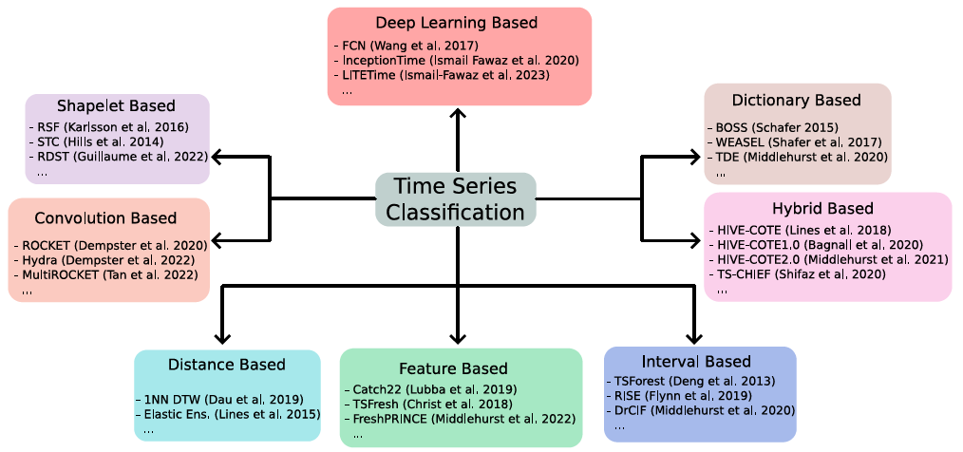
Taxonomy of Algorithms
KDD 2024 Workshop

Slide 7
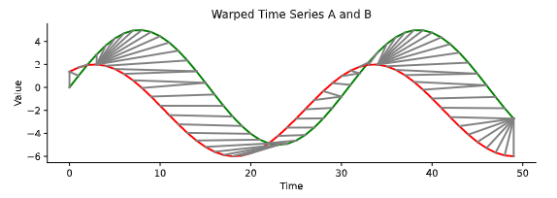
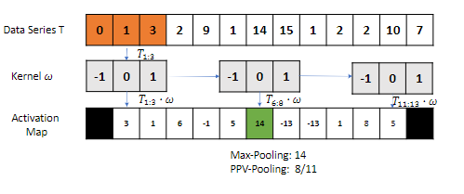
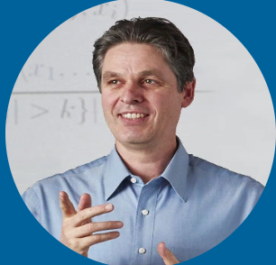
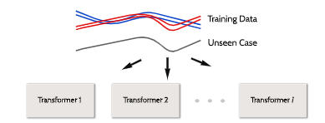
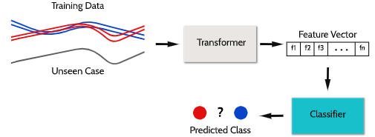
Schedule
KDD 2024 Workshop
14:15 – 14:45
Distance measures for time series
Convolutional kernels
14:45 – 15:15
Summary features
Phase dependent interval
based
15 min break

Slide 8
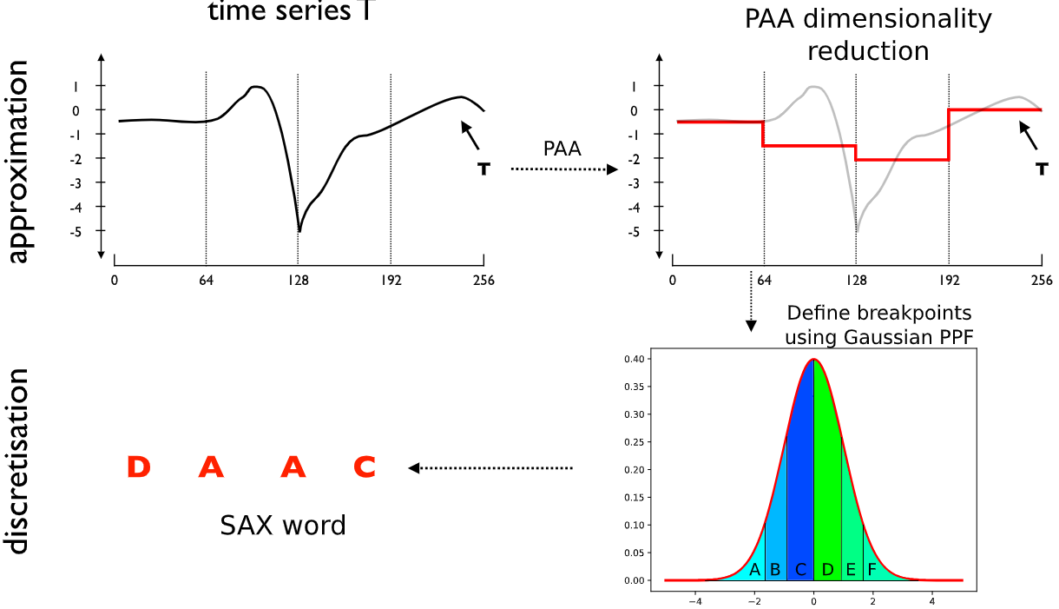
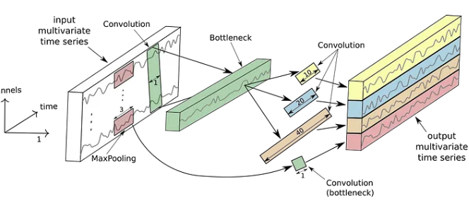

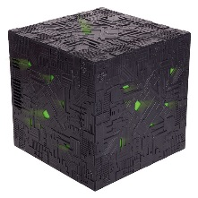
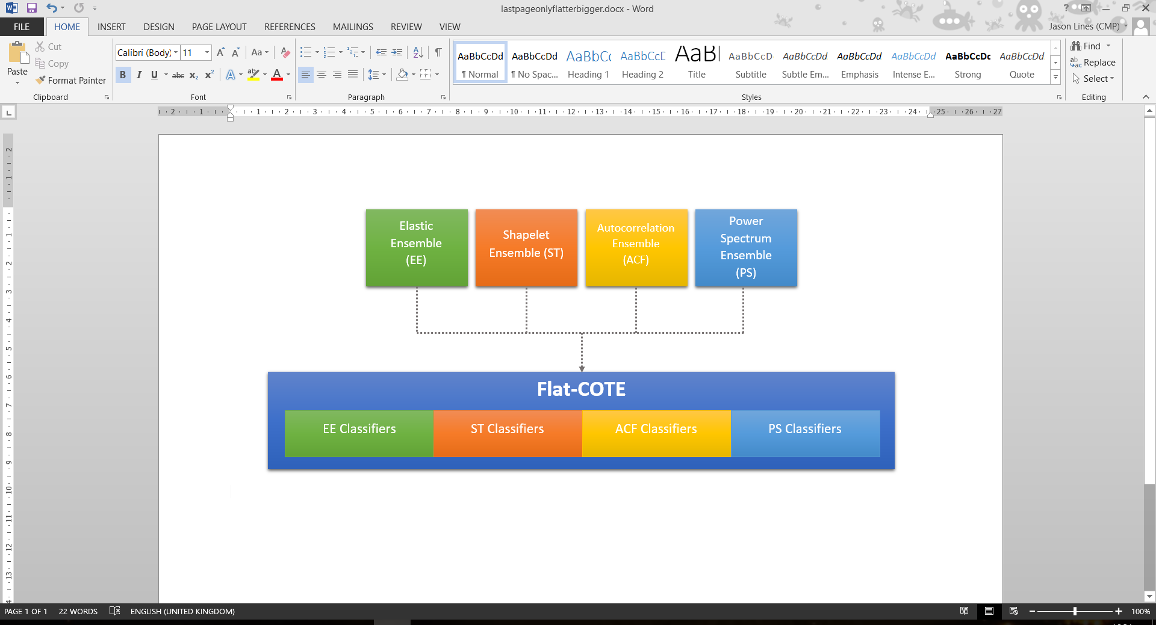
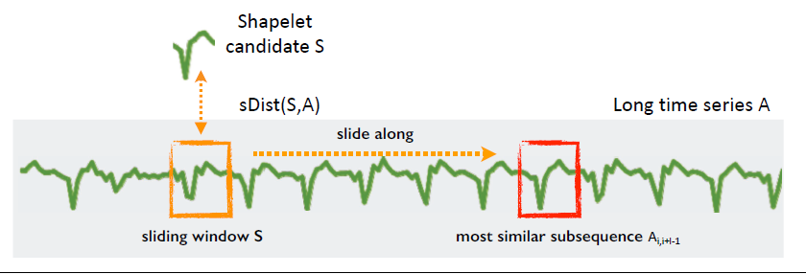
Schedule
KDD 2024 Workshop
15:30 – 16:10
Dictionary-based bag-of-words
Deep learning for time series
16:10 – 16:40
Phase independent shapelets
Hybrid approaches
16:40 – 17:00
Conclusion, future outlook and Q&A
https://aeon-tutorials.github.io/KDD-2024/
https://github.com/aeon-toolkit/aeon-tutorials/blob/main/KDD-2024/Notebooks/part1_introduction.ipynb
https://aeon-tutorials.github.io/KDD-2024/code.html

