Slide 1




Detecting Subsequence Anomalies in Time Series
ECML/PKDD 2024 Tutorial
An Introduction to Machine Learning from Time Series
Sebastian Schmidl
sebastian.schmidl@hpi.de
Phillip Wenig
phillip.wenig@hpi.de
Thorsten Papenbrock
papenbrock@uni-marburg.de
Hasso Plattner Institute (HPI)
University of Potsdam, Germany
Hasso Plattner Institute (HPI)
University of Potsdam, Germany
Philllipps-University of Marburg
Germany

Slide 2
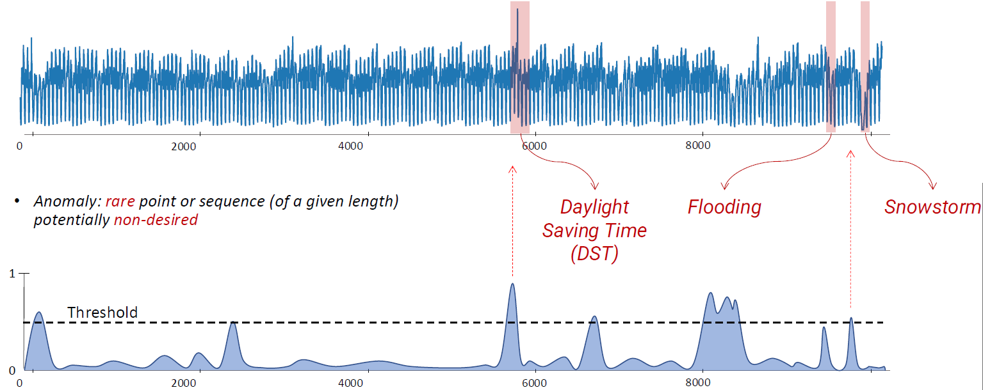
Introduction
„
An anomaly is a point or a sequence of points that deviate w.r.t. some measure or model from the regular patterns of the time series.
“
For this tutorial:
A potentially undesired rare point or rare sequence of points of a given length.
Screenshot from Boniol et al Tutorial VLDB 2024

Slide 3
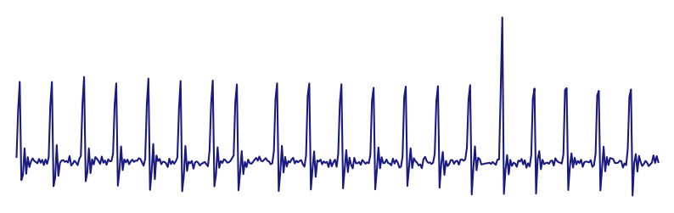
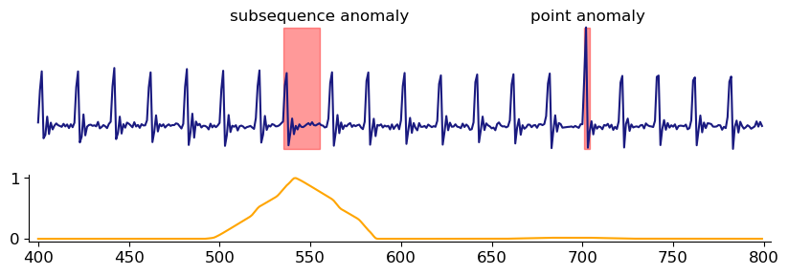
Introduction
Subsequence Anomaly
Point Anomaly
Anomaly Detection Algorithms
Anomalous: High Score
Normal: Low Score

Slide 4
Outline
Types of Anomalies
Anomaly Detection Methods
Example Methods
Distance-based: Matrix Profile
Tree-based: Isolation Forest
Forecasting-based: LSTM-AD
Benchmarks & Datasets
Performance Comparison
Outlook

Slide 5




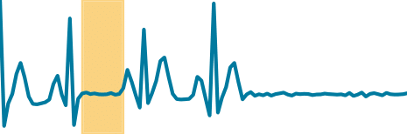
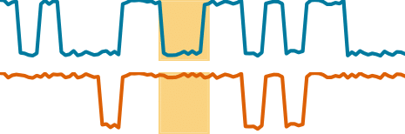
Types of Anomalies
Anomaly Types
Point
Subsequence
Correlation
Global
Contextual
Global
Contextual
Global
Contextual

Slide 6
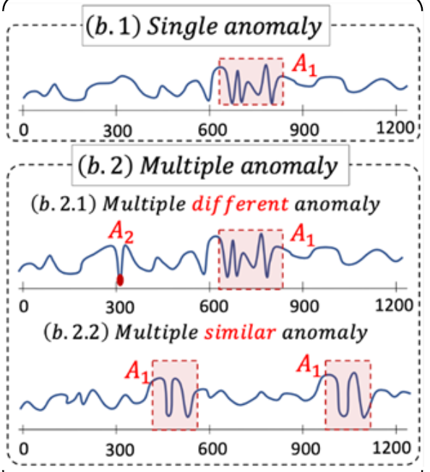
Types of Anomalies
Screenshot from Boniol et al Tutorial VLDB 2024

Slide 7
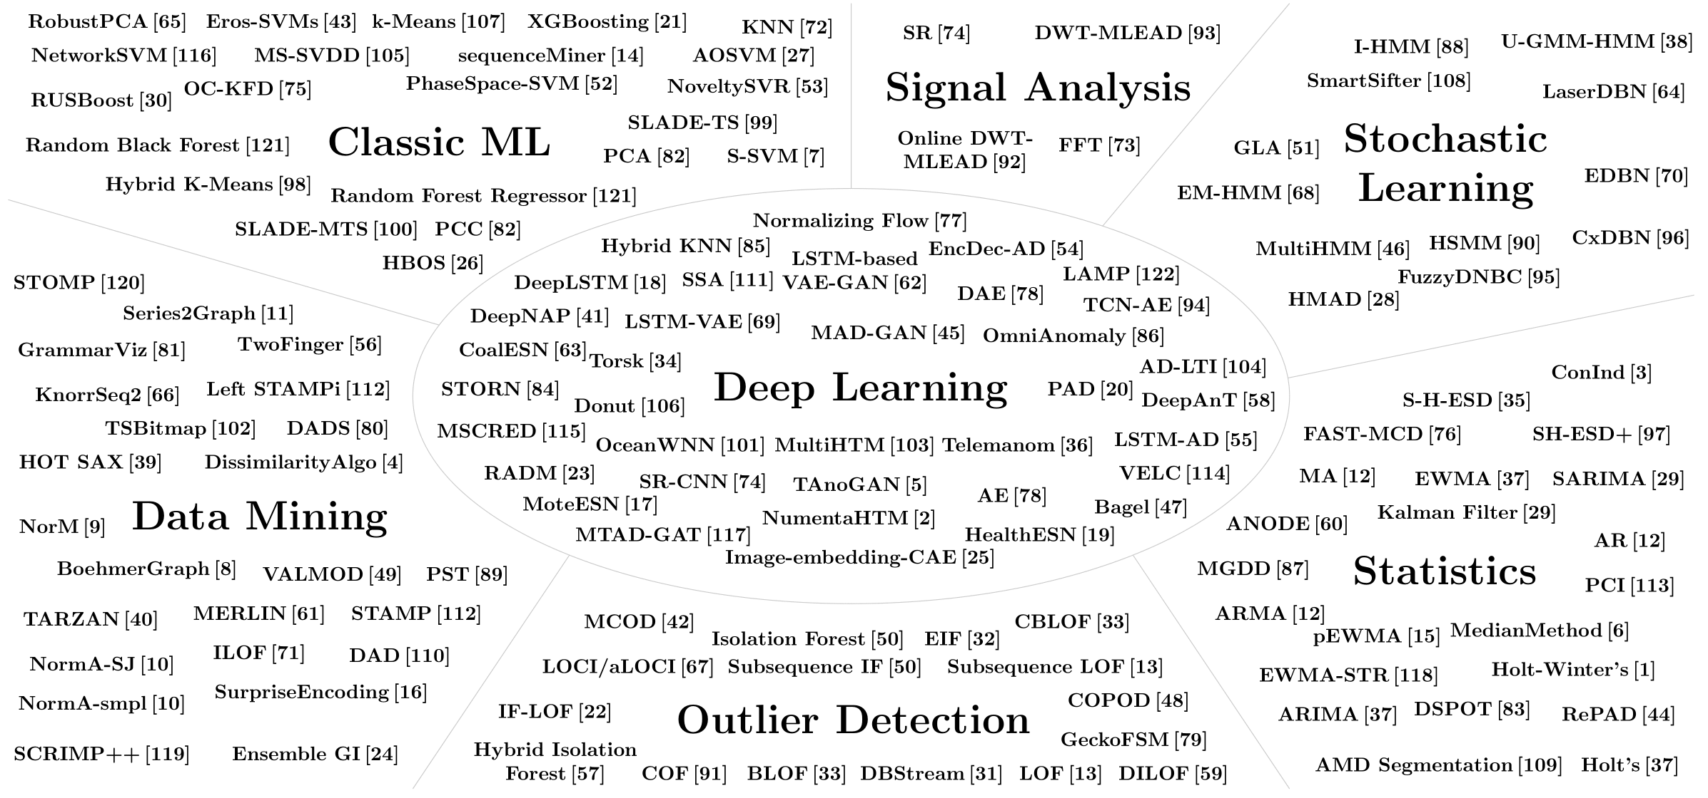
Anomaly Detection Methods – by Research Domains

Slide 8
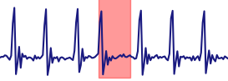

Anomaly Detection Methods – by Learning Type
Training
Testing
Unsupervised
(Type I [a])
Supervised
(Type II [a])
Semi-Supervised
(Type II [a])
$$∅$$

Slide 9
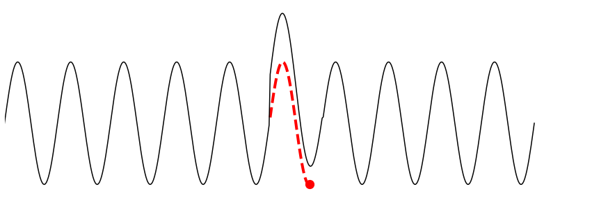

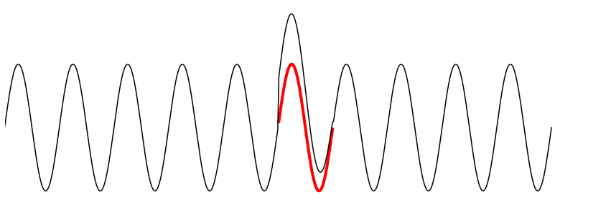

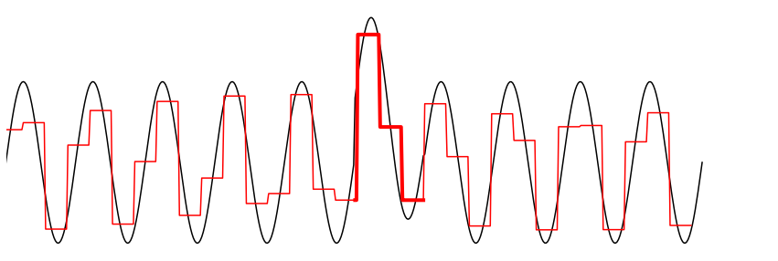

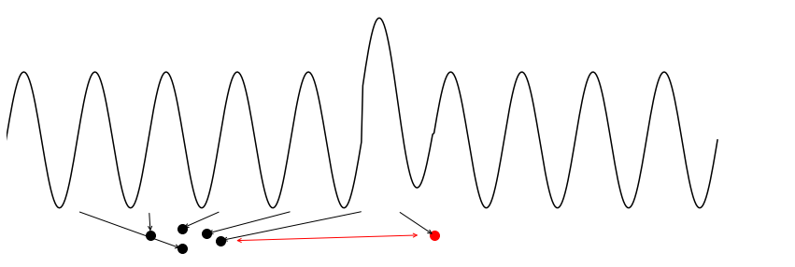



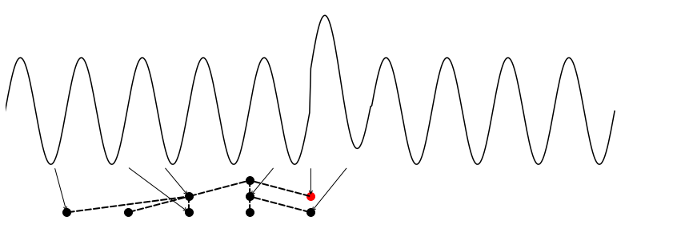

Anomaly Detection Methods – by Family
ARIMA, DeepAnT, DeepNAP, HealthESN, LSTM-AD, MedianMethod, MTAD-GAT, NumentaHTM, NoveltySVR, OceanWNN, RBForest, RForest, SARIMA, Telemanom, Torsk, Triple ES, XGBoosting (17 techniques)
Forecasting
Reconstruction
Encoding
Distance
Distribution
Isolation Tree
AE, Bagel, DAE, Donut, EncDec-AD, FFT, IE-CAE, LSTM-VAE, MSCRED, OmniAnomaly, PCI, PCC, RobustPCA, SR, SR-CNN, TAnoGan
(16 techniques)
Ensemble GI, GrammarViz, LaserDBN, MultiHMM, PST, Series2Graph, TARZAN, TSBitmap
(8 techniques)
CBLOF, COF, DBStream, HOT SAX, Hybrid KNN, k-Means, KNN, LOF, NormA-SJ, PS-SVM, SAND, SSA, STAMP, STOMP, Sub-LOF, VALMOD, Left STAMPi
(17 techniques)
COPOD, DWT-MLEAD, Fast-MCD, HBOS, NF, S-H-ESD, DSPOT, Sub-Fast-MCD
(8 techniques)
EIF, HIF, IF-LOF, iForest, Sub-IF
(5 techniques)

Slide 10
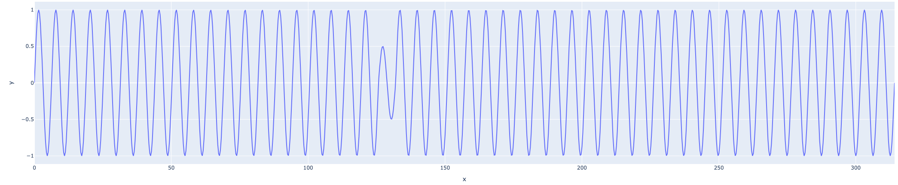
Distance-based: MatrixProfile

Slide 11
Distance-based: MatrixProfile

Slide 12
Distance-based: MatrixProfile
closest neighbor

Slide 13
Distance-based: MatrixProfile
closest neighbor
Distance to closest neighbor

Slide 14
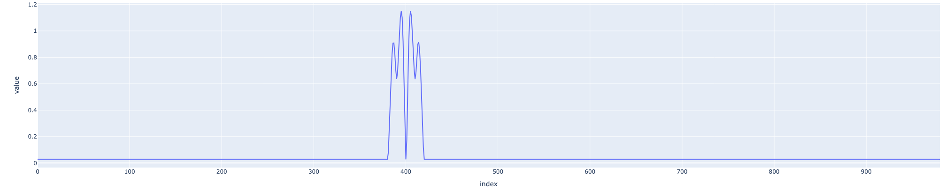
Distance-based: MatrixProfile
closest neighbor

Slide 15
Tree-based: Isolation Forest

Slide 16
Forecasting-based: LSTM-AD

Slide 17
Benchmarks & Datasets
NAB: …
TimeEval
NAB
NASA
TSB-UAD
HEX/UCR
…

Slide 18
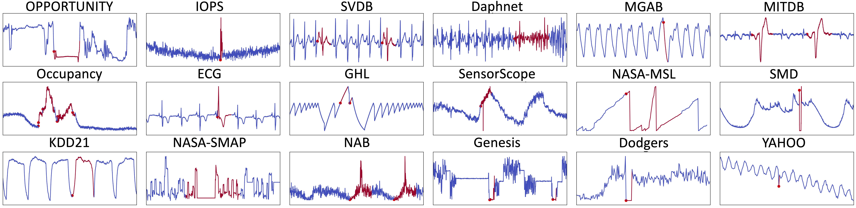
Benchmarks & Datasets
Real-world dataset examples

Slide 19
Performance Comparison
Use TimeEval insights
Distance-based have better accuracy than forecasting or reconstruction
Semi-supervised are NOT outperforming unsupervised
HEX/UCR
Distance-based have better accuracy than forecasting or reconstruction
TSB-UAD
Distance-based have better accuracy than forecasting
Isolation forest is very competitive (despite not being proposed for time series)
AE is competitive
Forecasting is good for point anomalies but bad for subsequence anomalies
There is no overall winner!
Dau, H.A., Bagnall, A., Kamgar, K., Yeh, C.C.M., Zhu, Y., Gharghabi, S., Ratanamahatana, C.A. and Keogh, E., 2019. The UCR time series archive. IEEE/CAA Journal of Automatica Sinica, 6(6), pp.1293-1305.

Slide 20
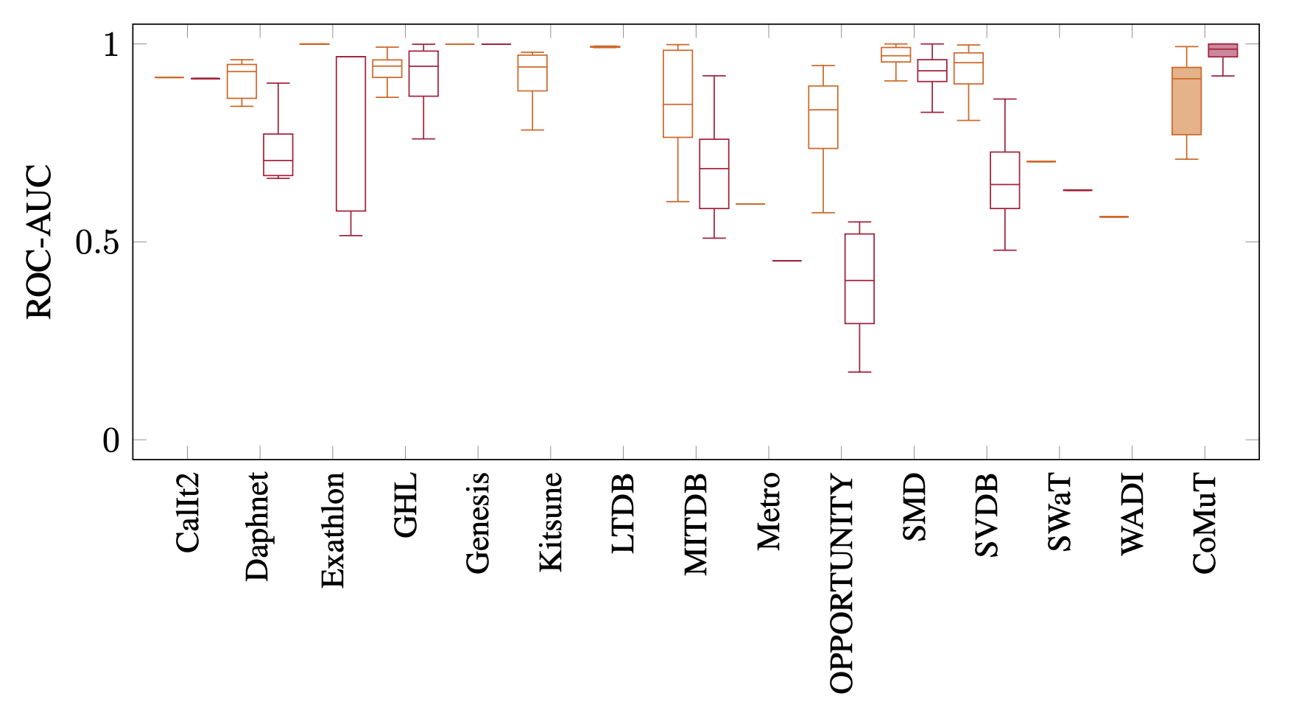
Multivariate Benchmarks are too easy
Max ROC-AUC per time series over all algorithms
Univariate
Multivariate

Slide 21
Multivariate Benchmarks are too easy
Max ROC-AUC per time series over all algorithms
Univariate
Multivariate

Slide 22
Example code
M.Middlehurst@uea.ac.uk
See part6_anomaly_detection.ipynb

Slide 23
Outlook
For Research
No one-size-fits-all solution, but already 100s of methods
Research into automatic method selection and ensembling methods (copy example from Paul)
More and better benchmarks
Existing benchmark datasets have flaws
Existing evaluations are biased
LLMs / TS Foundation Models ?
Explainability / Precursor Detection / Anomaly Classification
In Aeon
Add more detectors (especially deep learning)
Add missing metrics

Slide 24
References

Slide 25

Canonical Time-series Characteristics (Catch22)
Catch22 feature set
22 features.
Implemented in C (and more, Python wrapper available). numba implementation available in aeon.
Subset of hctsa.
https://github.com/chlubba/catch22
Lubba, C.H., Sethi, S.S., Knaute, P., Schultz, S.R., Fulcher, B.D. and Jones, N.S., 2019. catch22: CAnonical Time-series CHaracteristics: Selected through highly comparative time-series analysis. Data Mining and Knowledge Discovery, 33(6), pp.1821-1852.

