Slide 1





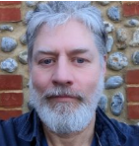













An Introduction to Machine Learning from Time Series
ECML 2024 Workshop
https://aeon-tutorials.github.io/ECML-2024/
Germain Forestier
Tony Bagnall
Ali Ismail-Fawaz
Matthew Middlehurst
Arik Ermshaus
Antoine Guillaume
Patrick Schäfer
Sebastian Schmidl
Phillip Wenig
Thorsten Papenbrock
David Guijo Rubio

Slide 2
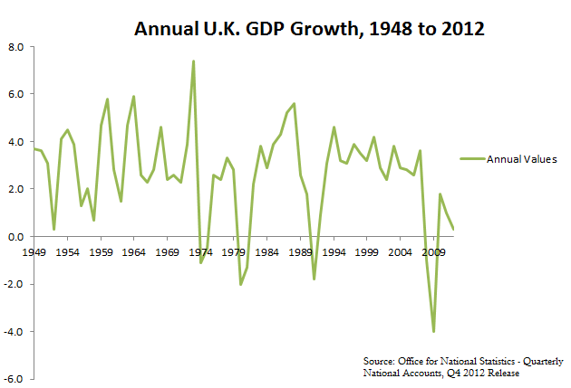
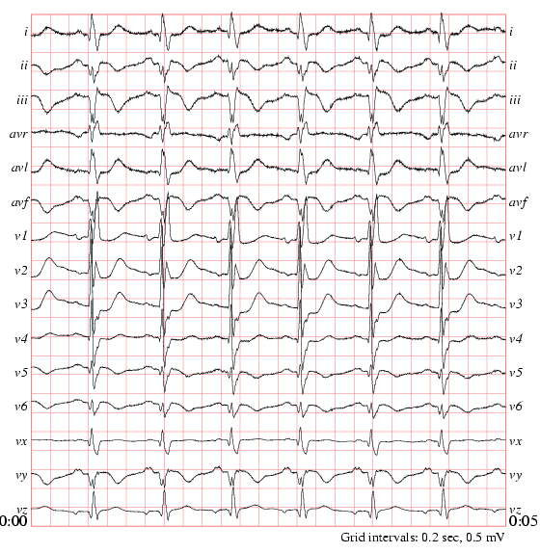

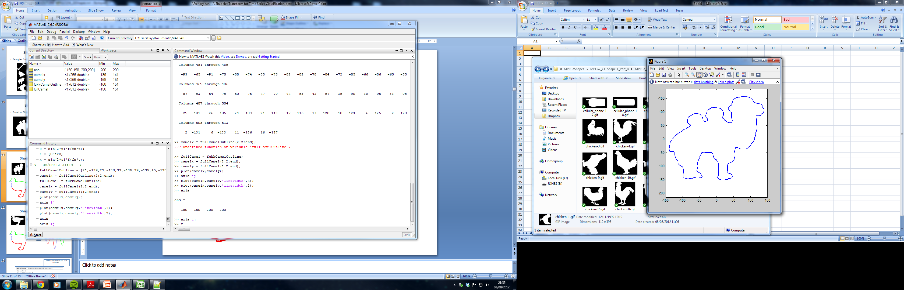
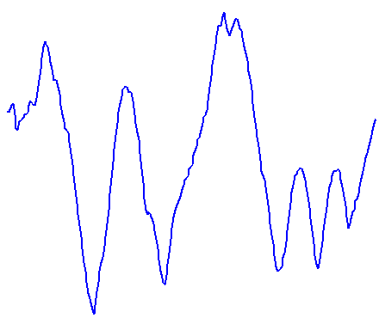
What is a time series?
A time series is an ordered list of observations of real valued variable(s)
If each observation is a scalar, we call it a univariate time series
If each observation is a vector of observations we call it a multivariate time series
The data does not need be ordered in time (sometimes called a data series)
We may have one series, or a collection of series
We may have unequal length, missing values, different sampling rates …..

Slide 3
What is a time series?
A time series is an ordered list of observations of real valued variable(s)
If each observation is a scalar, we call it a univariate time series
If each observation is a vector of observations we call it a multivariate time series
The data does not need be ordered in time (sometimes called a data series)

Slide 4
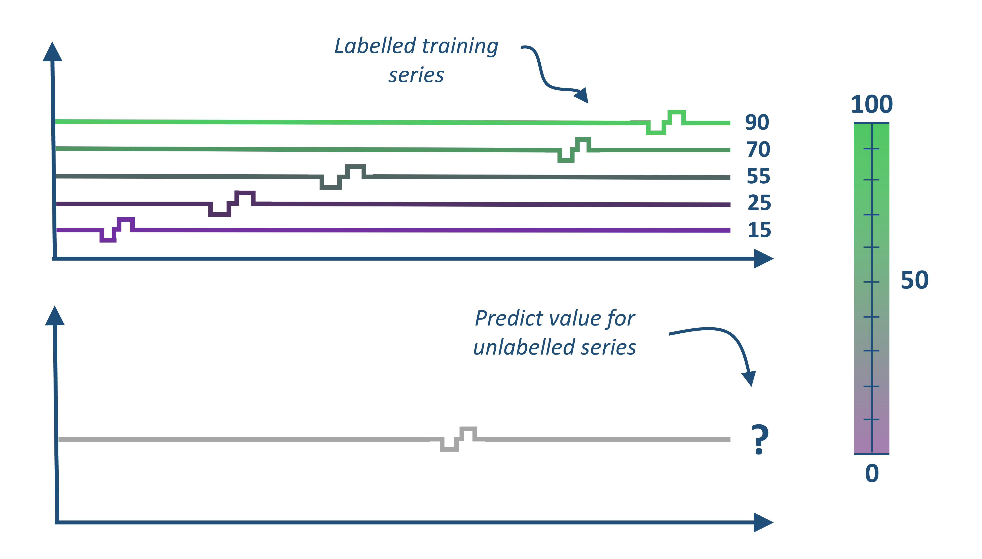
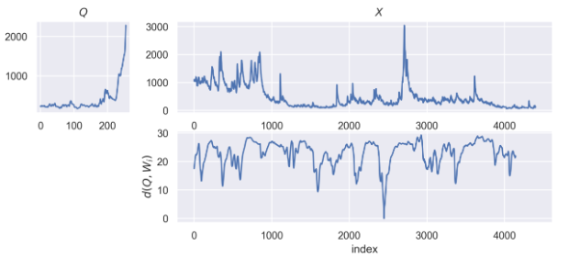
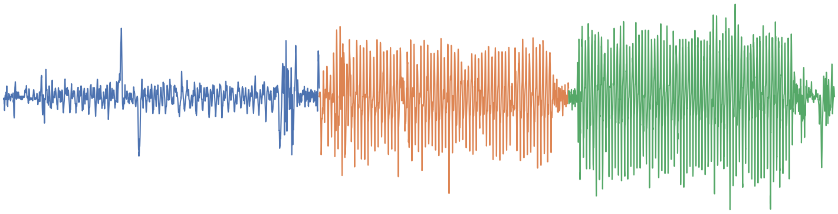
Time Series Machine Learning Tasks
Classification
Regression
Clustering
Labelled training series
Classify unlabelled series
?
Anomaly Detection
Similarity Search
Segmentation
Deep learning

Slide 5











Hands on with the aeon toolkit
Similarity search
classification
clustering
regression
transformations
distances
anomaly detection
aeon
Algorithm research
Scientific research
Industry application
Data science community

Slide 6
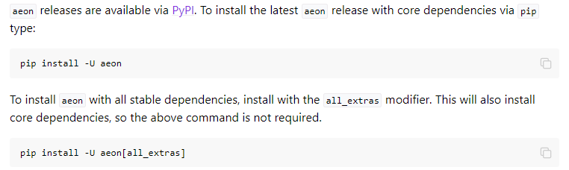
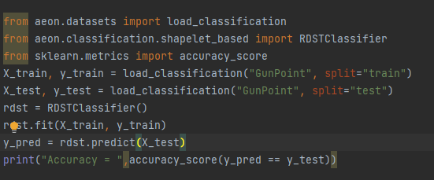
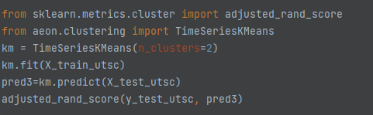
the aeon tsml toolkit
https://github.com/aeon-toolkit/aeon
https://www.aeon-toolkit.org/
aeon clusterers, classifiers and regressors are compatible with sklearn

Slide 7

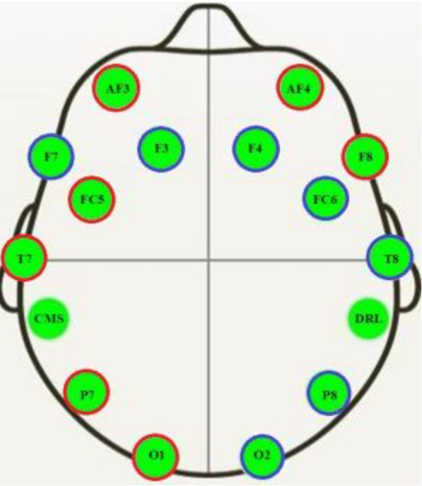
Example EEG datasets
https://github.com/aeon-toolkit/aeon-neuro
aeon-neuro is a fledgling sub project for EEG classification and regression
TSC Data collected by PhD student Aiden Rushbrooke and used by GSoC intern/PhD student Gabriel Riegner
https://github.com/aeon-toolkit/aeon-neuro/blob/main/examples/data_loading.ipynb
TSER Data collected by Southampton post-doc Christoph Tremmel (part of the the wellth lab)
https://www.wellthlab.ac.uk/
Both data sets preprocessed for use as an example. They can be downloaded from the tutorial site or directly with aeon
from aeon.datasets import load_classification from aeon.classification.convolution_based import RocketClassifier from sklearn.metrics import accuracy_score datasets = ["KDD_UTSC", "KDD_MTSC"] r1 = RocketClassifier(rocket_transform="minirocket") for d in datasets: X_train, y_train =load_classification(d, split="TRAIN") print("X shape = ",X_train.shape) X_test, y_test = load_classification(d, split="TEST") print("X shape = ",X_test.shape) r1.fit(X_train, y_train) y_pred = r1.predict(X_test) print("Accuracy miniROCKET = ", accuracy_score(y_pred,y_test))

Slide 8
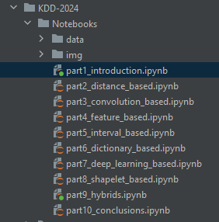
Code Examples
Each section has an associated notebook
The notebook for this section contains information on the datasets
and basic use cases for aeon classifiers and regressors
https://github.com/aeon-toolkit/aeon-tutorials/blob/main/ECML-2024/Notebooks/part1_introduction.ipynb
Join our slack if you want to chat about any element of the code
from aeon.transformations.collection import AutocorrelationFunctionTransformer from sklearn.pipeline import make_pipeline from sklearn.model_selection import GridSearchCV pipe = make_pipeline(AutocorrelationFunctionTransformer(n_lags=25), RocketClassifier (rocket_transform="minirocket")) param_grid = {'rocketclassifier__num_kernels': [5000, 10000, 15000]} grid = GridSearchCV(pipe, param_grid, cv=3) grid.fit(X_train_utsc, y_train_utsc) print(grid.best_params_) preds = grid.predict(X_test_utsc) print("Rocket classifier accuracy:", accuracy_score(y_test_utsc, preds))

Slide 9
Schedule
https://github.com/aeon-toolkit/aeon-tutorials/blob/main/ECML-2024/Notebooks
https://aeon-tutorials.github.io/ECML-2024/
https://aeon-tutorials.github.io/ECML-2024/code.html
Labelled training series
14:10 – 14:40
Matthew Middlehurst
Classification and
Regression
Classify unlabelled series
?
14:40 – 15:05
Tony Bagnall
Clustering
15:05 – 15:30
Similarity Search

Slide 10
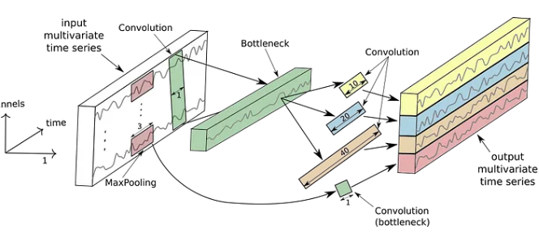
Schedule
Arik Ermshaus
15:30 – 16:00
Patrick Schäfer
Segmentation
COFFEE BREAK
16:30 – 17:00
Anomaly Detection
17:00 – 17:30
Deep learning
17:30 – 18:00
Conclusions, future direction, Q&A

