Slide 1
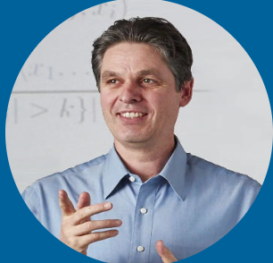









A Hands-on Introduction to Time Series Classification and Regression
KDD 2024 Workshop
Geoff Webb
Angus Dempster
Chang Wei Tan
Germain Forestier
Tony Bagnall
Ali Ismail-Fawaz
Matthew Middlehurst
David Guijo Rubio
Antoine Guillaume
https://aeon-tutorials.github.io/KDD-2024/

Slide 2
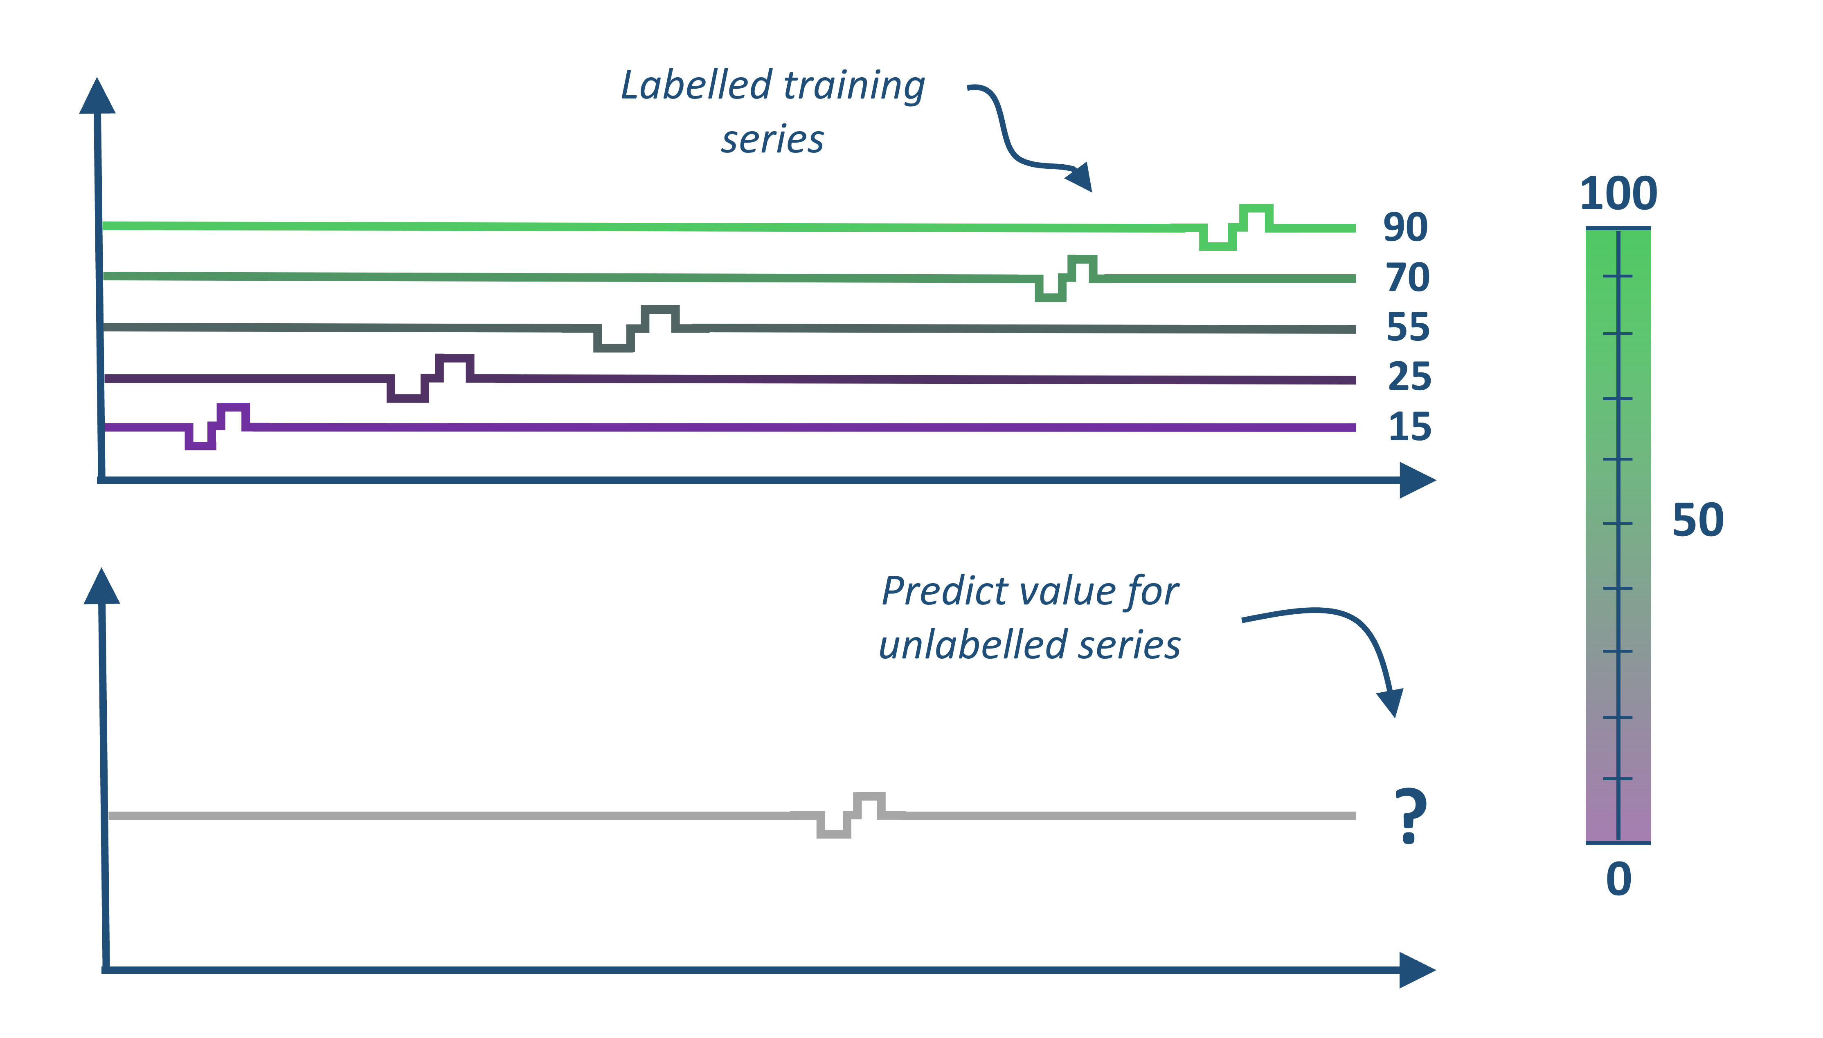
Time Series Classification and Regression
KDD 2024 Workshop
Labelled training series
Classify unlabelled series
?
Our aim is to give you an overview of recent the algorithmic developments in these fields and an idea about how to uses these algorithms to mine collections of time series
We do not cover how to deal with unequal length series, missing values or data sampled at different frequencies. We do also not discuss in detail efficiency and scalability

Slide 3

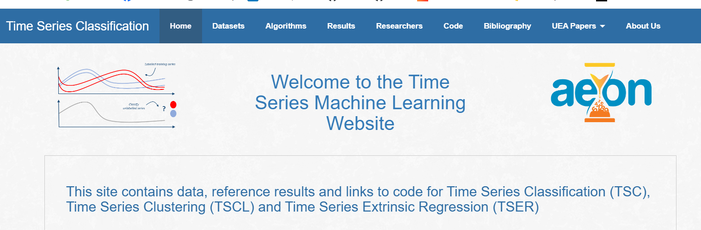
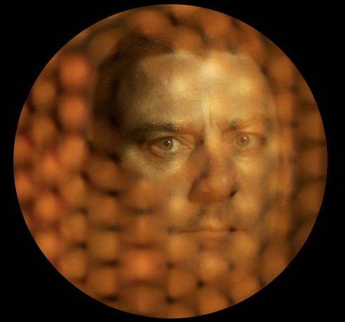

Time Series Machine Learning Repositories
timeseriesclassification.com
tseregression.org
2002: 22
2015: 85
2018: 128
now > 200
Introduced in 2002 by Eamonn Keogh and expanded several times since, the archive datasets have been used in thousands of papers
Expanded in 2018 to 128 datasets
Multivariate archive introduced in 2019 with 30 datasets
Regression archive introduced in 2021/22 with 19 datasets
We would like to thank everyone who donates and helps maintain these archives

Slide 4
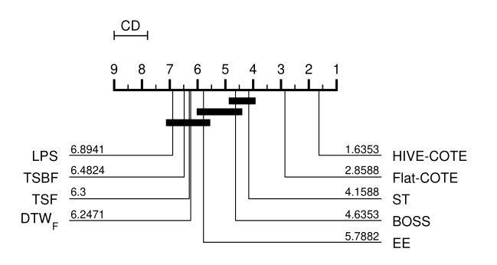
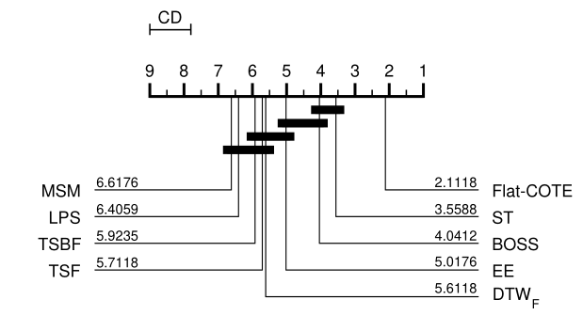
Time Series Classification (TSC) 2014 - 2018
Distance based:
1-NN DTW “hard to beat”
Elastic Ensemble
The collective of transformation-based ensembles: flat-COTE
Bake off finds nine better than DTW, and Flat-COTE SOTA
HIVE-COTE new SOTA
Up to 2014
2015
2016
2017
2018
Feature based algorithms:BOP, BOSS, TSF, TSBF, DTWF, ST etc
comparative study (bake off) of 19 algorithms on 100 resamples of the new 85 datasets
UCR archive re-released with 85 datasets

Slide 5
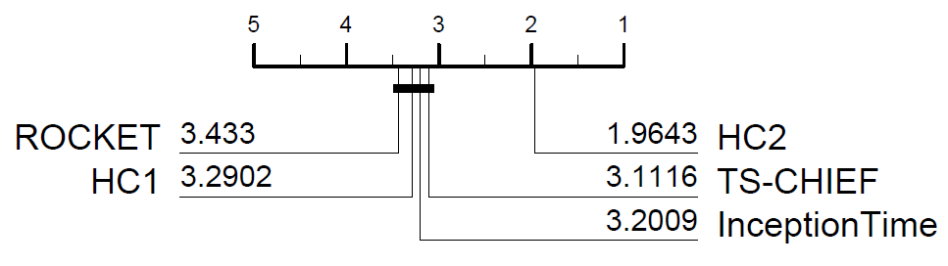
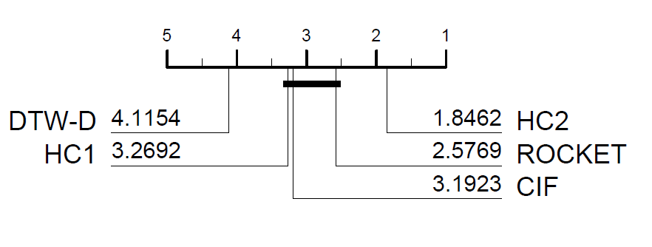
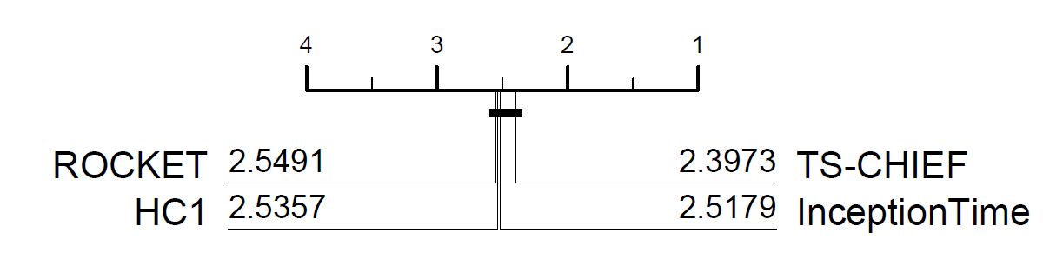
TSC: 2018-2021
Univariate
(UCR archive 112)
timeseriesclassification.com
UCR Archive relaunched with 128 problems
Multivariate archive (2020)
Proximity Forest
Kernel based ROCKET
HIVE-COTE V2 (HC2)
2019
2020
2021
Deep learning bake off
Tree based TS-CHIEF
HIVE-COTE V1 (HC1)
Multivariate bake off
Deep learning: Inception Time
Multivariate
(UEA archive 26)

Slide 6

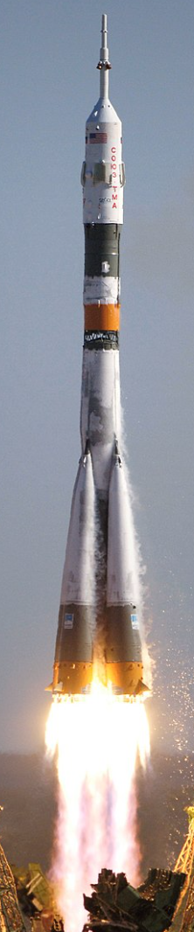
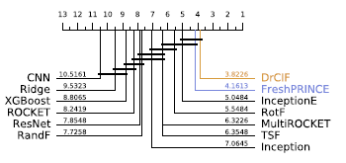


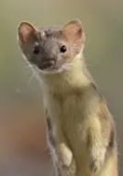
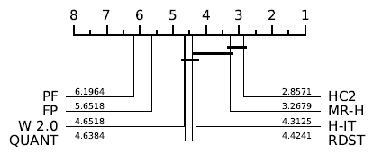
2021/22 onwards
timeseriesclassification.com
aeon-toolkit.org
MiniRocket
Hydra
MultiRocket
Regression archive expanded to 62
RSAST
2022
2023
2024
RDST
WEASEL v2.0
QUANT
Bake off redux
FreshPRINCE
Proximity Forest 2
H-Inception
Regression archive launched
RSTSF
LiteTime
30 new archive problems

Slide 7












Hands on with the aeon toolkit
Similarity search
classification
clustering
regression
transformations
distances
anomaly detection
aeon
Algorithm research
Scientific research
Industry application
Data science community

Slide 8

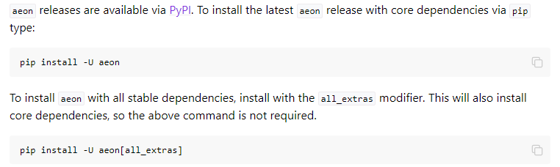
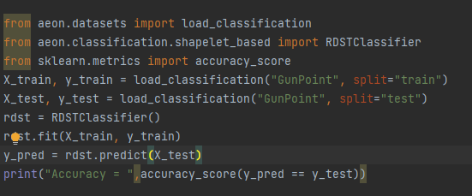
Hands on with the aeon toolkit
KDD 2024 Workshop
https://github.com/aeon-toolkit/aeon
https://www.aeon-toolkit.org/
aeon classifiers and regressors are compatible with sklearn

Slide 9

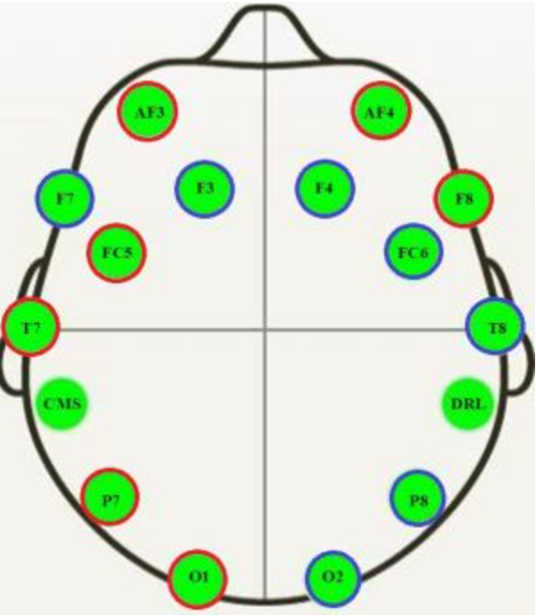
Example EEG datasets
KDD 2024 Workshop
https://github.com/aeon-toolkit/aeon-neuro
aeon-neuro is a fledgling sub project for EEG classification and regression
TSC Data collected by PhD student Aiden Rushbrooke and used by GSoC intern/PhD student Gabriel Riegner
https://github.com/aeon-toolkit/aeon-neuro/blob/main/examples/data_loading.ipynb
TSER Data collected by Southampton post-doc Christoph Tremmel (part of the the wellth lab)
https://www.wellthlab.ac.uk/
Both data sets preprocessed for use as an example. They can be downloaded from the tutorial site or directly with aeon
from aeon.datasets import load_classification from aeon.classification.convolution_based import RocketClassifier from sklearn.metrics import accuracy_score datasets = ["KDD_UTSC", "KDD_MTSC"] r1 = RocketClassifier(rocket_transform="minirocket") for d in datasets: X_train, y_train =load_classification(d, split="TRAIN") print("X shape = ",X_train.shape) X_test, y_test = load_classification(d, split="TEST") print("X shape = ",X_test.shape) r1.fit(X_train, y_train) y_pred = r1.predict(X_test) print("Accuracy miniROCKET = ", accuracy_score(y_pred,y_test))

Slide 10
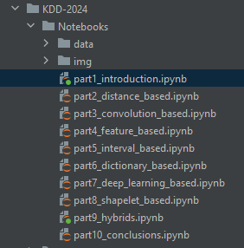
Code Examples
KDD 2024 Workshop
Each section has an associated notebook
The notebook for this section contains information on the datasets
and basic use cases for aeon classifiers and regressors
https://github.com/aeon-toolkit/aeon-tutorials/blob/main/KDD-2024/Notebooks/part1_introduction.ipynb
Join our slack if you want to chat about any element of the code
from aeon.transformations.collection import AutocorrelationFunctionTransformer from sklearn.pipeline import make_pipeline from sklearn.model_selection import GridSearchCV pipe = make_pipeline(AutocorrelationFunctionTransformer(n_lags=25), RocketClassifier (rocket_transform="minirocket")) param_grid = {'rocketclassifier__num_kernels': [5000, 10000, 15000]} grid = GridSearchCV(pipe, param_grid, cv=3) grid.fit(X_train_utsc, y_train_utsc) print(grid.best_params_) preds = grid.predict(X_test_utsc) print("Rocket classifier accuracy:", accuracy_score(y_test_utsc, preds))

Slide 11
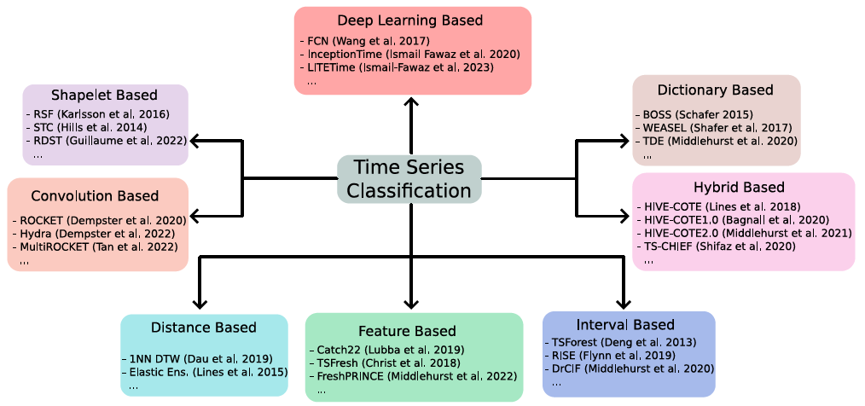
Taxonomy of Algorithms
KDD 2024 Workshop

Slide 12
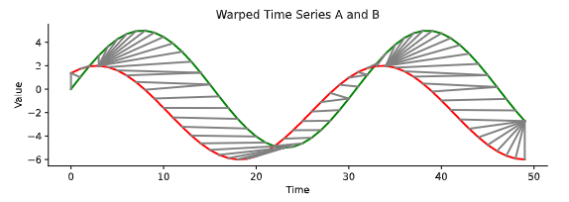
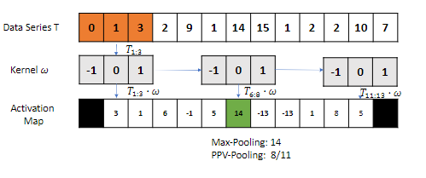
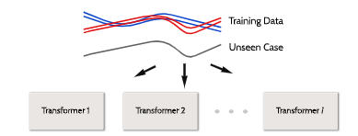
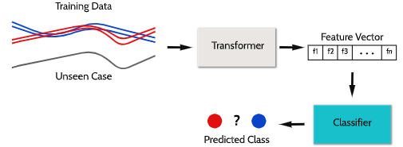
Schedule
KDD 2024 Workshop
14:15 – 14:45
Distance measures for time series
Convolutional kernels
14:45 – 15:15
Summary features
Phase dependent interval
based
15 min break

Slide 13
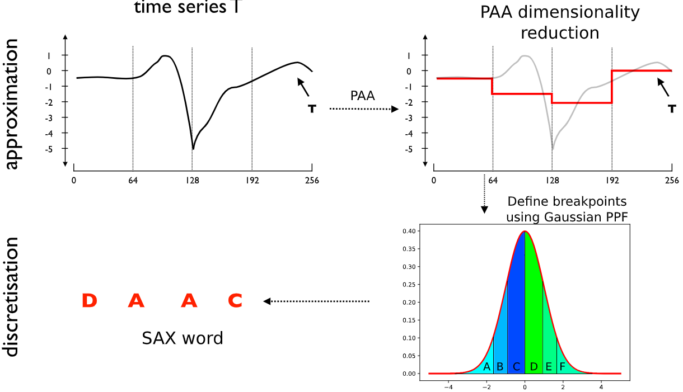
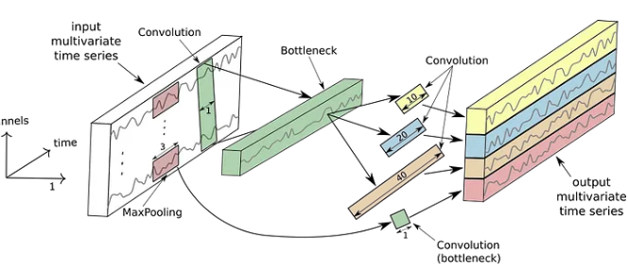
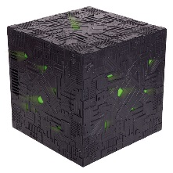
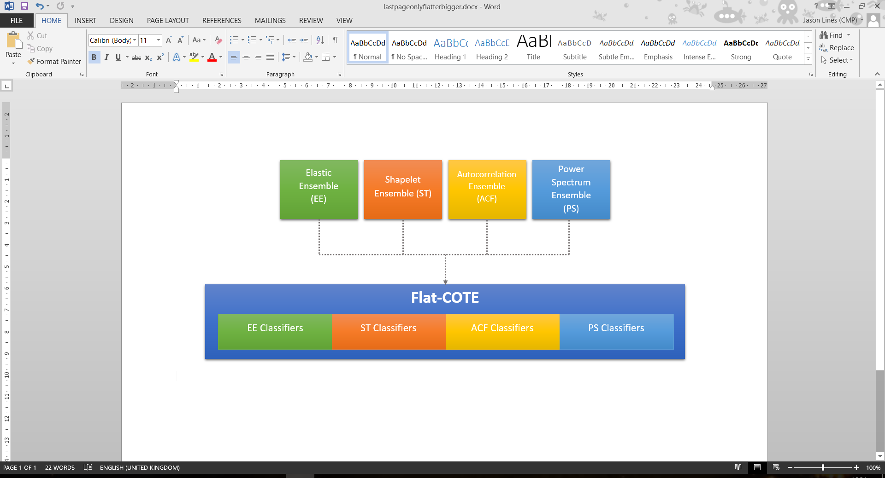
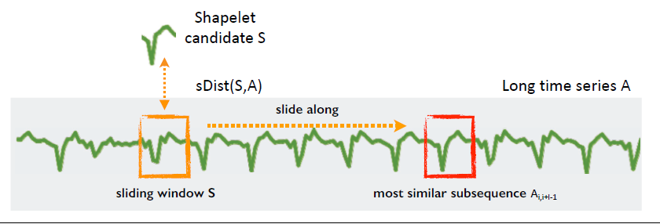
Schedule
KDD 2024 Workshop
15:30 – 16:10
Dictionary-based bag-of-words
Deep learning for time series
16:10 – 16:40
Phase independent shapelets
Hybrid approaches
16:40 – 17:00
Conclusion, future outlook and Q&A
https://aeon-tutorials.github.io/KDD-2024/
https://github.com/aeon-toolkit/aeon-tutorials/blob/main/KDD-2024/Notebooks/part1_introduction.ipynb
https://aeon-tutorials.github.io/KDD-2024/code.html

