Slide 1
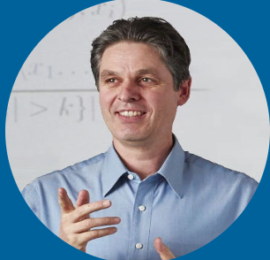



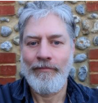





A Hands-on Introduction to Time Series Classification and Regression
KDD 2024 Workshop
Geoff Webb
Angus Dempster
Chang Wei Tan
Germain Forestier
Tony Bagnall
Ali Ismail-Fawaz
Matthew Middlehurst
David Guijo Rubio
Antoine Guillaume

Slide 2
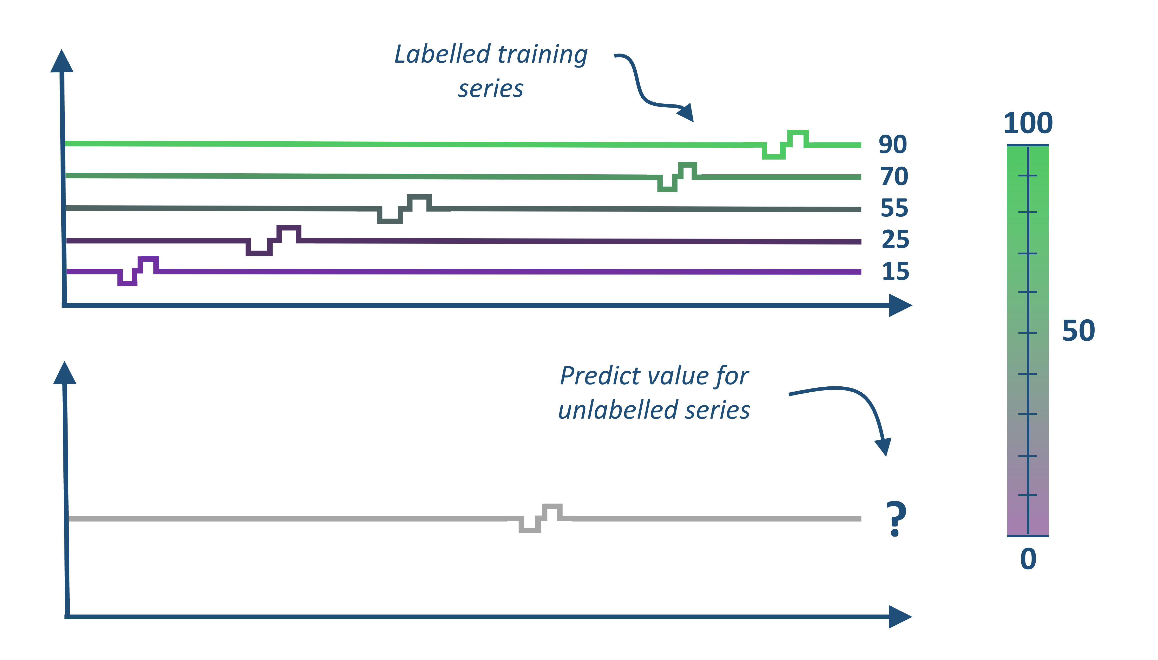
Time Series Classification and Regression
KDD 2024 Workshop
Labelled training series
Classify unlabelled series
?

Slide 3
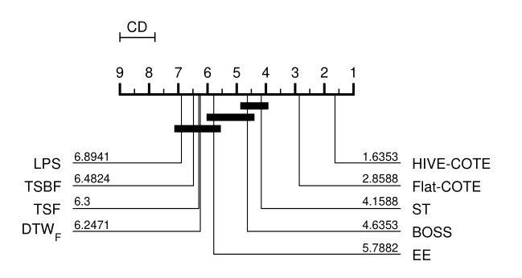
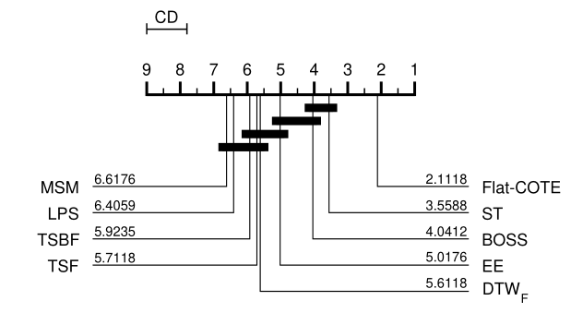
Time Series Classification (TSC) 2014 - 2018
Distance based:
1-NN DTW “hard to beat”
Elastic Ensemble
The collective of transformation-based ensembles: flat-COTE
Bake off finds nine better than DTW, and Flat-COTE SOTA
HIVE-COTE new SOTA
Up to 2014
2015
2016
2017
2018
Feature based algorithms:BOP, BOSS, TSF, TSBF, DTWF, ST etc
comparative study (bake off) of 19 algorithms on 100 resamples of the new 85 datasets
UCR archive re-released with 85 datasets

Slide 4
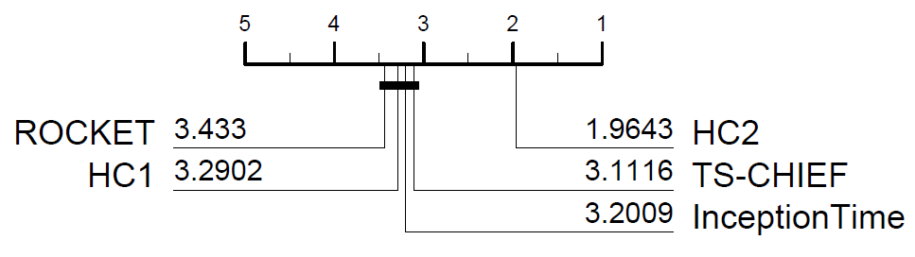
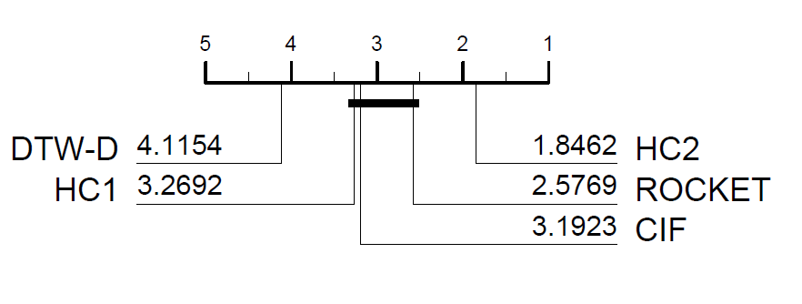
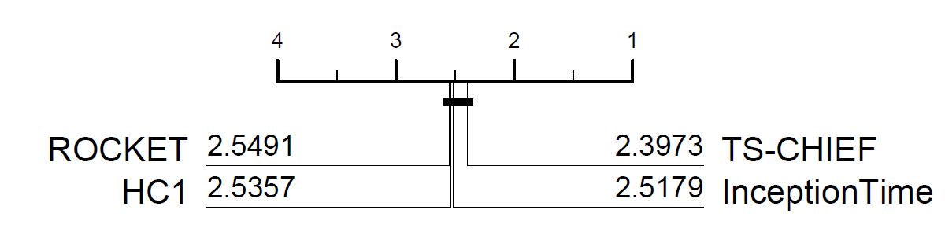
TSC: 2018-2021
Univariate
(UCR archive 112)
timeseriesclassification.com
UCR Archive relaunched with 128 problems
Multivariate archive (2020)
Proximity Forest
Kernel based ROCKET
HIVE-COTE V2 (HC2)
2019
2020
2021
Deep learning bake off
Tree based TS-CHIEF
HIVE-COTE V1 (HC1)
Multivariate bake off
Deep learning: Inception Time
Multivariate
(UEA archive 26)

Slide 5

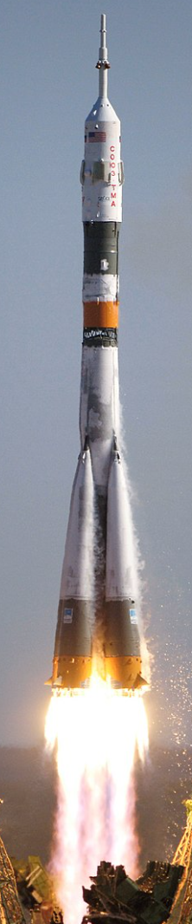
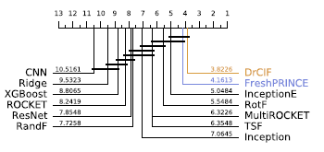



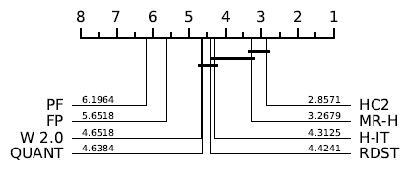
2021/22 onwards
timeseriesclassification.com
aeon-toolkit.org
MiniRocket
Hydra
MultiRocket
Regression archive expanded to 62
RSAST
2022
2023
2024
RDST
WEASEL v2.0
QUANT
Bake off redux
FreshPRINCE
Proximity Forest 2
H-Inception
Regression archive launched
RSTSF
LiteTime
30 new archive problems

Slide 6












Hands on with the aeon toolkit
Similarity search
classification
clustering
regression
transformations
distances
anomaly detection
aeon
Algorithm research
Scientific research
Industry application
Data science community

Slide 7

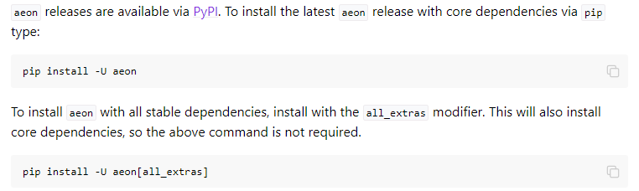
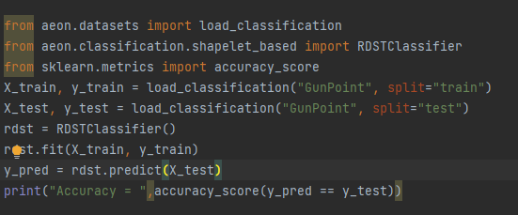
Hands on with the aeon toolkit
KDD 2024 Workshop
https://github.com/aeon-toolkit/aeon
https://www.aeon-toolkit.org/
Aeon classifiers and regressors are compatible with sklearn

Slide 8

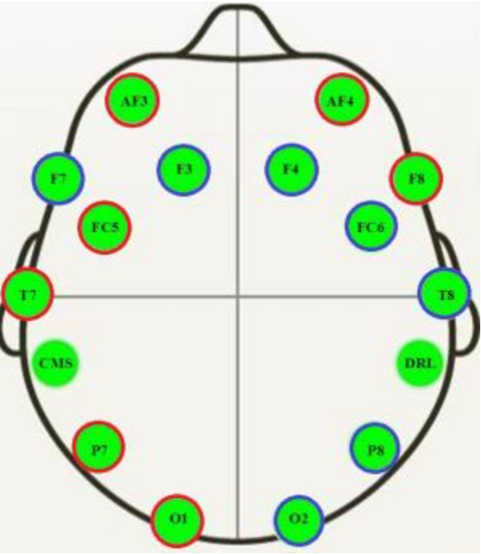
Example EEG datasets
KDD 2024 Workshop
https://github.com/aeon-toolkit/aeon-neuro
aeon-neuro is a fledgling sub project for EEG classification and regression
TSC Data collected by PhD student Aiden Rushbrooke and used by GSoC intern/PhD student Gabriel Riegner
https://github.com/aeon-toolkit/aeon-neuro/blob/main/examples/data_loading.ipynb
TSER Data collected by Southampton post-doc Christoph Tremmel (part of the the wellth lab)
https://www.wellthlab.ac.uk/
Both data sets preprocessed for use as an example. They can be downloaded from the tutorial site or directly with aeon
from aeon.datasets import load_classification from aeon.classification.convolution_based import RocketClassifier from sklearn.metrics import accuracy_score datasets = ["KDD_UTSC", "KDD_MTSC"] r1 = RocketClassifier(rocket_transform="minirocket") for d in datasets: X_train, y_train =load_classification(d, split="TRAIN") print("X shape = ",X_train.shape) X_test, y_test = load_classification(d, split="TEST") print("X shape = ",X_test.shape) r1.fit(X_train, y_train) y_pred = r1.predict(X_test) print("Accuracy miniROCKET = ", accuracy_score(y_pred,y_test))

Slide 9
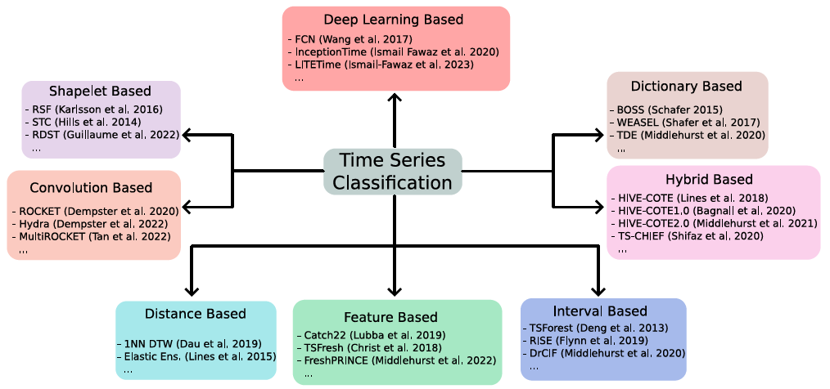
Taxonomy of Algorithms
KDD 2024 Workshop

Slide 10
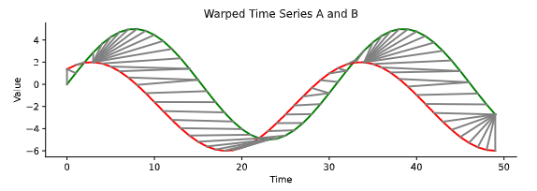
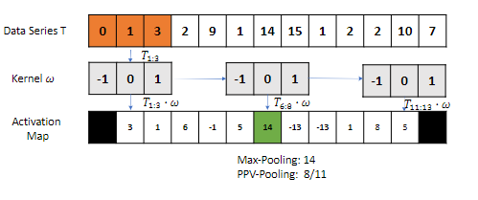
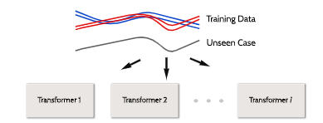
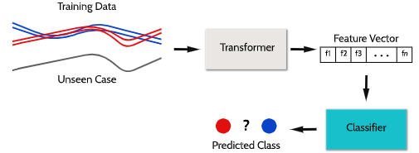
Schedule
KDD 2024 Workshop
13:15 – 13:45
Distance Measures for Time Series
Convolutional Kernels
13:45 – 14:15
Summary Features
Phase Dependent Intervals
15 min break

Slide 11
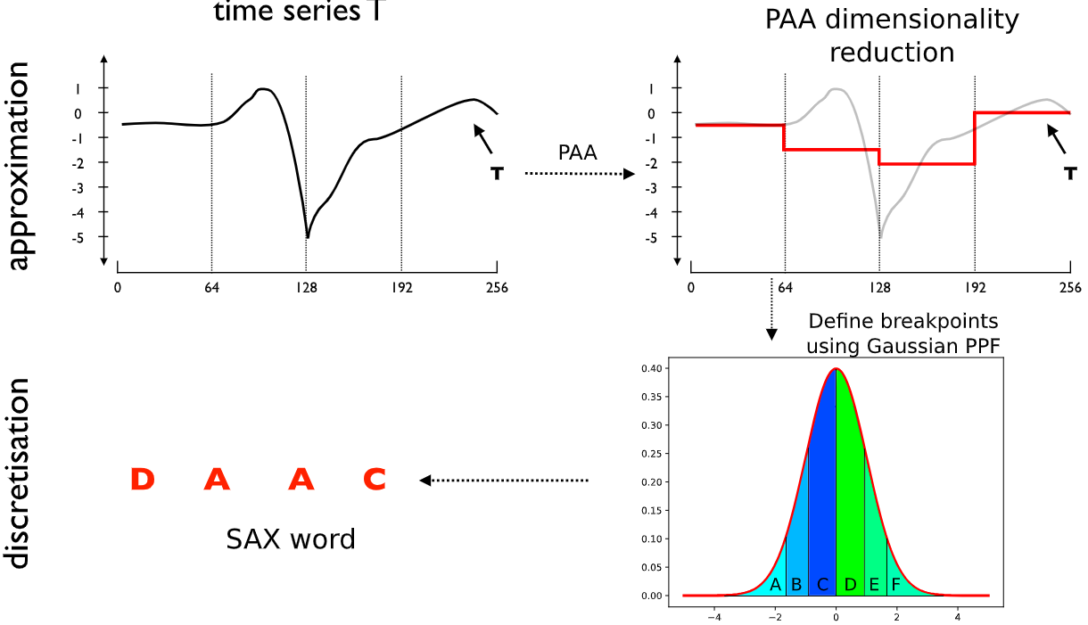
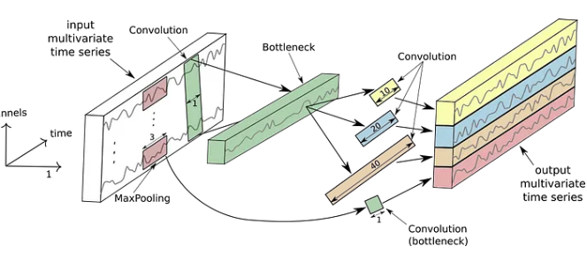
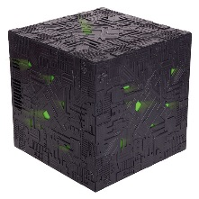
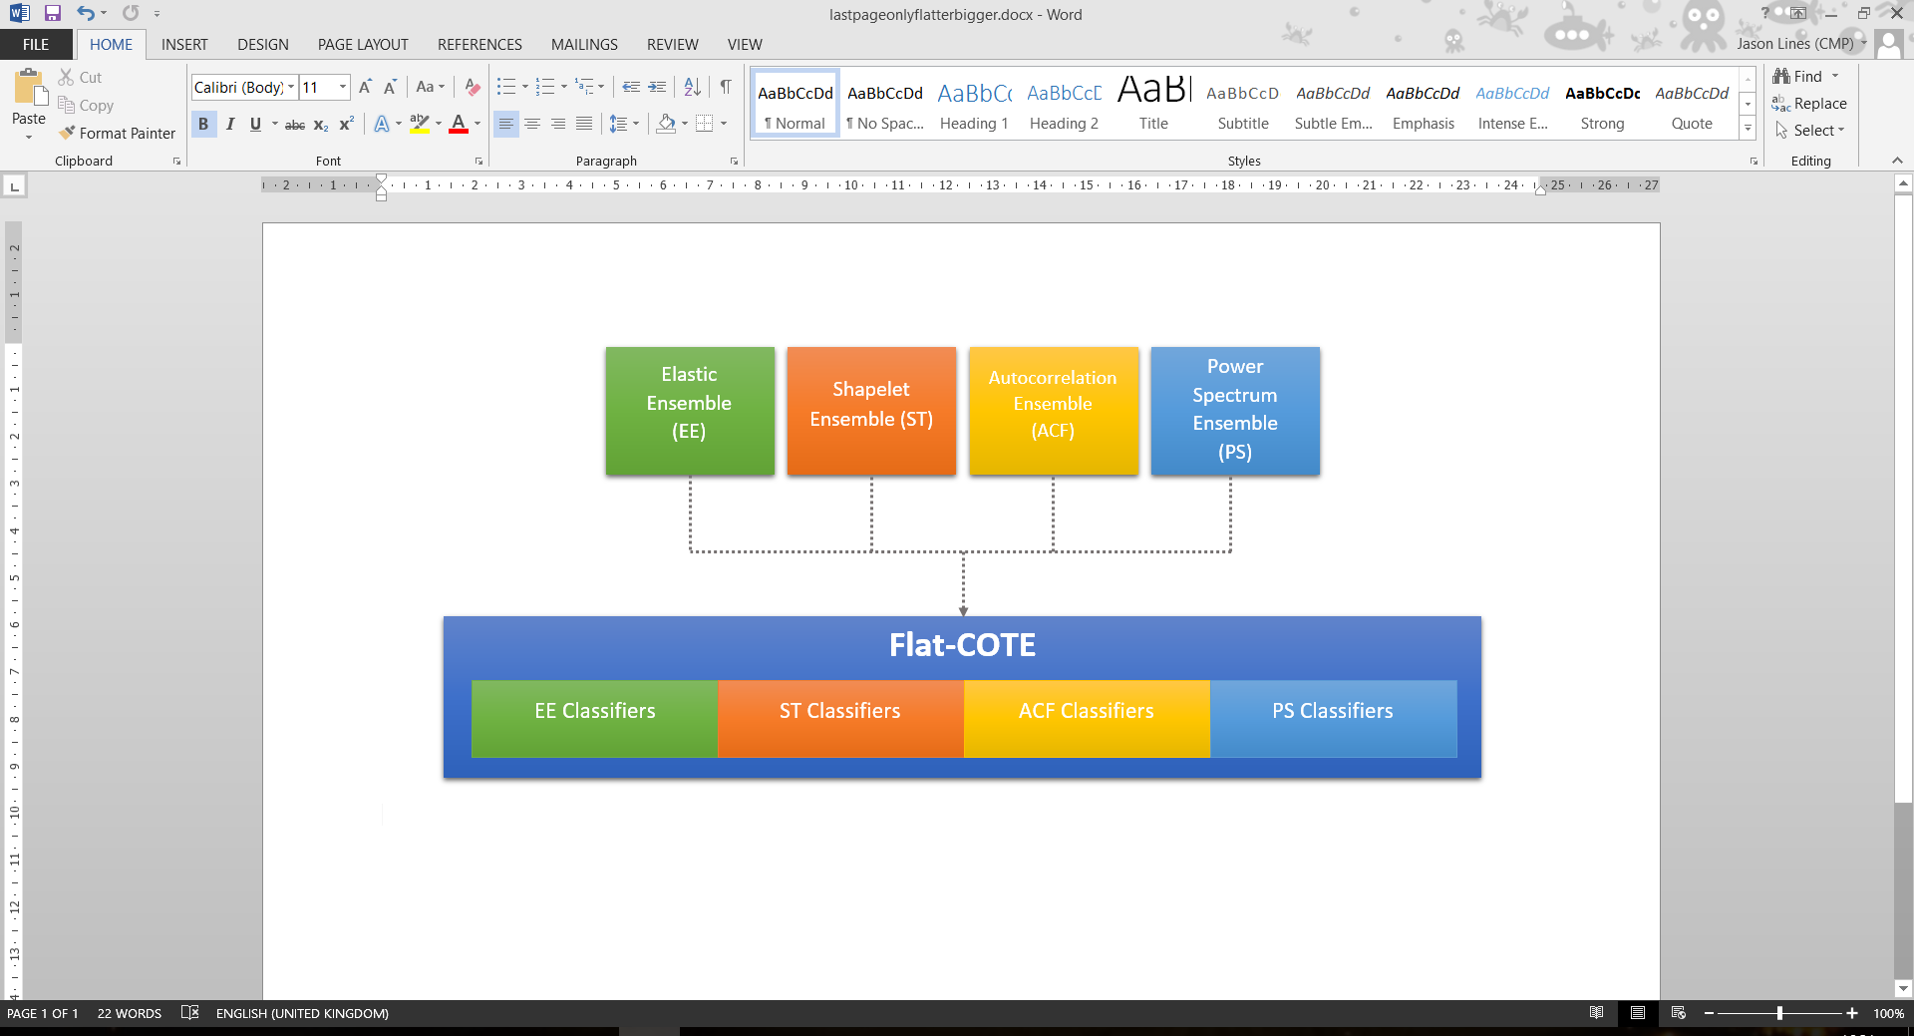
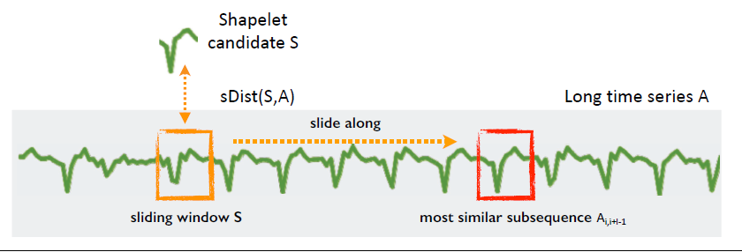
Schedule
KDD 2024 Workshop
14:30 – 15:10
Dictionary-based bag-of-words
Deep Learning for Time Series
15:10 – 15:40
Phase independent shapelets
Hybrid Approaches
15:40 – 16:00
Conclusion and Future Outlook
Q&A
Finish 16:00

