Slide 1
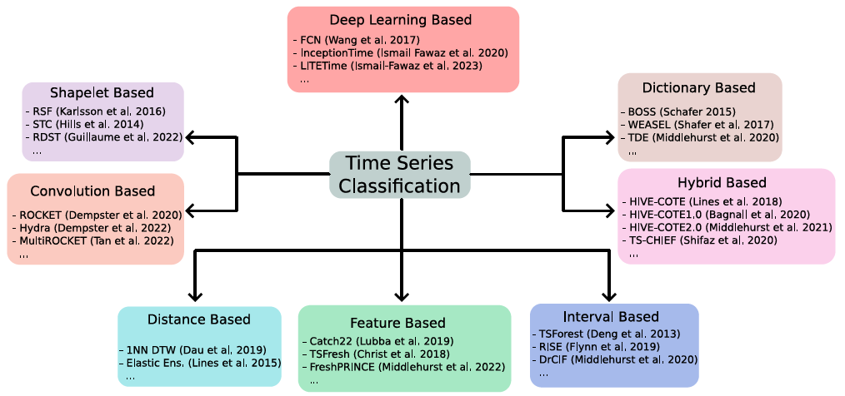
KDD 2024 Workshop
Part 8: Shapelet Based Classifiers

Slide 2
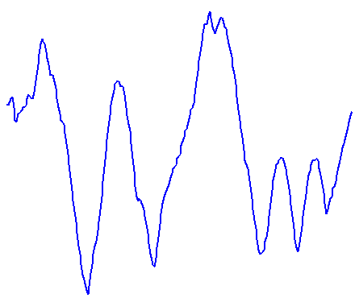
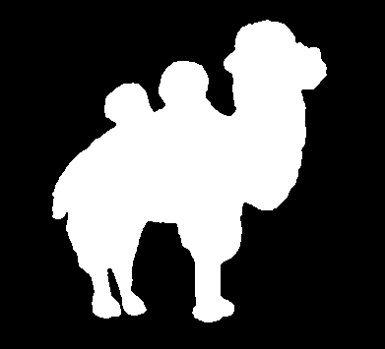
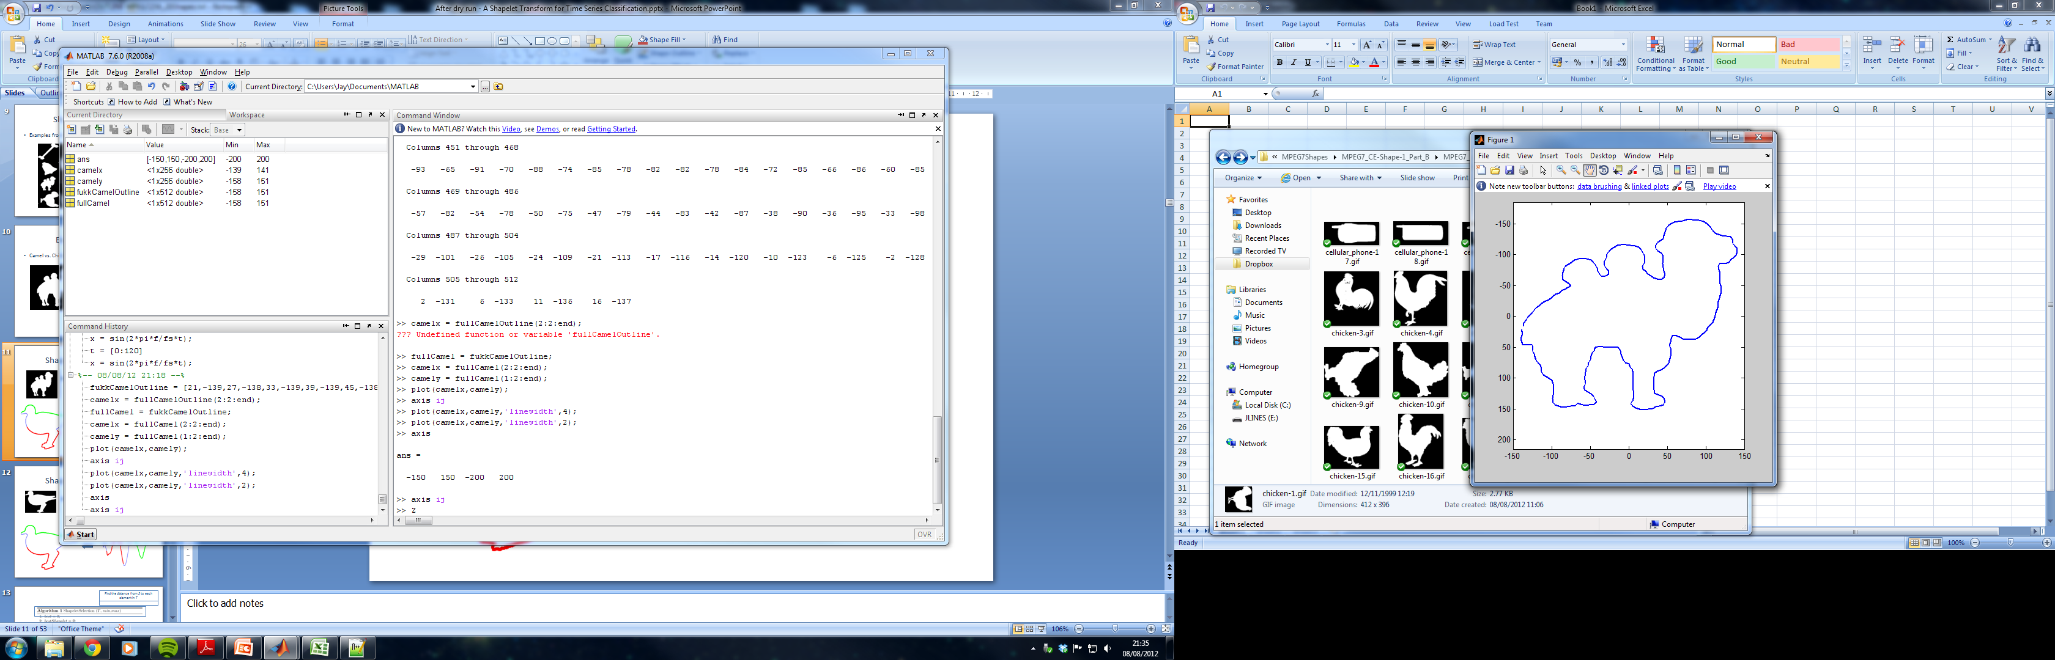

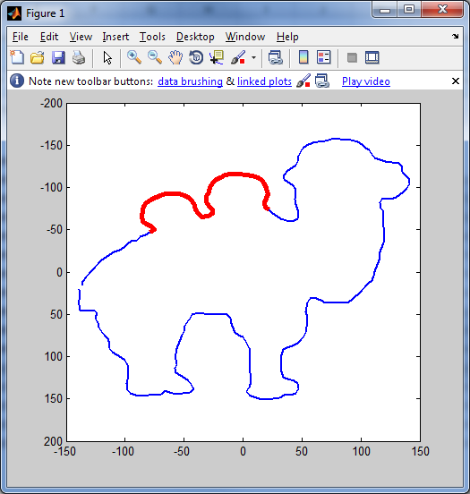
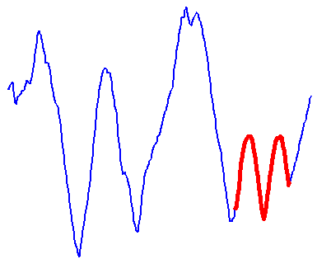
Camel or Chicken?
Shapelets are discriminatory phase independent subseries
Shapelets are taken from the training data

Slide 3
Using Shapelets
Classify based on distance between shapelets and series
Non invasive fetal heartbeat data
shapelet extracted
from series
Class 32: Bad Match
Class 28: OK Match
Class 27: Good Match

Slide 4

Shapelets fundamentals
Time series shapelets are a data mining primitive that were first introduced by [1].
They provide a mechanism for measuring local similarity between series by observing common subsequences.
The original research embedded shapelets in a decision tree for TSC.
The shapelet transform [2] separated the finding of shapelets from the classifier.
There have been many variants proposed subsequently
[1] L. Ye and E. Keogh. Time series shapelets: A new primitive for data mining. In Proc. 15th ACM SIGKDD, 2009.
[2] J. Lines et al. A shapelet transform for time series classification. In Proc. 18th ACM SIGKDD, 2012.

Slide 5
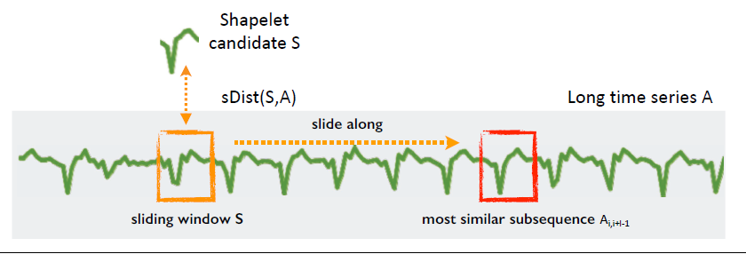
Shapelet Based Classifiers
RSAST
Shapelets are discriminatory phase independent subseries taken from the train data
Learning shapelets
Shapelet Transform Classifier
FedST
LRS
TSL
DSLMF
Shapelet Tree
2009
2012
2014
2016
2017
2022
2023
2024
Original Shapelet Transform
Shapelet Forest
Random Dilated Shapelet Transform (RDST)
ShapeFormer
Z-Time
ShapeConv
ASS
CASTOR
RSAST
PPSN
We only cover the basics and relate discuss high level design issues

Slide 6
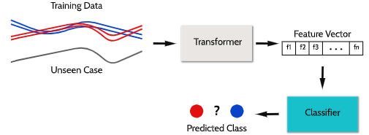
Shapelet Transform Classifier
Transform using k shapelets into a vector of distances to shapelets
Key Issues
How to select shapelets?
How to measure the distance between a shapelet and a single series?
How to measure shapelet quality?
What classifier to use?
Rotation Forest Classifier

Slide 7

Selecting shapelets
The original shapelet transform followed the original paper and enumerated all possible shapelets
This is very inefficient and is in impractical for all but the smallest problems.
It is also less effective as it can lead to over fitting
The current version of STC randomly samples a large number (default 10k) and keeps the best k (default 1000)

Slide 8
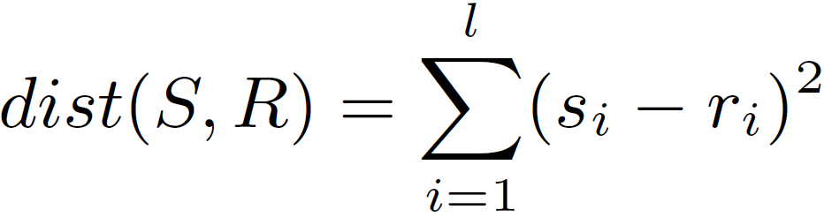
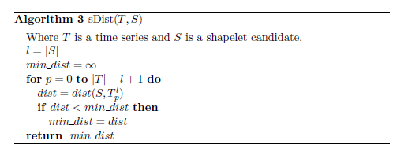
Shapelet Distance
We need to measure how likely it is that a shapelet is in any time series
0 | 3 | 9 | 14 | 1 | 2 | 7 | 1 | 2 | 1 | 15 | 2 | 10
-5 | 0 | 5
Slide shapelet along T
0 | 3 | 9
-1.07 | -0.267 | 1.336
3 | 9 | 14
Normalise subseries
Measure Euclidean distance to normalised shapelet
9 | 14 | 1
14 | 1 | 2
The distance between a subsequence S of length l and a time series T_{i} is the minimum distance between S and all normalised subsequences of T_{i} of length l
1 | 2 | 7
Record lowest distance so far slide along

Slide 9
Shapelet Quality
For each shapelet we calculate a list of distances from the shapelet to each of the training set time series
The quality of the shapelet is based on how well we can use these distance to predict the class values
We use binary shapelets that predict a single class. Suppose we have eight training cases and get these distances
We measure the quality using a measure like information gain
Class 1:
Class 2:
10.5
42.3
23.8
72.1
54.2
67.4
28.2
98.9

Slide 10
The Order line
D_{S} =
0
100
Class 1:
Class 2:
10.5
42.3
23.8
72.1
54.2
67.4
28.2
98.9

Slide 11
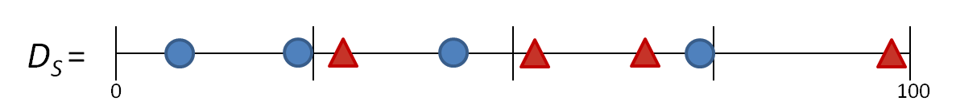
Information Gain
Now that D_{S} is sorted, assess all possible split points, where a split point, sp, is the average between two consecutive distances.
0.138
0.312
0.049
0.189
0.049
0
Note: the position of the best split point is used as the decision criteria for the decision tree

Slide 12
Shapelet Transform
1. Randomly sample shapelets a fixed number of times for each class
2. Find distances to all series in the training set
3. Measure quality with IG
4. Keep the best scoring shapelets
Find Shapelets
Find Transform
Train Classifier

Slide 13
The Transform
4 extracted shapelets:
Given a series T_{i}
Calculate: dist(T_{i},S1), dist(T_{i},S₂), dist(T_{i},S₃), dist(T_{i},S₄)
Create a tabular train dataset
 | S1 | S2 | S3 | S4
T1 | 0.024 | 5.124 | 7.682 | 0.715
T2 | 0.567 | 1.234 | 4.667 | 0.001
T3 | 4.567 | 6.231 | 12.435 | 4.456
T4 | 2.33 | 0.184 | 3.111 | 5.232
0.024
5.124
7.682
0.715

Slide 14
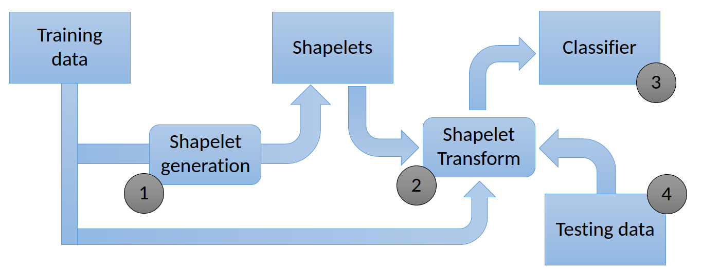
From Shapelets to Rocket
Both are pipelines, The fundamental differences are
1. shapelets are from the train data, convolutions are generated
2. STC uses a supervised transform, rocket a random one
3. Rocket uses PPV in addition to distance
4. Rocket uses dilation and fixed lengths
5. Rocket uses a linear classifier, STC uses rotation forest

Slide 15
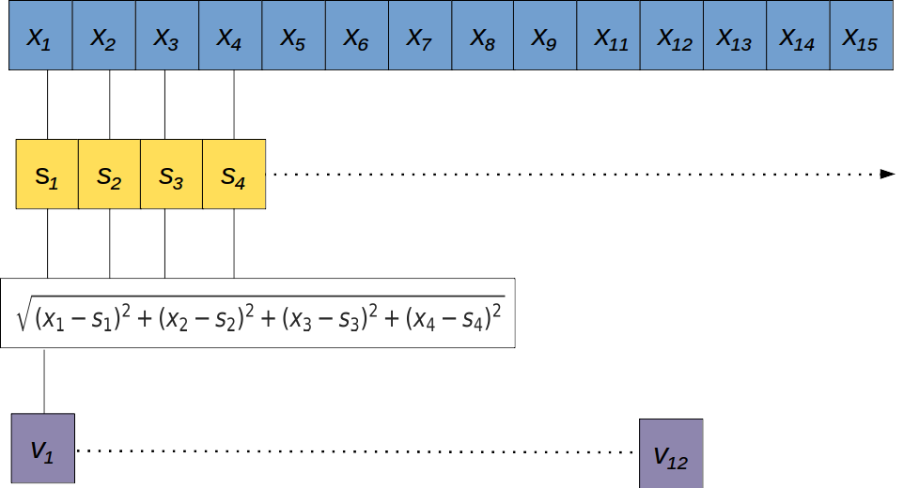
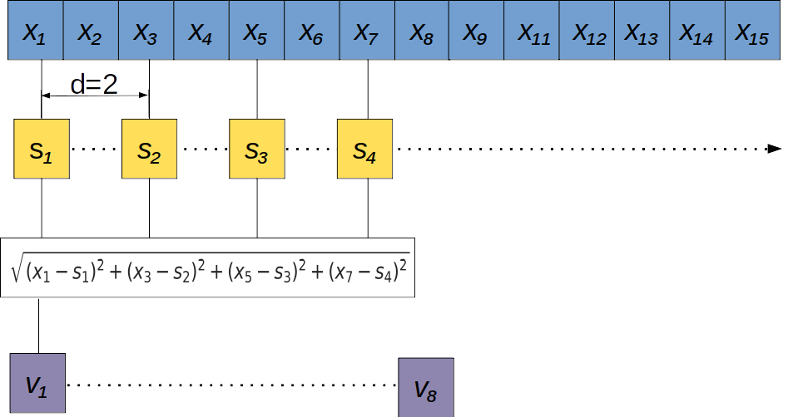
Random Dilated Shapelet Transform (RDST) [1]
Dilation improves many algorithms (e.g. ROCKET, WEASEL, RDST)
[1] A Guillaume, C Vrain, W Elloumi, Random dilated shapelet transform: A new approach for time series shapelets, International Conference on Pattern Recognition and Artificial Intelligence, 2022

Slide 16
Some of the many variants ….
Use time encoding for position [1]
Use frequency of occurrence measures (e.g. PPV) [2]
Tune shapelets with gradient descent [3]
Discretise subseries and match words [4]
[1] M. Guilleme, Malinowski, R Tavenard and X Renard, Localized random shapelets, AALTD 2020.
[2] A Guillaume, C Vrain, W Elloumi, Random dilated shapelet transform: A new approach for time series shapelets, International Conference on Pattern Recognition and Artificial Intelligence, 2022
[3] D Guijo-Rubio, P Gutiérrez, R Tavenard and A Bagnall A Hybrid Approach to Time Series Classification with Shapelets, IDEAL 2019
[4] T. Nguyen and G. Ifrim Fast time series classification with random symbolic subsequences, AALTD 2022

