Slide 1
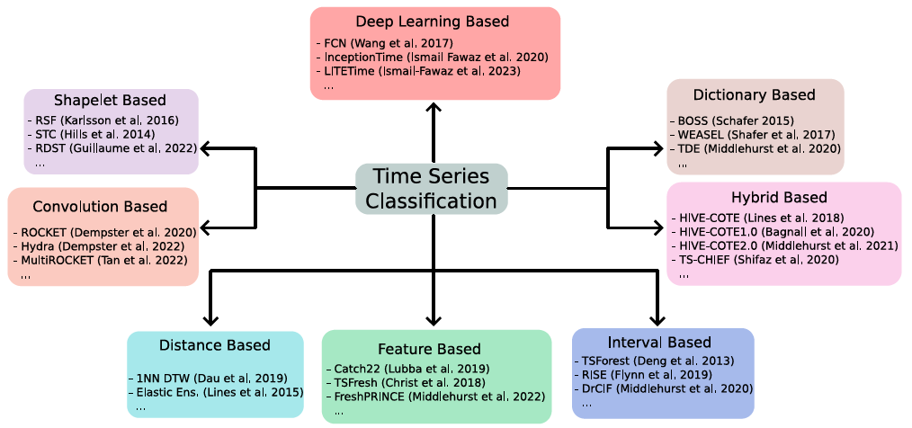
KDD 2024 Workshop
Part 9: Hybrids

