Slide 1
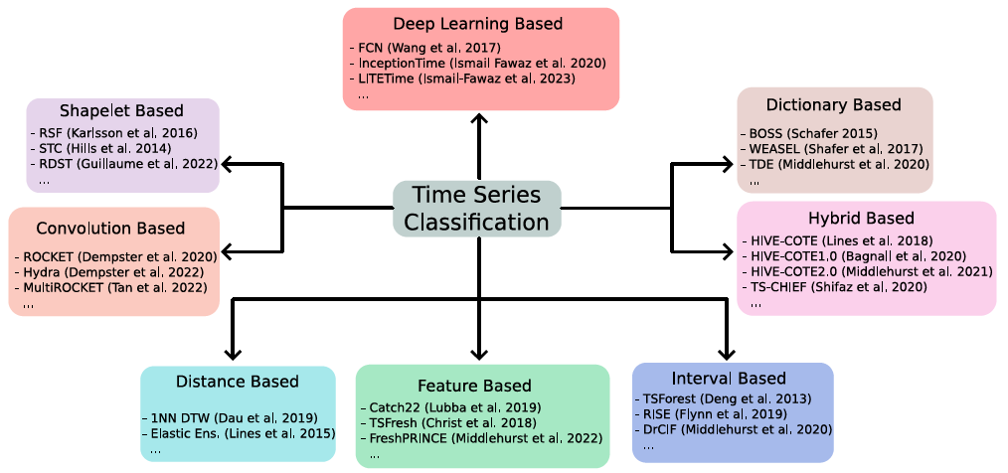
KDD 2024 Workshop
Part 9: Hybrids

Slide 2
KDD 2024 Workshop
Part 9: Hybrids
Many algorithms implicitly combine different representations
Multirocket combines convolutions and dictionaries
MrSQM could be classed as dictionary or shapelet
TS-CHIEF combines distance and dictionary approaches
Basic hypothesis: if there is no prior knowledge as to the best approach, ensembling strong classifiers over different representations is the best approach

Slide 3
KDD 2024 Workshop
Collective of Transformation-based Ensembles (COTE)
Basic hypothesis: if there is no prior knowledge as to the best approach, ensembling strong classifiers over different representations is the best approach
Flat COTE [1]
HIVE-COTE alpha [2]
HIVE-COTE V1 [3]
HIVE-COTE V2 [4]
2016
2018
2020
2021
MultiRocket-Hydra
TS-CHIEF

Slide 4
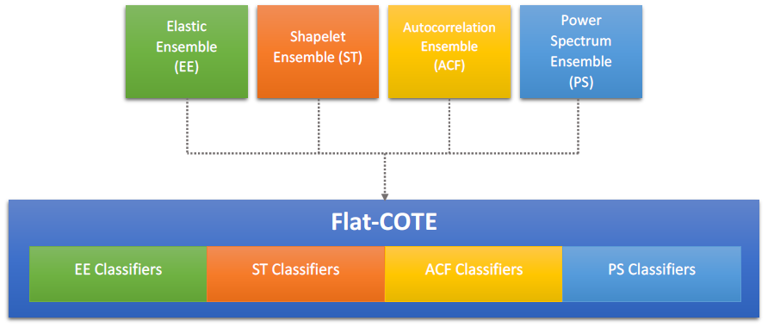
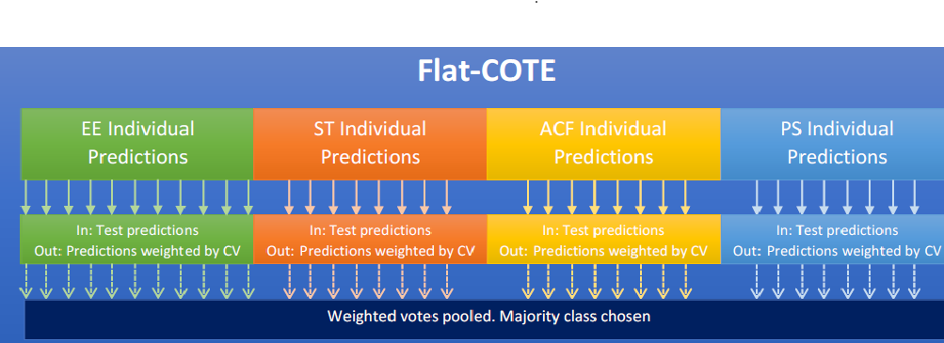
KDD 2024 Workshop
Flat-COTE (2015) [1]
Everything we had recently done chucked in an ensemble, with some frequency domain classifiers for good measure
Winner of first bake off
Very slow: full shapelet enumeration and distance based
Unstructured: more EE classifiers, greater weight in the ensemble.
1] A Bagnall, J Lines, J Hills, A Bostrom, Time-series classification with COTE: the collective of transformation-based ensembles IEEE Transactions on Knowledge and Data Engineering 27 (9), 2522-2535, 2015

Slide 5
KDD 2024 Workshop
Heterogeneous Ensembles
Basic hypothesis:
if there is no prior knowledge as to the best approach, ensembling strong classifiers over different representations is the best approach
Heterogeneous ensembles of a small number of strong estimators outperforms large homogeneous ensembles
Ensemble design
What estimators to use? Diversity though estimator choice
How to estimate component performance on train data? Cross validation is time consuming
What biases are introduced through these estimates?
How to combine estimates to get final predictions?

Slide 6
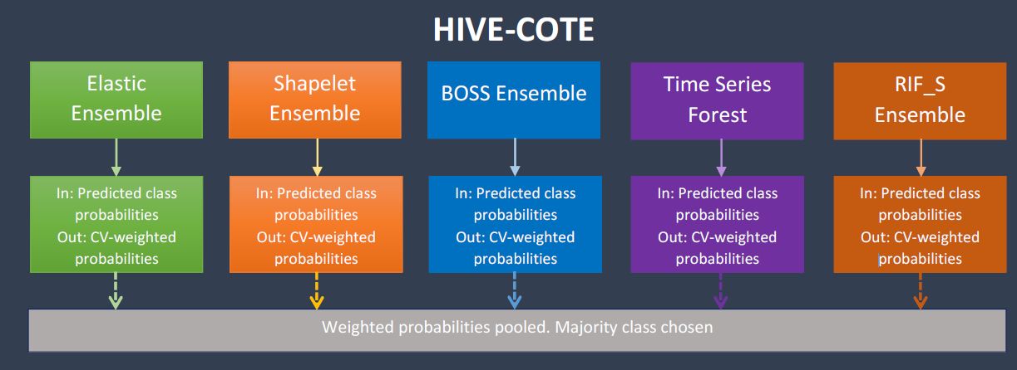
HIVE-COTE alpha (2018) [2]
Modularise into a meta ensemble: each component using a different approach
Adds dictionary based approach (BOSS)
Consolidates frequency domain approaches (RIF_S)
[2] J Lines, S Taylor, A Bagnall, Time series classification with HIVE-COTE: The hierarchical vote collective of transformation-based ensembles ACM Transactions on Knowledge Discovery from Data12 (5), 1-35, 2018

Slide 7
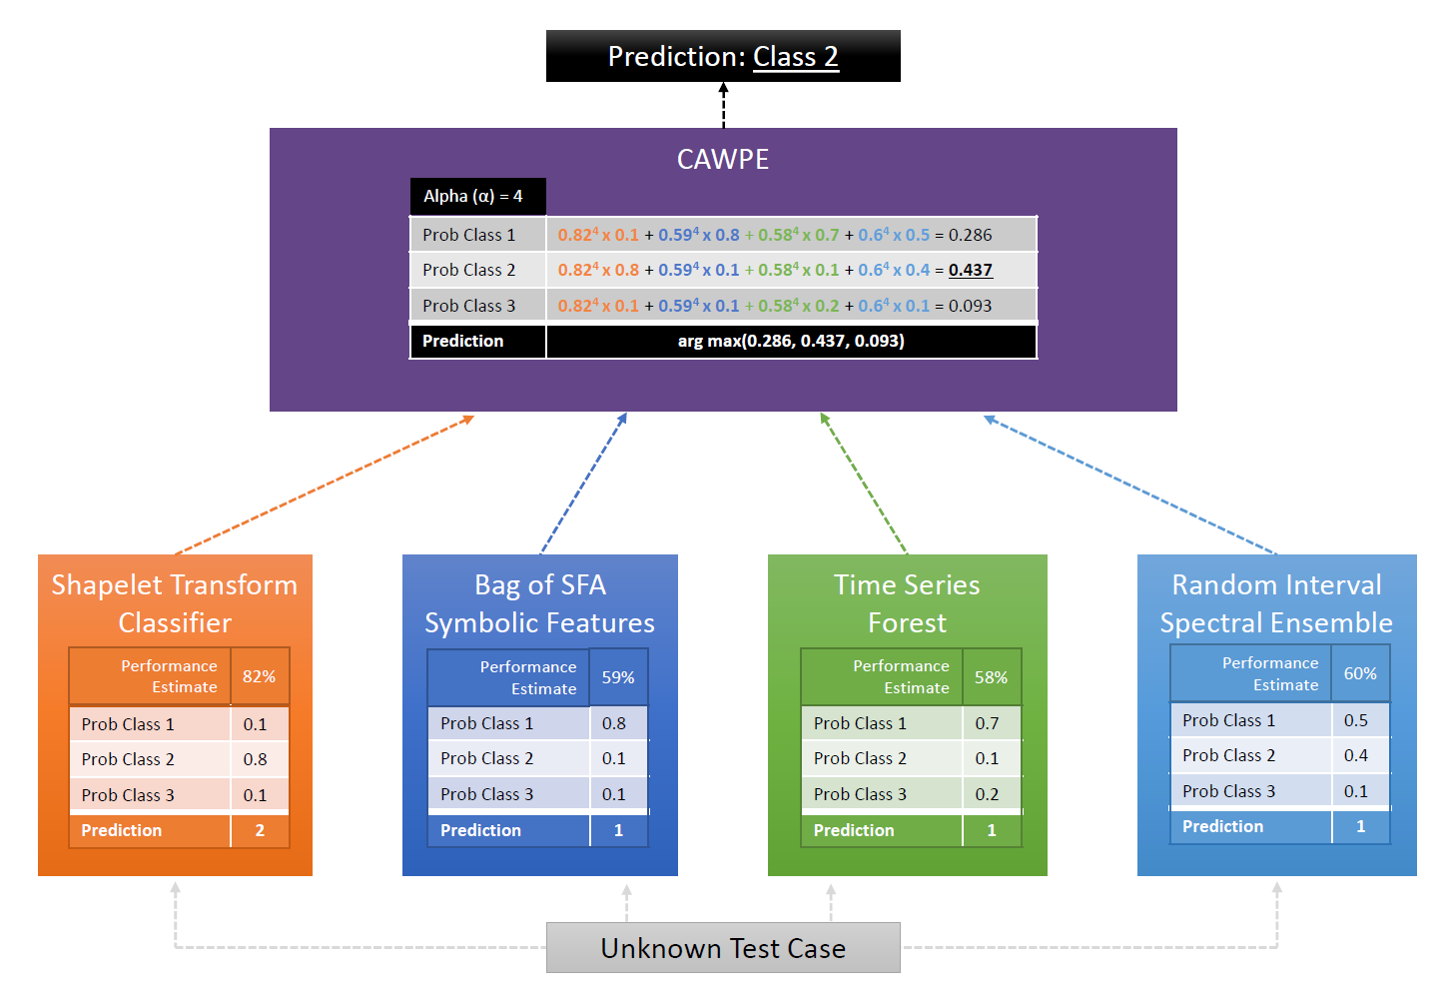
HIVE-COTE V1 (2020) [3]
Removed distance based Elastic Ensemble
Introduced a randomised shapelet transform
Introduced a new frequency based ensemble
[3] A Bagnall, M Flynn, J Large, J Lines, M Middlehurst, On the usage and performance of the hierarchical vote collective of transformation-based ensembles version 1.0 (HIVE-COTEV1.0) Advanced Analytics and Learning on Temporal Data: 5th ECML PKDD Workshop 2020

Slide 8
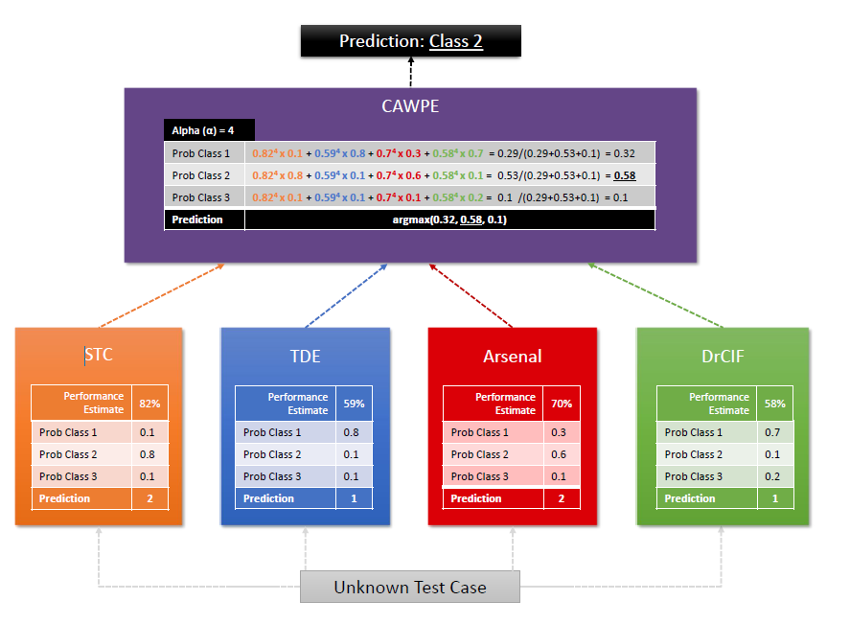
HIVE-COTE V2 (2021) [4]
Introduced a new dictionary classifier (TDE), convolution based (the Arsenal) and interval based (DrCIF)
Dropped spectral RISE (frequency domain embedded in other classifiers)
Improved methods for estimating accuracy from the train set
[4] M Middlehurst, J Large, M Flynn, J Lines, A Bostrom, A Bagnall. HIVE-COTE 2.0: a new meta ensemble for time series classification Machine Learning 110 (11), 3211-3243, 2021

Slide 9
HC2 Module 1: Shapelet Transform Classifier

Slide 10
HC2 Module 2: Temporal Dictionary Ensemble (TDE)

Slide 11
HC2 Module 3: The Arsenal

Slide 12
HC2 Module 4: Diverse representation

Slide 13
Bake off Redux (2024)

