Slide 1








Time series classification and regression
ECML/PKDD 2024 Tutorial
Germain Forestier
Tony Bagnall
Ali Ismail-Fawaz
Matthew Middlehurst
David Guijo Rubio
Antoine Guillaume
https://aeon-tutorials.github.io/KDD-2024/

Slide 2
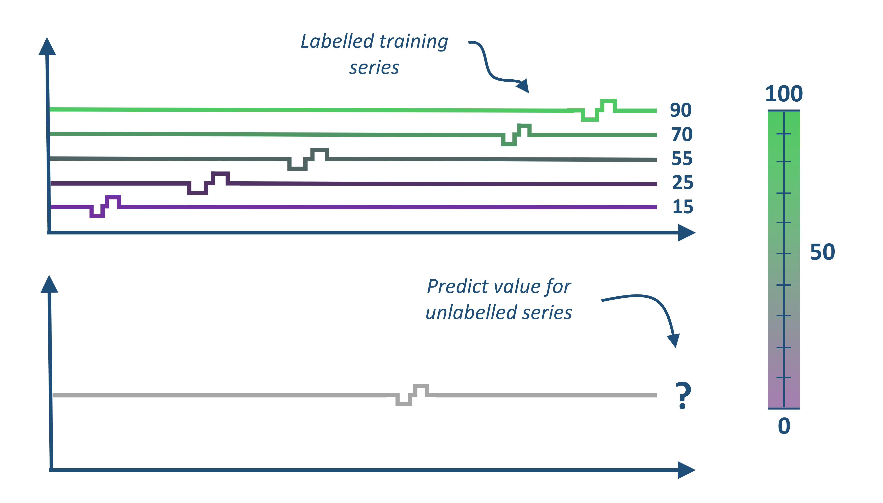
Time Series Classification and Regression
ECML/PKDD 2024 Tutorial
Labelled training series
Classify unlabelled series
?
Our aim is to give you an overview of recent the algorithmic developments in these fields and an idea about how to uses these algorithms to mine collections of time series
We do not cover how to deal with unequal length series, missing values or data sampled at different frequencies. We do also not discuss in detail efficiency and scalability

