Slide 1
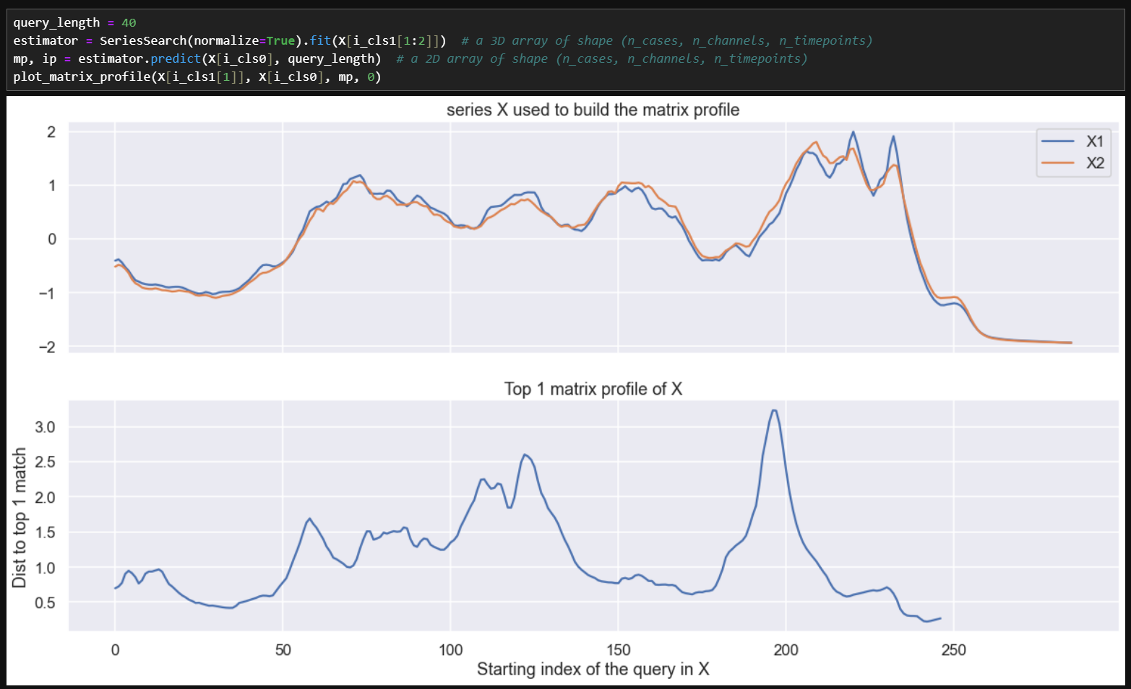
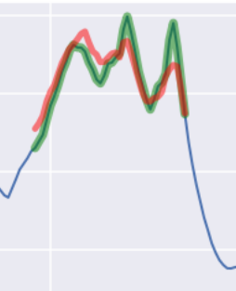
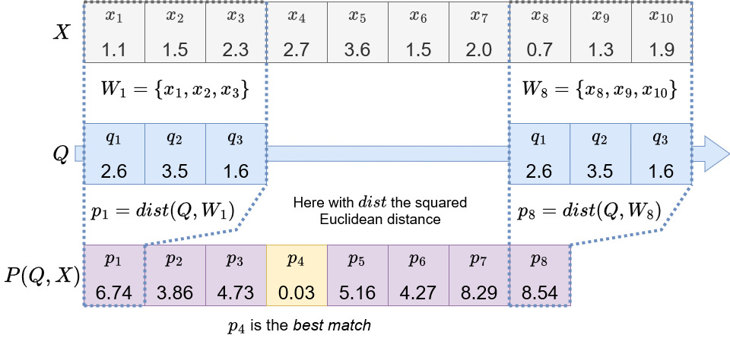
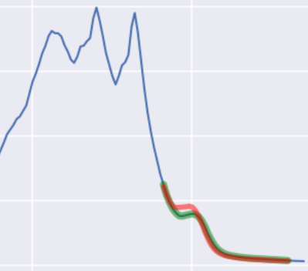
Similarity search
ECML/PKDD 2024 Tutorial
What we will cover today :
The different kind of similarity search tasks with example use cases
Some benchmarking results
Current state of the aeon similarity search API
Plans for the future
What we won’t cover today :
Mathematical details behind the computational optimisation (see example notebooks in aeon)
The full state-of-the-art review
Expand on the uses of matrix profiles (Next section will cover some of them !)
https://aeon-tutorials.github.io/ECML-2024/

Slide 2
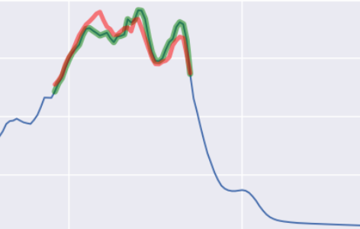
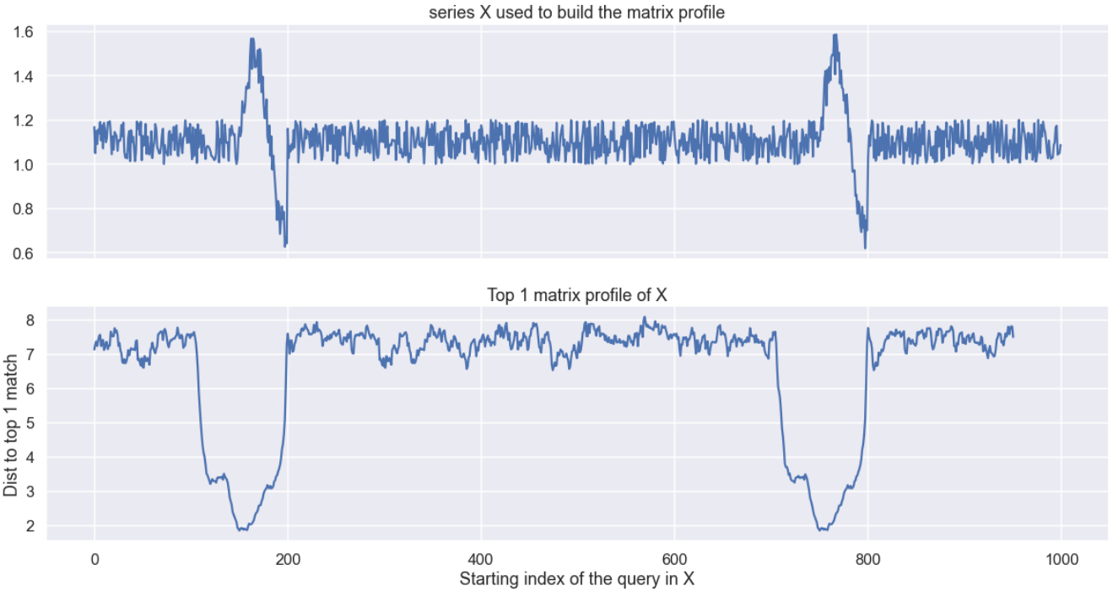
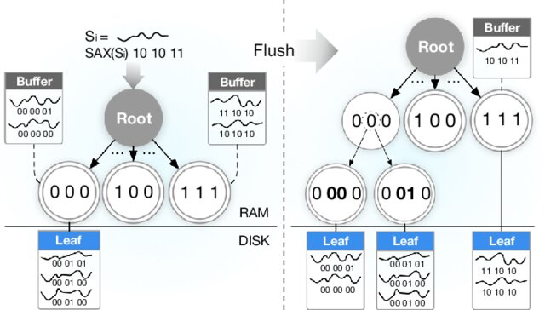

The different tasks
ECML/PKDD 2024 Tutorial
Query Search
Given a query, find its best (or worse) matches in a time series dataset.
Series Search
Given a time series, find the matches of all queries of size L in a time series dataset.
Index Search
Given a time series dataset, build an index to perform similarity search tasks.
Image from [1]

Slide 3

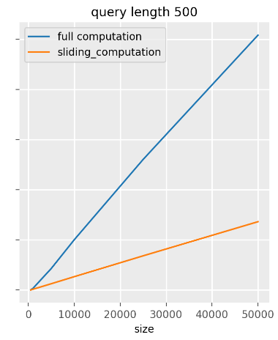
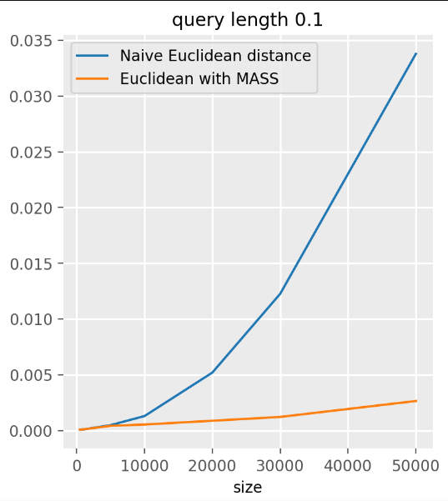
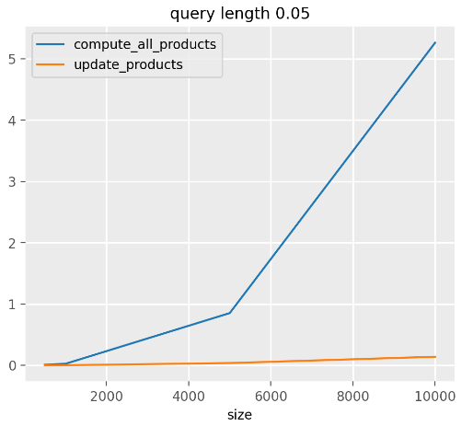
Interest for other fields
(a.k.a. why should I care?)
ECML/PKDD 2024 Tutorial
Computing similarity is a common task in time series machine learning (e.g. distance-based algorithms, shapelets, etc.). Computational optimisation from similarity search can also be used in these other methods.
Mean and std of the subsequences
of a time series
Euclidean distance between a query and the subsequences of a time series
Dot products between a query a the subsequences of a time series

Slide 4
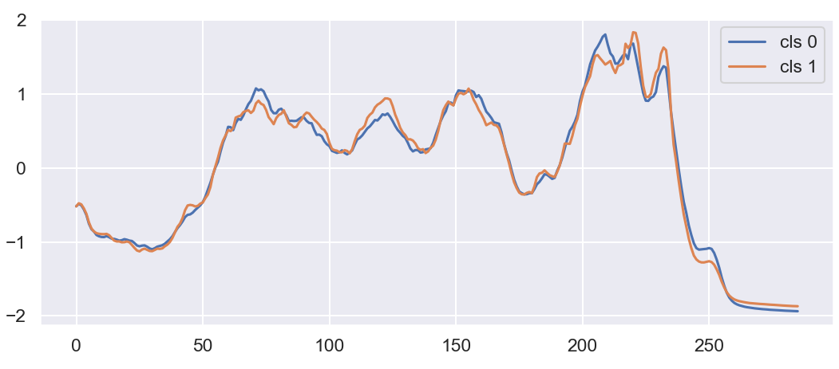
Dataset used
ECML/PKDD 2024 Tutorial
Coffee dataset : a food spectrograph dataset used to classify food types in food safety and quality assurance applications. The coffee dataset has two classes to distinguish between Robusta (0) and Arabica (1) coffee beans

Slide 5
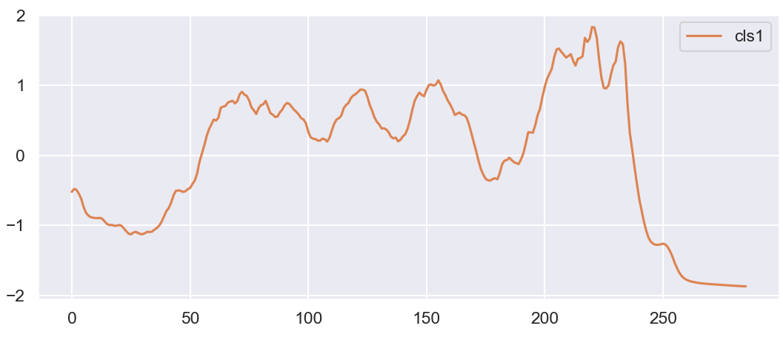
Dataset used
ECML/PKDD 2024 Tutorial
Coffee dataset : a food spectrograph dataset used to classify food types in food safety and quality assurance applications. The coffee dataset has two classes to distinguish between Robusta (0) and Arabica (1) coffee beans
This will be our Query for the next examples

Slide 6
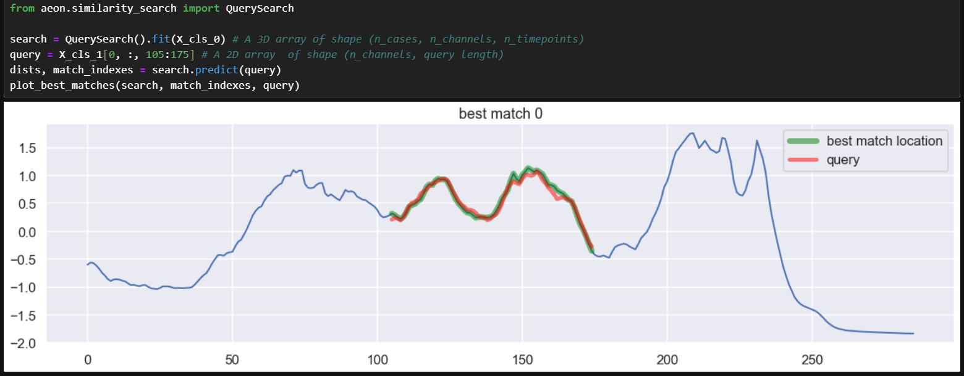
Query Search
ECML/PKDD 2024 Tutorial
Case 1 : What is the best match of this query ?

Slide 7
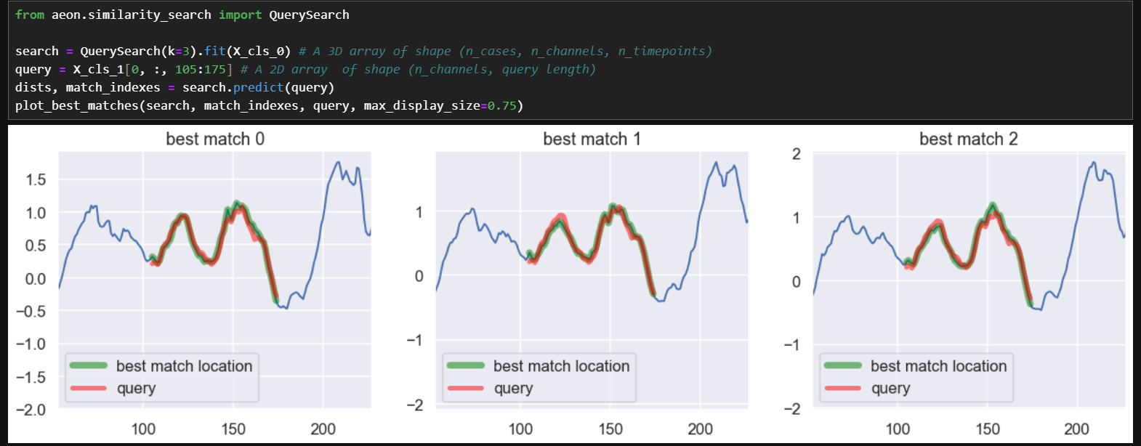
Query Search
ECML/PKDD 2024 Tutorial
Case 1.5 : What are the k-best match of this query ?

Slide 8
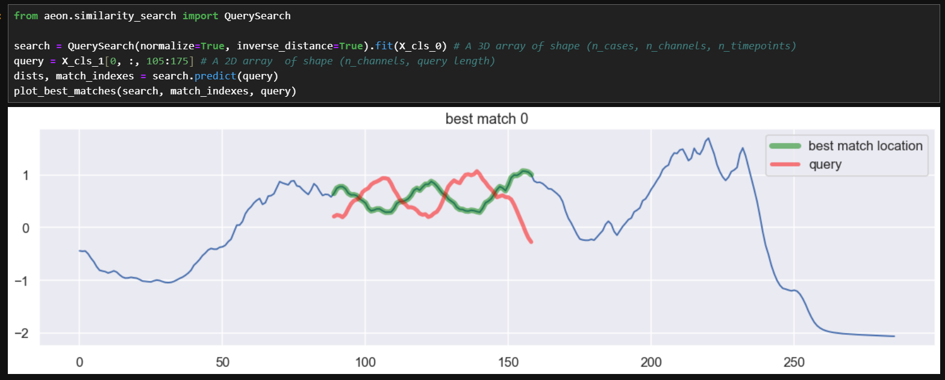
Query Search
ECML/PKDD 2024 Tutorial
Case 2 : What is the worst match of this query using a normalized distance?

Slide 9
Query Search
ECML/PKDD 2024 Tutorial
What is happening under the hood ?
This is also how a Shapelet would be used !

Slide 10
Query Search : current state
ECML/PKDD 2024 Tutorial
Query search API :
inverse distance : to find best or worst matches
normalize : whether to compute a z-normalized distance
distance : which distance function to use (can provide your own)
k & threshold : the matching conditions
speedup : which distance profile implementation to use
Current implementations :
generic implementation for any distance
MASS [cite] for :
(z-normalized) Euclidean
(z-normalized) Squared
supported inputs :
univariate and multivariate time series
equal and unequal length time series

Slide 11
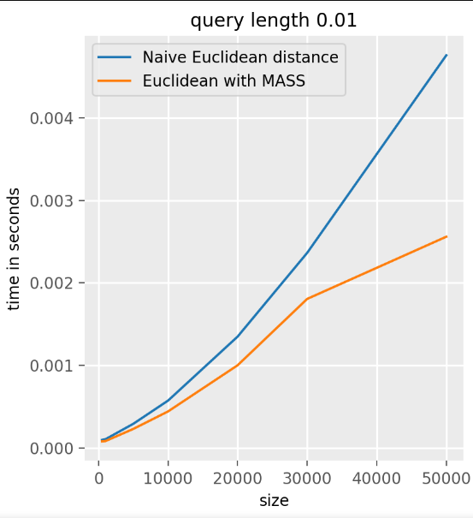
Benchmark for MASS
ECML/PKDD 2024 Tutorial
query length as a fraction of the input size
x-axis : size of the input time series

Slide 12
Query Search : future plan
ECML/PKDD 2024 Tutorial
API options :
Channel dependent or independent distance computations
Planned implementations:
Early abandoning and pruning for elastic distances [2]
Optimized lower bounding computation for elastic distances when using sliding subsequences
CUDA Kernels to leverage GPUs
More code optimisations :
Due to the versatility of the API, some part of the code are not as optimal as they could be

Slide 13
Series Search
ECML/PKDD 2024 Tutorial
Case 1 : motifs and discords between two time series
Notes:
Query search allows us to find relationships between a subsequence and a (collection of) time series
Series search allows us to search for relation between a time series and a (collection of) time series given a length parameter

Slide 14
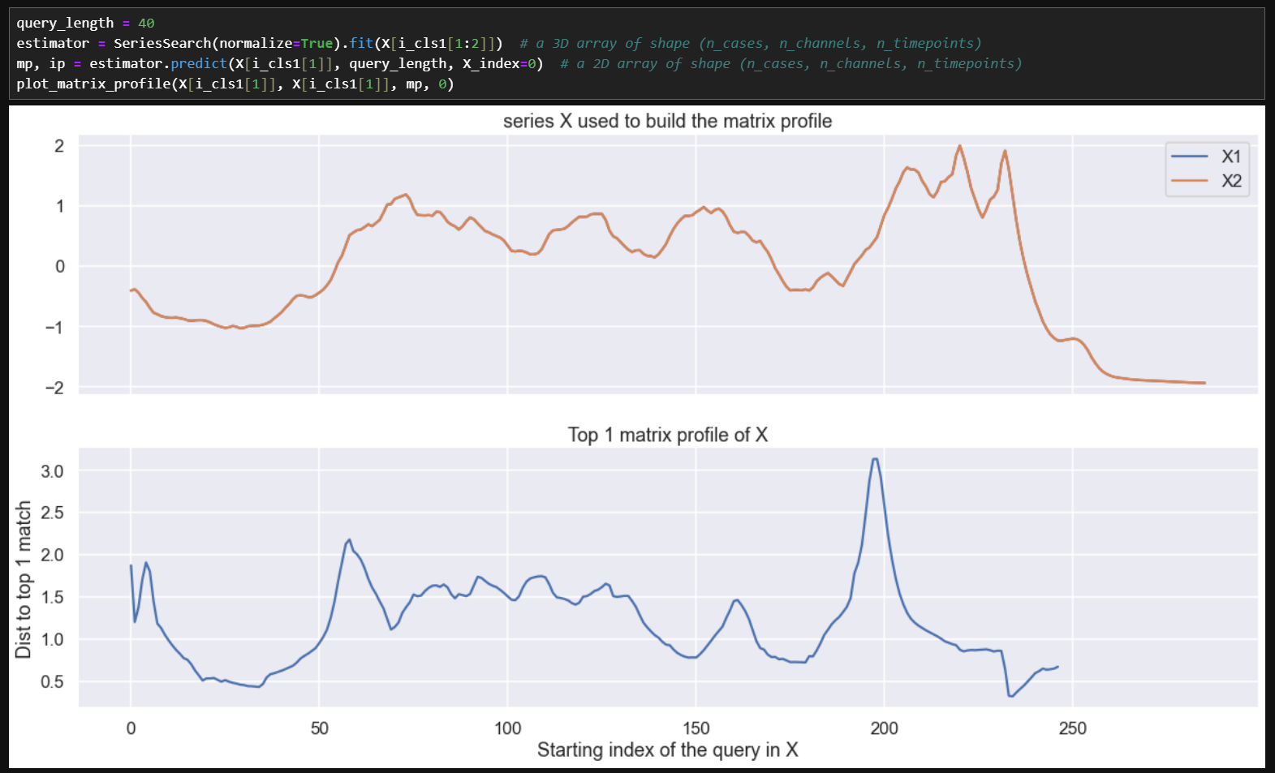
Series Search
ECML/PKDD 2024 Tutorial
Case 2 : motifs and discords in the same time series
discord in X1
a repeating motif in X1
Notes:
It is possible to perform self-similarity search, in that case, we must take care of self-matches.
Otherwise, the matrix profile would have been full of 0

Slide 15
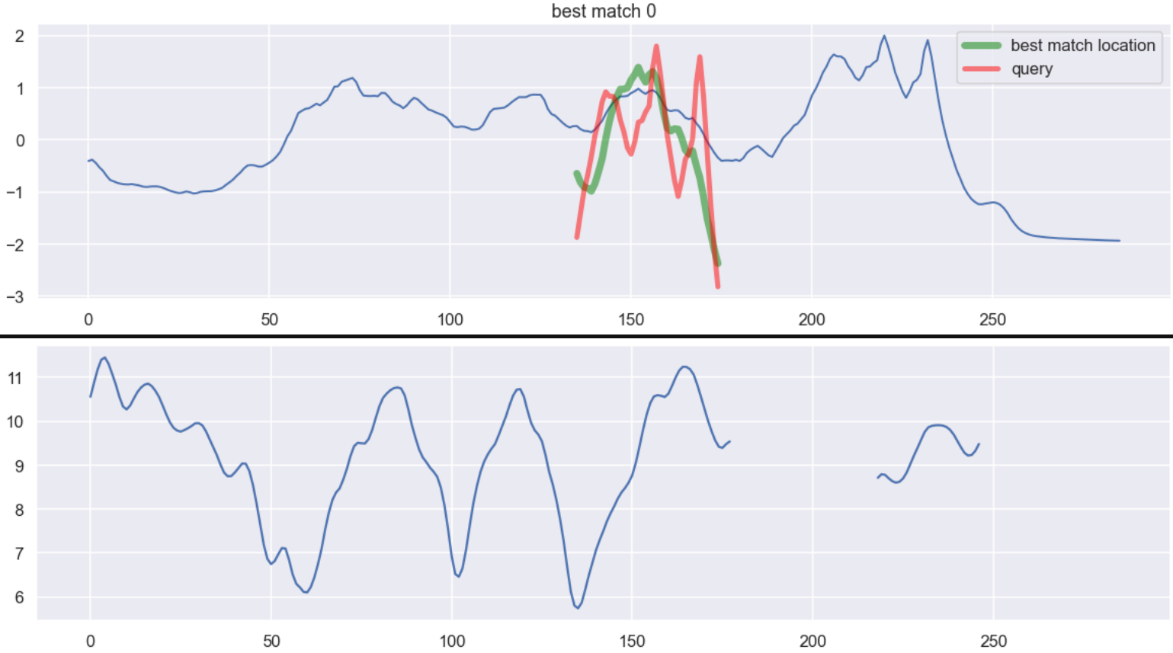
Series Search
ECML/PKDD 2024 Tutorial
Case 2 : motifs and discords in the same time series
Visualization is made with z-normalized query and match
discord in X1
min of the distance profile
a repeating motif in X1
Notes:
It is possible to perform self-similarity search, in that case, we must take care of self-matches.
Otherwise, the matrix profile would have been full of 0

Slide 16
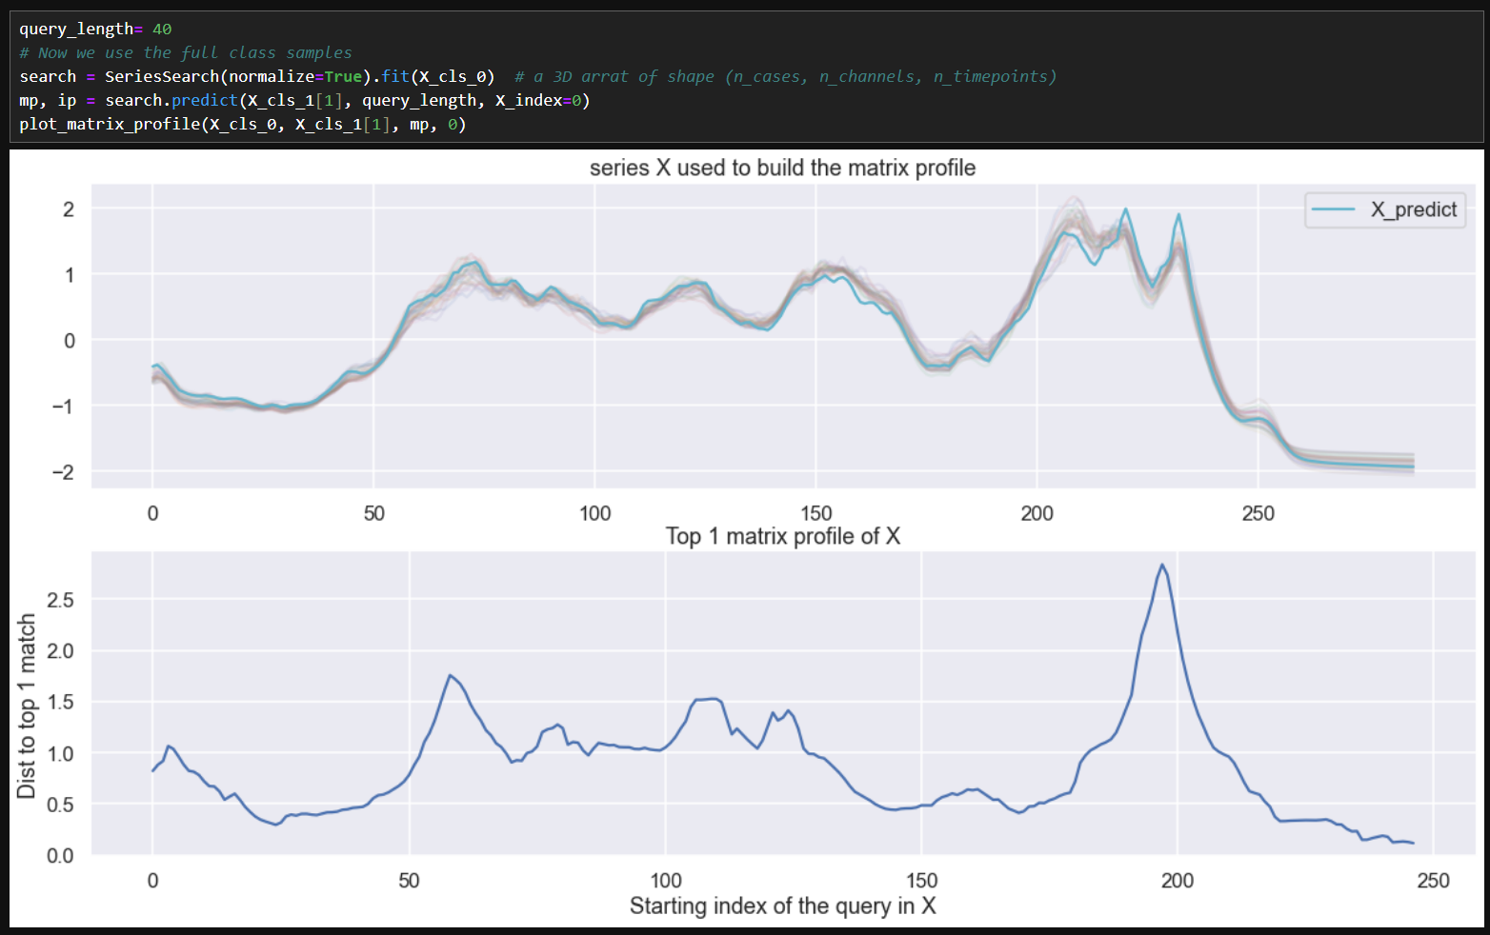
Series Search
ECML/PKDD 2024 Tutorial
Case 3 : motifs and discords to the other class
Notes:
It is possible to perform self-similarity search, in that case, we must take care of self-matches.
Otherwise, the matrix profile would have been full of 0

Slide 17
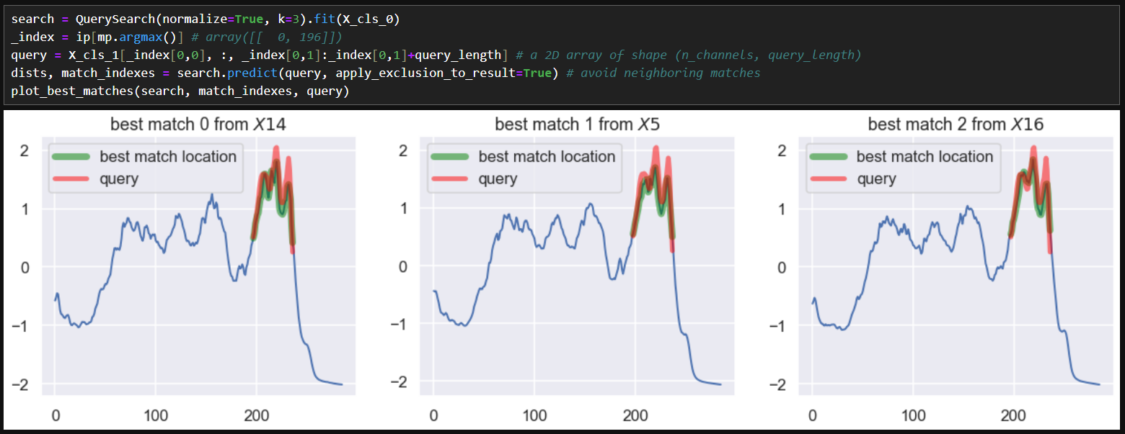
Series Search
ECML/PKDD 2024 Tutorial
Case 3 : motifs and discords to the other class
Notes:
It is possible to perform self-similarity search, in that case, we must take care of self-matches.
Otherwise, the matrix profile would have been full of 0

Slide 18
Series Search : current state
ECML/PKDD 2024 Tutorial
Series search API :
inverse distance : to find best or worst matches
normalize : whether to compute a z-normalized distance
distance : which distance function to use (can provide your own)
k & threshold : the matching conditions
speedup : which matrix profile implementation to use
Current implementations :
generic implementation for any distance
STOMP [3] for :
(z-normalized) Euclidean
(z-normalized) Squared
Supported inputs :
univariate and multivariate time series
equal and unequal length time series

Slide 19
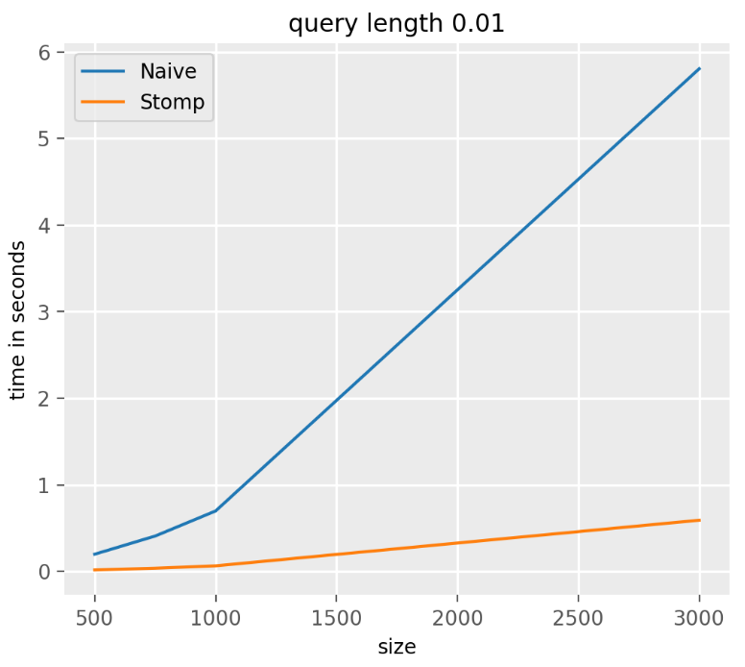
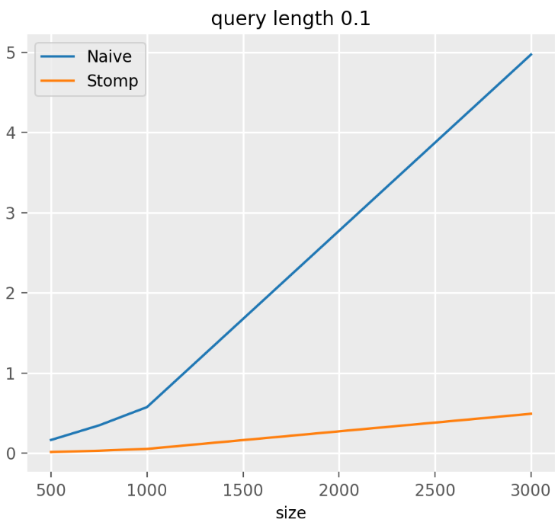
Benchmark for STOMP
ECML/PKDD 2024 Tutorial
query length as a fraction of the input size
x-axis : size of the input time series

Slide 20
Series Search : Future plan
ECML/PKDD 2024 Tutorial
Planned implementations:
The diverse matrix profile implementations for Euclidean and DTW [4]
Attempt to generalize their DTW approach to other elastic distances
STOMP optimisations and refactoring
The current implementation is a bit messy, and could use some optimisations and refactoring

Slide 21
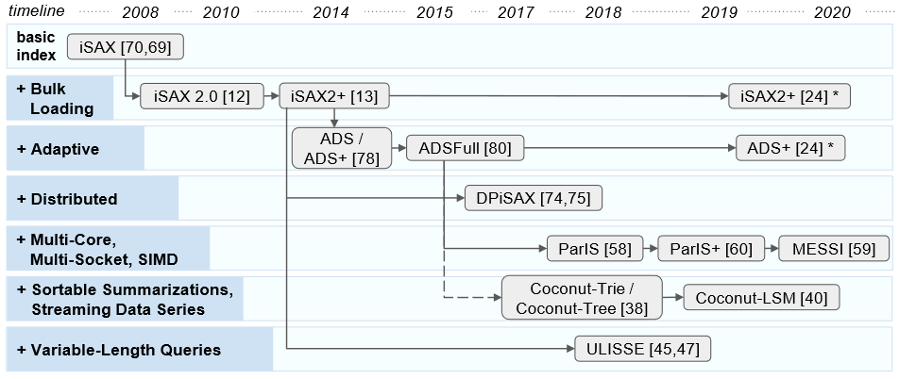
Index Search : future plans
ECML/PKDD 2024 Tutorial
Planned implementations:
We’ll start with the iSAX familly of methods [5]

Slide 22
References
ECML/PKDD 2024 Tutorial
[1] Coconut: sortable summarizations for scalable indexes over static and streaming data series. Kondylakis, H., Dayan, N., Zoumpatianos, K. et al. VLDB Journal 28 (2019)
[2] Early abandoning and pruning for elastic distances including dynamic time warping Matthieu Herrmann, Geoffrey l. Webb. Data Min Knowl Disc 35 (2021).
[3] Matrix Profile II: Exploiting a Novel Algorithm and GPUs to break the one Hundred Million Barrier for Time Series Motifs and Joins. Yan Zhu et al. ICDM (2016)
[4] https://www.cs.ucr.edu/~eamonn/MatrixProfile.html
[5] Evolution of a Data Series Index. Themis Palpanas. ISIP (2019)

