Slide 1



















An Introduction to Machine Learning from Time Series
ECML 2024 Workshop
https://aeon-tutorials.github.io/ECML-2024/
Germain Forestier
Tony Bagnall
Ali Ismail-Fawaz
Matthew Middlehurst
Arik Ermshaus
Antoine Guillaume
Patrick Schäfer
Sebastian Schmidl
Phillip Wenig
Thorsten Papenbrock
David Guijo Rubio

Slide 2
Growing Popularity

Slide 3
But everything is growing …

Slide 4
Detrended: Relative Popularity
1000*(matching Time Series + TERM)/(matching THE)
from Web of Science (2000-2022)

Slide 5
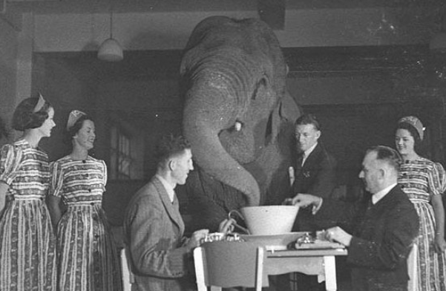
What about forecasting?
We are about to remove the current forecasting
module and replace it with a numpy based
machine learning oriented module

Slide 6
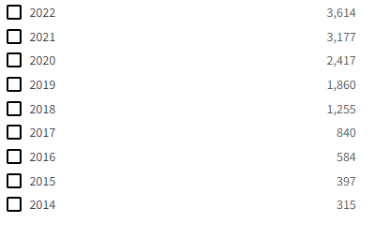
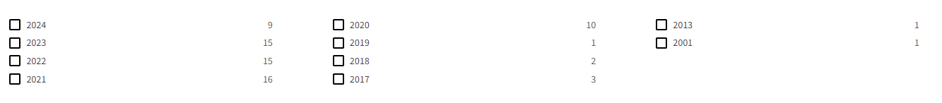
“Time Series Machine Learning” is not really used yet
Search: time series machine learning
Search: “time series machine learning”

Slide 7


aeon: get involved
aeon version 0.11.0 just released with 19 contributors, seven new from release 0.10.0. We have 13 core developers from
1. academia: Provide a framework for easy development of new ideas and to encourage reproducibility
Contributing your code to aeon increases your impact
We are not gatekeepers: if its published and the code is correct, it can come in
2. Industry and scientists: Allow easy access to latest algorithms
3. Education: provide centralised teaching material for undergraduate and postgraduate modules
If you use aeon in your research or teaching, let us know

Slide 8
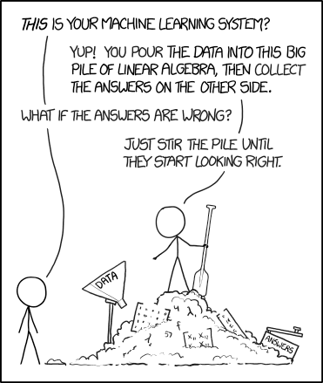
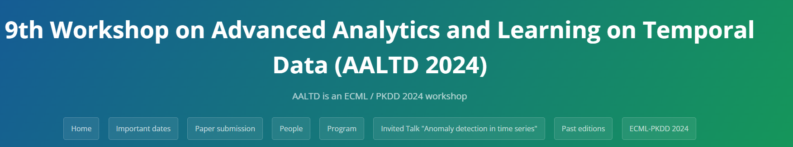
Thank you for attending this tutorial, hope to see you Friday/ Any questions?
https://ecml-aaltd.github.io/aaltd2024/

