Slide 1
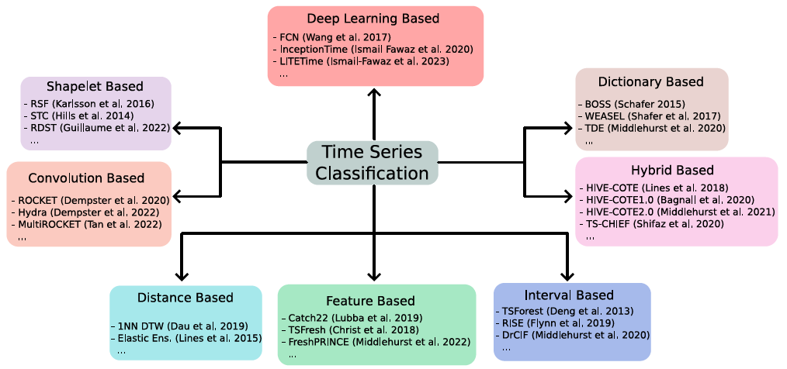
KDD 2024 Workshop
Conclusions

Slide 2
Time Series Classification
KDD 2024 Workshop
Labelled training series
Classify unlabelled series
?

Slide 3
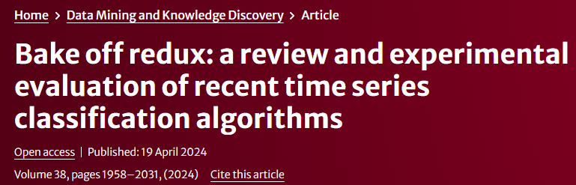
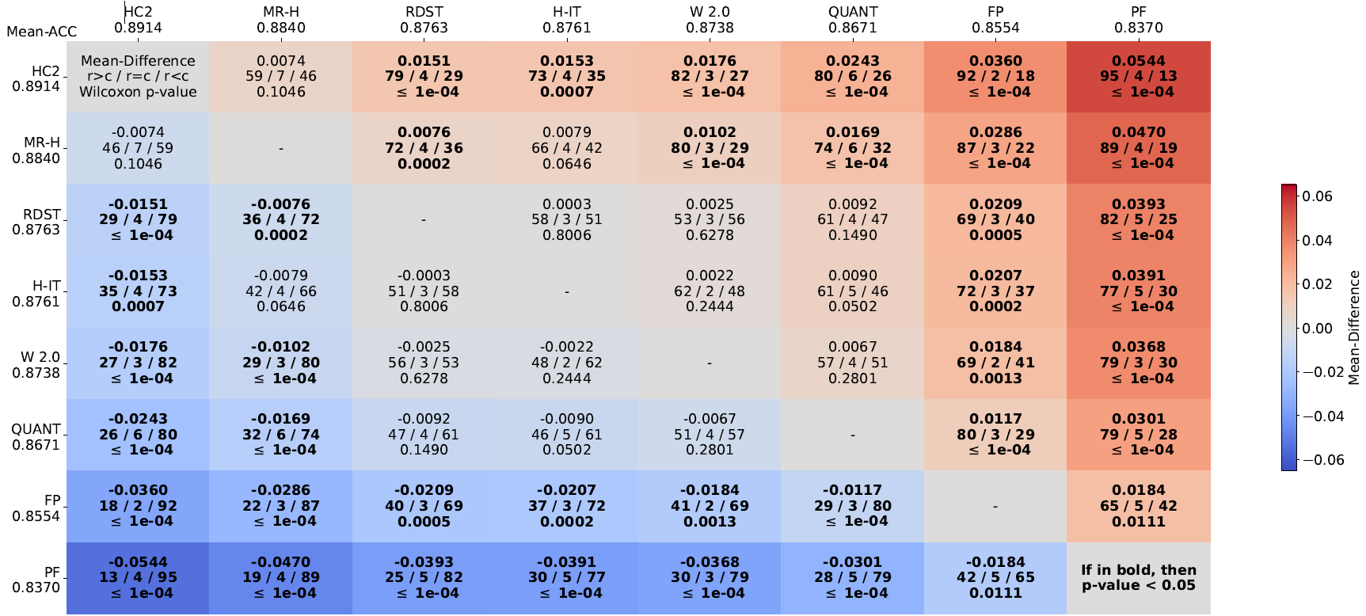
TSC Bake off Redux (2024)
https://link.springer.com/article/10.1007/s10618-024-01022-1

Slide 4
TSC Bake off redux conclusions
https://link.springer.com/article/10.1007/s10618-024-01022-1
MultiRocket-Hydra (MR-H) and HC2 best performing on average
HC2 on average 12% more accurate than 1NN-DTW (SOTA in 2014)
H-InceptionTime best of deep learners
RDST, Weasel2.0 (W 2.0), QUANT, FreshPrince (FP) and Proximity Forest (PF) best in class, but don’t discount the other algorithms
There is no one model to rule them all
HC2 much slower than MR-H
HC2 better at estimating probabilities
HC2 (marginally) better with small train sets, MR-H (marginally) better with large train sets
Results broadly replicated on 30 new datasets

Slide 5
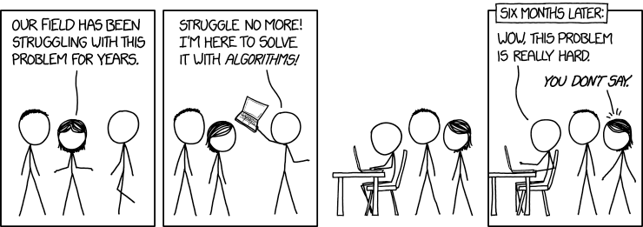
TSC Future Directions?
Improved algorithms for each approach
Wider use cases: multivariate, unequal length, missing values, different sampling rates, non IID datasets
Scalability: how to deal with large number of cases, channels and time points
On chip/edge: how to classify with very limited resources
XAI/Interpretability
Choosing an algorithm/class of algorithms for a single problem
Transfer learning and Bayesian inference
Expanding the archives, larger problems, and domain specific (EEG and HAR)
Foundation models

Slide 6
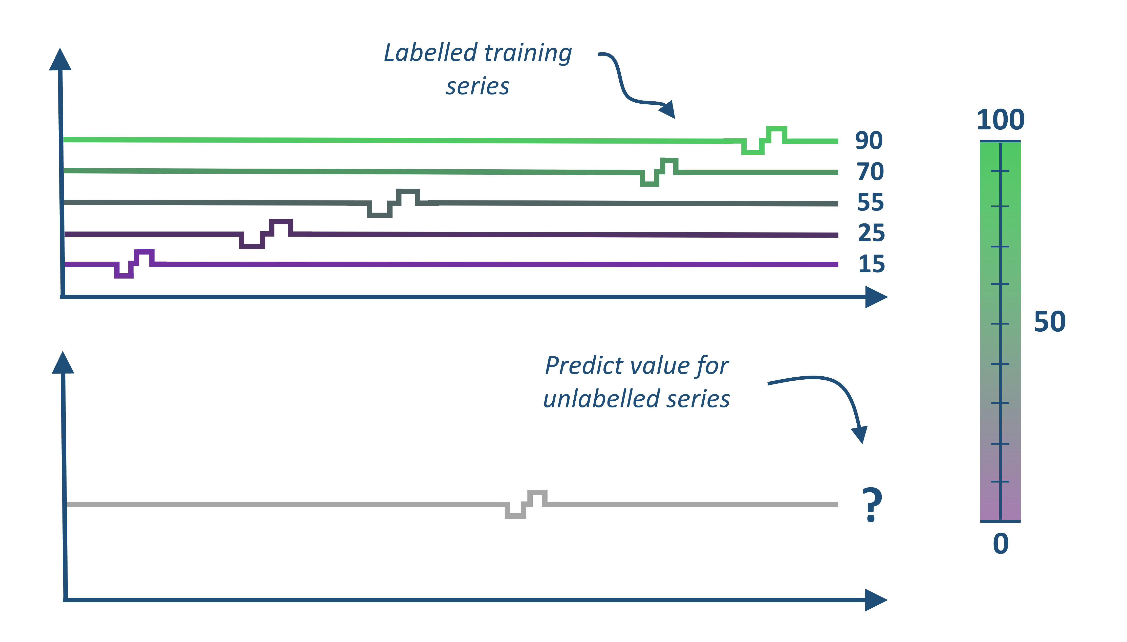
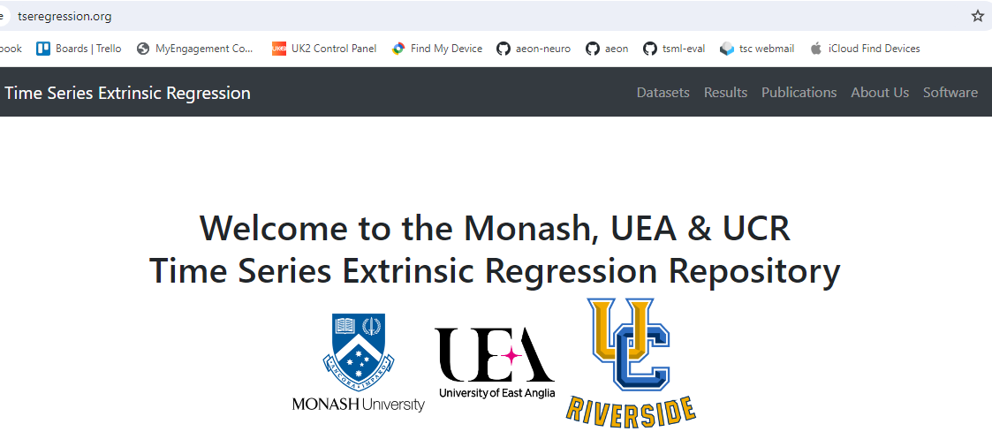
Time Series Extrinsic Regression (TSER)
KDD 2024 Workshop

Slide 7
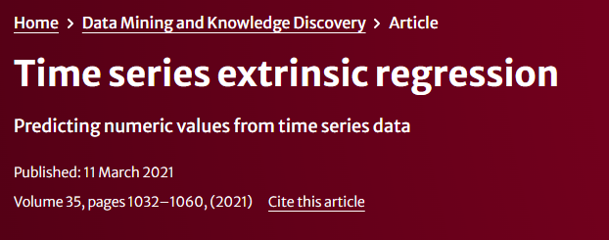
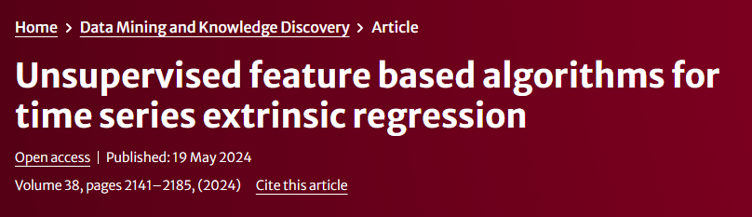
TSER is a new field
TSER first defined as distinct to window based forecasting in 2021.
Collated 19 TSER problems and compared a range of classifiers
Baseline estimators hard to beat
TSER archive recently expanded to 63 problems
Unsupervised pipeline classifiers adapted for regression

Slide 8
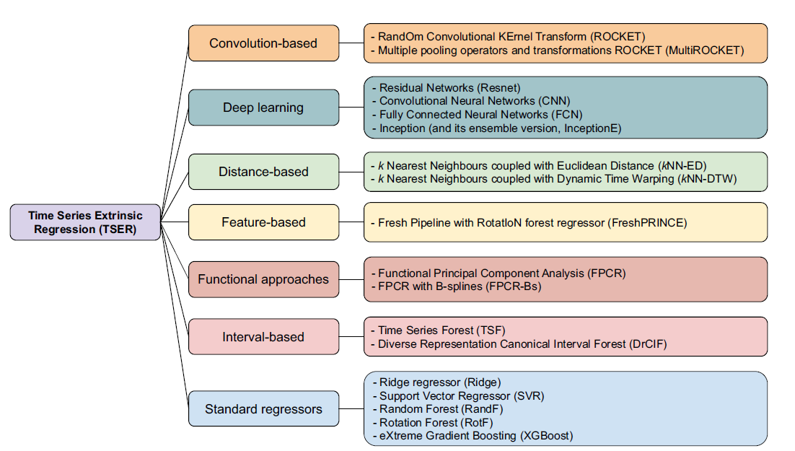
TSER Bake off (2024)
https://link.springer.com/article/10.1007/s10618-024-01027-w

Slide 9
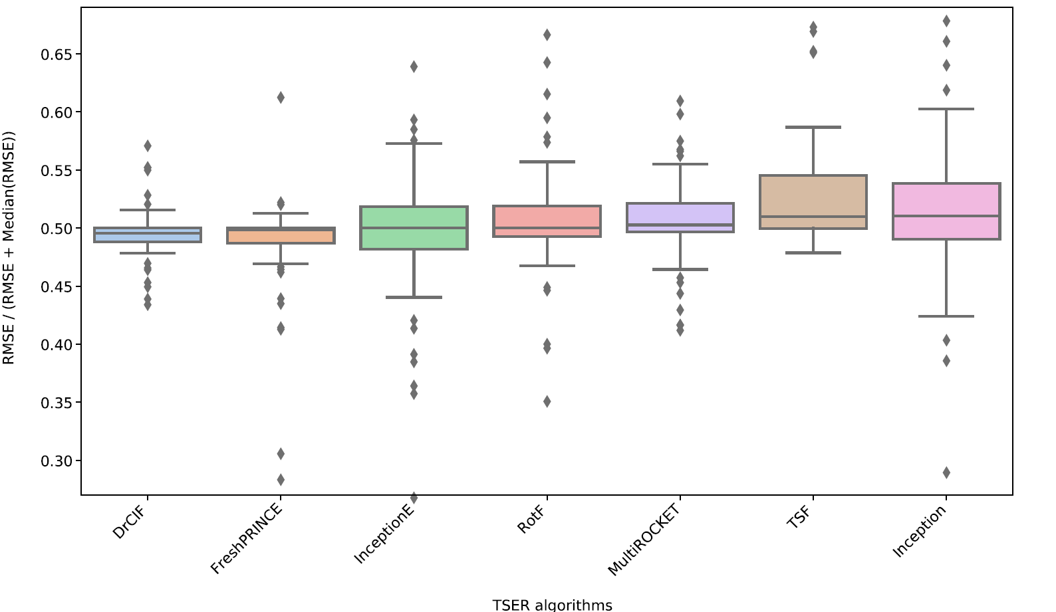
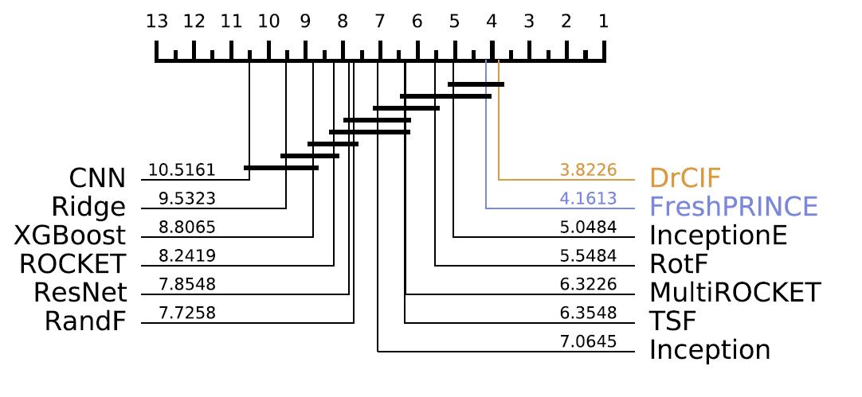
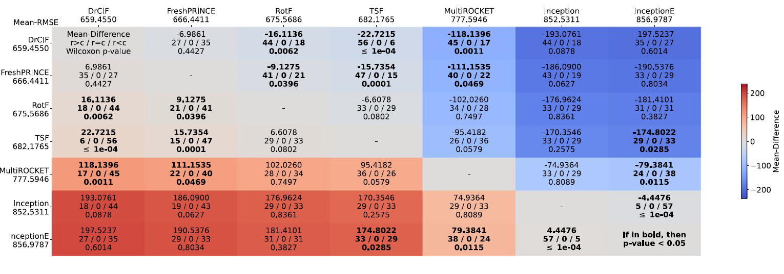
TSER Bake off results

Slide 10
TSER Bake off conclusions
DrCIF regressor the only one significantly better than a standard regressor (rotation forest adapted to regression)
InceptionTime has high variance, sometimes failing spectacularly (good overall rank, very bad average MSE)
Others may need regression specific adaptation

Slide 11
TSR/TSER Future Directions?
Huge scope for improvement
Adapt supervised transforms (shapelets) for regression
HIVE-COTE for regression
Make deep learners more robust
Exploit extra information from train estimates (residuals)
Try TSER algorithms for window based forecasting

Slide 12
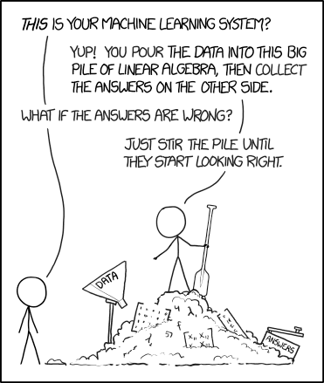


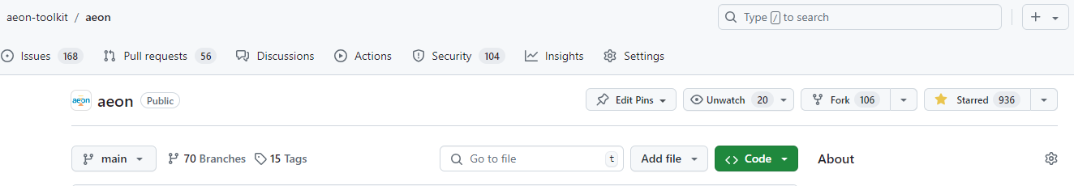
Thank you for attending this tutorial, Q&A to follow
aeon version 0.11.0 just released with 19 contributors, seven new from release 0.10.0.

