Slide 1
Feature-based approaches for time series machine learning
KDD 2024 Workshop
A Hands-on Introduction to Time Series Classification and Regression
Matthew Middlehurst
M.B.Middlehurst@soton.ac.uk
School of Electronics and Computer Science (ECS)
University of Southampton (Soton)

Slide 2
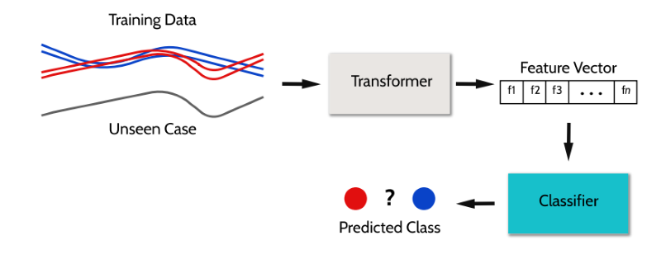
Pipeline Estimators
One of the easiest approaches is to just summarise the full set of series into a collection of feature vectors. Other categories also use pipelines, i.e. ROCKET.
(or numeric value)
(or regressor)

Slide 3
Simple Summary Statistics
We include statistics that average, select single values or are otherwise well-known and simple to understand in this category
Averages: mean, std, min, max, 25% percentile, 50% percentile, 75 % percentile
Percentiles: 2.15% percentile, 8.87% percentile, 25% percentile, 50% percentile, 75% percentile, 91.13% percentile, 97.85% percentile
Bowley: min, max, 10% percentile, 25% percentile, 50% percentile, 75% percentile, 90% percentile
Tukey: min, max, 12.5% percentile, 25% percentile, 50% percentile, 75% percentile, 87.5% percentile

Slide 4
Time Series Feature Extraction
Max
10
10
8
8
Max | Min | … | Mean | 25% Q | Class
10 | 3 | … | 5 | 10 | Blue
8 | 2 | … | 4 | 8 | Blue
10 | 2 | … | 5 | 4 | Red
8 | 1 | … | 4 | 2 | Red

Slide 5
Summary Statistic Collections
There are many feature collections available for time series, we will present 3 more here:
Seven number summary – 7 features (Small), efficient but simple
Catch22 - 22 features (Medium), subset of hctsa
TSFresh - ~800 features (Large), includes an algorithm for feature selection
hctsa - ~8000 features (Huge), powerful but sluggish

Slide 6


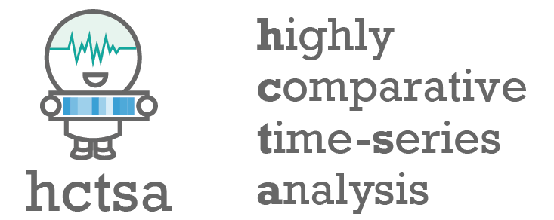
Highly Comparative Time-Series Analysis (hctsa)
hctsa feature set
Over 7700 features.
Only complete implementation is available in MATLAB.
https://github.com/benfulcher/hctsa
Fulcher, B.D. and Jones, N.S., 2017. hctsa: A computational framework for automated time-series phenotyping using massive feature extraction. Cell systems, 5(5), pp.527-531.

Slide 7

Canonical Time-series Characteristics (Catch22)
Catch22 feature set
22 features.
Implemented in C (and more, Python wrapper available). numba implementation available in aeon.
Subset of hctsa.
https://github.com/chlubba/catch22
Lubba, C.H., Sethi, S.S., Knaute, P., Schultz, S.R., Fulcher, B.D. and Jones, N.S., 2019. catch22: CAnonical Time-series CHaracteristics: Selected through highly comparative time-series analysis. Data Mining and Knowledge Discovery, 33(6), pp.1821-1852.

Slide 8
Example of Complex Summary Statistics (Catch22)
SB_BinaryStats_mean_longstretch1 (stretch_high) - Longest period of consecutive values above the mean
SP_Summaries_welch_rect_area_5_1 (low_freq_power) - Total power in lowest fifth of frequencies in the Fourier power spectrum
FC_LocalSimple_mean3_stderr (forecast_error ) – Mean error from a rolling 3-sample mean forecasting
DN_OutlierInclude_p_001_mdrmd (outlier_timing_pos) – Time intervals between successive extreme events above the mean
Further descriptions: https://time-series-features.gitbook.io/catch22/information-about-catch22/feature-descriptions

Slide 9

Time Series Feature extraction based on scalable hypothesis tests (TSFresh)
TSFresh feature set
Just under 800 features (no features selection).
Implemented in Python.
One of the more popular feature sets (Over 8000 GitHub start and 1000 citations)
https://github.com/blue-yonder/tsfresh
Christ, M., Braun, N., Neuffer, J. and Kempa-Liehr, A.W., 2018. Time series feature extraction on basis of scalable hypothesis tests (tsfresh–a python package). Neurocomputing, 307, pp.72-77.

Slide 10
Example of Complex Summary Statistics (TSFresh)
linear_trend_timewise - Calculate a linear least-squares regression for the values of the time series versus the sequence from 0 to length of the time series minus one
partial_autocorrelation - Calculates the value of the partial autocorrelation function at the given lag
sum_of_reoccurring_values - Returns the sum of all values, that are present in the time series more than once
longest_strike_above_mean - Returns the length of the longest consecutive subsequence in x that is bigger than the mean of x
Further descriptions: https://tsfresh.readthedocs.io/en/latest/text/list_of_features.html

Slide 11
TSFresh + Rotation forest (FreshPRINCE)
Despite its popularity, TSFresh does not show up in many comparisons in TSC algorithmic literature.
However, the feature set with a rotation forest base beats many of the feature sets shown here and more complex algorithms on benchmark data!
TSFresh for classification is not at all competitive according to previous experiments.
I'd invoke here "relevance justifies inclusion" rather than "performance justifies inclusion".
PS: "according to previous experiments" is not a scientific reference.
I'll take any bets you want on TSFresh+Random Forest against anything close to SOTA. I'll run the experiment next week.
Middlehurst, M. and Bagnall, A., 2022, May. The freshprince: A simple transformation based pipeline time series classifier. In International Conference on Pattern Recognition and Artificial Intelligence (pp. 150-161). Cham: Springer International Publishing

Slide 12
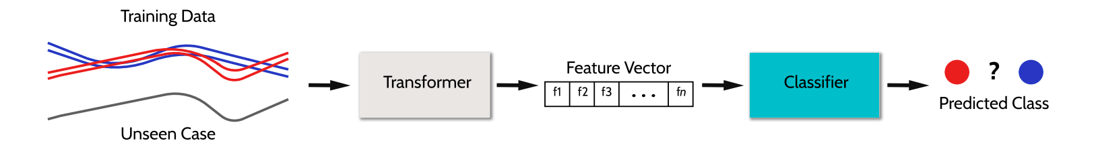
Pipeline Base Classifiers to Explore
Random forests are good, but it can be better!
Rotation Forest (RotF) – Generally good with numeric data.
Cross-validated Ridge Regression (RidgeCV) – Base estimator of ROCKET.
XGBoost – Estimator of Kaggle fame, generally strong.

Slide 13
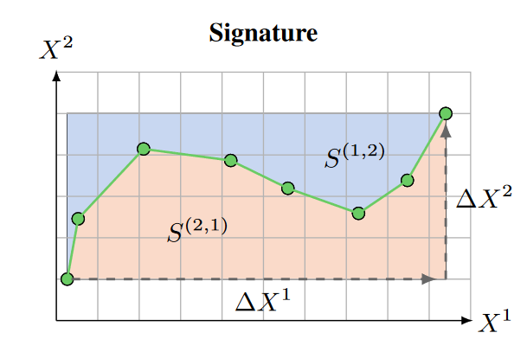
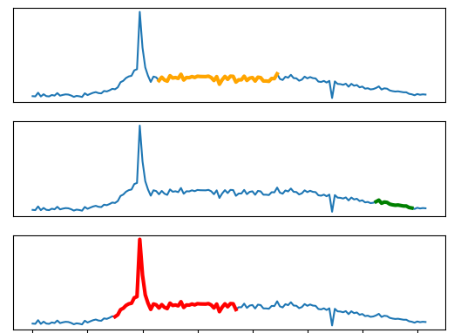
Other Unsupervised Transforms
Randomly Selected Intervals
Extract from subseries. Uses summary features but is a category of its own (see next topic)!
Generalised Signatures
Collections of ordered cross-moments, outputting 450 features. Not a summary feature set.

Slide 14
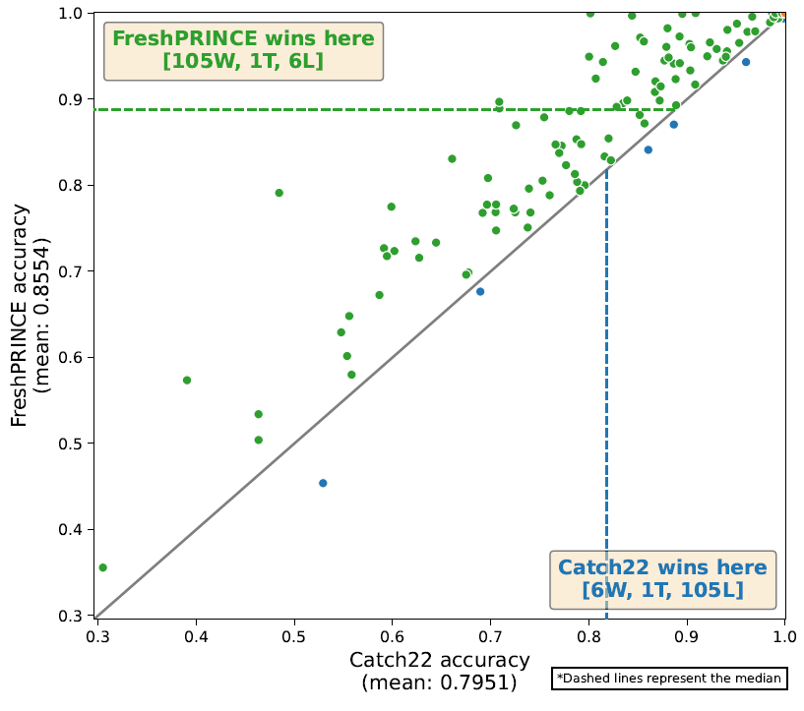
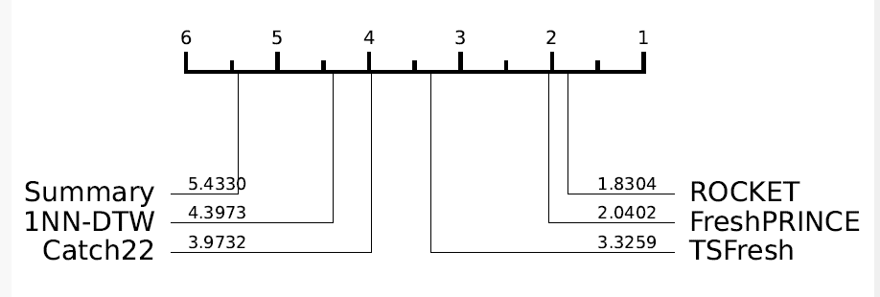
Feature Based Performance
While a lot faster, the smaller feature sets are usually perform worse.
Dau, H.A., Bagnall, A., Kamgar, K., Yeh, C.C.M., Zhu, Y., Gharghabi, S., Ratanamahatana, C.A. and Keogh, E., 2019. The UCR time series archive. IEEE/CAA Journal of Automatica Sinica, 6(6), pp.1293-1305.

Slide 15
Example code
M.Middlehurst@uea.ac.uk
See part4_feature_based.ipynb

