Slide 1
Interval-based approaches for time series machine learning
KDD 2024 Workshop
A Hands-on Introduction to Time Series Classification and Regression
Matthew Middlehurst
M.B.Middlehurst@soton.ac.uk
School of Electronics and Computer Science (ECS)
University of Southampton (Soton)

Slide 2
Time Series Feature Extraction
Max
10
10
8
8
Max | Min | … | Mean | 25% Q | Class
10 | 3 | … | 5 | 10 | Blue
8 | 2 | … | 4 | 8 | Blue
10 | 2 | … | 5 | 4 | Red
8 | 1 | … | 4 | 2 | Red

Slide 3
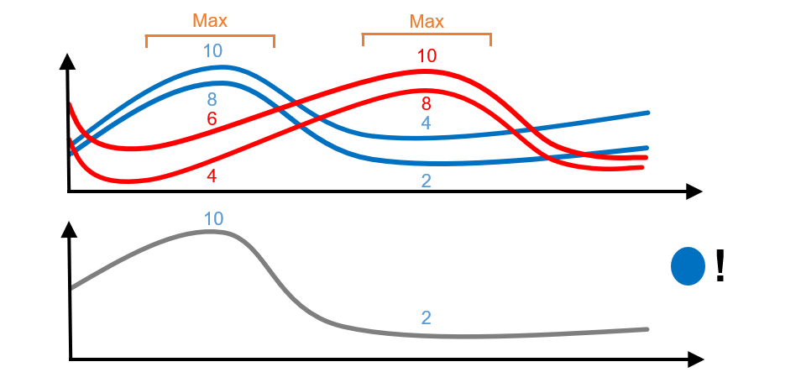
Time Series Intervals

Slide 4
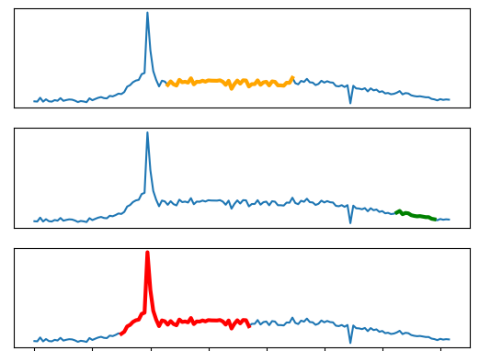
Time Series Intervals
Select multiple time interval subseries
These selected intervals are at the same timepoints for all series

Slide 5
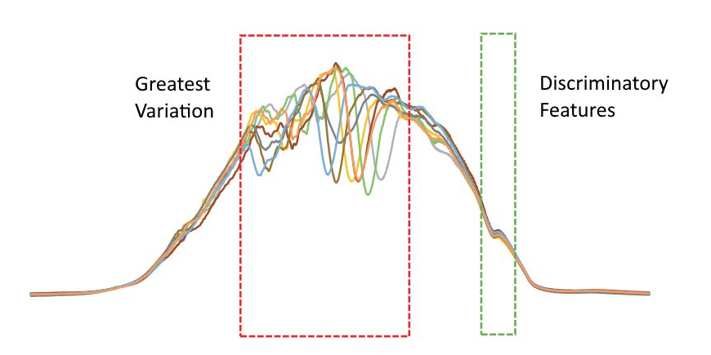
Why Intervals?

Slide 6
Interval-based Algorithms
While there are many interval-based approaches, we will focus on four:
Time Series Forest (TSF)
Diverse Representation Canonical Interval Forest (DrCIF)
Random Supervised Time Series Forest (R-STSF)
QUANT

Slide 7
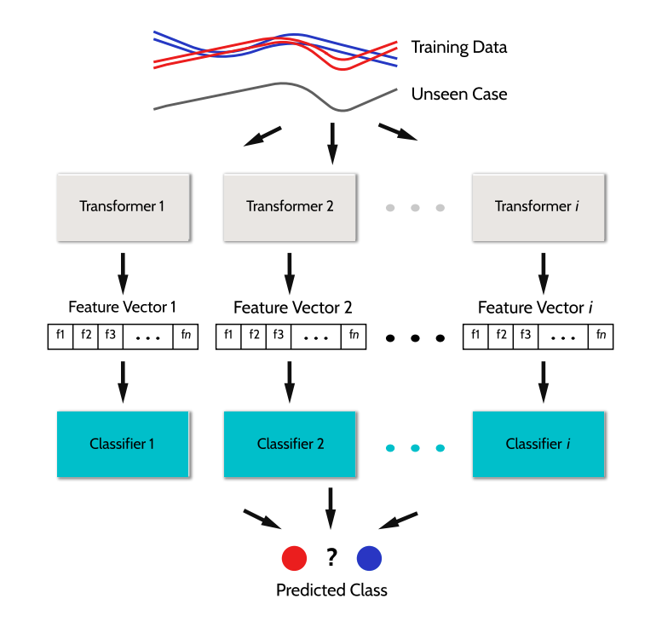
Time Series Forest (TSF)
Key features:
Ensemble of trees
Randomly selects intervals
Extracts simple summary statistics
One of the earliest interval-based approaches
Deng, H., Runger, G., Tuv, E. and Vladimir, M., 2013. A time series forest for classification and feature extraction. Information Sciences, 239, pp.142-153.

Slide 8
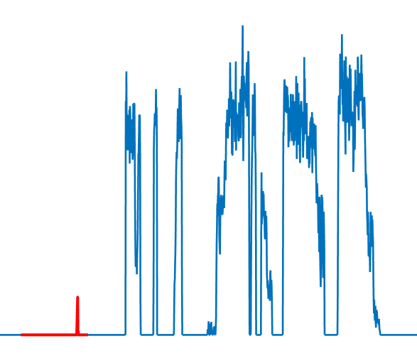
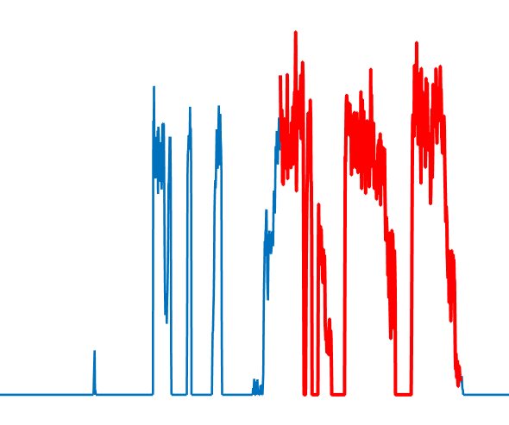
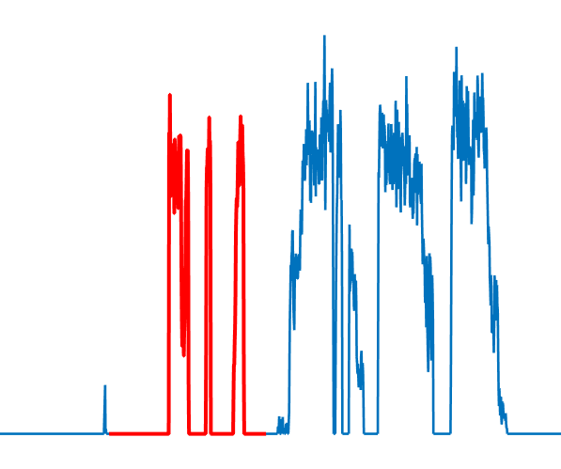
TSF Features Extraction
For each tree
Randomly select multiple intervals
Time Series
Use interval mean, standard deviation and slope as features
Mean 1 | stdev 1 | Slope 1 | Mean 2 | stdev 2 | Slope 2 | Mean 3 | stdev 3 | Slope 3
Extracted Features

Slide 9

Diverse Representation Canonical Interval Forest (DrCIF)
Key features:
Ensemble of trees and randomly selects intervals like TSF
Extracts the Catch22 features as well as simple summary statistics
Creates intervals for a transformed periodogram and first order differences
Middlehurst, M., Large, J., Flynn, M., Lines, J., Bostrom, A. and Bagnall, A., 2021. HIVE-COTE 2.0: a new meta ensemble for time series classification. Machine Learning, 110(11), pp.3211-3243. Middlehurst, M., Large, J. and Bagnall, A., 2020, December. The canonical interval forest (CIF) classifier for time series classification. In 2020 IEEE international conference on big data (big data) (pp. 188-195). IEEE.

Slide 10
Attribute Subsampling
Attributes are subsampled per tree for efficiency and to increase the diversity of the ensemble.
C22F1 | C22F2 | C22F3 | C22F4 | C22F5
C22F6 | C22F7 | C22F8 | C22F9 | C22F10
C22F11 | C22F12 | C22F13 | C22F14 | C22F15
C22F16 | C22F17 | C22F18 | C22F19 | C22F20
C22F21 | C22F22 | Mean | Stdev | Slope
Dimension 1
Dimension 2
Dimension 3
Dimension 4
Select 8 random attributes per tree.
Select a random dimension per interval (if multivariate).

Slide 11
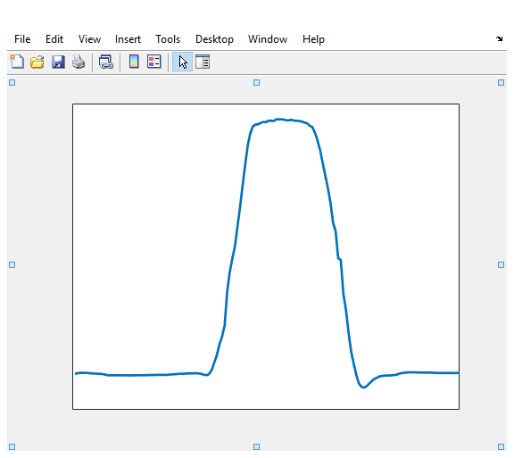
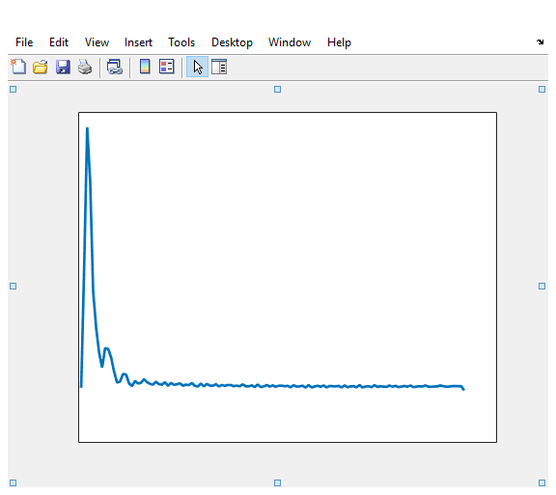
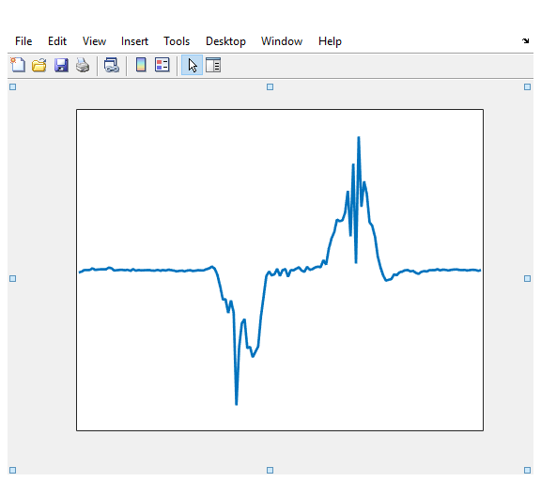
Series Transformations
As well as the original series, a periodogram and first order differences series are used to select features. The number of intervals is split between the three representations.
Base series
Power spectrum
First order differences

Slide 12
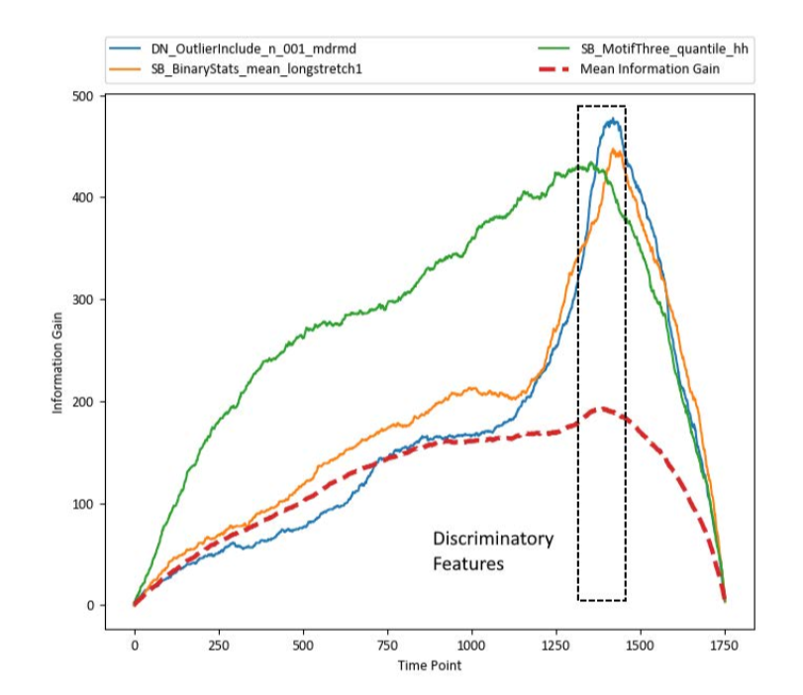
Visualising Interval Forests
Although intervals are randomly selected, the tree estimator can effectively select the most informative subseries features.

Slide 13
Random Supervised Time Series Forest (R-STSF)
Key features:
Pipeline classifier from extracted intervals
Extracts intervals using a supervised process
Extracts simple summary statistics
Uses a periodogram, first order differences and autoregressive series representation
0.55
0.7
0.9
0.6
0.6
0.8
Cabello, N., Naghizade, E., Qi, J. and Kulik, L., 2024. Fast, accurate and explainable time series classification through randomization. Data Mining and Knowledge Discovery, 38(2), pp.748-811.

Slide 14
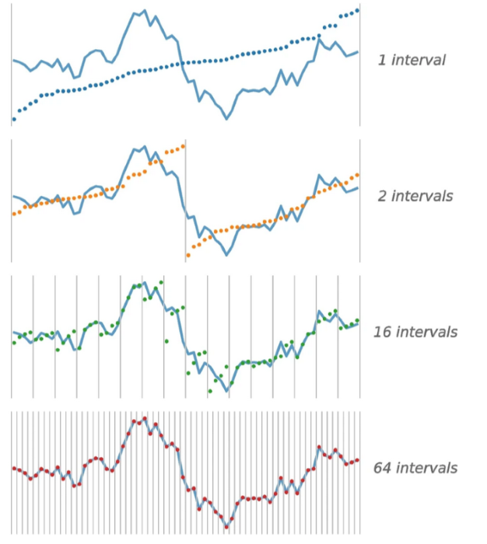
QUANT
Key features:
Pipeline classifier from extracted intervals
Extracts fixed dyadic intervals
Uses the quantiles of intervals as features
Extracts from multiple series representations like previous approaches.
Dempster, A., Schmidt, D.F. and Webb, G.I., 2024. Quant: A minimalist interval method for time series classification. Data Mining and Knowledge Discovery, pp.1-26.

Slide 15
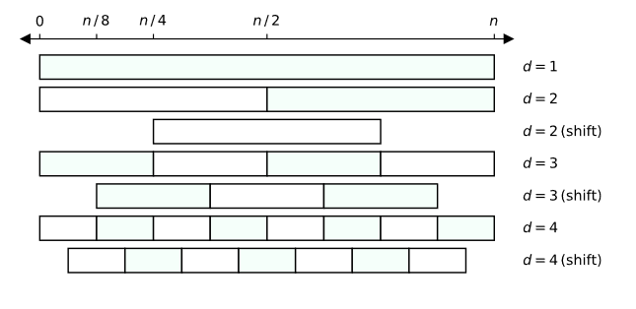
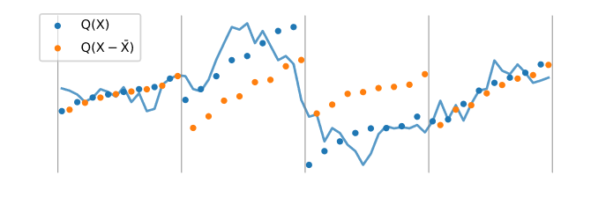
QUANT Features
Intervals are shifted by half their length for greater coverage of the series
Extracts mean normalised quantiles as well as absolute values.

Slide 16
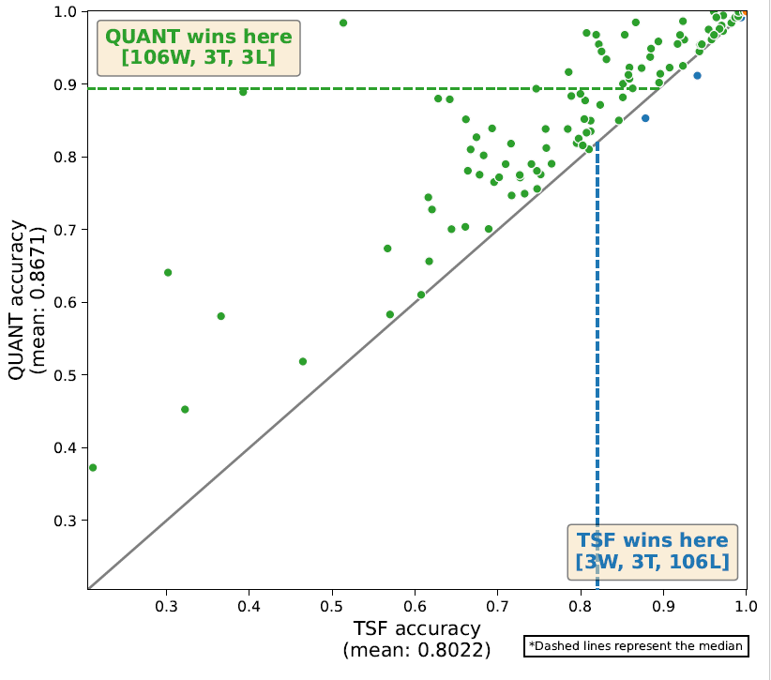
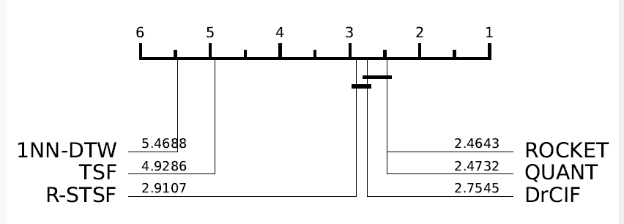
Interval Based Performance
Interval approaches have had a significant amount of improvement over time, with recent approaches eclipsing TSF on benchmark data.
Dau, H.A., Bagnall, A., Kamgar, K., Yeh, C.C.M., Zhu, Y., Gharghabi, S., Ratanamahatana, C.A. and Keogh, E., 2019. The UCR time series archive. IEEE/CAA Journal of Automatica Sinica, 6(6), pp.1293-1305.

Slide 17
Example code
M.Middlehurst@uea.ac.uk
See part5_interval_based.ipynb

