Slide 1
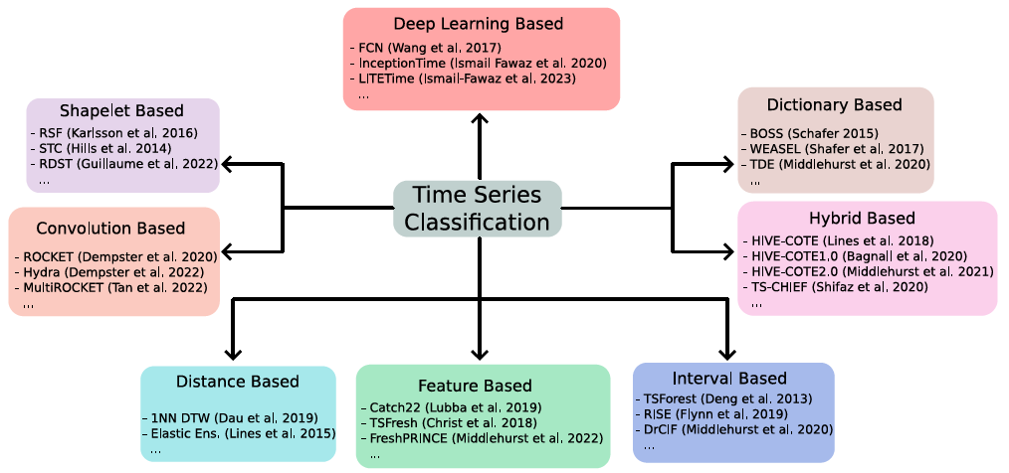
KDD 2024 Workshop
Part 9: Hybrids

Slide 2
KDD 2024 Workshop
Part 9: Hybrids
Many algorithms implicitly combine different representations
MultiRocket combines convolutions and dictionaries
MrSQM could be classed as dictionary or shapelet
TS-CHIEF combines distance and dictionary approaches
DrCIF and WEASEL use spectral features
This section focusses on meta ensembles that explicitly combine classifiers on strong classifiers built on each representation
Basic hypothesis:
If there is no prior knowledge as to the best approach, ensembling strong classifiers over different representations is the best approach

Slide 3
KDD 2024 Workshop
Collective of Transformation-based Ensembles (COTE)
Basic hypothesis: if there is no prior knowledge as to the best approach, ensembling strong classifiers over different representations is the best approach
Flat COTE [1]
HIVE-COTE alpha [2]
HIVE-COTE V1 [3]
HIVE-COTE V2 [4]
2016
2018
2020
2021
TS-CHIEF [5]
MultiRocket-Hydra [6]
[1] A Bagnall, J Lines, J Hills, A Bostrom, Time-series classification with COTE: the collective of transformation-based ensembles,
IEEE Transactions on Knowledge and Data Engineering 27 (9), 2522-2535, 2015
[2] J Lines, S Taylor, A Bagnall, Time series classification with HIVE-COTE: The hierarchical vote collective of transformation-based ensembles
ACM Transactions on Knowledge Discovery from Data (TKDD) 12 (5), 1-35, 2018
[3] A Bagnall, M Flynn, J Large, J Lines, M Middlehurst, On the usage and performance of the hierarchical vote collective of transformation-based ensembles version 1.0 (HIVE-COTE v1. 0), 5th ECML PKDD Workshop on Advanced Analytics and Learning on Temporal Data (AALTD), 2020
[4] M Middlehurst, J Large, M Flynn, J Lines, A Bostrom, A Bagnall, HIVE-COTE 2.0: a new meta ensemble for time series classification, Machine Learning 110 (11), 3211-3243, 2021
[5] A Shifaz, C Pelletier, F Petitjean, GI Webb, TS-CHIEF: a scalable and accurate forest algorithm for time series classification, Data Mining and Knowledge Discovery 34 (3), 742-775, 2020
[6] CW Tan, A Dempster, C Bergmeir, GI Webb, MultiRocket: multiple pooling operators and transformations for fast and effective time series classification, Data Mining and Knowledge Discovery 36 (5), 1623-1646, 2022

Slide 4
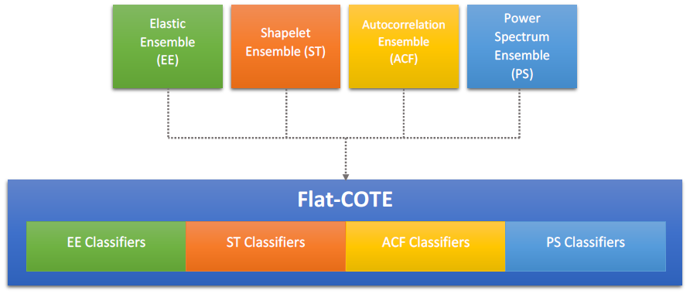
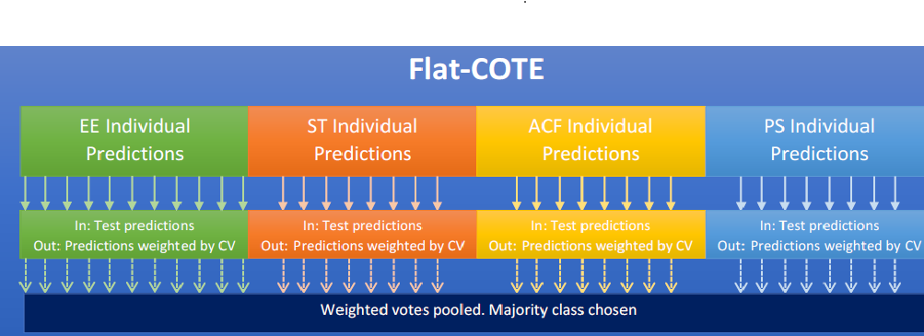
KDD 2024 Workshop
Flat-COTE (2015) [1]
Everything we had recently done chucked in an ensemble, with some frequency domain classifiers for good measure
Winner of first bake off
Very slow: full shapelet enumeration and distance based
Unstructured: more EE classifiers, greater weight in the ensemble.
1] A Bagnall, J Lines, J Hills, A Bostrom, Time-series classification with COTE: the collective of transformation-based ensembles IEEE Transactions on Knowledge and Data Engineering 27 (9), 2522-2535, 2015

Slide 5
KDD 2024 Workshop
Heterogeneous Ensembles
Basic hypothesis:
if there is no prior knowledge as to the best approach, ensembling strong classifiers over different representations is the best approach
Heterogeneous ensembles of a small number of strong estimators outperforms large homogeneous ensembles
Ensemble design
What estimators to use? Diversity though estimator choice
How to estimate component performance on train data? Cross validation is time consuming
What biases are introduced through these estimates?
How to combine estimates to get final predictions?

Slide 6
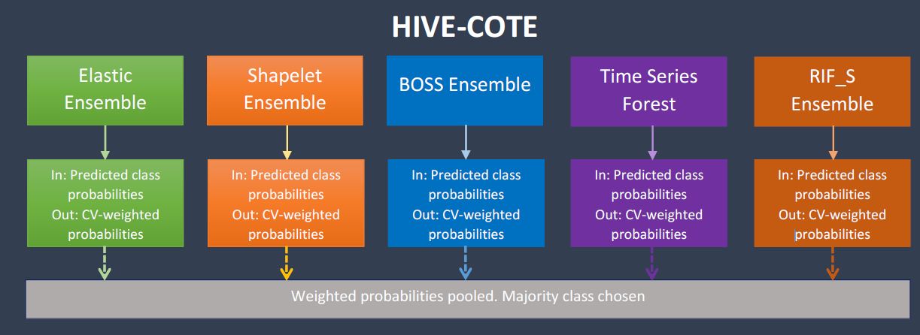
HIVE-COTE alpha (2018) [2]
Modularise into a meta ensemble: each component using a different approach
Adds dictionary based approach (BOSS)
Consolidates frequency domain approaches (RIF_S)
[2] J Lines, S Taylor, A Bagnall, Time series classification with HIVE-COTE: The hierarchical vote collective of transformation-based ensembles ACM Transactions on Knowledge Discovery from Data12 (5), 1-35, 2018

Slide 7
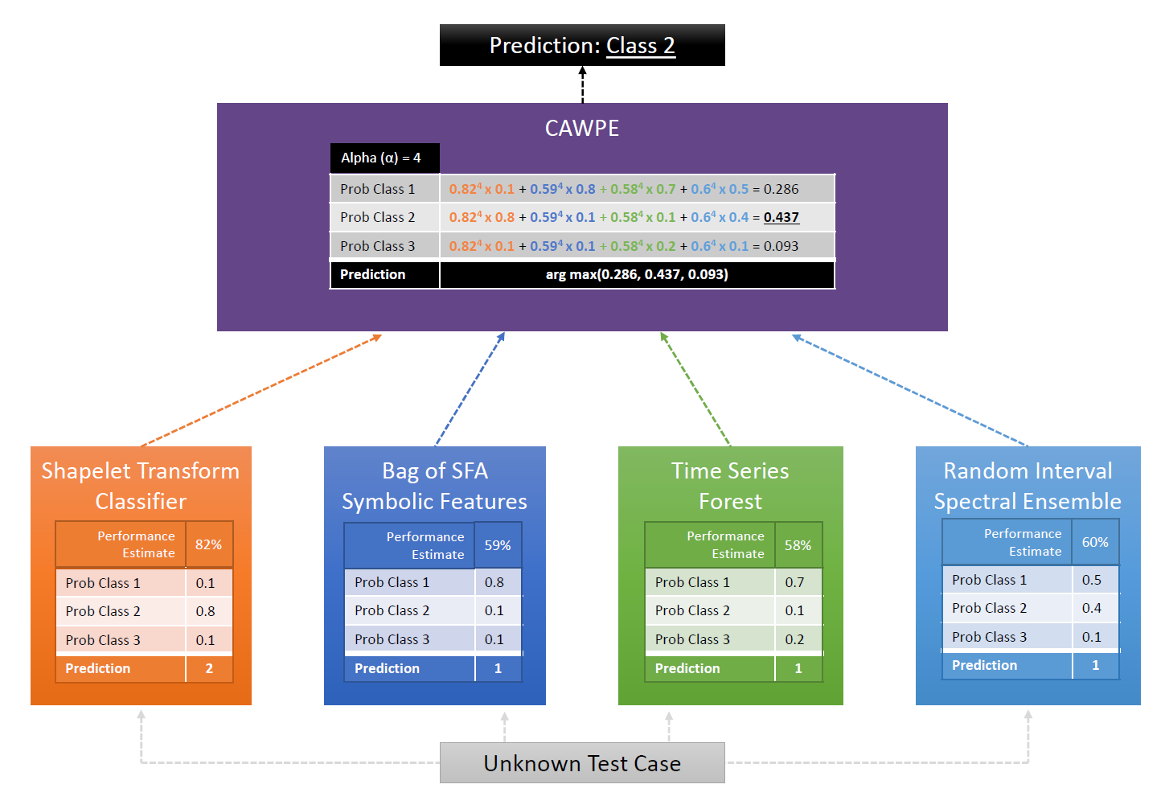
HIVE-COTE V1 (2020) [3]
Removed distance based Elastic Ensemble
Introduced a randomised shapelet transform
Introduced a new frequency based ensemble
[3] A Bagnall, M Flynn, J Large, J Lines, M Middlehurst, On the usage and performance of the hierarchical vote collective of transformation-based ensembles version 1.0 (HIVE-COTEV1.0) Advanced Analytics and Learning on Temporal Data: 5th ECML PKDD Workshop 2020

Slide 8
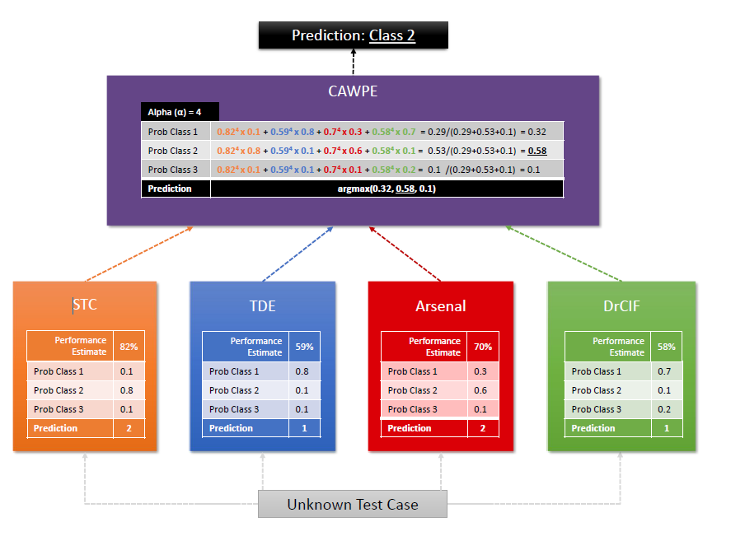
HIVE-COTE V2 (2021) [4]
Introduced a new dictionary classifier (TDE), convolution based (the Arsenal) and interval based (DrCIF)
Dropped spectral RISE (frequency domain embedded in other classifiers)
Improved methods for estimating accuracy from the train set
[4] M Middlehurst, J Large, M Flynn, J Lines, A Bostrom, A Bagnall. HIVE-COTE 2.0: a new meta ensemble for time series classification Machine Learning 110 (11), 3211-3243, 2021

Slide 9
Shapelet Based: Shapelet Transform Classifier (STC)
Randomly select dimension for each shapelet
IF data is multivariate
Start
Randomly select k shapelets
Keep top s shapelets by information gain
Concatenate distances to all shapelets
Build rotation forest classifier on features
End
ELSE
Design: Pipeline of supervised transformation and rotation forest classifier
Accuracy weighting: Do supervised transform, use rotation forest Out of Bag Accuracy as weight
Positive Bias? likely to be optimistic since weight found supervised transform

Slide 10
Interval Based: Temporal Dictionary Ensemble (TDE)
BOSS
Design: Ensemble of nearest neighbour classifiers using distance between histograms
Accuracy weighting: when fitting model, each base classifier produces a LOOCV estimate. These are combined to produce the overall estimate
Positive Bias? likely to be optimistic since weight found after optimisation process
cBOSS
S-BOSS
WEASEL
Revised ensemble structure.
Addition of spatial pyramids, new distance measure.
New word extraction techniques.
TDE
Gaussian process based parameter selection.

Slide 11
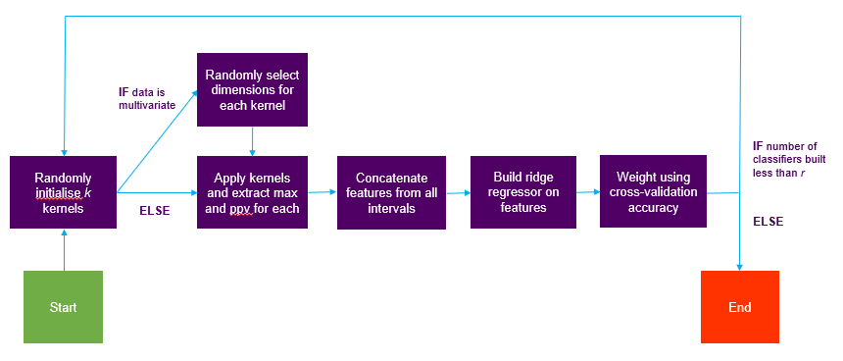
Convolution based: The Arsenal
Arsenal
RocketClassifier does not produce probability estimates, so our solution is to simply ensemble
ROCKET 1
ROCKET 2
ROCKET 3
ROCKET 4
2
3
2
4
Design: Ensemble of RocketClassifier pipeline classifiers
Accuracy weighting: Combine Out of Bag estimates for each component
Negative Bias? likely to be slightly pessimistic because estimates from smaller train sets

Slide 12
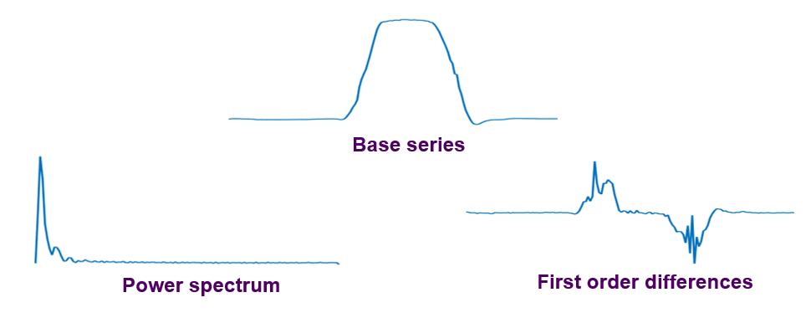
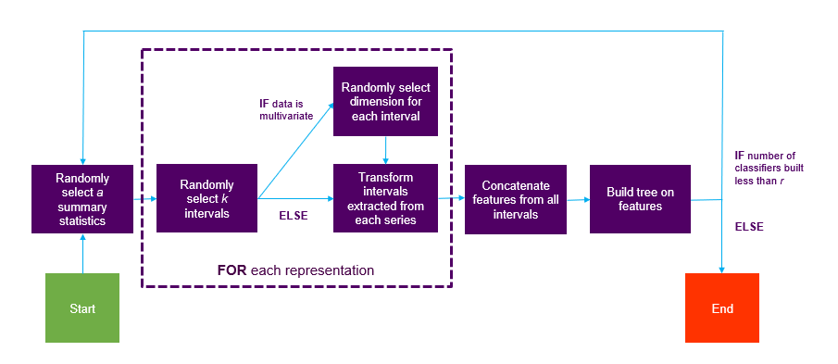
Interval Based: DrCIF
Design: Ensemble of decision tree classifiers
Accuracy weighting: Combine out of bag estimates for each component
Negative Bias? likely to be slightly pessimistic because estimates from smaller train sets

Slide 13
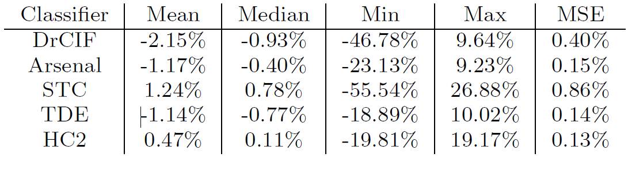
HC2 Bias
Summary of the difference between estimated and observed test accuracy for HC2
and its components. A positive value means that the classier is overestimating accuracy from the train data.
Somewhat confounded our prior beliefs

Slide 14
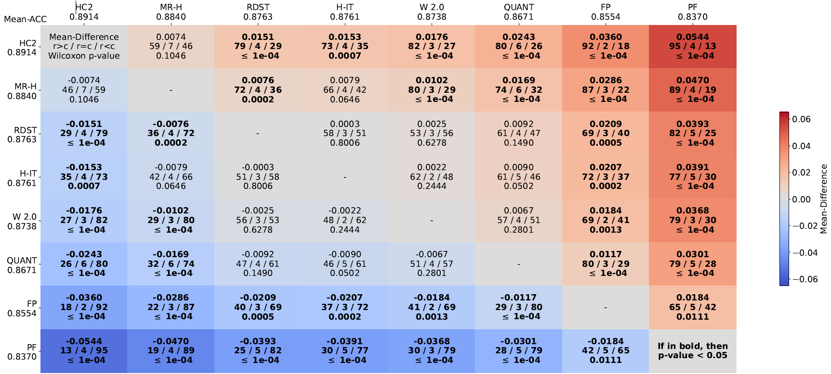
Bake off Redux (2024)
MultiRocket-Hydra and HC2 best performing
H-InceptionTime best of deep learners, and catching up?
RDST Weasel2.0 (W 2.0), QUANT, FreshPrince (FP) and Proximity Forest (PF) best in class

