Slide 1
Over5000
Still loading
Anghel Marian Cioncu Ionut

Slide 2
What we used:
Sql server 2019 by Microsoft
C# (Windows Form)
Entity Framework
ADO.NET Entity data model
Entity Framework is an Object-Relational Mapping (ORM) framework. An ORM structure provides database access and data operation process.
Difference between ADO.Net and Entity Framework. Entity framework is an Object/Relational Mapping (O/RM) framework. It is an enhancement to ADO.NET that gives developers an automated mechanism for accessing & storing the data in the database.

Slide 3



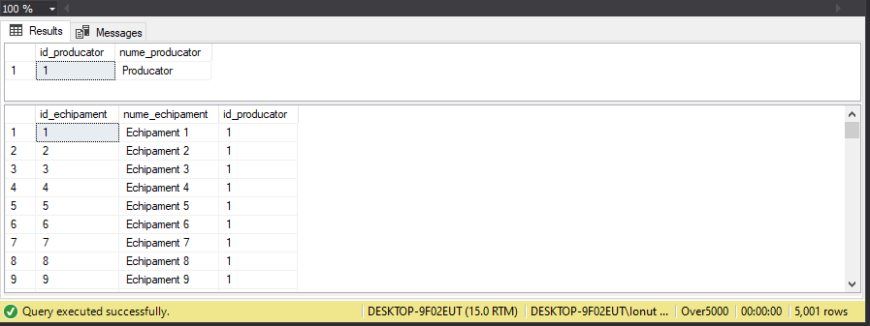

Performance
5000 SQL Inserts
Time=1.149 SEC
Screenshot #1
Screenshot #2
Still Loading

Slide 4

1st Rule Of Programming:- If It Works Don't Touch It:

Slide 5
Thank you!

