Slide 1
Measuring SNAP Policy Generosity Across the United States .
By: Shawn Ding, Grace George, Razan Habboub, Arnav Jain, Aeon Levy

Slide 2
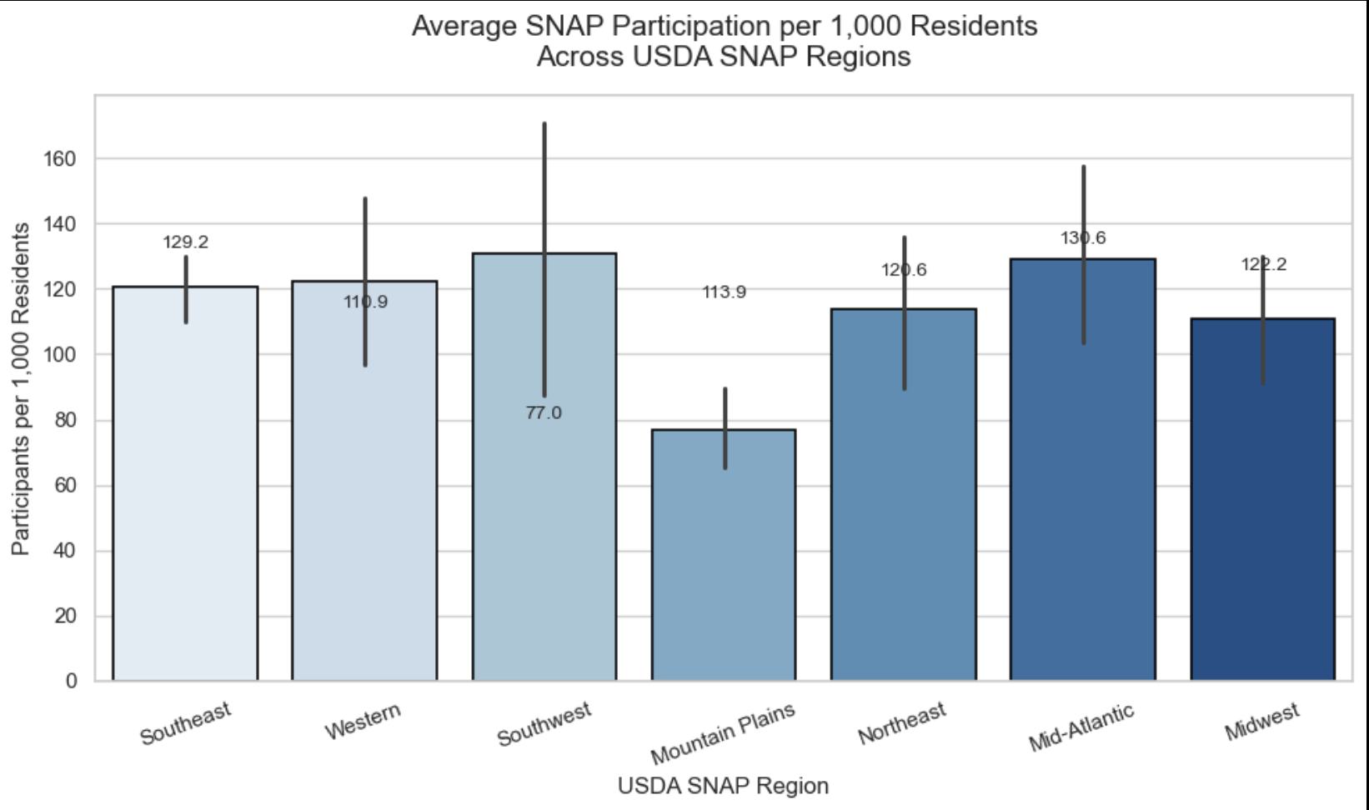
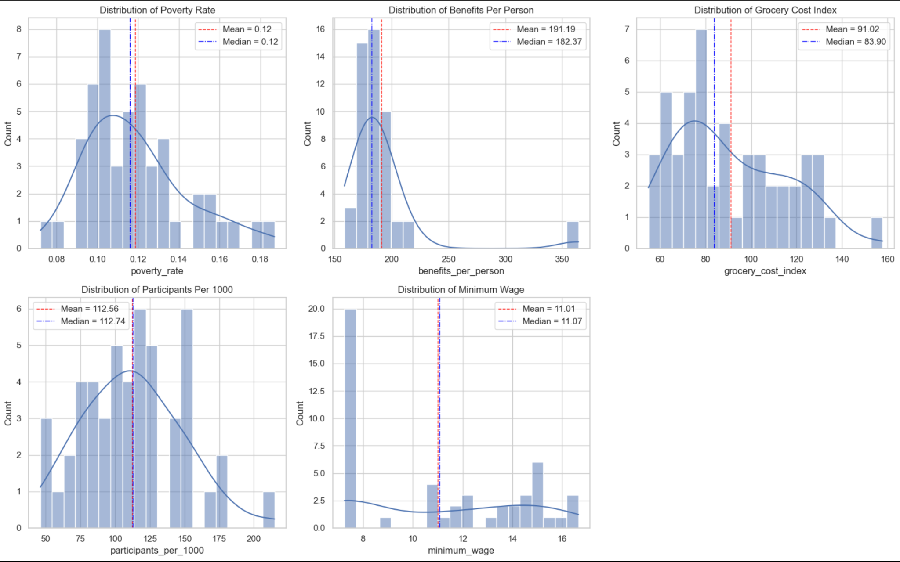
Key Variables
Benefits_per_person – May 2025 SNAP benefits divided by participants
Participants_per_1000 – SNAP participants per 1,000 residents
Grocery_cost_index – 2023 food-at-home RPP value for each state
Poverty_rate – ACS poverty share (proportion)
Median_household_income – ACS median household income (USD)
Race shares – white_pct, black_pct, native_pct, asian_pct, pacific_pct, two_plus_pct
Policy and geography – min_wage_tier, trifecta_2024, rural_urban_category, usda_snap_region

Slide 3
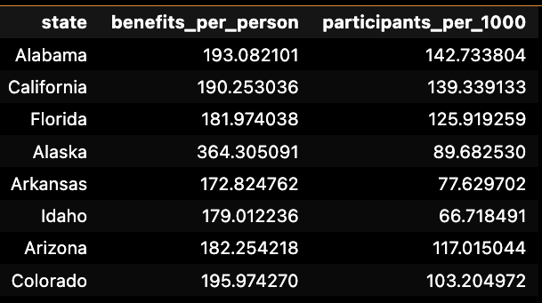
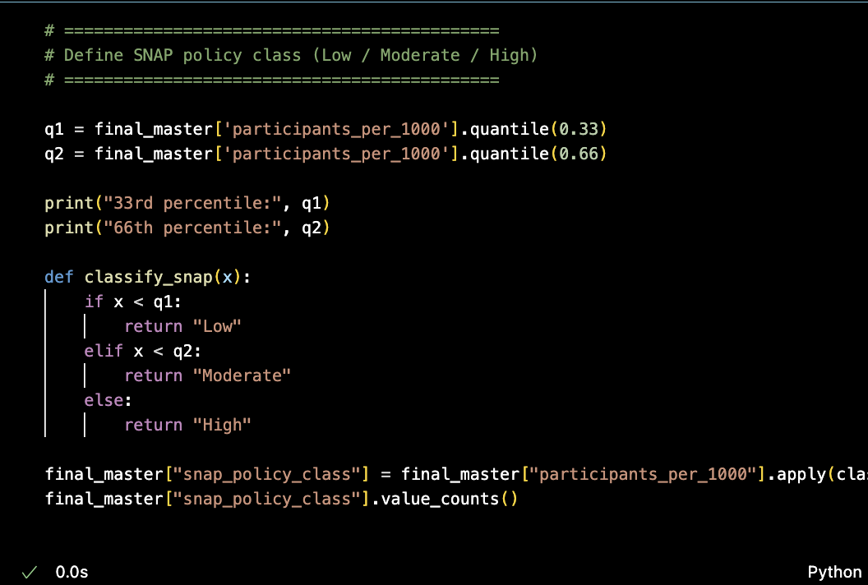
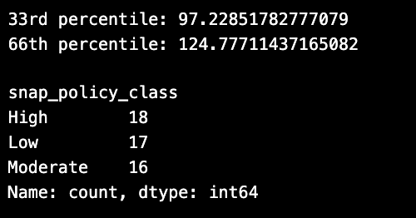
Measuring SNAP Generosity
How we created a constant measure
Defined generosity using two continuous measures
Assigned Low?Moderate/High classes, but these are descriptive

Slide 4
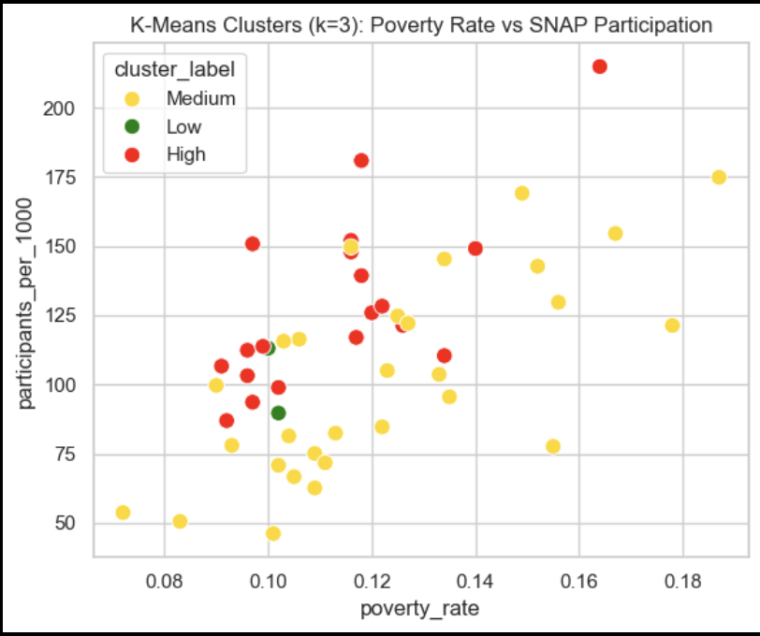
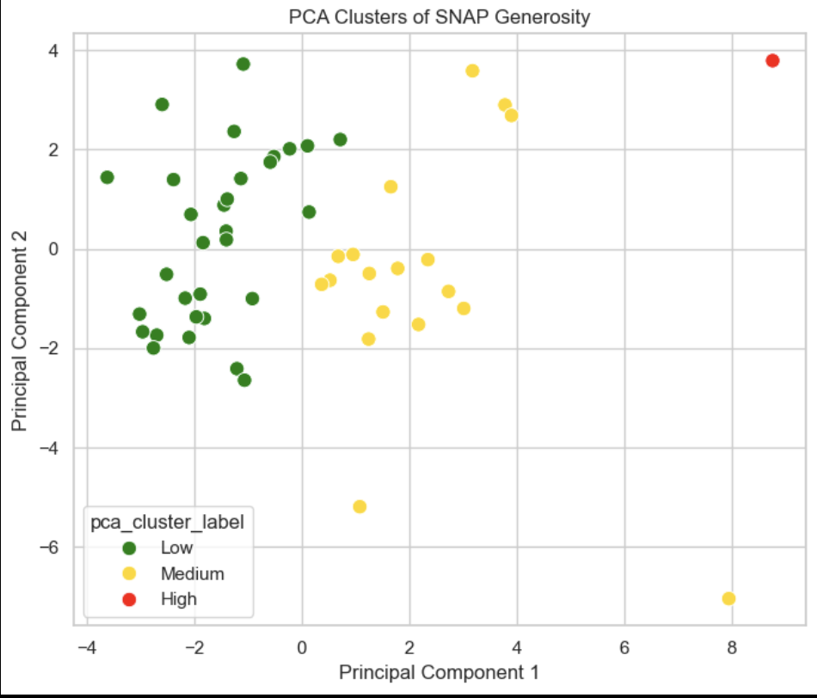
Predicting Low/Moderate/High Classes
The “High” cluster above-average SNAP participation
several High-policy states are in Medium or Low clusters.
generosity behaves like a continuous gradient, not three discrete groups.
Low-generosity might have share similar underlying characteristics.
One state appears as a major outlier in the high-generosity direction, reflecting extreme differences in policy or administrative context.

Slide 5
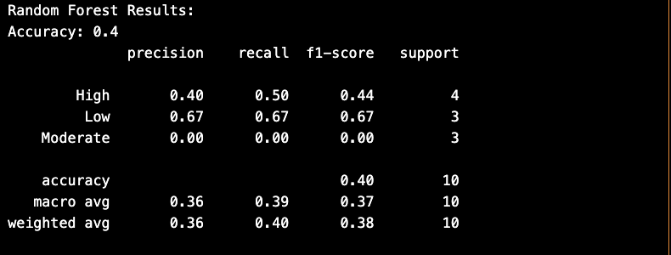
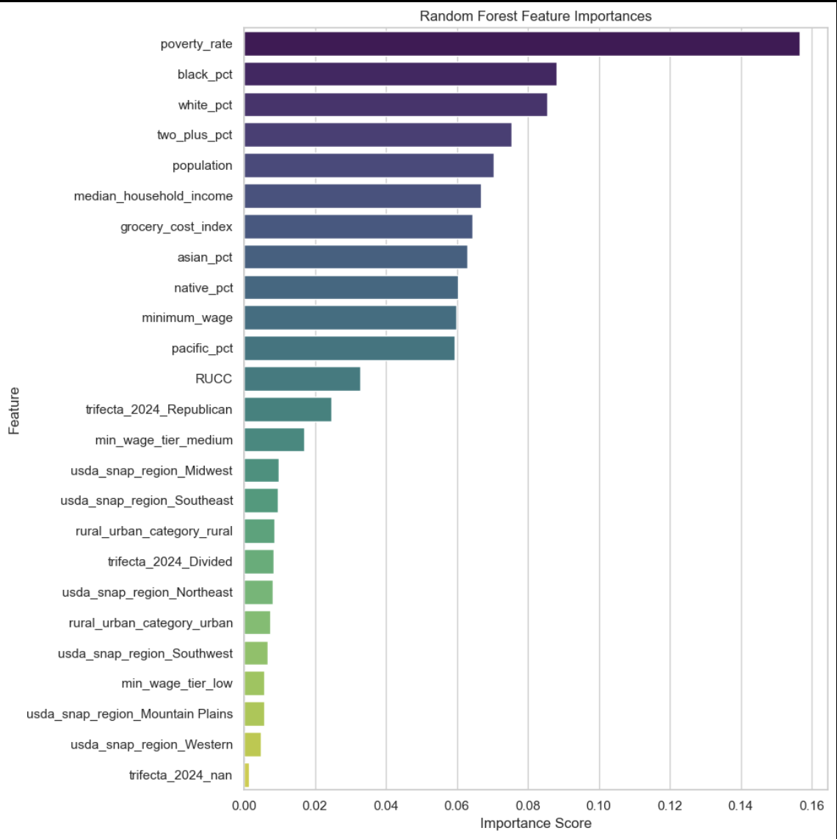
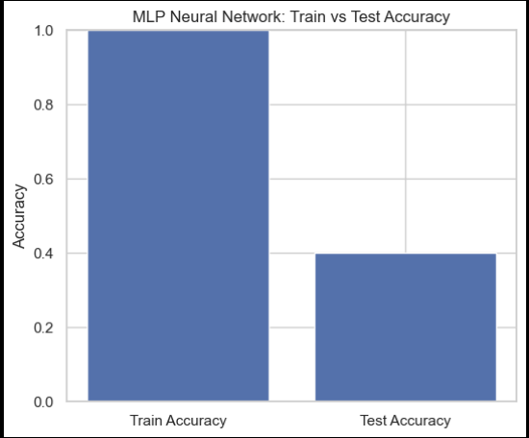
Generosity Is Continuous, Not Categorical
SNAP generosity varies in continuous, overlapping ways, not discrete Low/Moderate/High categories
Economic, demographic, and policy environments influence generosity, but not in separable clusters
The models struggled because the categories don’t reflect real structure in the predictors

Slide 6
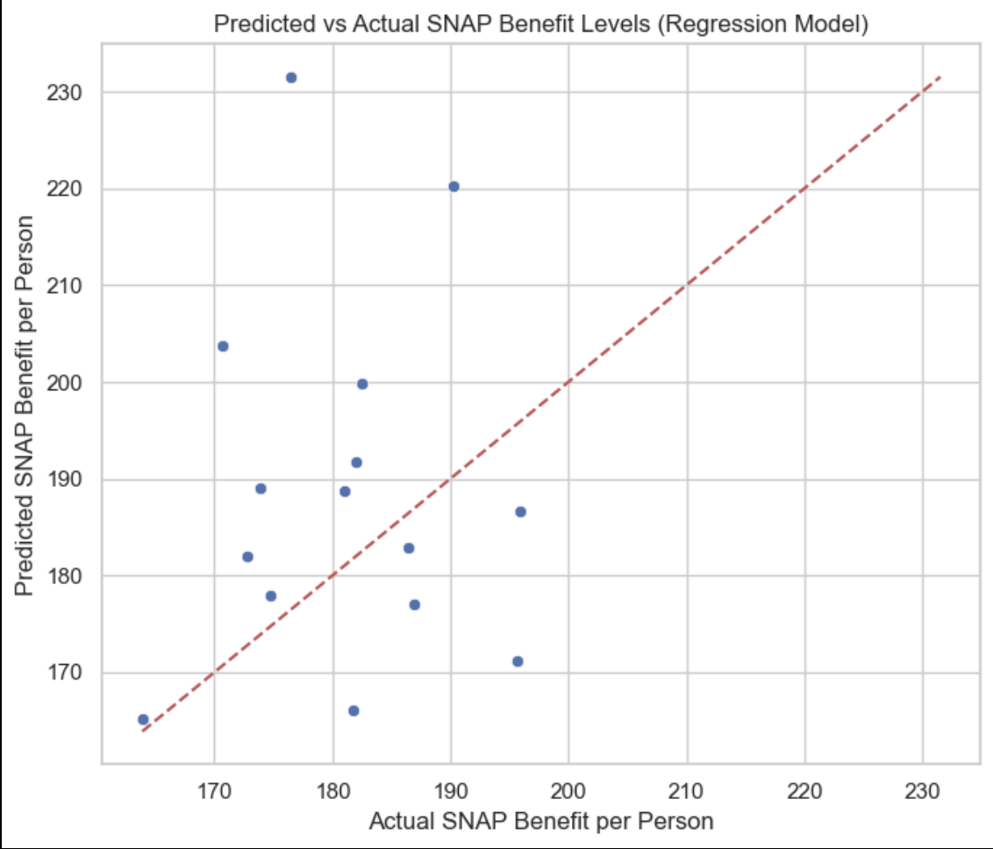
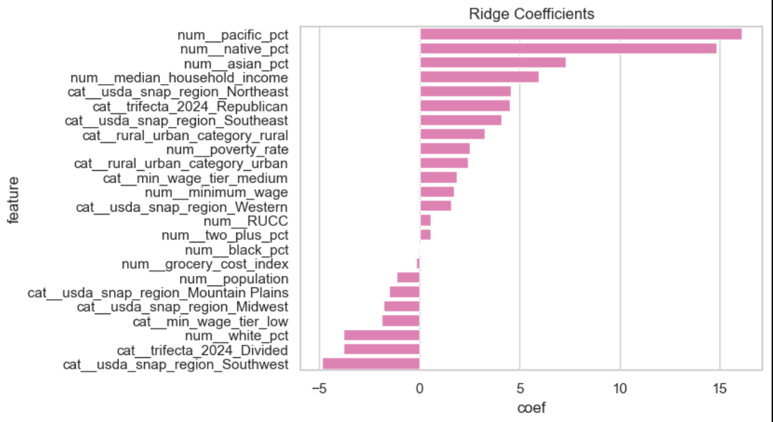
What Exactly Predicts Snap Generosity?
Difficulty with our models…
Even with regularization, the model performed poorly — the test R² was negative, meaning it did worse than predicting the average benefit.
Lasso and Ridge made the model more stable by shrinking coefficients and reducing noise.
  Reduced RMSE
But R² stayed negative, showing there’s no strong linear relationship in the predictors.
SNAP generosity likely follows nonlinear, overlapping patterns that linear regression can’t capture.

Slide 7
Conclusion
OUR SHINY APP
SNAP generosity is best measured continuously
Economic structure explains most variation
Categories (Low/Moderate/High) don’t correspond to real clusters
Classification models cannot predict these categories
Future work: time-series and more cost-of-living adjustments

