Slide 1
/Application Programming Interface (API)
Presnted by Abdulraman Aleid
Notes:
Hello, my presentation topic is Application Programming Interface
Commonly known as API

Slide 2
/TABLE OF CONTENTS
/01
/CONCEPTS
/02
/APIs functions
/03
/YouTube API
What is an API?
What are API functions?
Demo on how to use YouTube API
Notes:
In this presentation I will cover API concepts
Then we will see the different functions of APIs
And lastly, I will conclude with a demo on using YouTube API

Slide 3
/ CONCEPTS
YOUR LOGO HERE
What is an API?
INDEX.HTML
Notes:
First, let's take a look at what an API is

Slide 4
WEATHER APP
HTTP GET Request
Custom
APP
API
Notes:
Say for example that we have this weather application
This application has a huge network, set up all around the world, to collect weather data
In order for the stake holders to maximize the app success,
They would want the ability to integrate this application with other popular applications and services
For example they would want to provide their services to custom IOS or Android applications
To make integration with third party custom application more feasible APIs must be used
So, An API is essentially a door way into the application’s information and services
Now they way to access this application’s API is by sending an HTTP GET Request massege to this application

Slide 5
/WHAT IS HTTP?
YOUR LOGO HERE
/HTTP
/HTTPS
Hypertext Transfer Protocol
Used to load web pages using hypertext links
Designed to transfer info. between networked devices
Secure HTTP
Example:
https://www.google.com/
INDEX.HTML
Notes:
But what is HTTP?
HTTP stands for Hypertext Transfer Protocol
Used to load web pages using hypertext links
Commonly know as URLs
Designed to transfer info. between networked devices

Slide 6
/ HTTP METHODS
/POST
/GET
/PUT
/PATCH
/DELETE
Creates something on the web app
Reads info from the web app
Updates info on the web app (replace)
Update info no the web app (modify)
Delete info from the web app
Notes:
The are serval methods used to send a request using http
The most common methods are
POST: Creates something on the web app
GET: Reads info from the web app
PUT: Updates info on the web app (replace)
PATCH: also, used to Update info no the web app (modify)
The difference between PUT and PATCH
is that put is used to replace information
whereas PATCH is used to modify information
Lastly, DELETE: Delete info from the web app

Slide 7
WEATHER APP
HTTP GET Request
Custom
APP
API
JSON
Response
Notes:
Now, once the HTTP GET request is sent
The response from the application will be in JSON format
Some times application are set to respond with xml format
We will see how this going to look like in the demo part of this presntation

Slide 8
<WATHER API URL EXAMPLE>
https://api.openweathermap.org/data/2.5/wather?q={city name}&appid={API key}
Notes:
Here is an example of a real weather API URL
In this URL we see the main components of a request
First we need the end point from where the information will be retrived
Then a question mark is added indicating the start of our query details
The first parameter of this query is the city of which we want to retrieve the weather data
The second parameter of the query is the API key
The API key is mandatory to obtain from the platform form which the API is accessed
This key is used to track clients requests so that over whelming requests are prevented

Slide 9
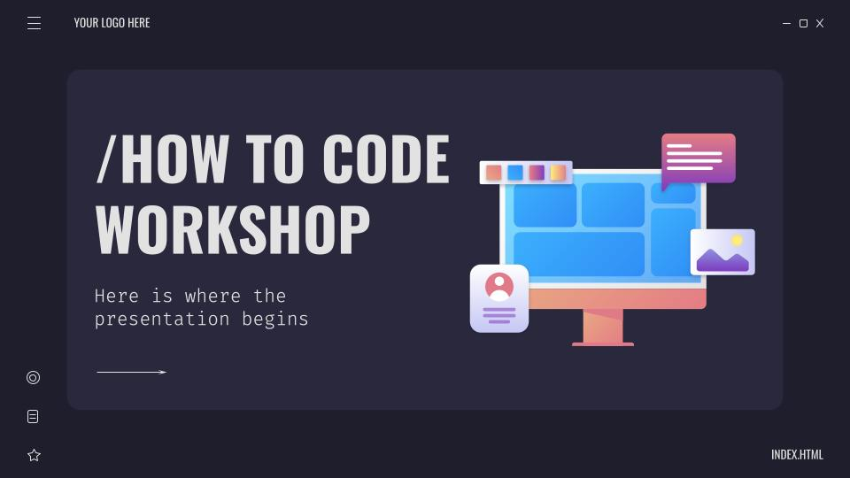
/LET US HAVE A LOOK AT YouTube API
Notes:
Now let us have a look at how to use YouTube API
Say for example we want to build a model that predicts YouTube video view-count
Based on the thumbnail image used for the video
In this case we need a dataset that has thumbnail images
And information about the video
So lets try to build such dataset.

Slide 10
/ Refrences
https://developers.google.com/youtube/v3
https://www.cloudflare.com/learning/ddos/glossary/hypertext-transfer-protocol-http/
https://aws.amazon.com/what-is/api/
https://www.redhat.com/en/topics/api/what-are-application-programming-interfaces
Notes:
The are serval methods used to send a request using http
The most common methods are
POST: Creates something on the web app
GET: Reads info from the web app
PUT: Updates info on the web app (replace)
PATCH: also, used to Update info no the web app (modify)
The difference between PUT and PATCH
is that put is used to replace information
whereas PATCH is used to modify information
Lastly, DELETE: Delete info from the web app

Slide 11
/THANKS!
YOUR LOGO HERE
/DO YOU HAVE ANY QUESTIONS?
INDEX.HTML

