Slide 1

Network Intrusion Detection With Machine Learning
Presented by Abdulrahman Aleid

Slide 2
Table of contents
01
Introduction
02
Project Goal
The Dataset
Steps Taken to Achieve the Goal
03
04
Challenges & Future Development
05
06
Conclusion

Slide 3

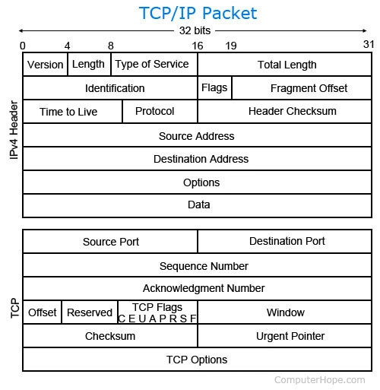
Introduction
How do computers network?
Network layers
Network packets
How to detect network intrusion?
Intrusion detection systems(IDS)
How does Machine Learning fit?

Slide 4


Project Goal
Analise the Canadian Institute Cybersecurity Intrusion Detection Dataset
Train a Machine Learning Model to detect network intrusion by classifying network packets
Develop an application that enables users to classify captured packets

Slide 5

CIC-IDS Dataset
Contains benign and the most up-to-date common attacks
Resembles the true real-world data packet capture (PCAPs)
Includes labelled observations
Came in 8 csv files

Slide 6
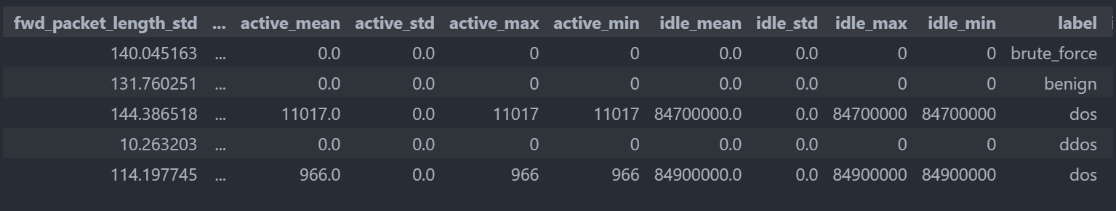
CIC-IDS Dataset
Number of Features | Number of Observations
80 | 928391
Target Classes
benign | dos | ddos | portscan | brute_force | web_attack | bot

Slide 7

Pre-processing
Concatenated all csv files
Since “benign” observations were over represented only kept those from one of the csv files
Added a new feature “is_intrusion” to account for label imbalance issues
Dropped features that have zero variance
Grouped similar attacks so they would have the same label
Dropped null and duplicated observations

Slide 8
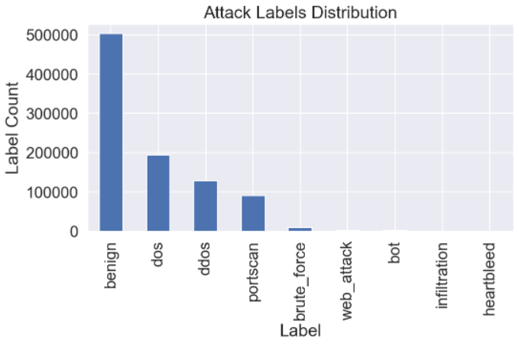
EDA
Label distribution shows extreme imbalance

Slide 9
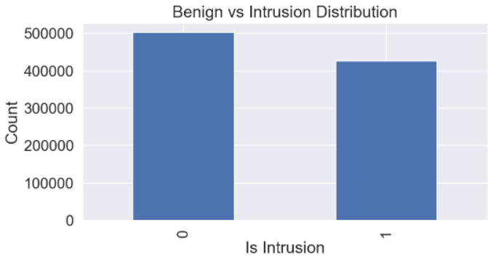
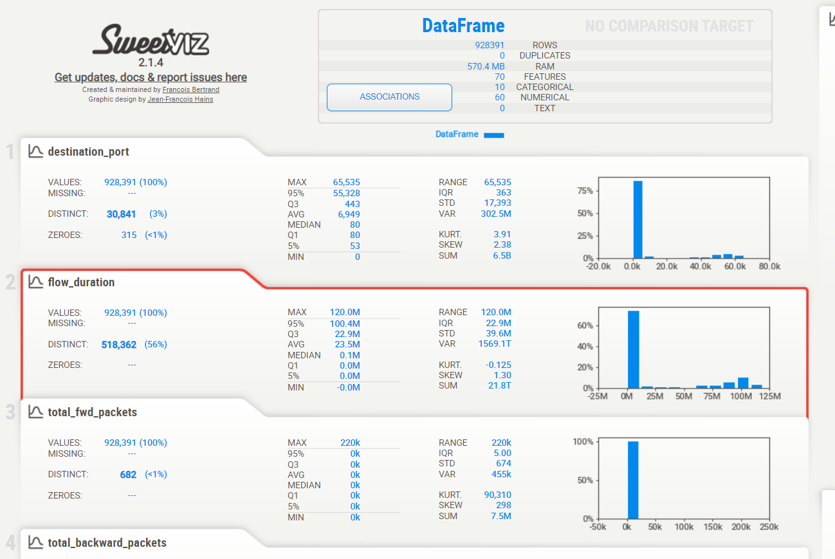
EDA
More balanced than labelled attacks
Auto EDA

Slide 10
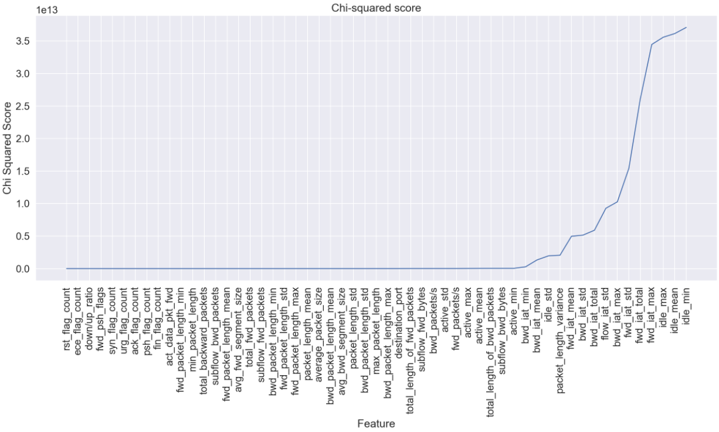
Feature Extraction
Chi Squared

Slide 11
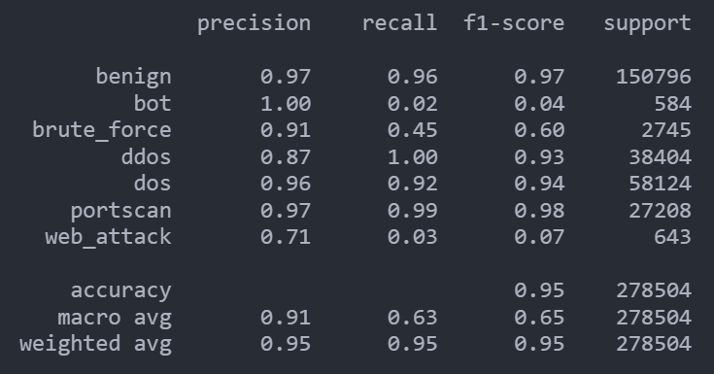
Logistic Regression
Base line with default parameter

Slide 12
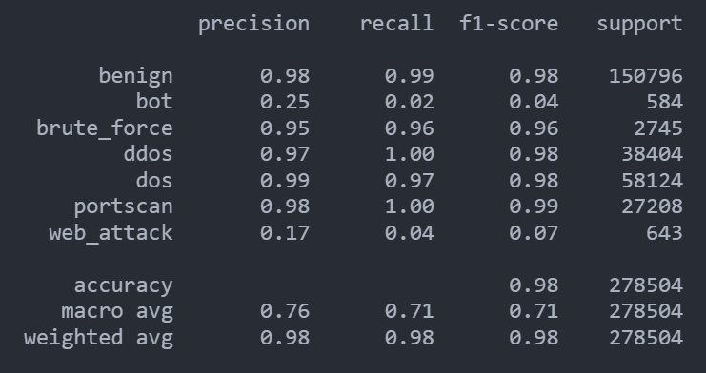
Linear Support Vector Classification (SVC)
Base line with default parameter

Slide 13
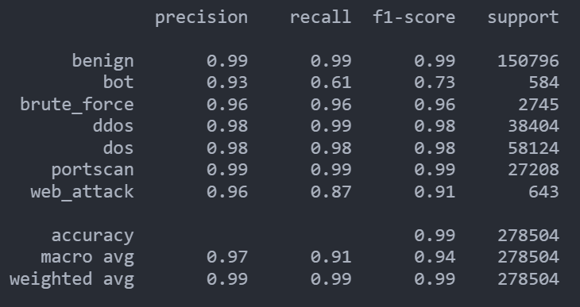
KNN
Variance Threshold: 0.1
PCA: 40
Standard Scaler
One-hot encoded labels
Best number of neighbours: 50

Slide 14

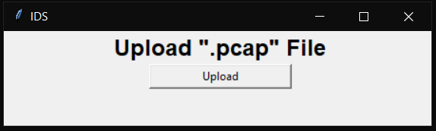
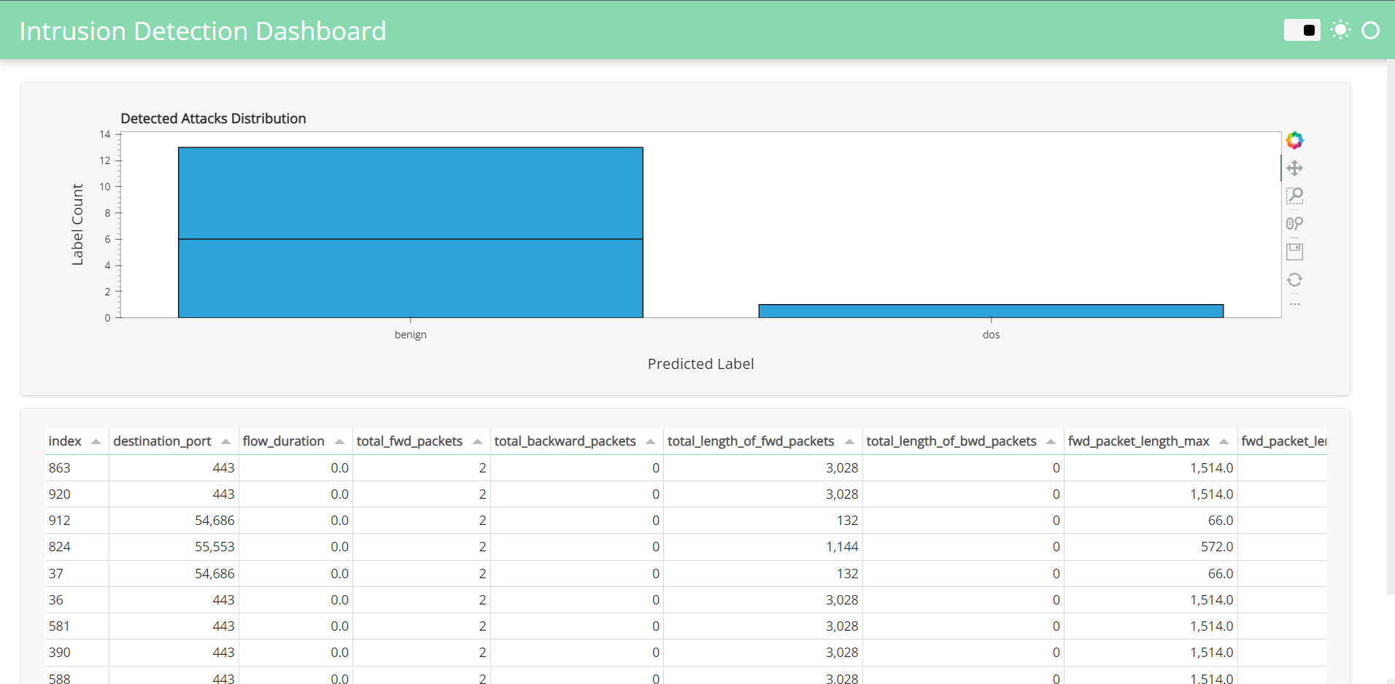
APP Development
Deployed model on Heroku
Developed an interface to allow user to upload “pcap” file
Extracted features using cicflowmeter package
Display prediction results
through a dashboard

Slide 15

Challenges
Large number of features
KNN is computationally intensive
Feature extraction
Large number of captured network packets
Heroku limitations

Slide 16
Future Development
Improve on feature extraction component
Improve on the dashboard
Further train the model to classify other types of attacks

Slide 17

Conclusion
Traditional IDSs fail in the event of previously unseen attacks such as zero-day attacks or anomaly-based intrusion detection. Therefore, the application of machine learning approach as an engine for attack detection can be used as complementary to the traditional system.

Slide 18

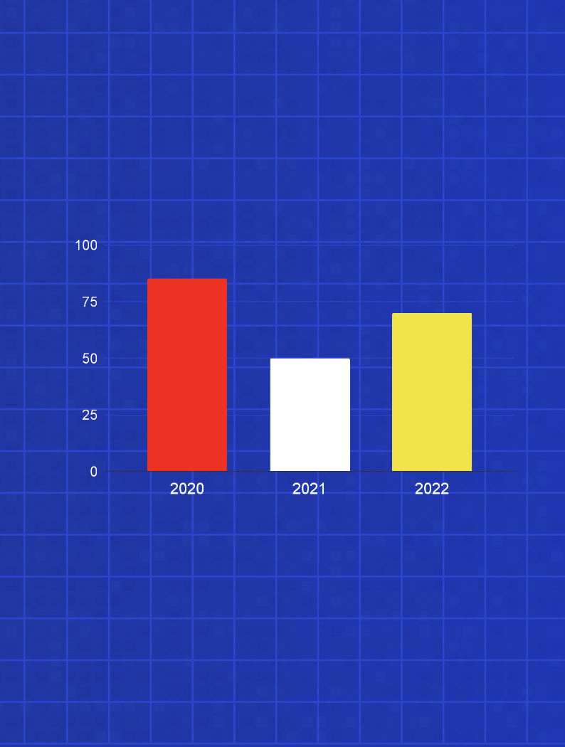

App demo

Slide 19
Thank You!
Do you have any questions?

