Slide 1

LOFO Importance
Rafah El-Khatib
Ahmet Erdem, Stephane Collot, Eva Van Weel

Slide 2

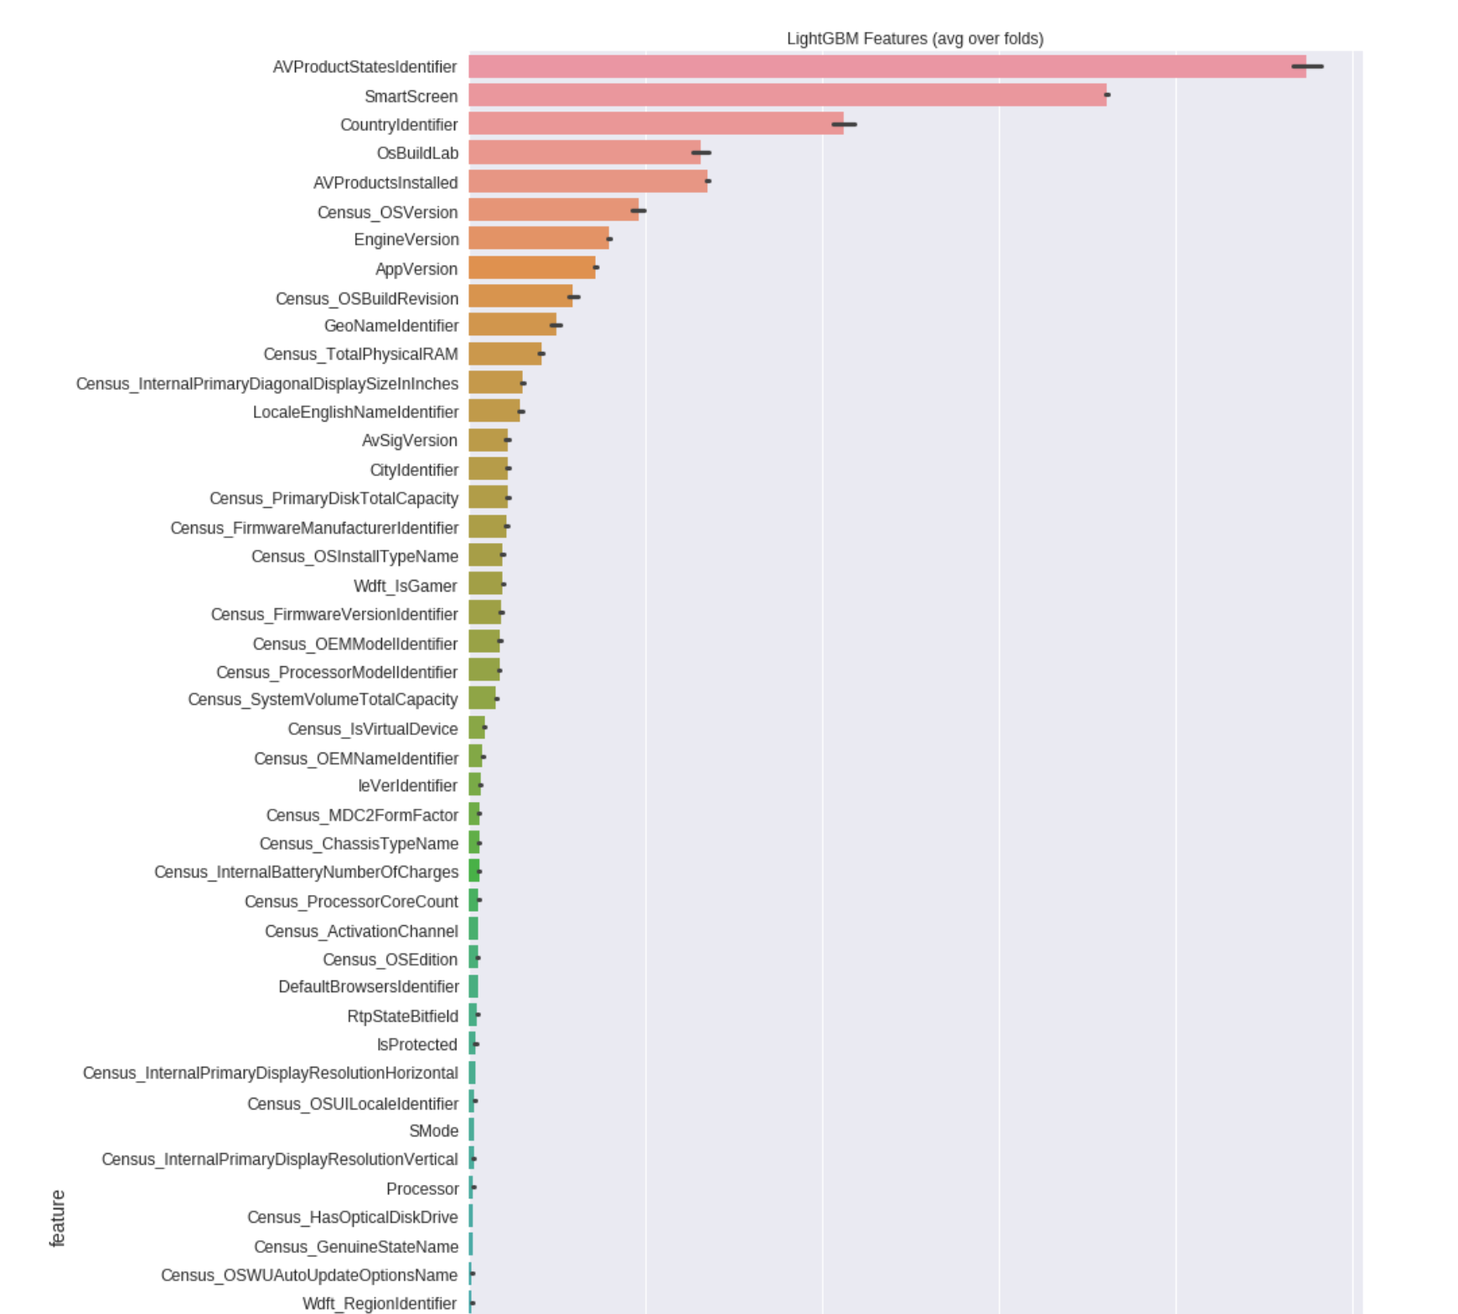
Example: Kaggle’s Microsoft Malware Prediction
Predict if a machine will soon be hit with malware
Seasonal feature: OS version
Split out of time
Training data: OS version was very predictive
Test data: What about new OS versions?
Tree model importances:
Consider tree structure in training phase
Give high importance to OS version
Centus_OSVersion

Slide 3
Feature Importance measures out there
Gini: mean decrease in impurity
Gain: average training loss reduction
Split: #splits involving a feature
Shapley values/Saabas score
Permutation: permute values in test set and compare performance
Overestimate importance to granular features
Do not generalise well to test sets
Model-
dependent
Overestimates importance to correlated features

Slide 4
LOFO (Leave One Feature Out) Importance
We want our models to generalise well to unseen test sets
LOFO algorithm:
Get baseline performance with all features
Remove features one by one, retrain the model, evaluate CV performance
For any sklearn-friendly model (with LightGBM as the default)
For any performance metric
Any validation scheme
Can even get negative LOFO importances when a feature is harmful

Slide 5
Kaggle’s Microsoft Malware Prediction, Revisited
https://www.kaggle.com/divrikwicky/lofo-importance

Slide 6
Install LOFO and try it out!
pip install git+https://github.com/aerdem4/lofo-importance
Caveats:
Slow although we parallelise!
So far still misleading when it comes to correlated features (as most other importance types)
Future Work:
Flag correlated features, leave-n-features-out

