Slide 1
Modeling Region-Specific Dynamics in Malaria Parasite Samples

Slide 2
Research Question
Different modes of infection impact genetic dynamics in malaria parasites
We consider two general classes of infection
Host infected by single mosquito → recombination between single parasite + host → infection spreads via another mosquito
Host infected by multiple mosquitos → recombination between multiple parasites + host → infection spreads via another mosquito
Expectation is that under 2. (aka “superinfections”), parasite genome will evolve more quickly than 1.
Potentially leads to higher rates of anti-malarial resistance, worse outcomes for infected people
No consensus on prevalence of different infection types across countries/regions
Notes:
Insert Figure showing infection dynamics (monoclonal vs. polyclonal)

Slide 3
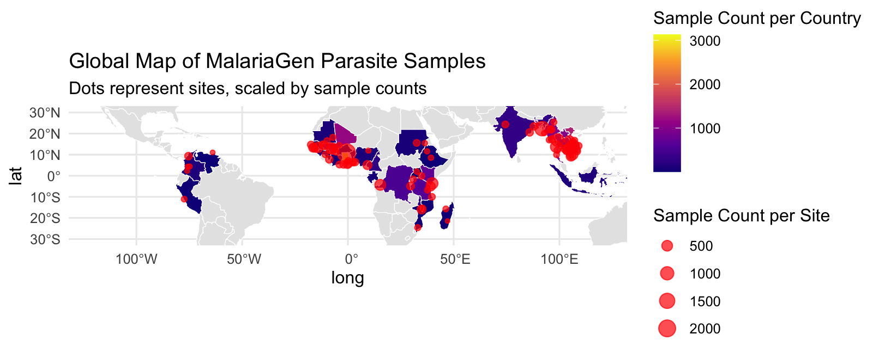
MalariaGen Data
Notes:
Mention IBD, other summary measures of parasite samples reflecting sequencing properties or potentially relevant biological info. (antimalarial resistance)

Slide 4
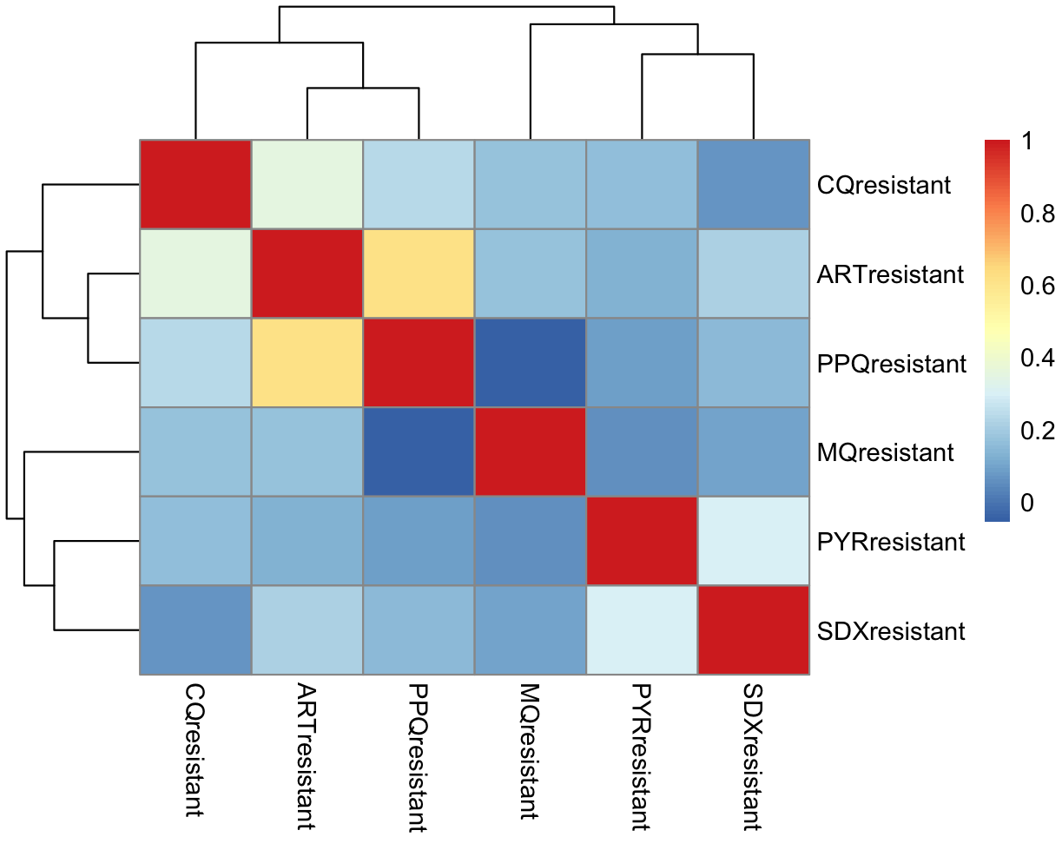
Anti-Malarial Drug Resistance

Slide 5
Mixed Effects Models
Random intercept
Random slope
How is this helpful?

Slide 6
Prediction (Methods & Results)

Slide 7
Exploring Effects Estimations: Shrinkage

Slide 8
Next Steps
Limitations
Fully Bayesian approach with stan?

Slide 9
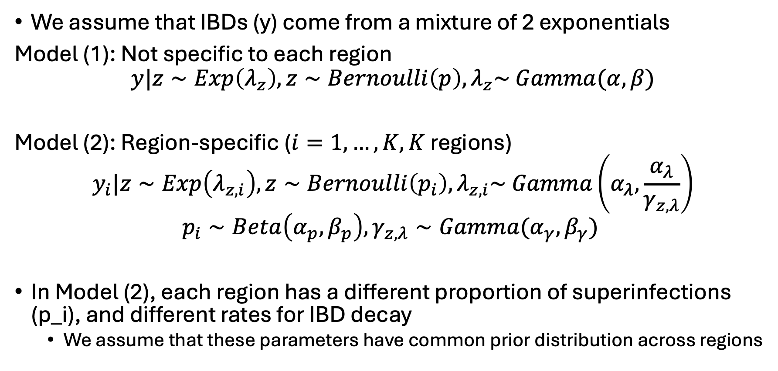
Exponential Mixture Models
We assume that IBDs (y) come from a mixture of 2 exponentials
Model (1): Not specific to each region
$$y|z∼Exp\left(λ_{z}\right), z∼Bernoulli\left(p\right), λ_{z}\sim Gamma(α, β)$$
Model (2): Region-specific ($i=1,…, K, K$ regions)
$$y_{i}|z∼Exp\left(λ_{z,i}\right), z∼Bernoulli\left(p_{i}\right), λ_{z,i}\sim Gamma\left(α_{λ},\frac{α_{λ}}{γ_{z,λ}}\right)$$
$$p_{i}∼Beta\left(α_{p}, β_{p}\right),γ_{z,λ}∼Gamma(α_{γ}, β_{γ})$$
In Model (2), each region has a different proportion of superinfections (p_i), and different rates for IBD decay
We assume that these parameters have common prior distribution across regions
Notes:
Need to add error

Slide 10
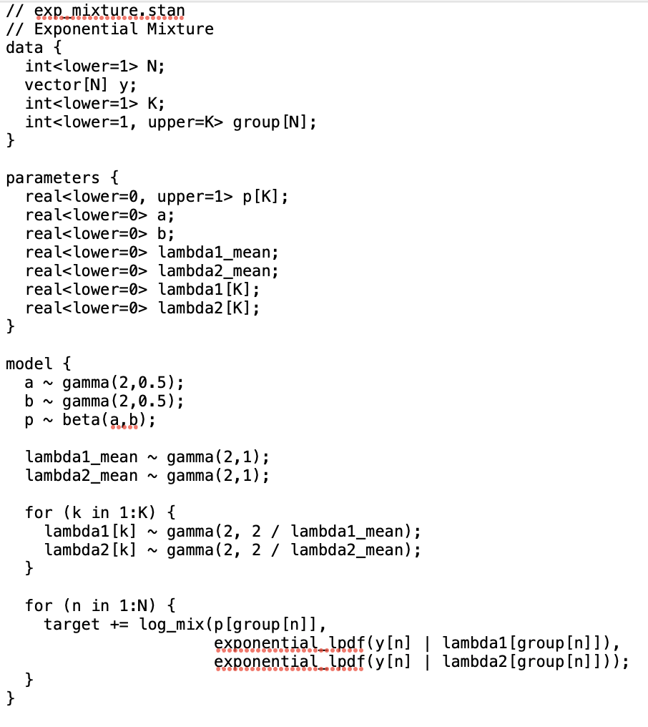
Use Stan for Bayesian model fitting

