Slide 1

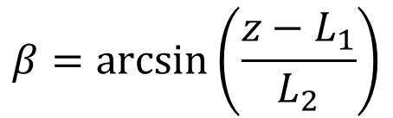
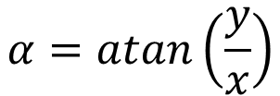



L2
Forward Kinematics
Y2
$$(x, y, z)$$
$$x=L_{2}·\cos\left(β\right)·cos⁡(α)$$
Z1
Z2
$$y=L_{2}·\cos\left(β\right)·sin⁡(α)$$
Y1
β
$$z=L_{1}+L_{2}·sin⁡(β)$$
β
X1
X2
L1
Z0
Z0
Inverse Kinematics
α
α
$$α=atan\left(\frac{y}{x}\right)$$
Y0
Y0
X0
X0
$$β=\arcsin\left(\frac{z−L_{1}}{L_{2}}\right)$$

