Slide 1

Unified Context-Behavioral Ad Recommendation System
FACULTY OF AUTOMATION AND COMPUTER SCIENCE
COMPUTER SCIENCE DEPARTMENT
Student
Florin Cristian MACICASAN
Octavian Lucian HASNA
Supervisor
Prof. Dr. Eng. Rodica POTOLEA
Assoc. Prof. Dr. Eng. Mihaela DINSOREANU

Slide 2
Contents
Introduction
Motivation
Related Work
Analysis and Design
Implementation status
Current Results
Bibliography

Slide 3
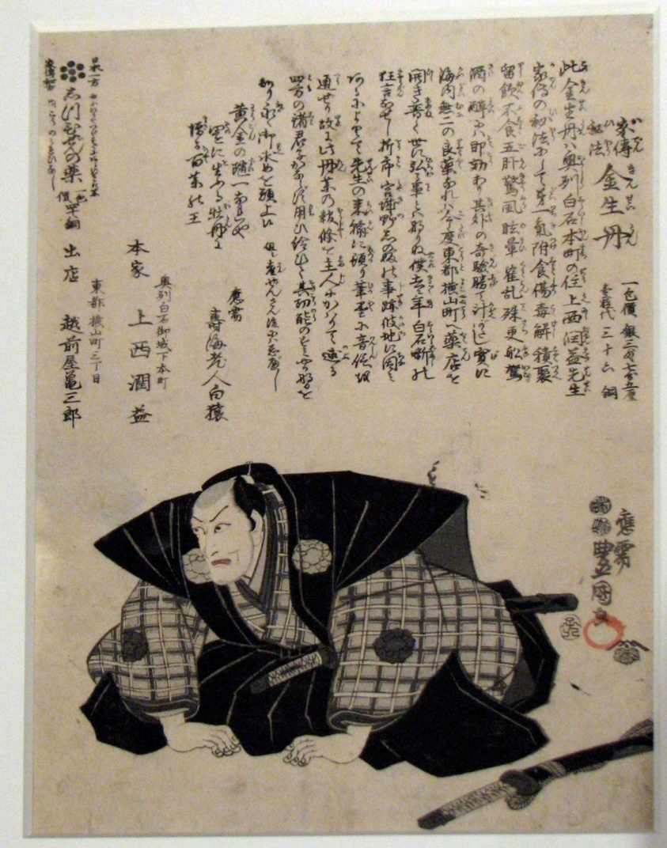
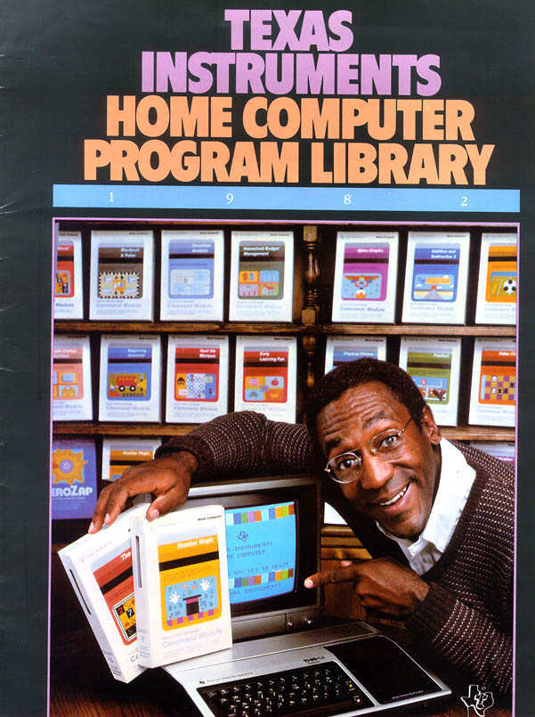
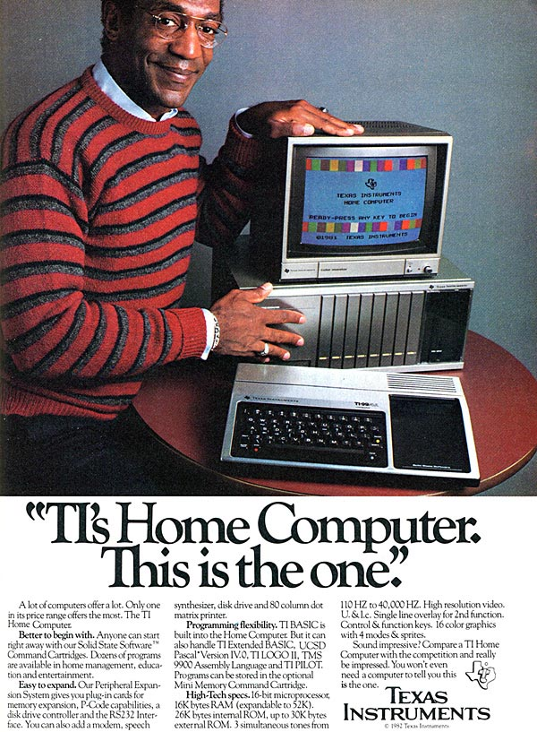
Advertisement Evolution
Introduction
Japan, 1806
USA, 1982
From http://en.wikipedia.org/wiki/Advertising
From http://www.ebaumsworld.com/pictures/view/231616/
Notes:
Edo period advertising flyer from 1806 for a traditional medicine called Kinseitan.
Bill Cosby in 1982 Texas Instruments TI-99 advertisement.

Slide 4
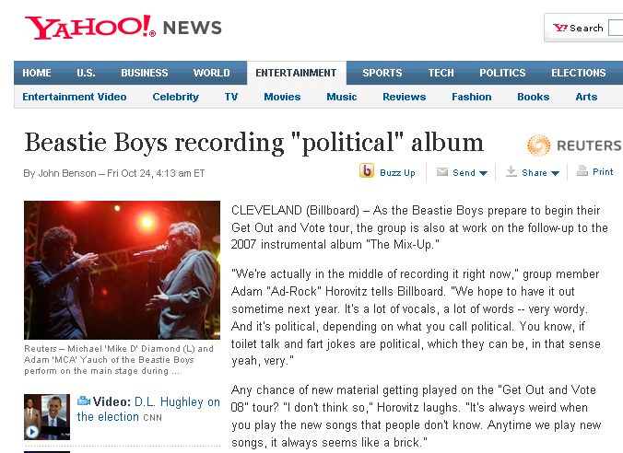
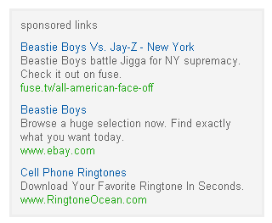
Contextual Advertising
Introduction

Slide 5
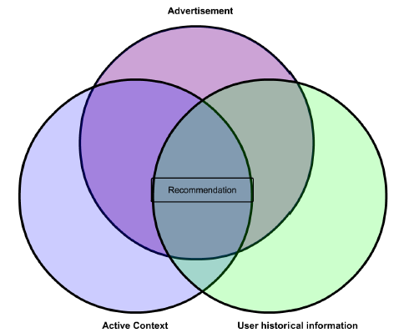
Project Overview
Introduction
Purpose
Context-sensitive recommendation
triple similarity relation between
the currently active context
an advertisement
the user’s historical information
Objectives
Extract keywords from content
Model topics around keywords
Unify context, ad and user at topic level
Maximize relevancy of recommended ads
Related fields
Information Retrieval
Knowledge Discovery and Data Mining
Machine Learning
Notes:
Nowadays, in an information centric society, we are flooded with data (the so called “deluge of data”). In this context, an automatic identification of entities that satisfy the user’s information needs is paramount. The goal is to expose to the user only meaningful information (relevant and of interest), more important, at the right time and in the right context [2].

Slide 6
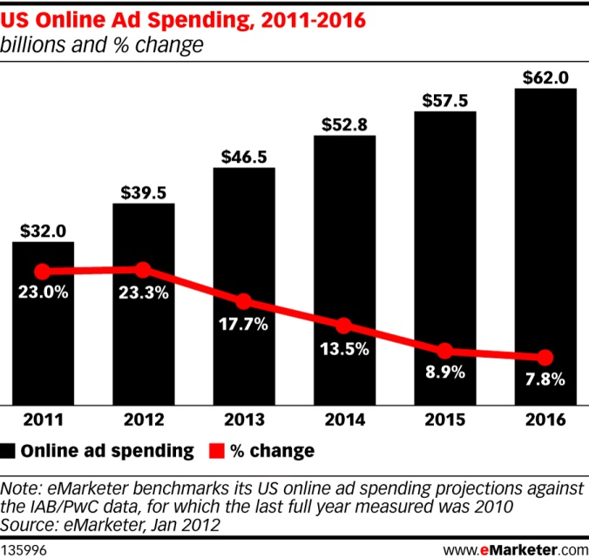
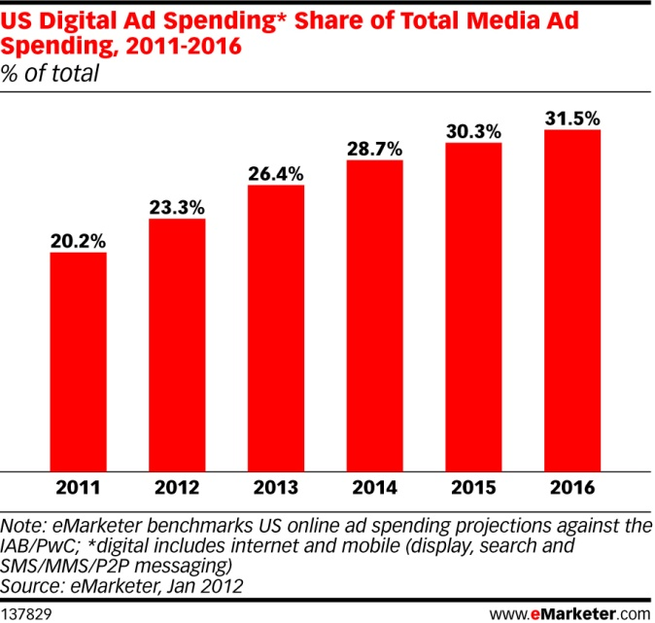
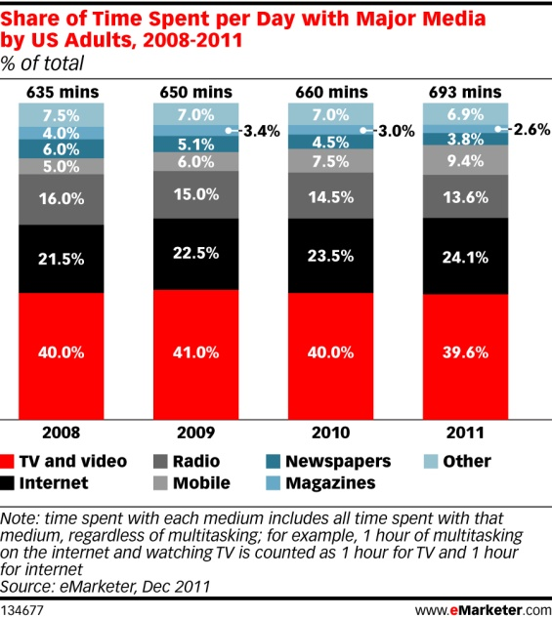
Online Advertising – as an Industry
Motivation
From [2]
From [2]
From [2]
Online advertisement budgets continue to increase
The Online advertisement share from overall advertisement budget continue to increase
Proportion of budget for online advertisement match with overall Internet usage time

Slide 7
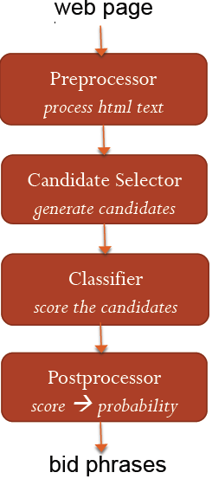
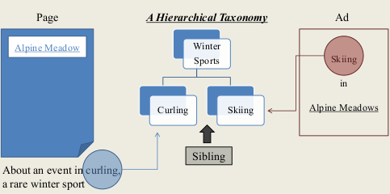
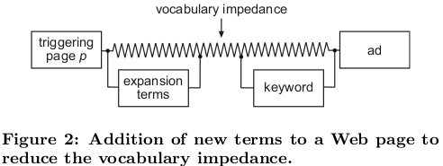
Keyword Extraction & Semantic Modeling
Related Work
Lexical Modeling
Keyword Extraction
Candidate Selection
Keyword Classification
Semantic Modeling
Ontology distance (LCA)
Vocabulary impedance reduction
From [a*]
From [c*]
From [b*]
[a*]Wen-tau Yih, Joshua Goodman and Vitor Carvalho, Finding Advertising Keywords on Web Pages, WWW 2006, Microsoft Research
[b*]Broder, Marcus Fontoura and Vanja Jasifovski, A Semantic Approach to Contextual Advertising, SIGIR 2007
[c*]Berthier Robeiro-Neto and Marco Cristo, Impedance Coupling in Content-targeted Advertising, SIGIR ’05, Brazil

Slide 8
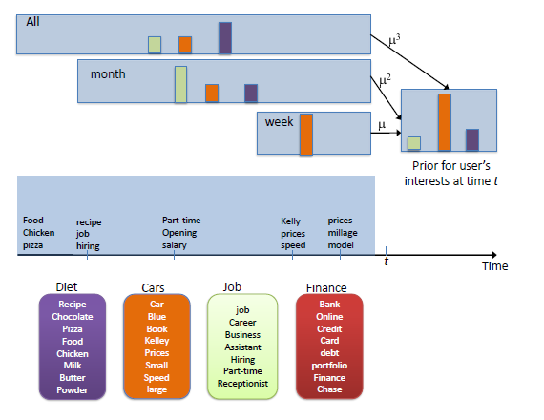
User History Modeling
Related Work
User History Modeling
Click based feedback user history [d*]
Dynamic user interests [e*]
User = set of interests & Action = choice of an interest
From [e*], capturing user long & short term interest
[d*]Deepayan Chakrabarti, Deepak Agarwal and Vanja Josifovski, Contextual Advertising by Combining Relevance with Click Feedback, WWW 2008, Yahoo Labs
[e*]A. Ahmde, Y. Low, M. Aly, V. Josifovski, A. Smola, Scalable Distributed Inference of Dynamic User Interests for Behavioral Targeting, KDD 2011, Yahoo! Research, Carnegie Mellon Univ.

Slide 9
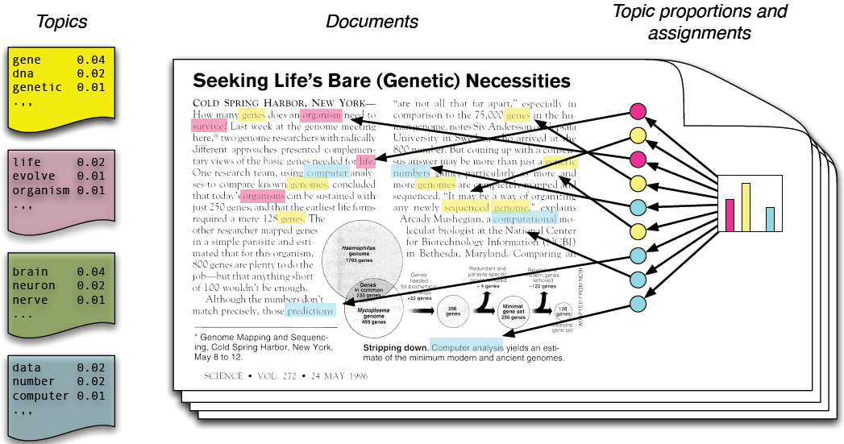
Topic Modeling
Related Work
Topic Modeling
Topic Models
Latent topic structure of documents
Latent Dirichlet Allocation (LDA)
From [g*, f*]
[f*] D. M. Blei, A. Y. Ng, and M. I. Jordan, Latent dirichlet allocation, J. Mach. Learn. Res., vol. 3, pp. 993{1022, Mar. 2003.
[g*] D. M. Blei, Introduction to probabilistic topic models, Communications of the ACM,2011.
[h*] G. Heinrich, Parameter estimation for text analysis, Tech. Rep., 2009.
Notes:
Each topic is a distribution over words
Each document is a mixture of corpus-wide topics
Each word is drawn from one of those topics
We only see the documents.
The others are hidden variables.
=> We need to infer the hidden variables

Slide 10
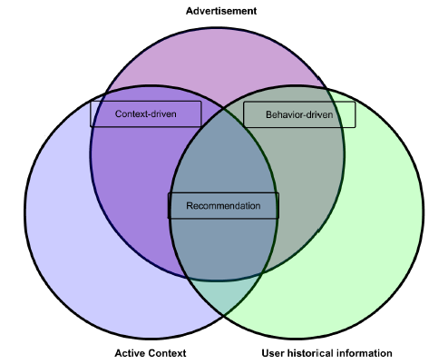
Recommendation Perspectives
Analysis And Design
Context-driven advertisement
page topic coverage
Behavior-driven advertisement
user interest coverage
Notes:
This separation generates the possibility of recommending advertisements from two different perspectives. The first, that maximizes the similarity between the “topics” describing the active context and the advertisement is considered to be a contextual recommendation and will influence the page topic coverage. The latter, that considers the best match between the user’s current interests and an advertisement is said to be a behavioral recommendation [6] and improves the user interest coverage.

Slide 11
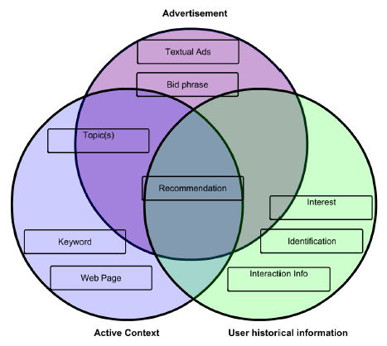
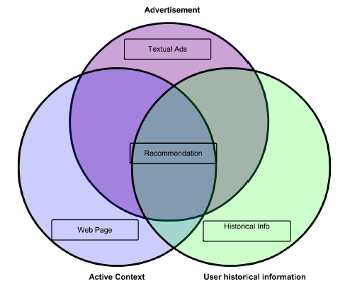
Unified Topic model
Analysis And Design
Affects all the actors in our system
Advertisement
Single, targeted topic
Active Context
Static set of topics
User
Dynamic set of topics due to evolution over time of interests

Slide 12
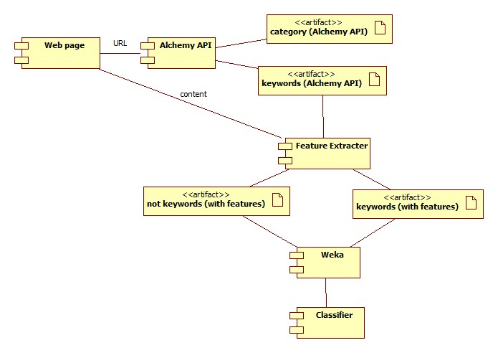

Learning Flow
Analysis And Design
Periodic calibration of the keyword classifier
Note: Between “[“ and “]” are the components I will work on

Slide 13
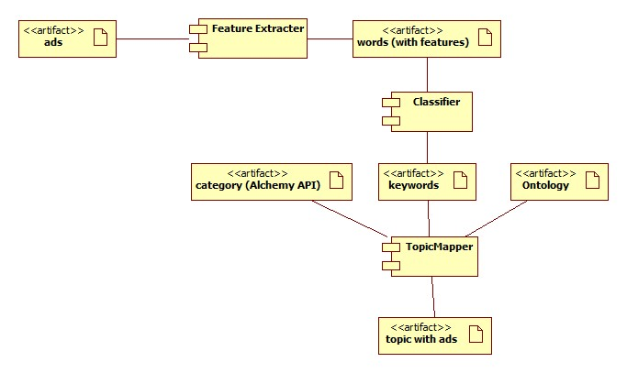
Offline Flow
Analysis And Design
Periodic topic model calibration (using new ads & web pages)
Note: Between “[“ and “]” are the components I will work on

Slide 14
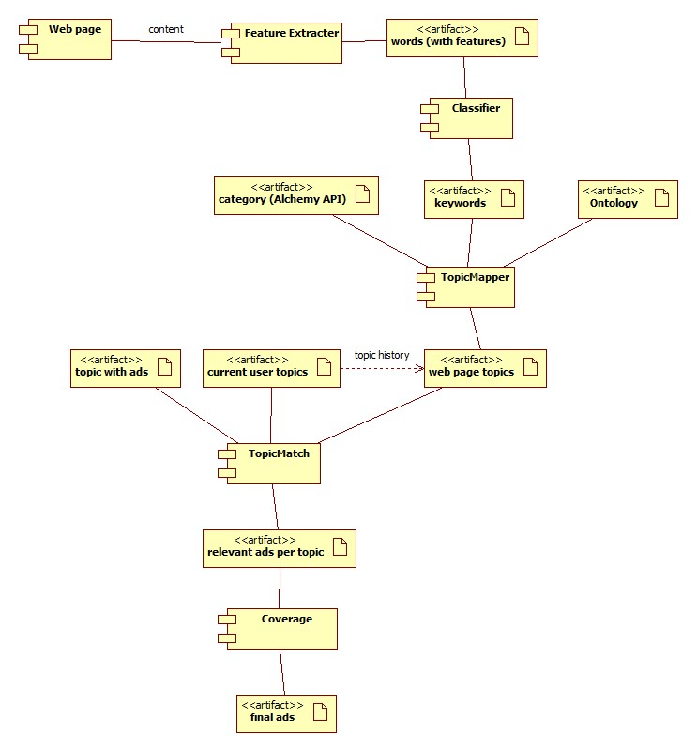
Online Flow
Analysis And Design
Real-time use case in which the system maximize the triple similarity relation and offers recommendations
Note: Between “[“ and “]” are the components I will work on

Slide 15
Component Implementation
Implementation Status
I currently implemented
Alchemy API integration
Keyword Classifier data preparation & choice
Topic Mapper (component using LDA)
To Do list
Component Integration
Topic Match
Responsible for scoring the similarity of the topic basic representation of context, ads and user interests
Coverage algorithm implementation
Topic based Round Robin

Slide 16
Dataset Gathering
Implementation Status
Web pages collection
gathered technological articles from www.techspot.com and www.techcrunch.com
Advertisement collection
used commercial system to gather test ads for the pages (Octavian will provide more details)
Bag of words model
under construction, LDA algorithm works on the collection of web pages and ads
Historical information
under construction, mock users, generated based on the recent trends (Google Trends) in technology to map on our test domain (tech articles)

Slide 17
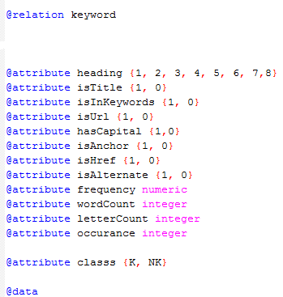
Classifier - Keyword Extraction
Current Results
Name | Correct Percentage (%) | Precision | True Positive | False Positive | F measure
Bayes Network | 89.73 | 0.96 | 0.90 | 0.12 | 0.93
Naïve Bayes | 86.44 | 0.92 | 0.90 | 0.24 | 0.91
MLP | 91.17 | 0.95 | 0.93 | 0.14 | 0.94
SMO | 86.24 | 0.90 | 0.92 | 0.31 | 0.91
Bagging | 91.79 | 0.96 | 0.93 | 0.13 | 0.94
Decision Table | 89.40 | 0.93 | 0.93 | 0.22 | 0.93
J48 | 91.70 | 0.95 | 0.93 | 0.14 | 0.94
Decision Stump | 79.20 | 1.0 | 0.72 | 0.0 | 0.84
AdaBoost | 87.81 | 0.93 | 0.91 | 0.22 | 0.92
SPegasos | 87.70 | 0.92 | 0.91 | 0.24 | 0.92
Keyword Features
Weka Classifier comparison (Dataset 22k keywords from 500 sites)

Slide 18
Topic Mapper - Parallel LDA
Current Results
Type | Thread Count | Topic Count | Iteration Count | Document Count | Sequential [ms] | Parallel [ms] | Relative Speedup
Est | 2 | 30 | 20 | 2246 | 5528.8 | 2936 | 1.8831
Est | 2 | 50 | 20 | 2246 | 8029.4 | 4148.8 | 1.9187
Est | 2 | 50 | 40 | 2246 | 16261.2 | 8281.2 | 1.9636
Est | 2 | 100 | 100 | 2246 | 77720 | 39036.6 | 1.9909
Est | 2 | 50 | 40 | 1123 | 8234.8 | 4219.4 | 1.9516
Est | 4 | 50 | 40 | 1123 | 8260.8 | 2170 | 3.8054
Inf | 2 | 100 | 100 | 1123 (rest) | 25385.4 | 13407 | 1.8934
LDA Parallel implementation compared with the original sequential version available at http://jgibblda.sourceforge.net/
Legend:
Est = Estimation
Inf = Inference (on the other half)

Slide 19
Bibliography
[1] A. Broder and V. Josifovki, Introduction to computational advertising, MSE 239, Stanford University, California, Sept-Dec 2011. [Online]. Available: http://www.stanford.edu/class/msande239
[2] David Hellerman, Digital Ad Trends – What’s Behind the Spending Boom, eMarketer.com Webinar, 22 march 2012, Available: http://www.slideshare.net/eMarketerInc/emarketer-webinar-digital-ad-trendswhats-behind-the-spending-boom-12121051

Slide 20
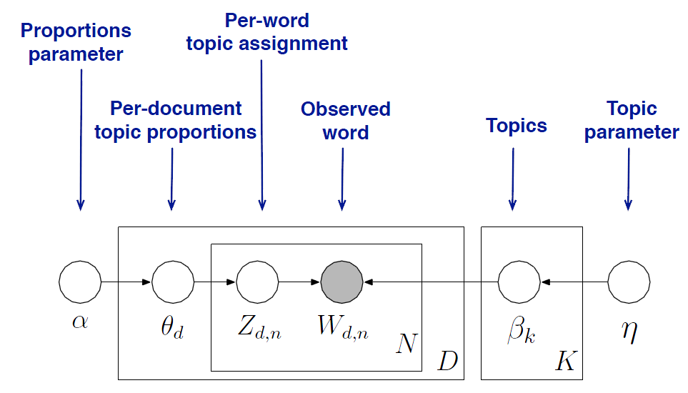
LDA Details – Graphical Model
From [g*]
[g*] D. M. Blei, Introduction to probabilistic topic models, Communications of the ACM,2011.

Slide 21
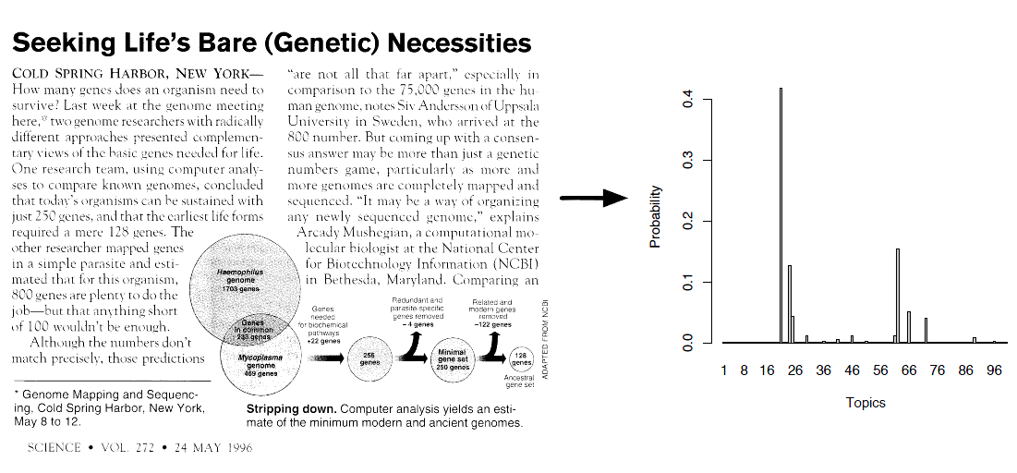
LDA Results
From [g*]
[g*] D. M. Blei, Introduction to probabilistic topic models, Communications of the ACM,2011.

Slide 22
Comparison Measure
For a given context
We have the recommendations of the commercial system (control set)
If both pass through the online flow we get
Topic distribution of the context
Topic distribution of the advertisements
Then we compute the similarity between the topics
Ideally, the most similar ads will be the control set
=> Success metric = distance between the recommended ads and the control set

