Slide 1
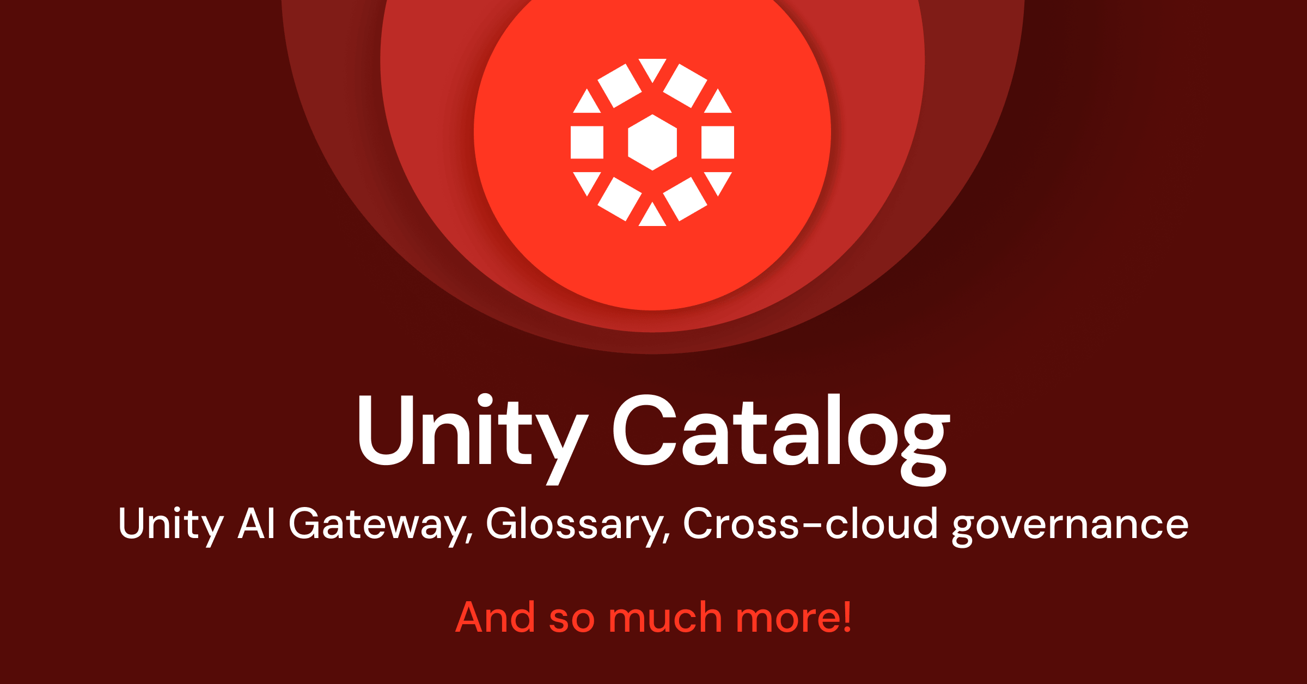
01
DATABRICKS DATA + AI SUMMIT 2026
Governance layer
Unity Catalog
What it is, why it matters, and what it means for customers.
WHAT IT IS
PROBLEM IT SOLVES
Unity Catalog is Databricks governance for data, models, agents and tools.
AI teams cannot safely reuse data if nobody trusts the permissions, lineage or definitions. It solves the “which data is approved, who owns it, and can this AI workflow use it?” problem.
WHY IT MATTERS
Official Databricks blog image
This is the bit that makes AI reusable, not just impressive in a demo. If the same customer, product or supplier data is used by analytics, agents and apps, leaders need one place to define who can use it, what it means and where it came from. Without that, every AI answer becomes another reconciliation meeting.
UK ENTERPRISE / SAINSBURY’S LENS
For a UK enterprise like Sainsbury’s, this is the audit spine: customer, supplier, colleague and operational data can be reused by AI without losing ownership, lineage or permission controls.
CUSTOMER IMPACT EXAMPLE
Customer meaning: fewer wrong offers, fewer inconsistent service answers, and less risk that sensitive loyalty or colleague data leaks into the wrong AI workflow.
So what: It can cut review time because security and data teams work from one rule book.
WHAT CHANGED
New AI Gateway links, policy updates, better glossary and domain support, external lineage, file support and wider governance links.
01/18 · Official Databricks source: https://www.databricks.com/blog/whats-new-unity-catalog-data-ai-summit-2026

Slide 2
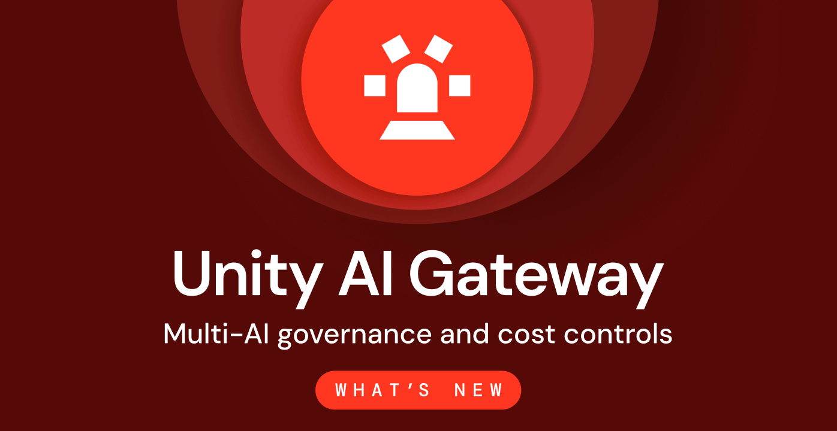
02
DATABRICKS DATA + AI SUMMIT 2026
Governance layer
Unity AI Gateway
What it is, why it matters, and what it means for customers.
WHAT IT IS
PROBLEM IT SOLVES
Unity AI Gateway controls how models, agents and tools run.
Enterprises are about to have model and agent sprawl: different tools, different costs, different risks. It solves the “how do we route, monitor and control AI usage centrally?” problem.
WHY IT MATTERS
Official Databricks blog image
As soon as teams start using multiple models and agents, the question changes from “can we build it?” to “can we control it?”. This matters because uncontrolled AI creates hidden cost, duplicated tools and risky actions. A gateway is the traffic control layer for model access, tool use, spend, audit and policy.
UK ENTERPRISE / SAINSBURY’S LENS
This is the control plane procurement will ask for: which models are allowed, what they cost, what tools they can touch, and who is accountable when an agent acts.
CUSTOMER IMPACT EXAMPLE
Customer meaning: AI experiences can be safer and more consistent because the company controls which models answer, what tools they can use, and when a human should stay in the loop.
So what: It gives platform teams a way to approve AI use without approving every tool one by one.
WHAT CHANGED
Runtime controls for models and agents, spend caps, smart routing, MCP controls and traces.
02/18 · Official Databricks source: https://www.databricks.com/blog/ai-governance-data-ai-summit-2026-whats-new-unity-ai-gateway

Slide 3
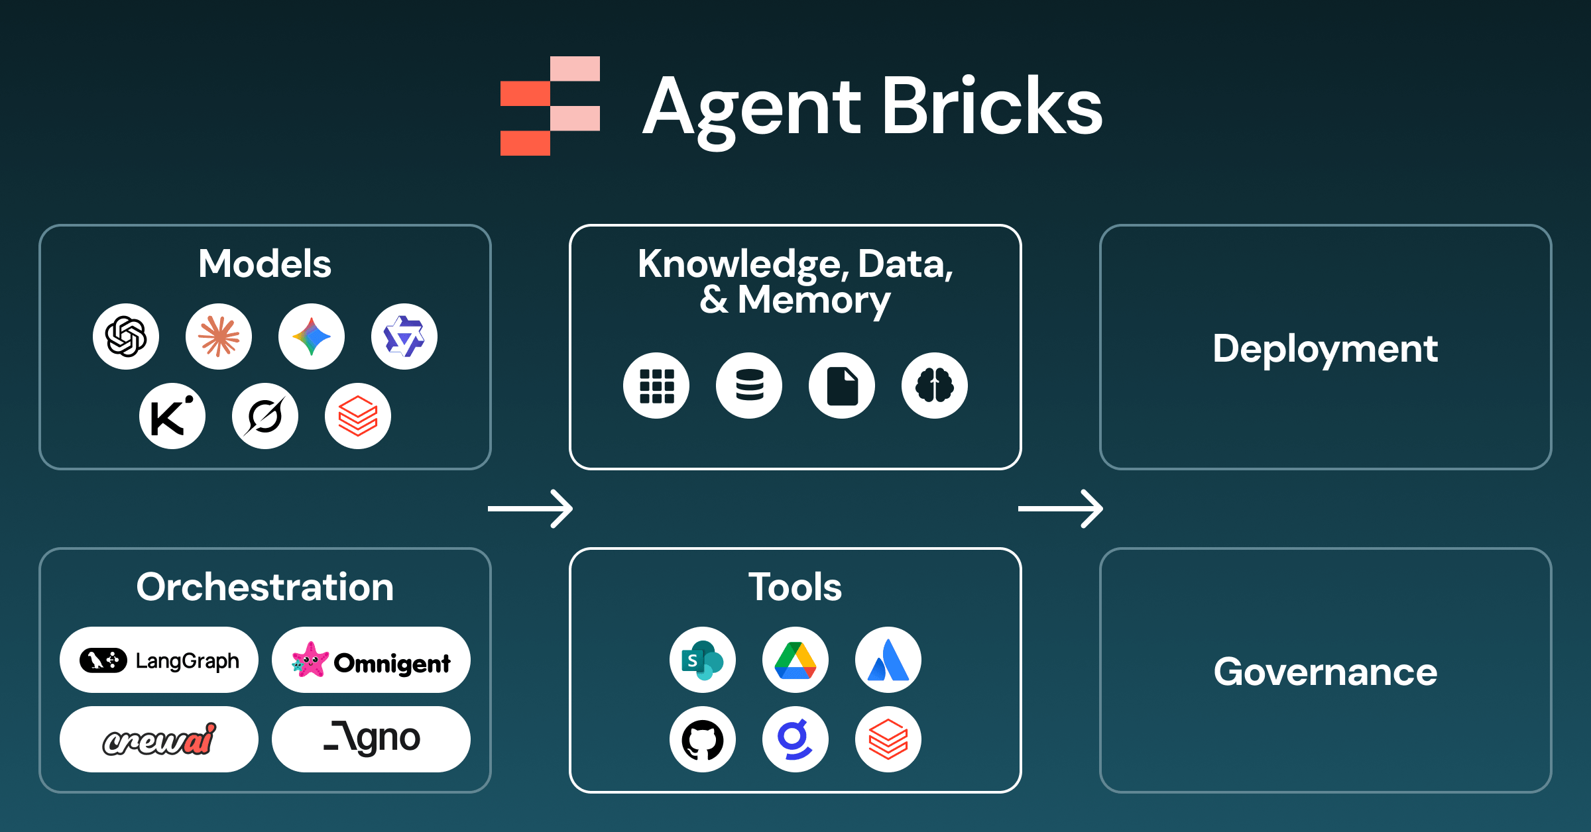
03
DATABRICKS DATA + AI SUMMIT 2026
Agent build layer
Agent Bricks
What it is, why it matters, and what it means for customers.
WHAT IT IS
PROBLEM IT SOLVES
Agent Bricks is Databricks platform for building and running AI agents.
Agent pilots often die because every team rebuilds retrieval, tools, memory, evaluation and monitoring from scratch. It solves the “how do we industrialise agent development?” problem.
WHY IT MATTERS
Official Databricks blog image
Most enterprises have plenty of agent experiments and very few agent products. Agent Bricks matters because it tries to turn agent-building into a repeatable factory: domain context, evaluation, memory, tracing and governance in one path. That is what moves agents from innovation theatre to business operations.
UK ENTERPRISE / SAINSBURY’S LENS
It gives teams a path from “clever demo” to repeatable domain agents for planning, service, supply chain or store operations without every squad inventing its own stack.
CUSTOMER IMPACT EXAMPLE
Customer meaning: more useful service and operations agents. For example, an availability agent can explain why an online order substitution happened instead of giving a generic “out of stock” message.
So what: It should reduce repeated setup work for teams building agents.
WHAT CHANGED
More model choice, more context connectors, Lakebase memory, Unity AI Gateway control and agent tracing.
03/18 · Official Databricks source: https://www.databricks.com/blog/agent-bricks-dais-2026

Slide 4
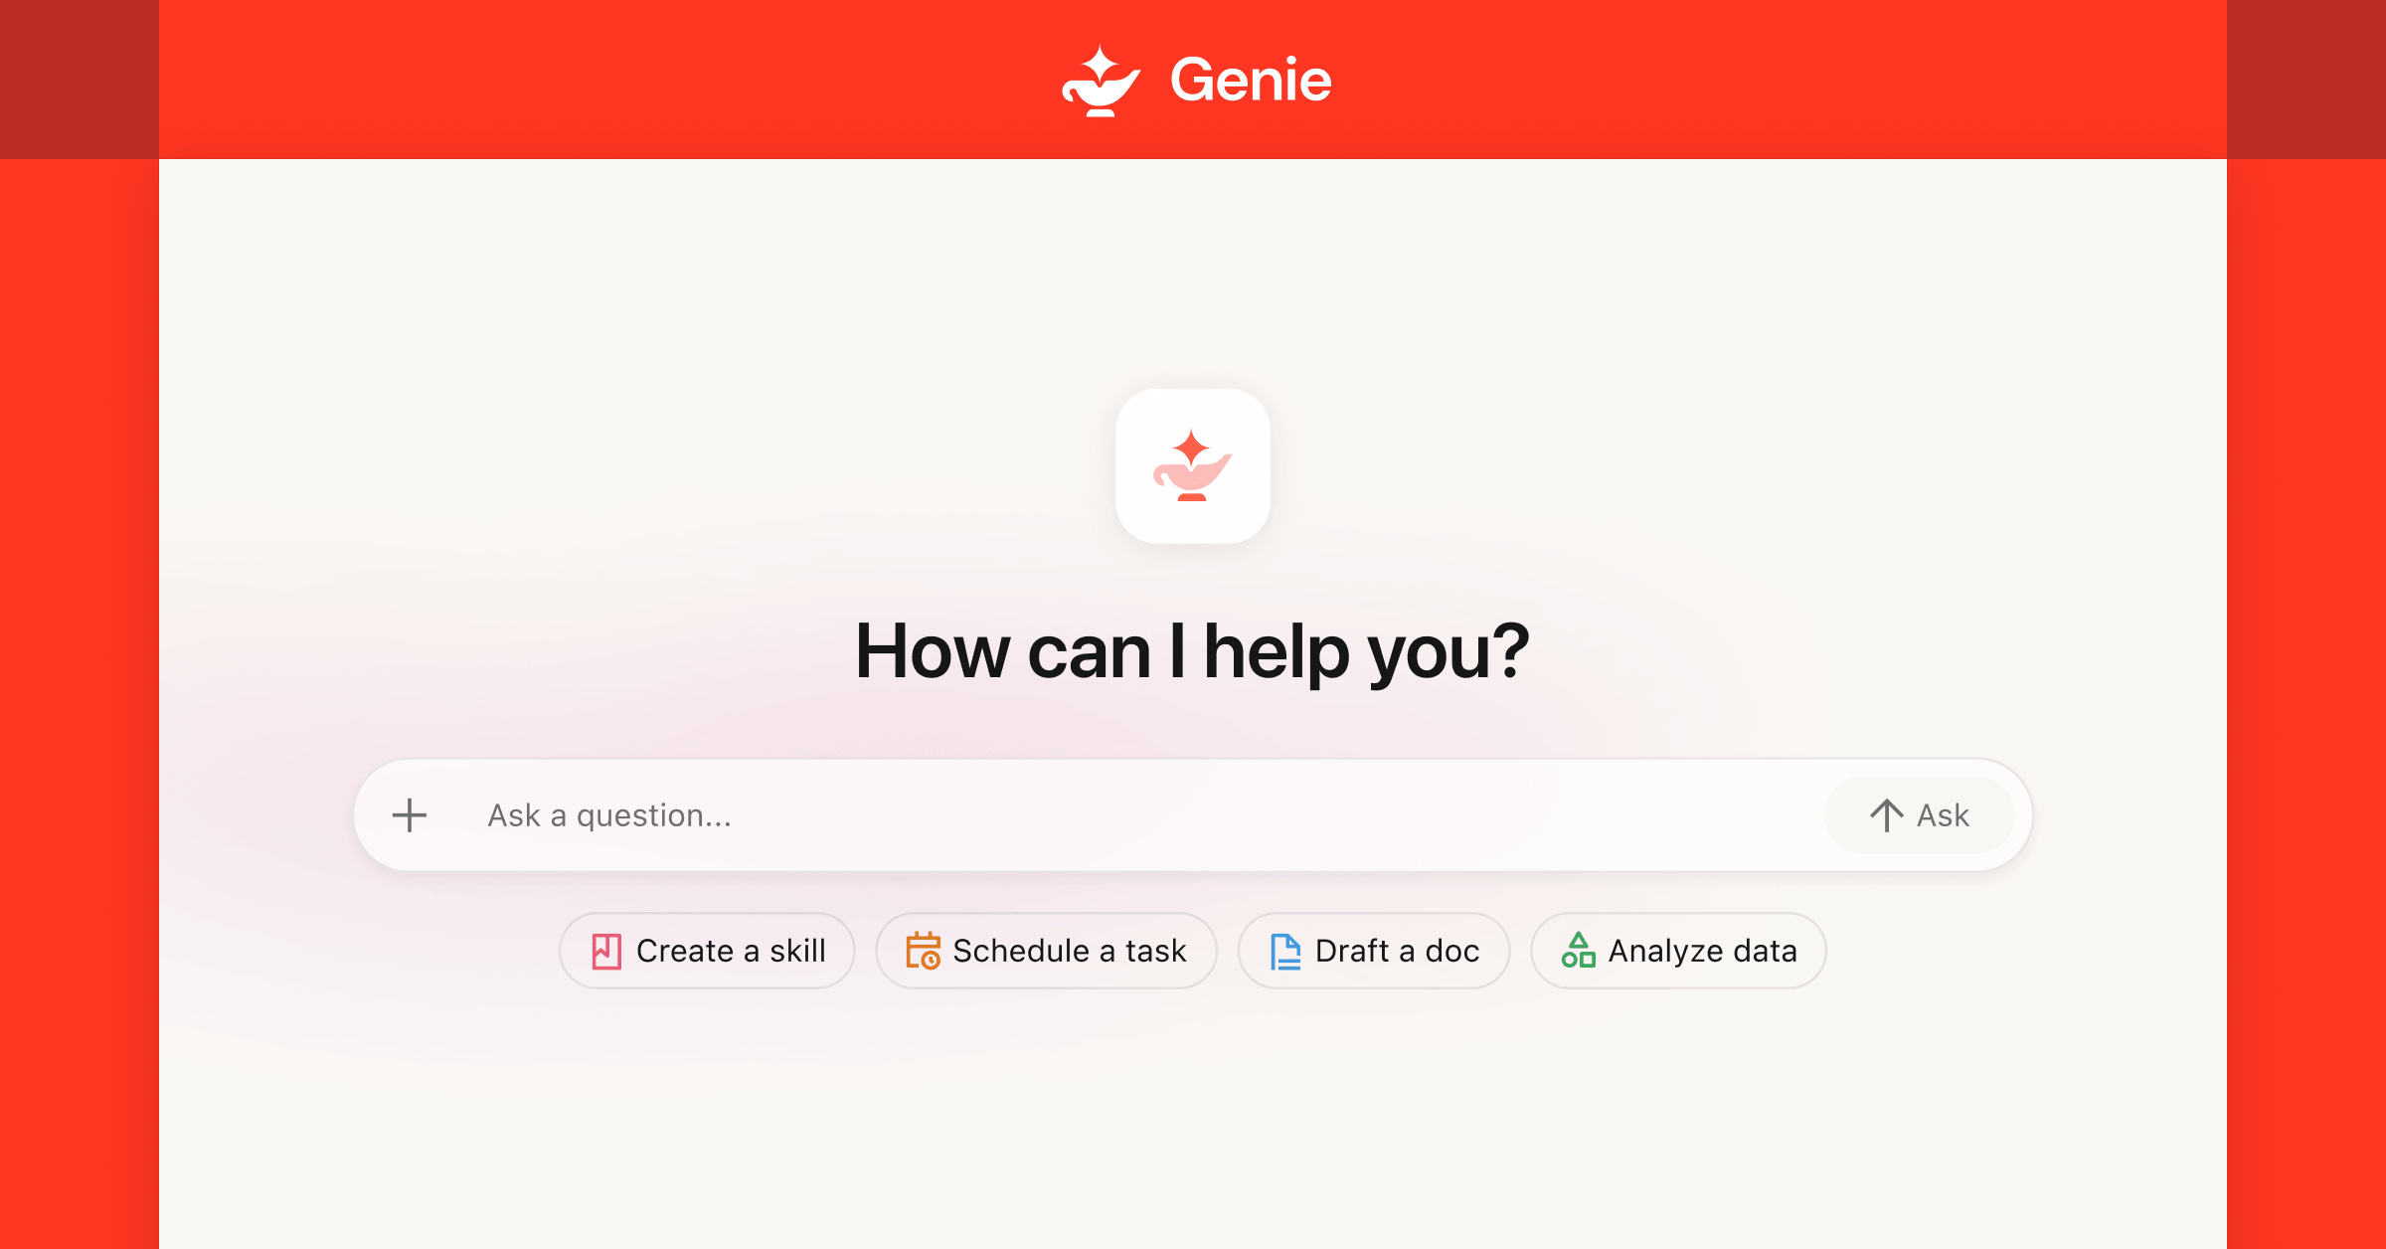
04
DATABRICKS DATA + AI SUMMIT 2026
Business AI layer
Genie One
What it is, why it matters, and what it means for customers.
WHAT IT IS
PROBLEM IT SOLVES
Genie One is an AI coworker for business teams.
Business users still depend on analysts for too many everyday questions and follow-up actions. It solves the “how do non-technical teams get trusted answers and take action faster?” problem.
WHY IT MATTERS
Official Databricks blog image
The real shift is not another chatbot. It is business users getting a governed AI worker that can understand company data, answer questions and help trigger work. That matters because demand for insight is always higher than analyst capacity, especially in trading, operations, marketing and finance teams.
UK ENTERPRISE / SAINSBURY’S LENS
Business teams get a safer way to ask questions and kick off work from governed data, useful for trading, availability, marketing and customer teams that cannot wait in BI queues.
CUSTOMER IMPACT EXAMPLE
Customer meaning: frontline and commercial teams get answers faster. A store or contact-centre leader can ask what changed today and act before customers see empty shelves or slow responses.
So what: It can move routine analysis out of analyst queues.
WHAT CHANGED
A business user agent, tool actions, enterprise context and workflow support through Genie Ontology.
04/18 · Official Databricks source: https://www.databricks.com/blog/introducing-genie-one-genie-ontology-and-genie-agents

Slide 5
05
DATABRICKS DATA + AI SUMMIT 2026
Business AI layer
Genie Ontology
What it is, why it matters, and what it means for customers.
WHAT IT IS
PROBLEM IT SOLVES
Genie Ontology is a living map of business meaning.
AI does not naturally understand company language, metric definitions or relationships. It solves the “how does the AI know what sales, margin, customer or product actually mean here?” problem.
WHY IT MATTERS
Official Databricks blog image
AI fails in enterprises when it does not understand business language. “Sales”, “availability”, “active customer”, “margin” and “churn” can mean different things by team. Genie Ontology matters because it gives agents a business map, so answers are grounded in the organisation’s definitions rather than whatever table name looked plausible.
UK ENTERPRISE / SAINSBURY’S LENS
This matters because UK retailers and banks argue over definitions: sales, margin, availability, churn, loyalty and consent. Agents need the business meaning, not just tables.
CUSTOMER IMPACT EXAMPLE
Customer meaning: the AI stops mixing up business definitions. A customer should not get one answer from marketing and another from service because systems disagree on loyalty status or product eligibility.
So what: It can reduce metric disputes and improve answer quality.
WHAT CHANGED
A semantic graph built from tables, dashboards, queries, apps, usage and ownership signals.
05/18 · Official Databricks source: https://www.databricks.com/blog/introducing-genie-one-genie-ontology-and-genie-agents

Slide 6
06
DATABRICKS DATA + AI SUMMIT 2026
Business AI layer
Genie Agents
What it is, why it matters, and what it means for customers.
WHAT IT IS
PROBLEM IT SOLVES
Genie Agents are conversational agents for analytics.
Dashboards answer yesterday’s fixed questions, but teams need conversational, governed help. It solves the “how do we turn BI into reusable assistants?” problem.
WHY IT MATTERS
Official Databricks blog image
This matters because it packages trusted analytics into assistants people can actually use. Instead of everyone learning SQL or waiting for a dashboard change, a category manager, store ops lead or finance partner can ask a governed agent and stay inside approved permissions and definitions.
UK ENTERPRISE / SAINSBURY’S LENS
This can turn trusted analytics into reusable assistants for category teams, store ops, finance and contact centres, while keeping permissions and definitions intact.
CUSTOMER IMPACT EXAMPLE
Customer meaning: faster, more trusted answers for the people serving customers. A colleague could ask a governed agent about a product, return policy or local availability and get a consistent response.
So what: They can reduce BI bottlenecks while keeping access controls in place.
WHAT CHANGED
Ontology grounded answers, permission checks and sharable analytics agents.
06/18 · Official Databricks source: https://www.databricks.com/blog/introducing-genie-one-genie-ontology-and-genie-agents

Slide 7
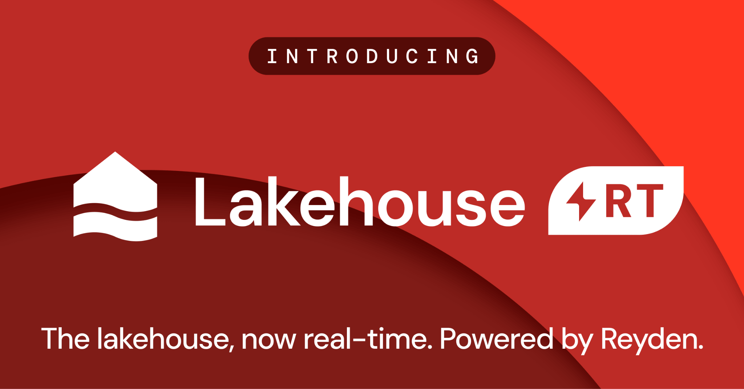
07
DATABRICKS DATA + AI SUMMIT 2026
Real-time data layer
Lakehouse RT
What it is, why it matters, and what it means for customers.
WHAT IT IS
PROBLEM IT SOLVES
Lakehouse RT brings low latency analytics directly to lakehouse data.
Traditional analytics can be too slow for operational decisions. It solves the “how do apps and agents act on fresh data without a separate real-time stack?” problem.
WHY IT MATTERS
Official Databricks blog image
Customer and operational decisions often have a short shelf life. If the data is hours old, the action is already late. Lakehouse RT matters because it pushes the lakehouse closer to real-time use cases: availability, fulfilment exceptions, fraud signals, service interventions and fast-changing demand.
UK ENTERPRISE / SAINSBURY’S LENS
Fresh data is the difference between a useful agent and a stale dashboard. Think stock availability, fraud signals, fulfilment exceptions and customer interventions.
CUSTOMER IMPACT EXAMPLE
Customer meaning: interventions happen while they still matter: stock alerts before a basket fails, fraud checks during the transaction, fulfilment updates before the delivery promise breaks.
So what: It can simplify real time architecture if the claims hold for the workload.
WHAT CHANGED
The Reyden engine, direct Delta and Iceberg reads, millisecond query claims and less need for a separate real time serving layer.
07/18 · Official Databricks source: https://www.databricks.com/blog/introducing-lakehousert-real-time-performance-unified-lakehouse

Slide 8
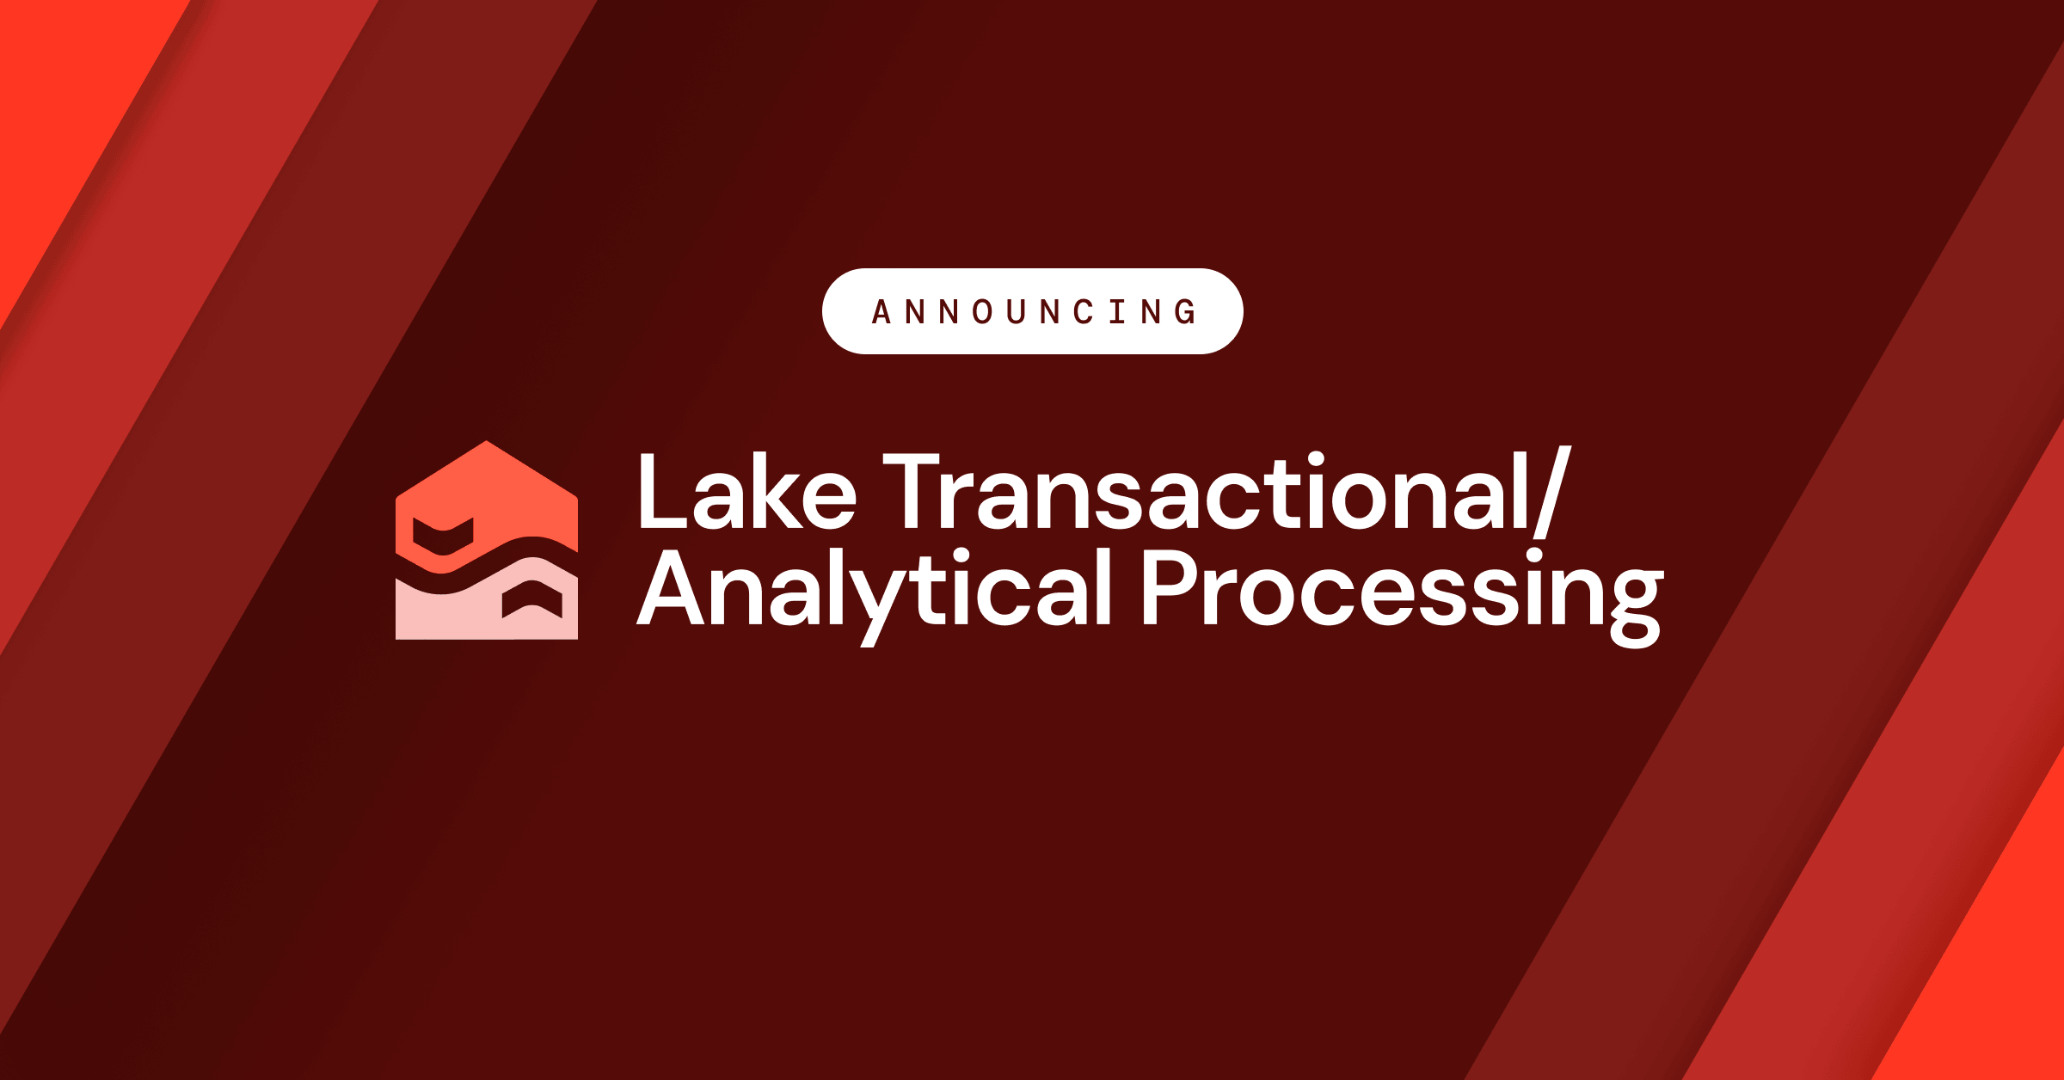
08
DATABRICKS DATA + AI SUMMIT 2026
Operational data layer
LTAP, Lakebase + disaster recovery
What it is, why it matters, and what it means for customers.
WHAT IT IS
PROBLEM IT SOLVES
LTAP gives apps, analytics and agents one governed system of record across transactions and analytics.
Apps and agents need transactional state as well as analytics. It solves the “where does an AI app store orders, cases, approvals, memory and recovery state?” problem.
WHY IT MATTERS
Official Databricks blog image
Analytics platforms have historically been great at insight and weaker at operational state. Agents and apps need both: the latest transaction, the task status, the case history, the approval trail. Lakebase and LTAP matter because they bring operational application patterns closer to governed analytical data.
UK ENTERPRISE / SAINSBURY’S LENS
Operational AI needs state: orders, cases, tasks, memory, approvals. Lakebase points Databricks closer to app-facing systems, not just analytics.
CUSTOMER IMPACT EXAMPLE
Customer meaning: AI apps can remember state. For example, a service agent can track a refund case, approvals and next action without bouncing the customer between systems.
So what: It can reduce data copies, failover work and engineering time if the production limits match the workload.
WHAT CHANGED
LTAP, Lakebase as the transactional layer, disaster recovery, branching and snapshots.
08/18 · Official Databricks source: https://www.databricks.com/company/newsroom/press-releases/databricks-launches-ltap-first-lake-transactionalanalytical

Slide 9
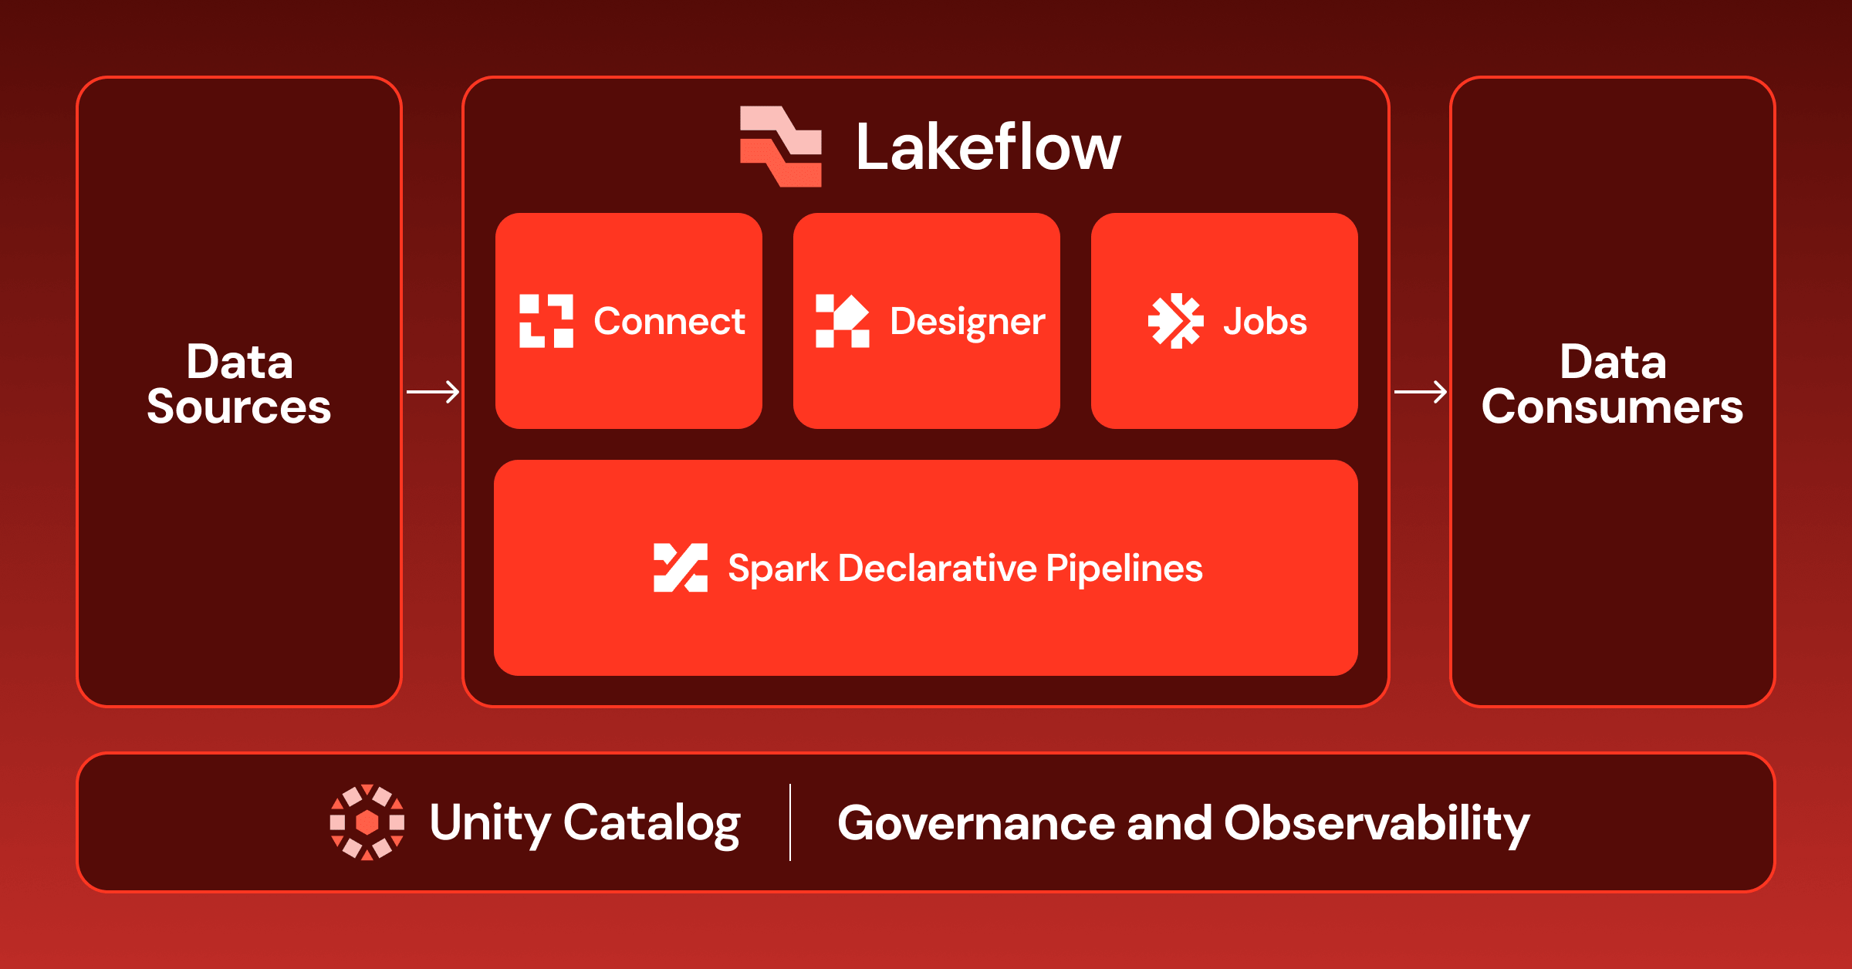
09
DATABRICKS DATA + AI SUMMIT 2026
Data engineering layer
Lakeflow
What it is, why it matters, and what it means for customers.
WHAT IT IS
PROBLEM IT SOLVES
Lakeflow is Databricks data engineering platform for ingestion, transform and orchestration.
Data pipelines are fragmented, brittle and slow to change. It solves the “how do we keep trusted data flowing into analytics and AI without endless plumbing?” problem.
WHY IT MATTERS
Official Databricks blog image
This matters because AI is only as good as the pipelines feeding it. If teams cannot reliably ingest, transform and orchestrate data, agents will give stale or broken answers. Lakeflow is about making the plumbing less bespoke, less fragile and easier to operate at scale.
UK ENTERPRISE / SAINSBURY’S LENS
Most AI programmes fail quietly in the plumbing. Faster governed ingestion and orchestration means less time stitching pipelines and more time shipping use cases.
CUSTOMER IMPACT EXAMPLE
Customer meaning: fewer broken journeys caused by stale or missing data. Better pipelines mean more reliable stock, pricing, delivery and personalisation signals.
So what: It can reduce pipeline build time and tool sprawl.
WHAT CHANGED
More connectors, Designer, Genie Code help, Zerobus ingest and Lakeflow Jobs.
09/18 · Official Databricks source: https://www.databricks.com/blog/lakeflow-new-era-agentic-data-engineering

Slide 10
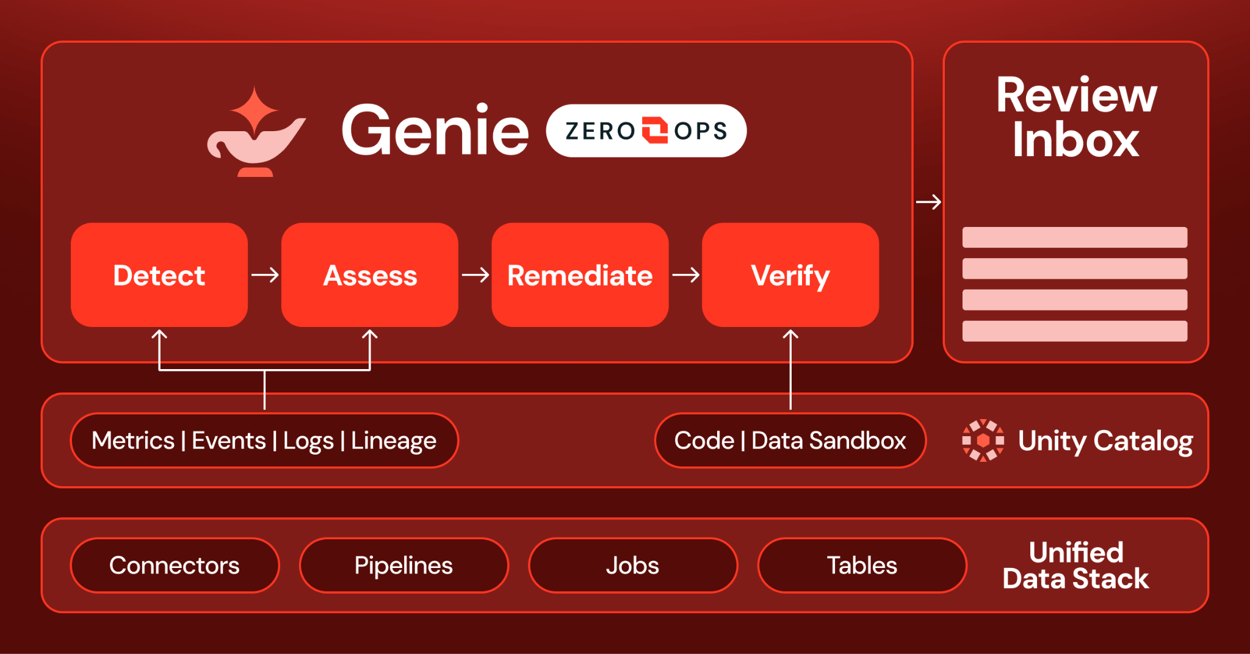
10
DATABRICKS DATA + AI SUMMIT 2026
Operations layer
Genie ZeroOps
What it is, why it matters, and what it means for customers.
WHAT IT IS
PROBLEM IT SOLVES
Genie ZeroOps watches production data and AI workloads.
Production data and AI systems break in ways humans spot too late. It solves the “how do we detect, diagnose and fix platform issues before users feel them?” problem.
WHY IT MATTERS
Official Databricks blog image
More AI means more production things to watch: data quality, jobs, models, agents, endpoints and pipelines. Genie ZeroOps matters because platform teams cannot manually inspect everything. The promise is earlier detection, faster diagnosis and safer suggested fixes before users feel the pain.
UK ENTERPRISE / SAINSBURY’S LENS
AI estates will create more moving parts, not fewer. Automated monitoring and suggested fixes help small platform teams keep production workloads healthy.
CUSTOMER IMPACT EXAMPLE
Customer meaning: fewer invisible platform failures turning into bad experiences. If a pricing feed, recommendation job or service model degrades, teams can detect and fix it faster.
So what: It can cut triage time, but human approval still matters.
WHAT CHANGED
Background checks, issue investigation, cloned data testing and suggested fixes.
10/18 · Official Databricks source: https://www.databricks.com/blog/introducing-genie-zeroops

Slide 11
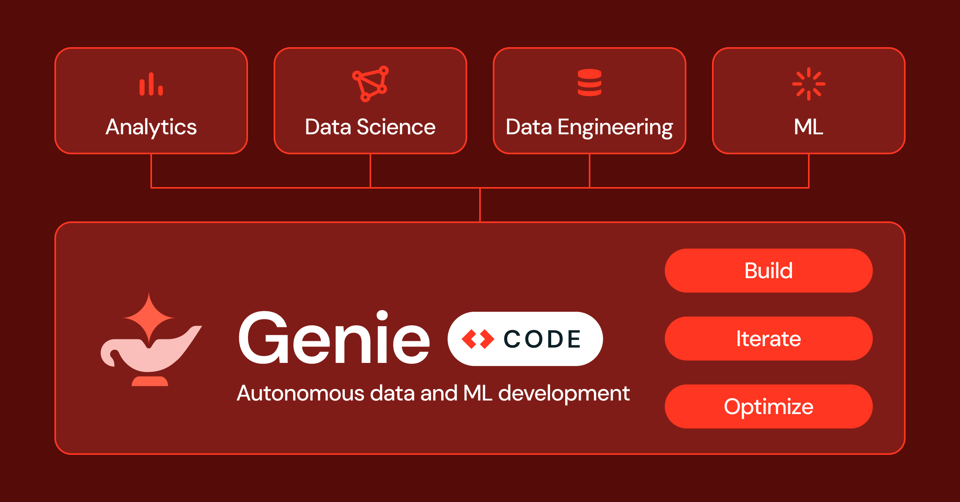
11
DATABRICKS DATA + AI SUMMIT 2026
Developer layer
Genie Code
What it is, why it matters, and what it means for customers.
WHAT IT IS
PROBLEM IT SOLVES
Genie Code is a coding agent for data and ML work.
Data teams lose time on repetitive notebook, pipeline and ML code work. It solves the “how do engineers move faster inside the data platform without leaving governance behind?” problem.
WHY IT MATTERS
Official Databricks blog image
This matters because data and ML teams spend too much time on repeatable coding chores: notebooks, pipelines, docs, endpoint checks and glue code. A coding agent inside the data platform can speed that up, but only if review, testing and release discipline stay in place.
UK ENTERPRISE / SAINSBURY’S LENS
Data engineers and ML teams get a helper for notebooks, pipelines and docs. Useful, but only if code review and production gates stay non-negotiable.
CUSTOMER IMPACT EXAMPLE
Customer meaning: teams can ship improvements faster, but the value only lands if governance stops rushed code becoming a customer-impacting bug.
So what: It can save engineering time if teams keep review gates in place.
WHAT CHANGED
A full page workspace, MLflow context, endpoint checks, scheduled tasks and GPU runtime switching.
11/18 · Official Databricks source: https://www.databricks.com/blog/whats-new-genie-code-data-ai-summit-2026

Slide 12
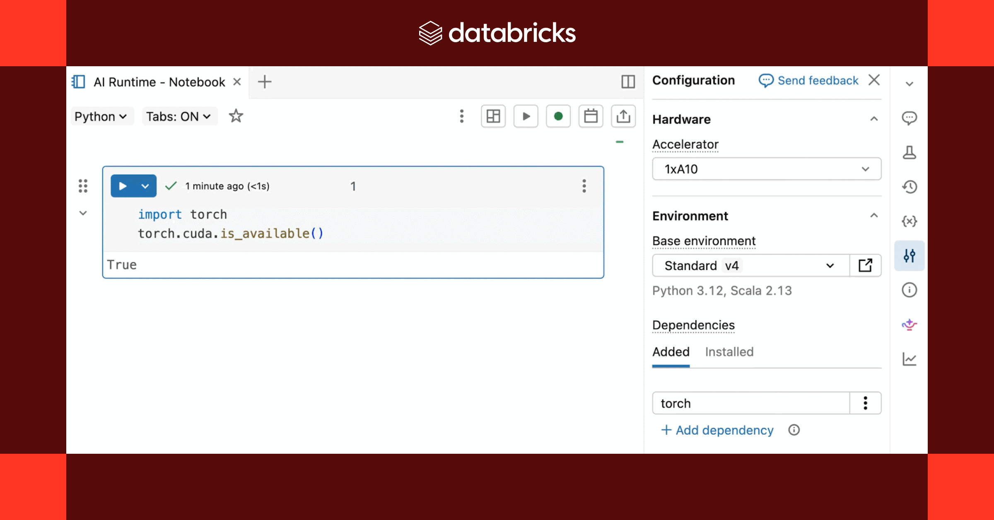
12
DATABRICKS DATA + AI SUMMIT 2026
Developer layer
Genie Code + ZeroOps for ML
What it is, why it matters, and what it means for customers.
WHAT IT IS
PROBLEM IT SOLVES
Databricks added agent help for ML engineering, model serving and model operations.
ML teams struggle with the handoff from experiment to production monitoring. It solves the “how do we operationalise models and keep them healthy?” problem.
WHY IT MATTERS
Official Databricks blog image
Many ML projects do not fail in the model-building stage; they stall between experiment, deployment, monitoring and remediation. This matters because it targets the messy middle of ML operations: getting models served, observed, fixed and improved without handoffs slowing everything down.
UK ENTERPRISE / SAINSBURY’S LENS
For mature UK firms, this compresses the slog between experiment, serving, monitoring and remediation — where many ML projects get stuck.
CUSTOMER IMPACT EXAMPLE
Customer meaning: models that power recommendations, demand forecasts or service triage can be monitored and improved more quickly when behaviour changes.
So what: It can speed model iteration and cut operations work, but teams still need review gates.
WHAT CHANGED
Genie Code for ML work, Genie ZeroOps for ML, online feature serving on Lakebase and model serving updates.
12/18 · Official Databricks source: https://www.databricks.com/blog/whats-new-ai-platform-agents-ml-engineering-our-deep-learning-platform-and-new-capabilities

Slide 13
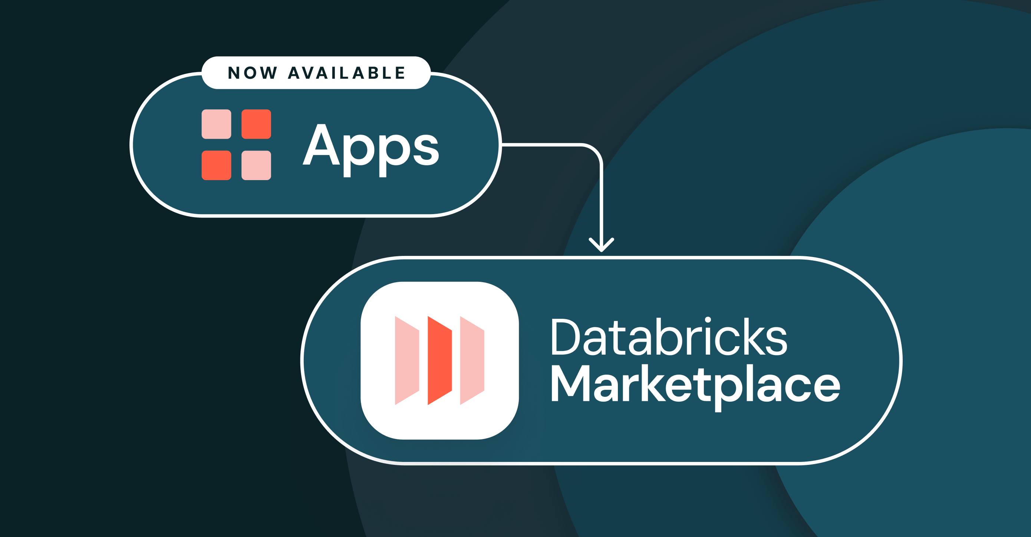
13
DATABRICKS DATA + AI SUMMIT 2026
Distribution layer
Apps on Databricks Marketplace
What it is, why it matters, and what it means for customers.
WHAT IT IS
PROBLEM IT SOLVES
Marketplace apps run third party tools on governed Databricks data.
Using specialist apps usually means copying sensitive data into another vendor environment. It solves the “how do we use third-party tools without exporting governed data everywhere?” problem.
WHY IT MATTERS
Official Databricks blog image
This matters because every vendor app usually asks for another copy of sensitive data. Marketplace apps running closer to governed Databricks data could reduce export risk, shorten setup and make it easier to try specialist tools without creating another shadow data estate.
UK ENTERPRISE / SAINSBURY’S LENS
Vendor apps can run closer to governed data instead of demanding another risky data export. That is a big deal for customer, loyalty and regulated datasets.
CUSTOMER IMPACT EXAMPLE
Customer meaning: companies can use specialist apps without copying customer data into every vendor environment, reducing privacy and security exposure.
So what: It can shorten vendor setup and reduce data export risk.
WHAT CHANGED
One click install, permission checks, serverless provisioning and app sandboxing.
13/18 · Official Databricks source: https://www.databricks.com/blog/announcing-apps-databricks-marketplace

Slide 14
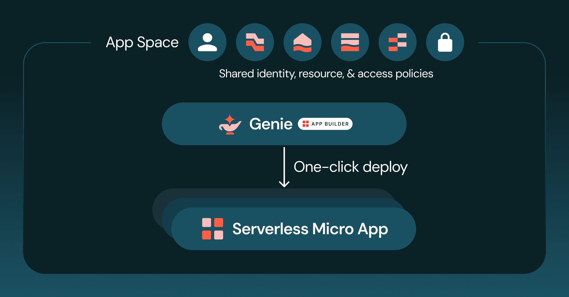
14
DATABRICKS DATA + AI SUMMIT 2026
App layer
App Spaces + Genie App Builder
What it is, why it matters, and what it means for customers.
WHAT IT IS
PROBLEM IT SOLVES
Databricks announced three app-building capabilities: App Spaces for governance, Genie App Builder for natural-language app creation, and a lightweight micro app runtime for cheaper scale-to-zero apps.
Small internal apps take too long or bypass IT when teams get desperate. It solves the “how do we build lightweight governed apps around business workflows?” problem.
WHY IT MATTERS
Official Databricks blog image
The useful AI work often shows up as small internal apps: a stock exception view, a campaign planner, a field sales tool, a service triage screen. This matters because it gives teams a faster route to build those apps while keeping them inside platform governance, cost controls and access rules.
UK ENTERPRISE / SAINSBURY’S LENS
Small internal apps are where AI becomes daily work. This offers a route to build them quickly without bypassing IT, security or data governance.
CUSTOMER IMPACT EXAMPLE
Customer meaning: teams can build small tools around real customer pain points quickly, such as a colleague app for substitutions, complaints, campaign checks or product queries.
So what: It can cut small app backlogs without copying data out of Databricks.
WHAT CHANGED
App Spaces for governing groups of apps, Genie App Builder as the data-aware build agent, and a lightweight micro app runtime for cheaper scale-to-zero apps.
14/18 · Official Databricks source: https://www.databricks.com/blog/enabling-governed-vibe-coding-enterprise-apps-databricks

Slide 15
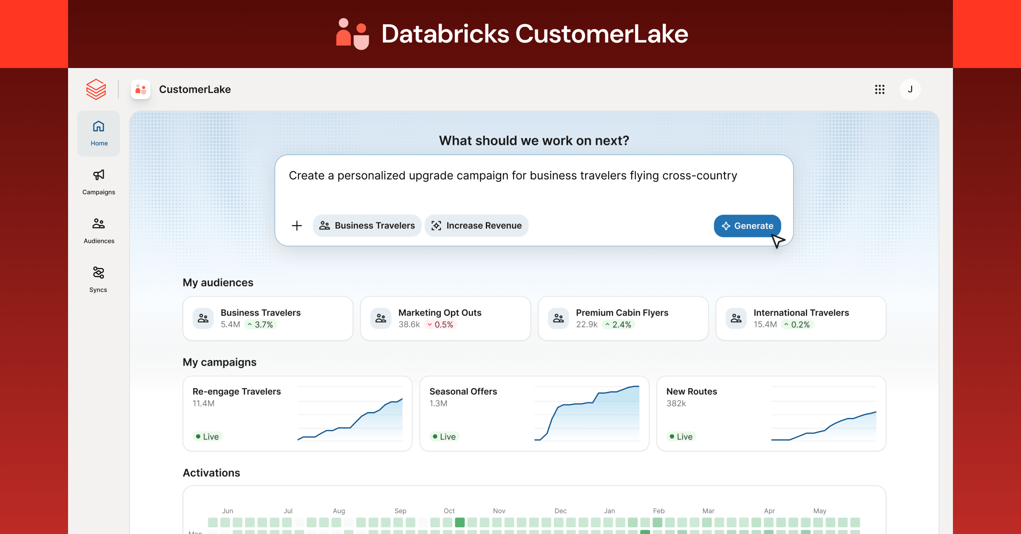
15
DATABRICKS DATA + AI SUMMIT 2026
Industry solution layer
CustomerLake
What it is, why it matters, and what it means for customers.
WHAT IT IS
PROBLEM IT SOLVES
CustomerLake is Databricks agentic customer data platform.
Customer data is split across marketing, loyalty, service, ecommerce and consent systems. It solves the “how do we give AI a joined-up, permission-aware customer view?” problem.
WHY IT MATTERS
Official Databricks blog image
Customer AI needs more than a profile table. It needs consent, identity, behaviour, transactions, preferences and journey context in one place agents can use safely. CustomerLake matters because it aims to make personalisation and customer service more actionable without spraying customer data across tools.
UK ENTERPRISE / SAINSBURY’S LENS
Customer AI needs consent-aware, joined-up context. This is directly relevant to loyalty, next-best-action, personalisation and service journeys.
CUSTOMER IMPACT EXAMPLE
Customer meaning: more relevant offers and service because the AI can see joined-up context, but only if consent, preference and suppression rules are treated as first-class data.
So what: It can reduce customer data platform sprawl and speed personalisation, but consent and governance need tight ownership.
WHAT CHANGED
CustomerLake, Golden Context, marketing agents and agentic CDP workflows inside Databricks.
15/18 · Official Databricks source: https://www.databricks.com/blog/introducing-customerlake-agentic-cdp

Slide 16
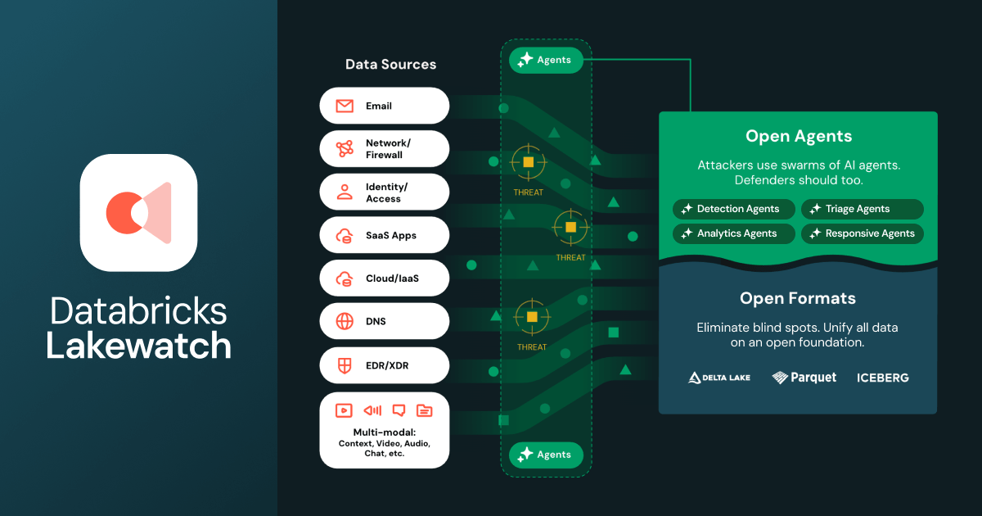
16
DATABRICKS DATA + AI SUMMIT 2026
Observability layer
Lakewatch + Panther
What it is, why it matters, and what it means for customers.
WHAT IT IS
PROBLEM IT SOLVES
Lakewatch is Databricks agentic SIEM built on a security lakehouse.
Security telemetry is expensive, fragmented and hard to investigate quickly. It solves the “how do we store more security history and investigate incidents faster?” problem.
WHY IT MATTERS
Official Databricks blog image
Security teams are drowning in data and cost. This matters because AI increases the attack surface while also creating more telemetry to inspect. A lakehouse SIEM approach could keep longer history at lower cost and give analysts agent assistance for investigation and response.
UK ENTERPRISE / SAINSBURY’S LENS
Security teams need cheaper retention and faster investigation as AI expands the attack surface. A lakehouse SIEM story could change the economics.
CUSTOMER IMPACT EXAMPLE
Customer meaning: better protection of customer and payment data. Longer security history and faster investigations can reduce breach dwell time and operational disruption.
So what: It can reduce security storage pressure and help analysts investigate faster, if connector coverage and detection quality are good enough.
WHAT CHANGED
Lakewatch, Panther ecosystem links, security data connectors, AI assisted investigation and open security lakehouse positioning.
16/18 · Official Databricks source: https://www.databricks.com/blog/databricks-announces-lakewatch-new-agentic-siem

Slide 17
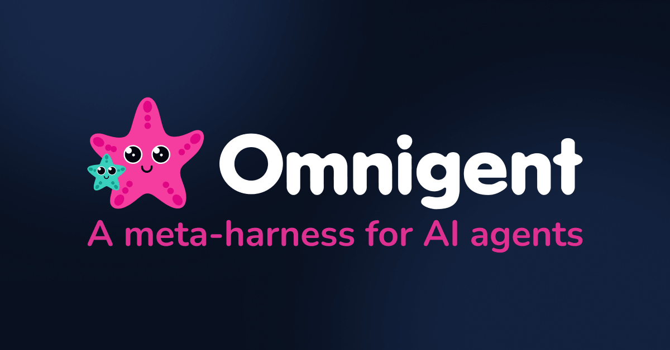
17
DATABRICKS DATA + AI SUMMIT 2026
Agent operations layer
Omnigent
What it is, why it matters, and what it means for customers.
WHAT IT IS
PROBLEM IT SOLVES
Omnigent is an open source harness for working with different agents.
Organisations will have many disconnected agents with no common harness. It solves the “how do we compare, combine, sandbox and govern different agents?” problem.
WHY IT MATTERS
Official Databricks blog image
Enterprises will not have one agent. They will have many: vendor agents, internal agents, copilots and workflow agents. Omnigent matters because it points to the next management problem: comparing, composing, sandboxing and sharing agents without letting the estate become chaos.
UK ENTERPRISE / SAINSBURY’S LENS
Agent sprawl is coming. A harness for comparing, composing and controlling agents helps platform teams avoid twenty disconnected assistants.
CUSTOMER IMPACT EXAMPLE
Customer meaning: customers experience fewer disconnected AI behaviours. The company can test and compare agents before letting them touch real journeys.
So what: It can reduce agent sprawl, though it adds another layer to manage.
WHAT CHANGED
A shared harness for composing, controlling and sharing agents with sandbox patterns.
17/18 · Official Databricks source: https://www.databricks.com/blog/introducing-omnigent-meta-harness-combine-control-and-share-your-agents

Slide 18

18
DATABRICKS DATA + AI SUMMIT 2026
Governance layer
Platform security + compliance
What it is, why it matters, and what it means for customers.
WHAT IT IS
PROBLEM IT SOLVES
Databricks announced security and compliance updates for the platform.
AI cannot scale if security, identity, networking and compliance are bolted on afterwards. It solves the “what must be true before risk and procurement approve production AI?” problem.
WHY IT MATTERS
Official Databricks blog image
This is the boring-but-essential layer. Boards, CISOs and procurement teams will not approve AI at scale unless identity, private networking, zero-trust ingress, audit and compliance are credible. Security updates matter because they decide whether pilots can become production services.
UK ENTERPRISE / SAINSBURY’S LENS
UK boards will not scale AI on vibes. Identity, network isolation and compliance coverage are what turn pilots into approved production services.
CUSTOMER IMPACT EXAMPLE
Customer meaning: AI can be used in sensitive journeys — payments, identity, service, colleague tools — without asking customers to accept a weaker security posture.
So what: It can reduce procurement friction when the controls are real and documented.
WHAT CHANGED
Identity, zero trust ingress, private networking and compliance coverage updates.
18/18 · Official Databricks source: https://www.databricks.com/blog/whats-new-databricks-platform-security-and-compliance-data-ai-summit-2026

