Slide 1
Kōan 3:Machine Reasoning based on Deep Learning
Members:向飞宇 张洪瑞 潘岳 易翔飞 匡元睿

Slide 2
Context
What is Machine Reasoning?
Difference between Machine Reasoning and Machine Learning
From Deep Blue to AlphaGo Zero
Challenging problems for embodied reasoning
Potentials of Machine Reasoning killer application
Limitations of Machine Reasoning killer application

Slide 3
Context
What is Machine Reasoning?
Difference between Machine Reasoning and Machine Learning
From Deep Blue to AlphaGo Zero
Challenging problems for embodied reasoning
Potentials of Machine Reasoning killer application
Limitations of Machine Reasoning killer application

Slide 4
What is Machine Reasoning?
A method to generates conclusions from available knowledge using logical techniques such as deduction(演绎)and induction(归纳).
--Wikipedia, Reasoning System
Reasoning Machines, on the other hand, train on and learn from available data, like Machine Learning systems, but tackle(处理)new problems with a deductive and inductive reasoning approach.
--an article from Internet

Slide 5
What is Machine Reasoning?
Machine Reasoning is a kind of actions that learn from available knowledge base and data, try to make conclusions through typical logic method like deduction and induction.
Machine: Use machine to analyze and learn data and knowledge base.
Reasoning: Use typical logic method to make conclusions.

Slide 6
Context
What is Machine Reasoning?
Difference between Machine Reasoning and Machine Learning
From Deep Blue to AlphaGo Zero
Challenging problems for embodied reasoning
Potentials of Machine Reasoning killer application
Limitations of Machine Reasoning killer application

Slide 7
Difference between Machine Reasoning and Machine Learning
The general meaning of Machine Reasoning includes rule-based machine like Deep Blue and learning-based machine like AlphaGo Zero.
The special meaning of Machine Reasoning refers to a kind of machine that can reason like our human, which is now nothing but future plans and pipe dreams.
--Machine Learning vs Machine Reasoning: Know the Difference, Zayan Guedim

Slide 8
Machine Learning has its Limit. Machine Learning focus on pre-determined problem and a set of input and expected outputs, if you don’t have many "correct" answers for your problem, Machine Learning is not the best choice.
For example: image recognition
Machine Reasoning is useful when we only have limited data or data are highly volatile(不稳定的) so Machine Learning is not reliable. Machine Reasoning try to find the connection between facts, observations and result.
For example: gravity rule and glass is fragile(易碎的)==> push glass from table will broke glass.

Slide 9
Context
What is Machine Reasoning?
Difference between Machine Reasoning and Machine Learning
From Deep Blue to AlphaGo Zero
Challenging problems for embodied reasoning
Potentials of Machine Reasoning killer application
Limitations of Machine Reasoning killer application

Slide 10
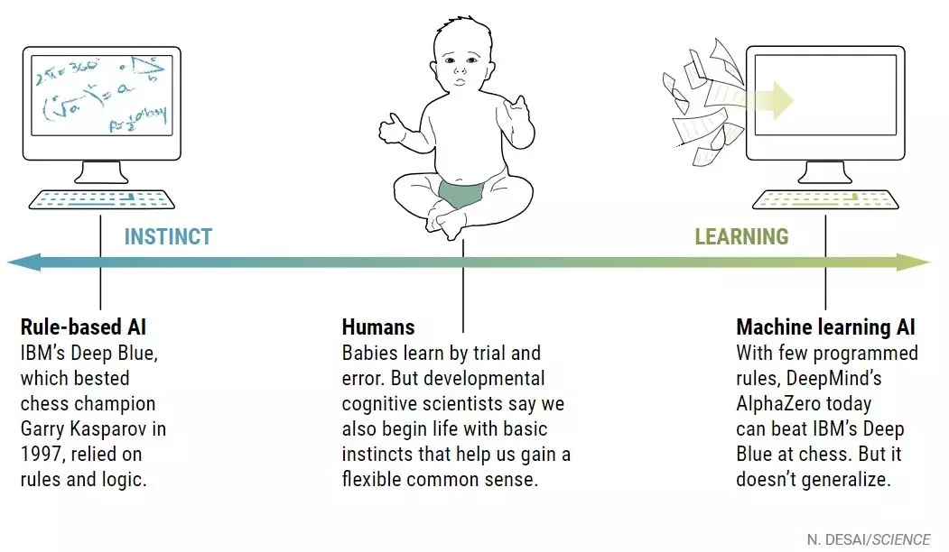
From Deep Blue to AlphaGo Zero

Slide 11
Deep Blue
1985-1997
Algorithm: alpha-beta search
“Good Old-Fashioned Artificial Intelligence”
Search for 6-20 moves
Base on evaluation function which includes initialized from and to-be-determined parameters

Slide 12
AlphaGo
2015-~
Algorithm: Monte Carlo tree search(蒙特卡洛树搜索)+Deep Learning
Use random heuristic search
Don’t need a evaluation function, the searching step is simulating the game
Use deep learning to analyze human gameplay(30 million) and reinforcement learning to improve.

Slide 13
AlphaGo Zero and Alpha Zero
No human data
Play 4.9 million games with itself
AlphaGo Zero 100:0 AlphaGo
Only start with basic rules of go, do not generate from human gameplay or rules.

Slide 14
From Deep Blue to AlphaGo Zero

Slide 15
Context
What is Machine Reasoning?
Difference between Machine Reasoning and Machine Learning
From Deep Blue to AlphaGo Zero
Challenging problems for embodied reasoning
Potentials of Machine Reasoning killer application
Limitations of Machine Reasoning killer application

Slide 16
Challenging problems for embodied reasoning
How to distinguish useful information and the environment
How to choose the reasoning method base on content
(Think about Alana)
How to show the reasoning result?(move? play? answer?)
How to deal with random situation in real world?(cheating? Special rule? Interrupts?)

Slide 17
Context
What is Machine Reasoning?
Difference between Machine Reasoning and Machine Learning
From Deep Blue to AlphaGo Zero
Challenging problems for embodied reasoning
Potentials of Machine Reasoning killer application
Limitations of Machine Reasoning killer application

Slide 18
Killer application(杀手级应用)
In marketing terminology, a killer application is any computer program that is so necessary or desirable that it proves the core value of some larger technology. In other words, consumers would buy the hardware just to run that application.
--Wikipedia

Slide 19
Potentials of Machine Reasoning killer application
Autonomous vehicles(5G + Machine Reasoning)
Robots that really speak and learn like human baby(further research on how human reason, Machine Reasoning base on context)
Express(快递)robots(5G + Machine Reasoning)
Scientific analysis(If Machine Reasoning can be more general and use in multiple aera)
More…

Slide 20
Context
What is Machine Reasoning?
Difference between Machine Reasoning and Machine Learning
From Deep Blue to AlphaGo Zero
Challenging problems for embodied reasoning
Potentials of Machine Reasoning killer application
Limitations of Machine Reasoning killer application

Slide 21
Limitations of Machine Reasoning killer application
Hardware limit: killer apps are more likely to run on personal devices such as cellphones, smart watches, vehicle media devices. An important problem is to implement Machine Reasoning with few hardware.
Possible solution: smaller and better chips, better Machine Reasoning algorithm, larger capacity battery…

Slide 22
Limitations of Machine Reasoning killer application
Sensor limit: Machine Reasoning in real world can’t be omniscient(全知的), there’re already few accident happened on autonomous vehicles. It is hard to receive all the information needed to do reasoning.
Possible solution: better algorithm, security measures, high-quality sensor, development of image recognition…

Slide 23
Limitations of Machine Reasoning killer application
Machine limit: Machine Reasoning is running on machines, we’re now not able to figure out how human think by brain and how machine learning works.
Possible solution: more research on human cognition field, figure out how to combine machine learning and rules.

Slide 24
That’s all, thanks for listening!

