Slide 1

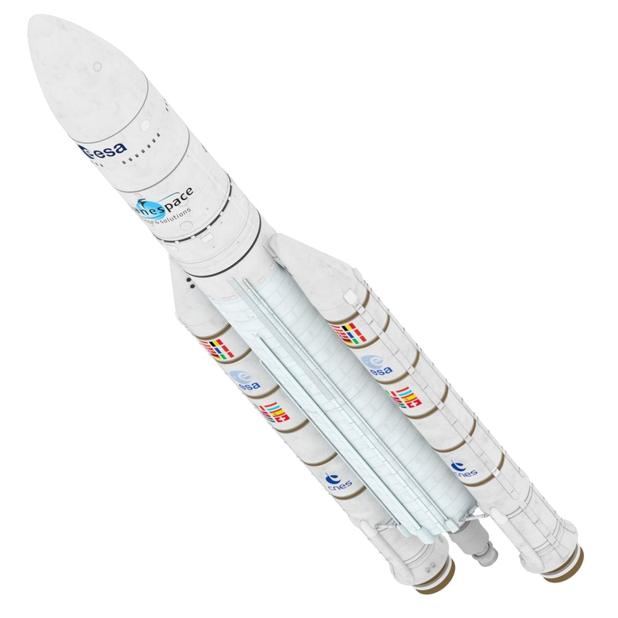
Bramani Nicolò
Masserini Maria Alessandro
Negri Alessio
Pansini Pierfrancesco
Scalera Marcello
Sedini Alberto
THRUST
IMBALANCE
ANALYSIS

Slide 2
Introduction
Conceptual Design
Results and
Conclusions
Requirements and
Specifications
Simulation
TVC
Boosting phase
Software
Analysis of the possible scenarios in case of imbalance between the twin external rockets operating as boost stage
Ariane 5 ECA

Slide 3

Introduction
Conceptual Design
Results and
Conclusions
Requirements and
Specifications
Cost
Customer requirements
Similar-to-target altitude and velocity at boosters’ detachment | Full control of trajectory
High precision attitude control | Lightweight system
Cheap system | Robustness to atmospheric disturbances
Risk/time
Performance

Slide 4
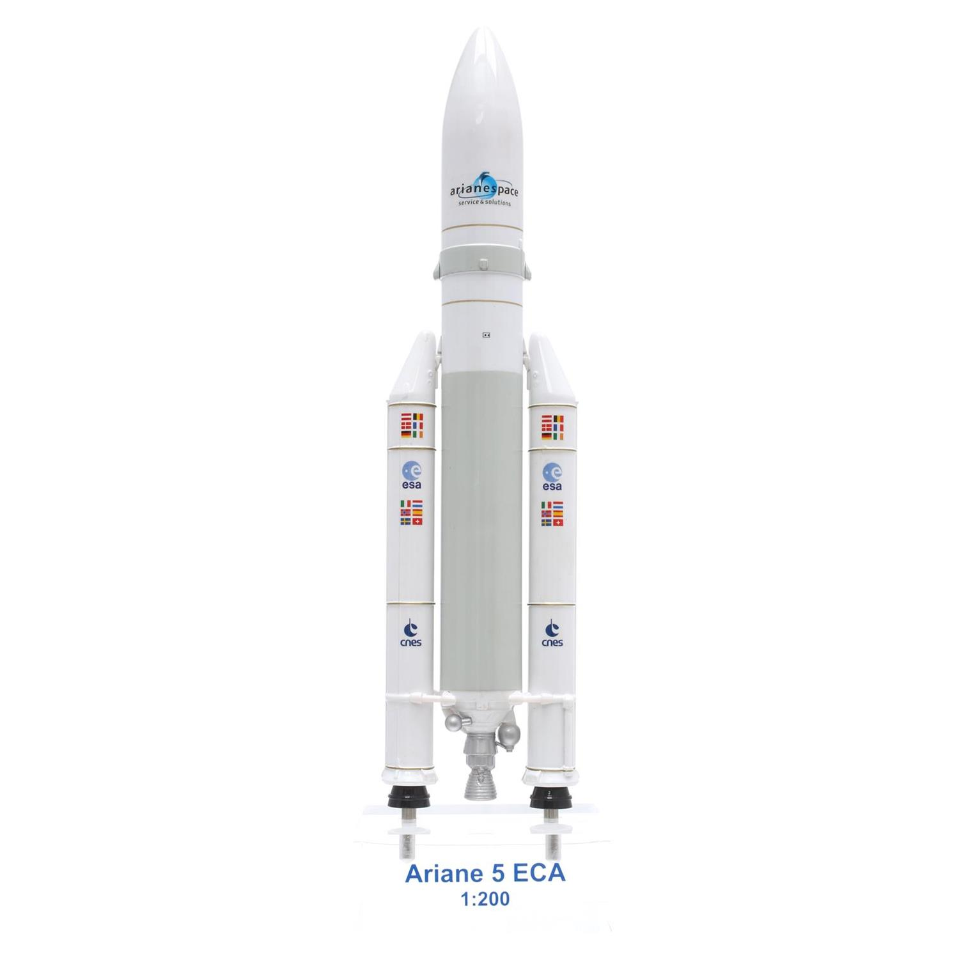
Introduction
Conceptual Design
Results and
Conclusions
Requirements and
Specifications
ESC-A
EPC
EAP
Launch Systems a.y. 2017/2018

Slide 5

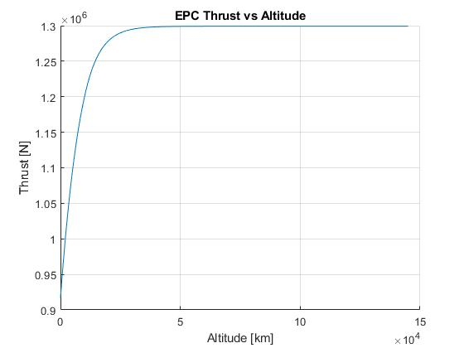
Introduction
Conceptual Design
Results and
Conclusions
Requirements and
Specifications
PROPULSION
Exit properties
Mass flow rate
Thrust
Launch Systems a.y. 2017/2018

Slide 6
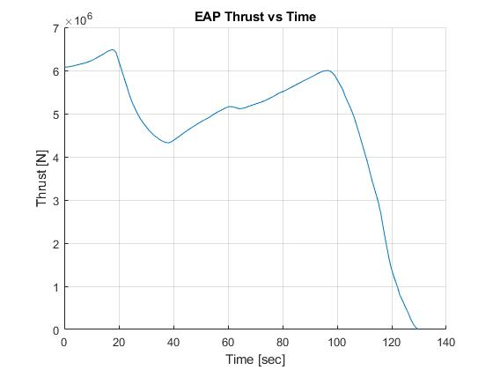
Introduction
Conceptual Design
Results and
Conclusions
Requirements and
Specifications
PROPULSION
Real data
Extrapolation
Interpolation

Slide 7
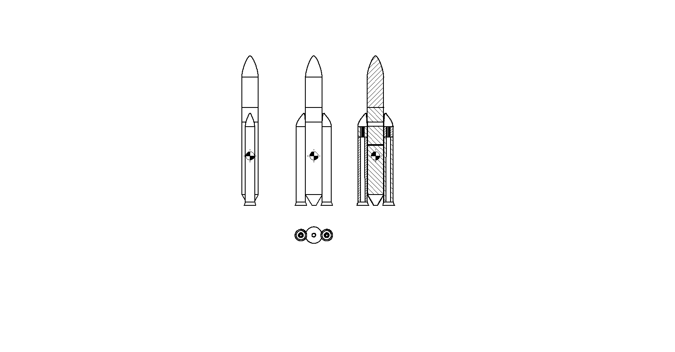
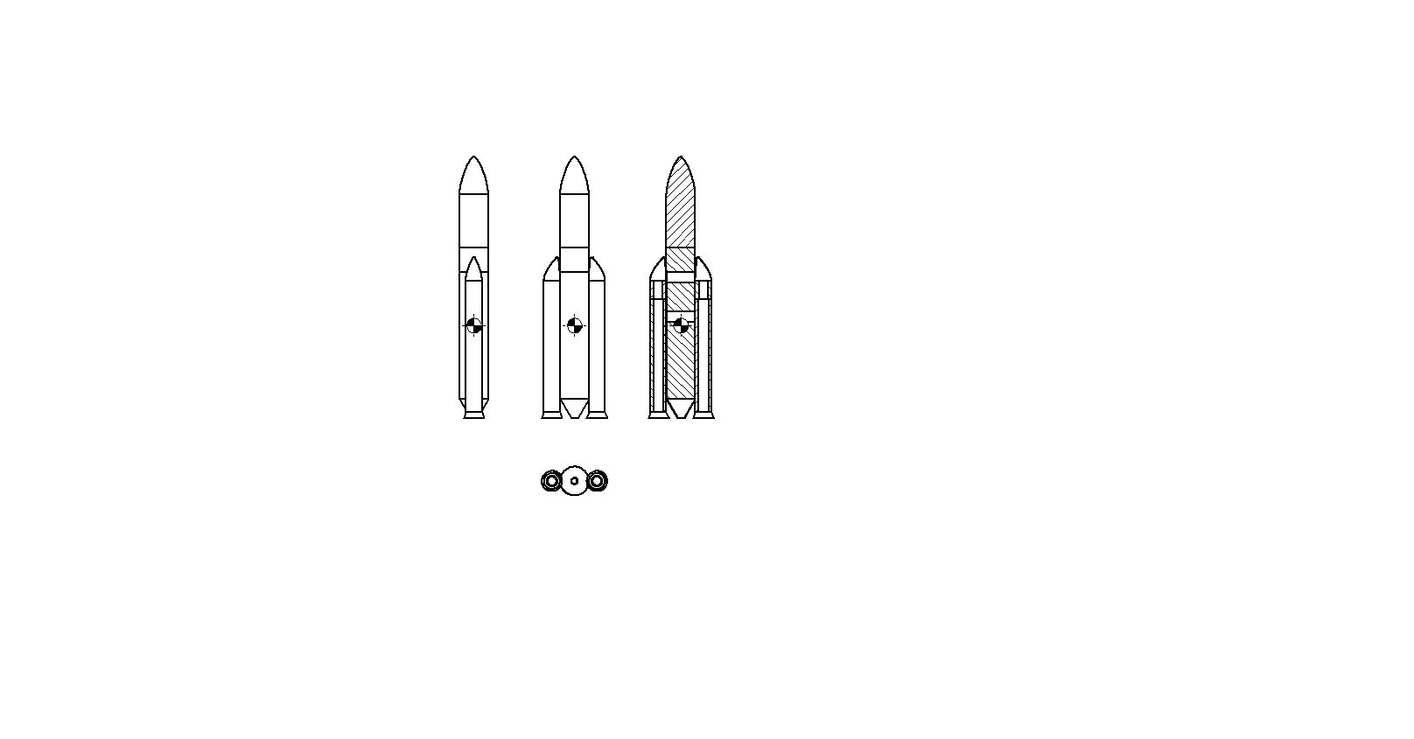
Introduction
Conceptual Design
Results and
Conclusions
Requirements and
Specifications
MASS DISTRIBUTION
Maximum EAP thrust → 18 s (left)
Maximum dynamic pressure → 71 s (right)

Slide 8
Introduction
Conceptual Design
Results and
Conclusions
Requirements and
Specifications
AERODYNAMICS
Zero-lift drag coefficient
Normal force coefficient & normal force coefficient derived by α
Centre of pressure → 19,28 m (from the nose)
Launch Systems a.y. 2017/2018

Slide 9
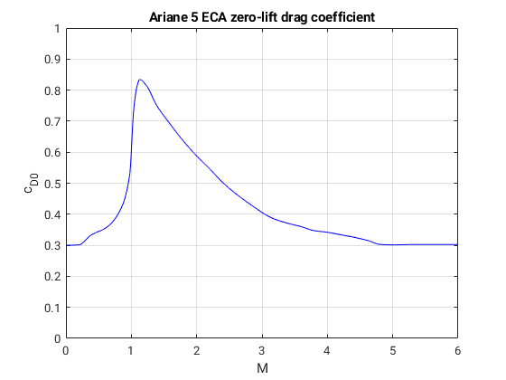
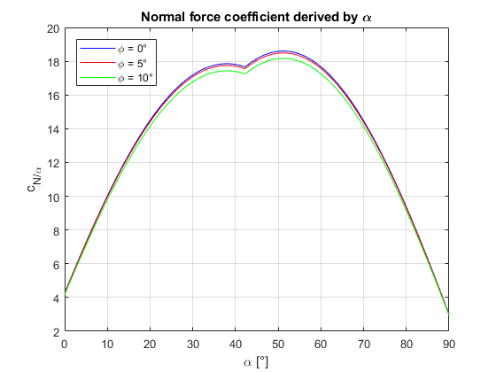
Introduction
Conceptual Design
Results and
Conclusions
Requirements and
Specifications
AERODYNAMICS
Launch Systems a.y. 2017/2018

Slide 10
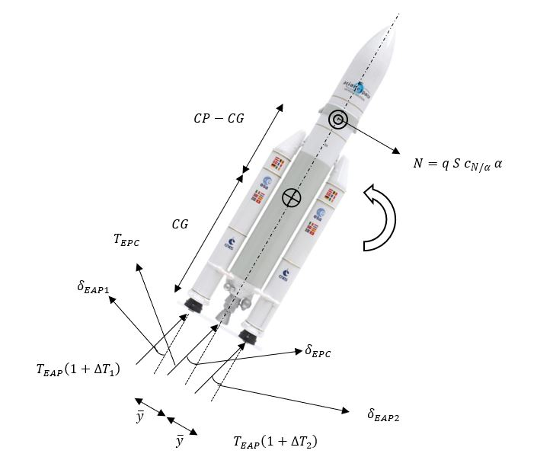
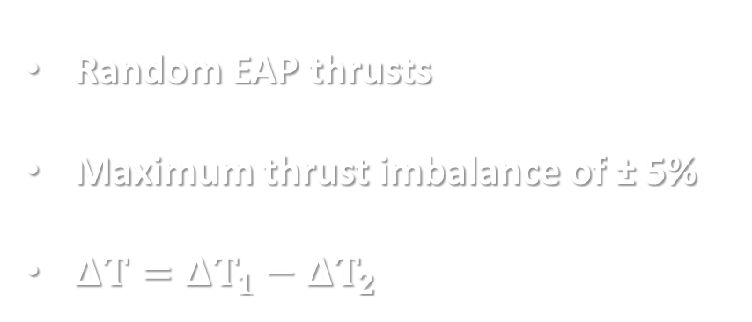
Introduction
Conceptual Design
Results and
Conclusions
Requirements and
Specifications
THRUST VECTOR CONTROL
Random EAP thrusts
Maximum thrust imbalance of ± 5%
$ΔT=ΔT_{1}−ΔT_{2}$

Slide 11
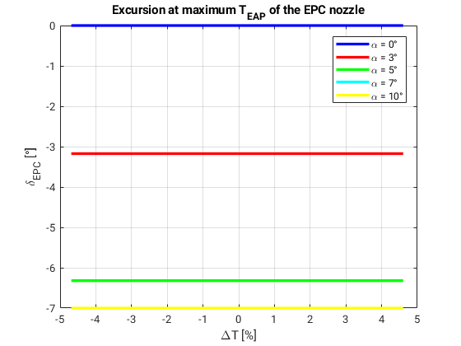
Introduction
Conceptual Design
Results and
Conclusions
Requirements and
Specifications
CASE 1: MAXIMUM EAP THRUST

Slide 12
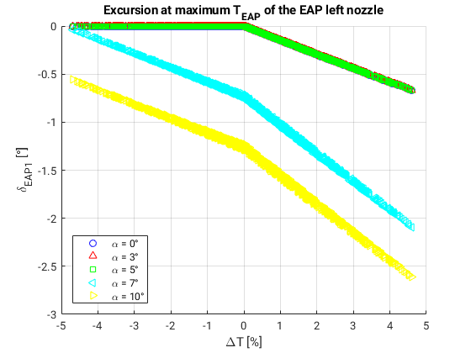
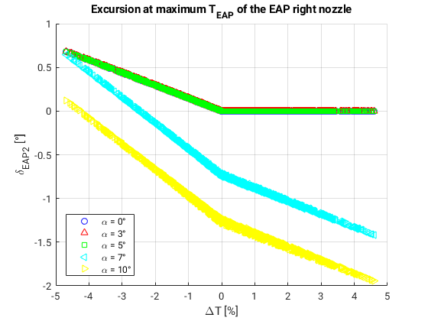
Introduction
Conceptual Design
Results and
Conclusions
Requirements and
Specifications
CASE 1: MAXIMUM EAP THRUST

Slide 13
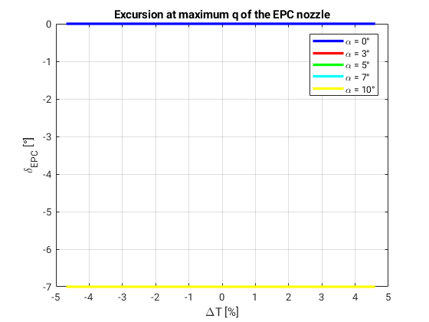
Introduction
Conceptual Design
Results and
Conclusions
Requirements and
Specifications
CASE 2: MAXIMUM DYNAMIC PRESSURE

Slide 14
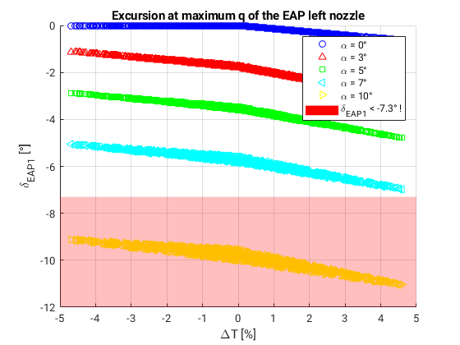
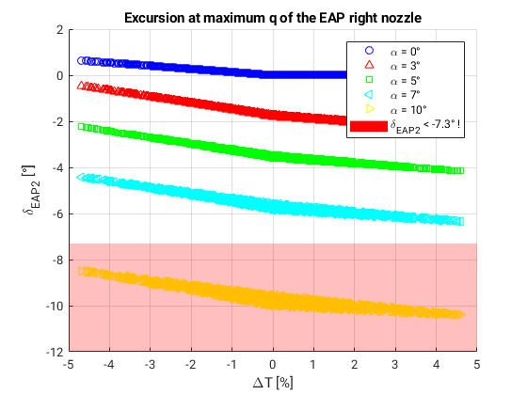
Introduction
Conceptual Design
Results and
Conclusions
Requirements and
Specifications
CASE 2: MAXIMUM DYNAMIC PRESSURE

Slide 15
Introduction
Conceptual Design
Results and
Conclusions
Requirements and
Specifications
THANKS FOR YOUR ATTENTION

