Slide 1
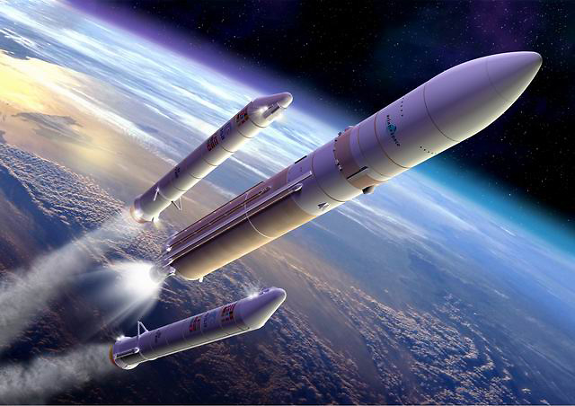
Nicolò Bramani
Alessandro Maria Masserini
Alessio Negri
Pierfrancesco Pansini
Marcello Scalera
Alberto Sedini
THRUST
IMBALANCE
ANALYSIS

Slide 2
Thrust Imbalance
Boosting Phase
Simulation
TVC
Introduction
Conceptual Design
Results and
Conclusions
Requirements and
Specifications
Analysis of the possible scenarios in case of imbalance between the twin external rockets operating as boost stage
Ariane 5 ECA

Slide 3


Introduction
Conceptual Design
Results and
Conclusions
Requirements and
Specifications
Customer requirements [weight over 100%]
Similar-to-target altitude and velocity at boosters’ detachment [30.3%] | Full control of trajectory [24.2%]
High precision attitude control [21.2%] | Lightweight system [6.1%]
Cheap system [6.1%] | Robustness to atmospheric disturbances [12.1%]
Cost
Risk/time
Performance

Slide 4
Introduction
Conceptual Design
Results and
Conclusions
Requirements and
Specifications
Functional Requirements [weight over 100%, Improvement Direction (↑,↔,↓)]
Sensor responding time [13.7%, ↔] | TVC angle excursion [13.0%, ↑] | Attitude angular position sensitivity [10.1%, ↔] | Attitude angular velocity sensitivity [10.1%, ↔]
Boosters thrust fraction [10.1%, ↔] | Misalignment of thrust wrt centre of mass [9.8%, ↓] | Attitude at booster detachment [9.1%, ↔] | Velocity at booster detachment [7.8%, ↔]
Centre of mass excursion [5.1%, ↓] | Sustainer thrust fraction [4.6%, ↔] | Aerodynamic drag [4.0%, ↓] | Radar/GPS visibility [2.6%, ↑]

Slide 5
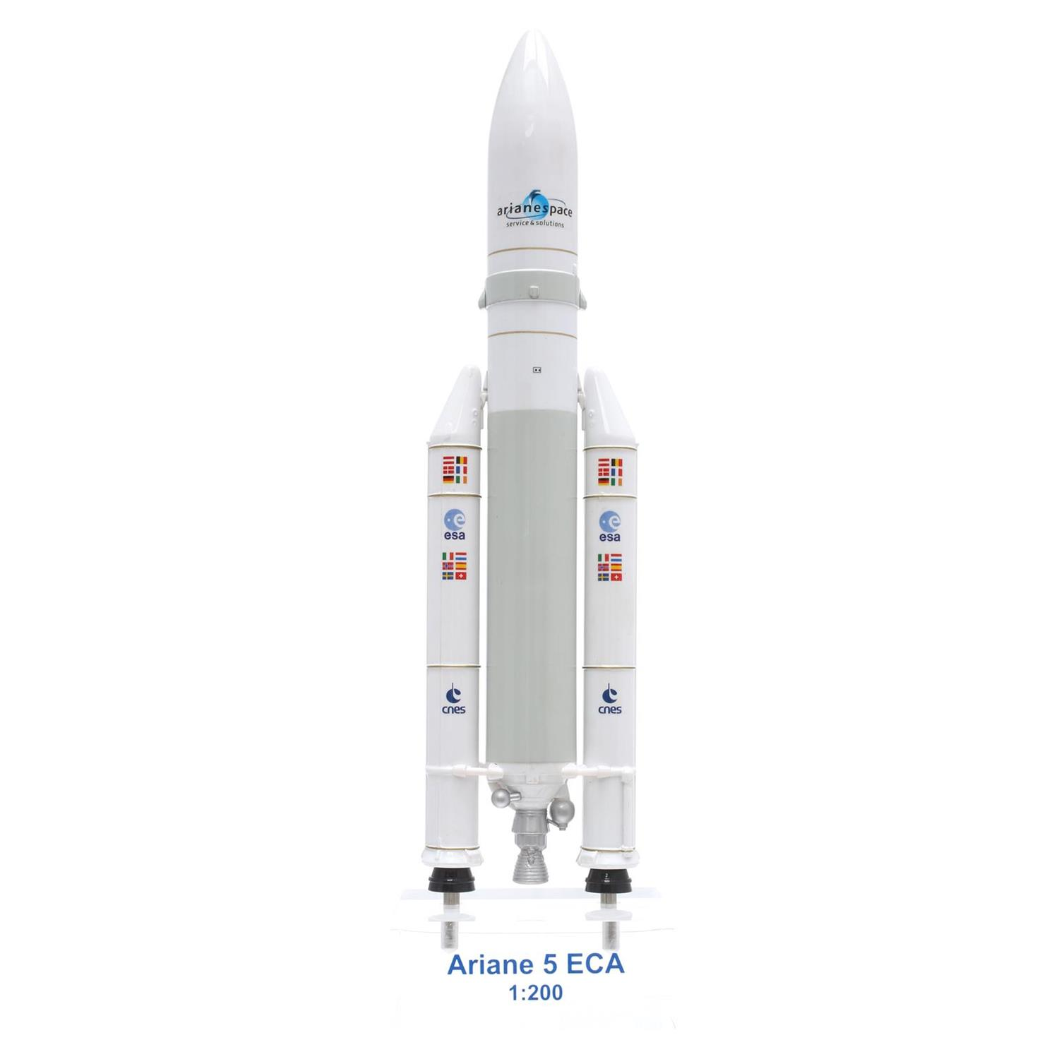
Introduction
Conceptual Design
Results and
Conclusions
Requirements and
Specifications
ESC-A
EPC
EAP
Launch Systems a.y. 2017/2018

Slide 6
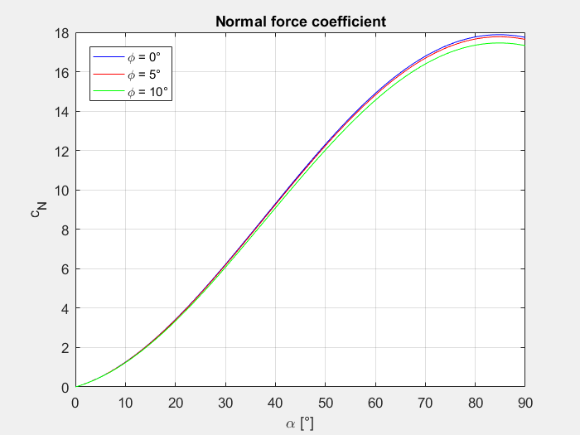
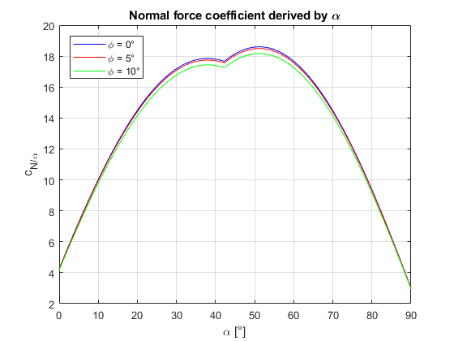
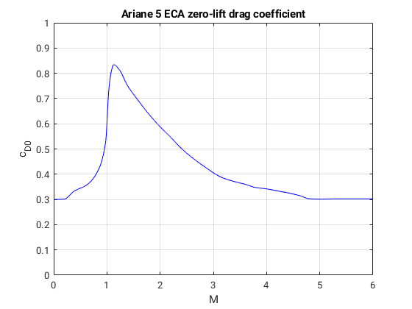
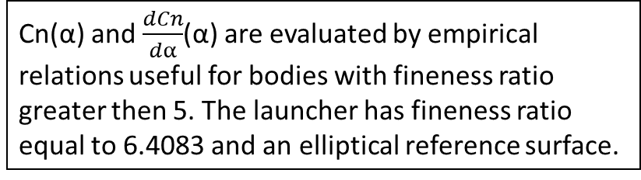
Introduction
Conceptual Design
Results and
Conclusions
Requirements and
Specifications
Cd0(α), Cn(α) and $\frac{dCn}{dα}$(α) aerodynamics coefficient evaluation
Cn(α) and $\frac{dCn}{dα}$(α) are evaluated by empirical relations useful for bodies with fineness ratio greater then 5. The launcher has fineness ratio equal to 6.4083 and an elliptical reference surface.
Cd0(M) was obtained by real experimental data of Ariane V ECA.

Slide 7
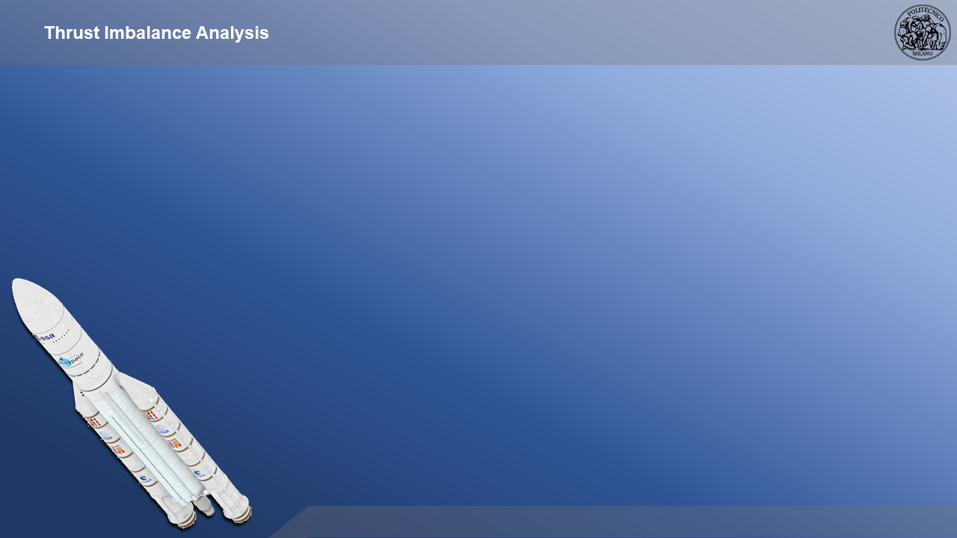

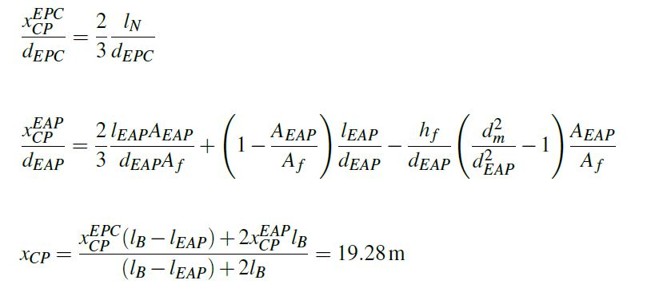
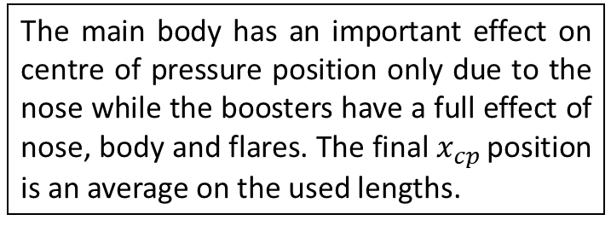
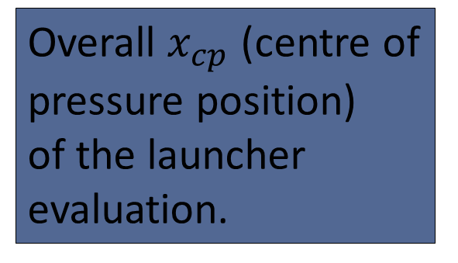


Introduction
Conceptual Design
Results and
Conclusions
Requirements and
Specifications
Overall $x_{cp}$ (centre of pressure position) of the launcher evaluation.
The main body has an important effect on centre of pressure position only due to the nose while the boosters have a full effect of nose, body and flares. The final $x_{cp }$position is an average on the used lengths.
$$X_{cp}$$
$$X_{cg}$$

Slide 8
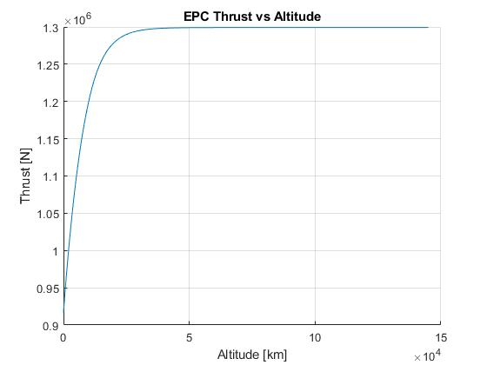

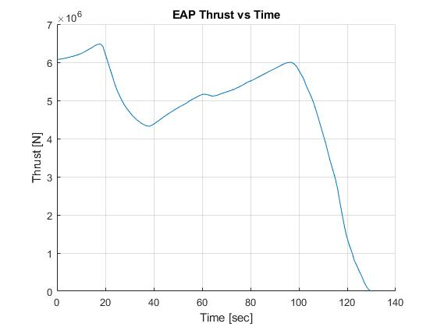
Introduction
Conceptual Design
Results and
Conclusions
Requirements and
Specifications
This is the real thrust profile of boosters over mission time obtained by operational data of Ariane V ECA.
The thrust profile of the main cryogenic engine over altitude is obtained by the isentropic model engine computations.

Slide 9





Introduction
Conceptual Design
Results and
Conclusions
Requirements and
Specifications
Propellant | t = 0s [kg] | t = 18s [kg] | t = 71s [kg]
LH2 | 24757.14 | 24252.83 | 21822.94
LOX | 148542.86 | 145516.96 | 130937.79
SRE cylinder | 214100 | 175583.76 | 85354.60
SRM star shape | 23150 | 18984.24 | 9225.40
Total mass | 410550 | 364337.79 | 247340.73
t = 17s
t = 71s
$$X_{CG}\left(18s\right)=16,23m$$
$$X_{CG}\left(71s\right)=17,38m$$

Slide 10
Introduction
Conceptual Design
Results and
Conclusions
Requirements and
Specifications
PROPULSION
Exit properties
Mass flow rate
Thrust
Launch Systems a.y. 2017/2018

Slide 11
Introduction
Conceptual Design
Results and
Conclusions
Requirements and
Specifications
PROPULSION
Real data
Extrapolation
Interpolation

Slide 12
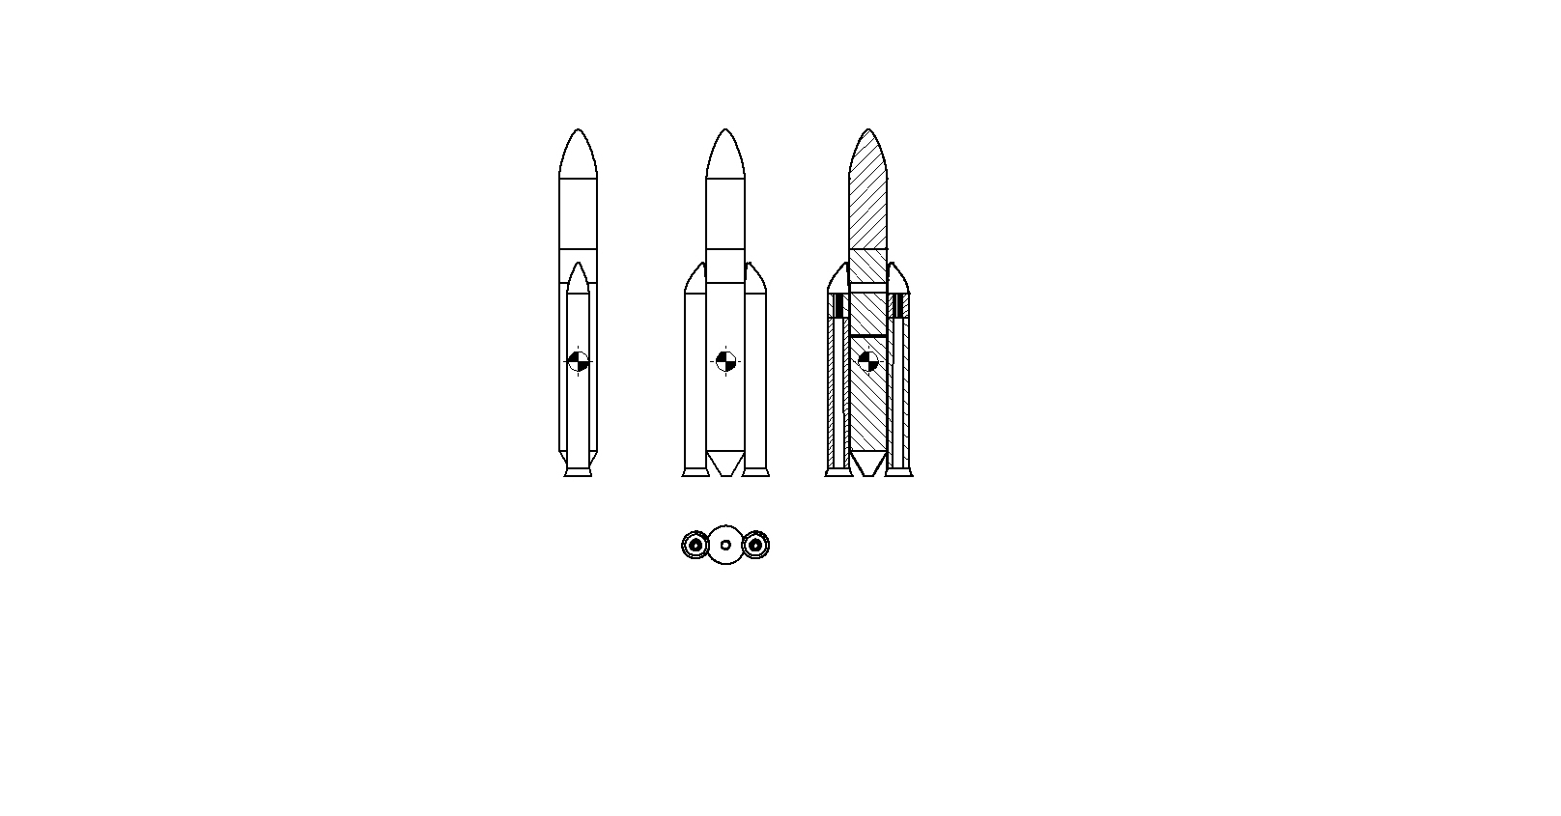
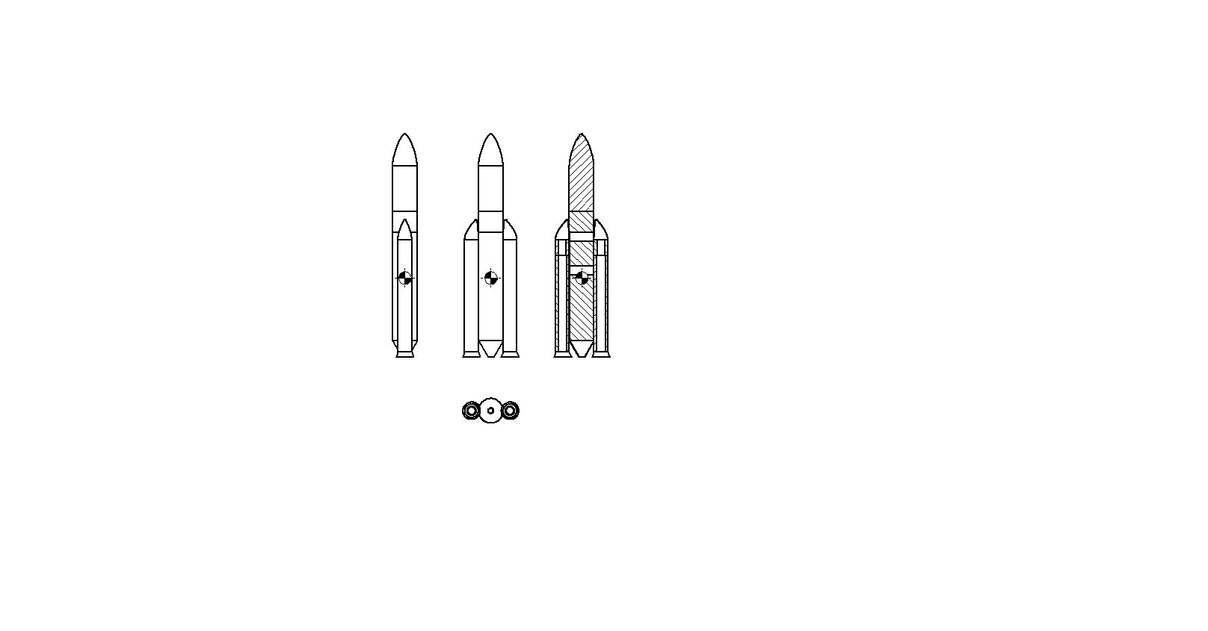
Introduction
Conceptual Design
Results and
Conclusions
Requirements and
Specifications
MASS DISTRIBUTION
Maximum EAP thrust → 18 s (left)
Maximum dynamic pressure → 71 s (right)

Slide 13
Introduction
Conceptual Design
Results and
Conclusions
Requirements and
Specifications
AERODYNAMICS
Zero-lift drag coefficient
Normal force coefficient & normal force coefficient derived by α
Centre of pressure → 19,28 m (from the nose)
Launch Systems a.y. 2017/2018

Slide 14
Introduction
Conceptual Design
Results and
Conclusions
Requirements and
Specifications
AERODYNAMICS
Launch Systems a.y. 2017/2018

Slide 15
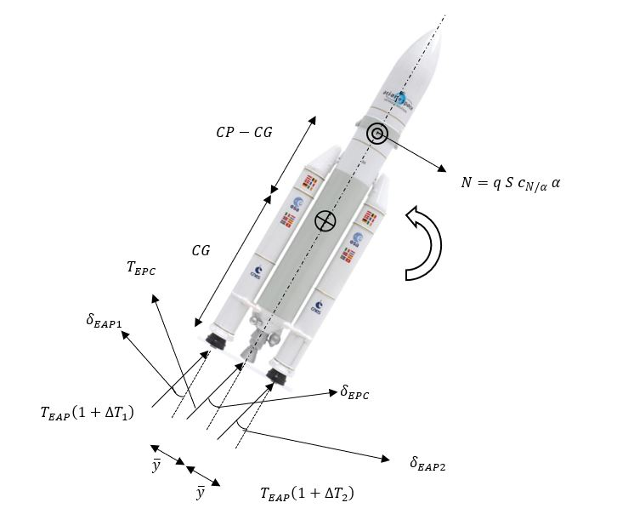
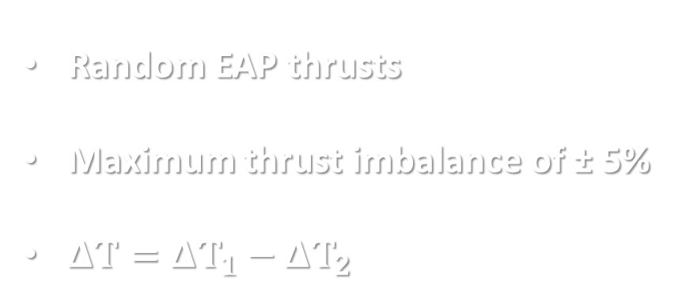
Introduction
Conceptual Design
Results and
Conclusions
Requirements and
Specifications
THRUST VECTOR CONTROL
Random EAP thrusts
Maximum thrust imbalance of ± 5%
$ΔT=ΔT_{1}−ΔT_{2}$

Slide 16
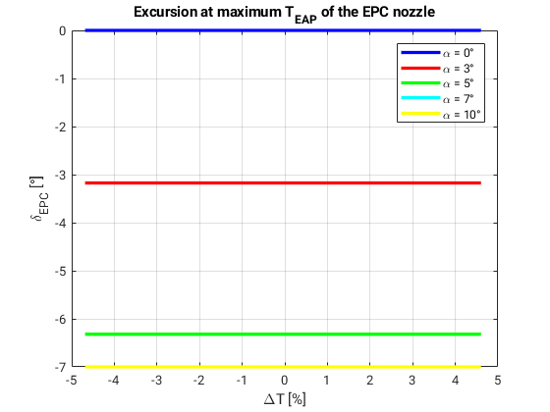
Introduction
Conceptual Design
Results and
Conclusions
Requirements and
Specifications
CASE 1: MAXIMUM EAP THRUST

Slide 17
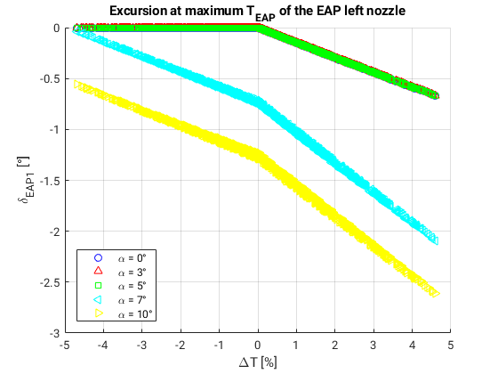
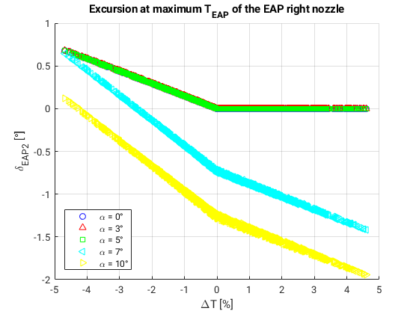
Introduction
Conceptual Design
Results and
Conclusions
Requirements and
Specifications
CASE 1: MAXIMUM EAP THRUST

Slide 18
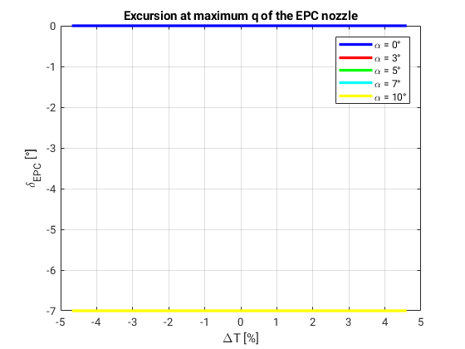
Introduction
Conceptual Design
Results and
Conclusions
Requirements and
Specifications
CASE 2: MAXIMUM DYNAMIC PRESSURE

Slide 19
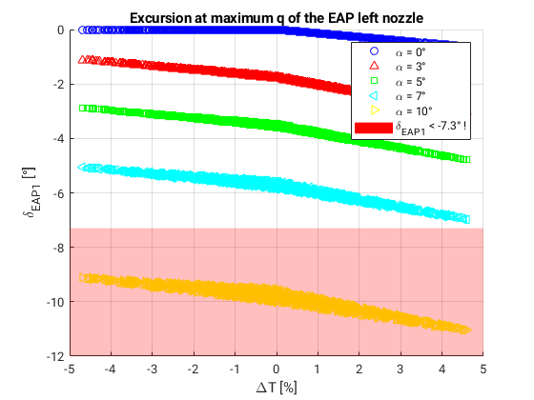
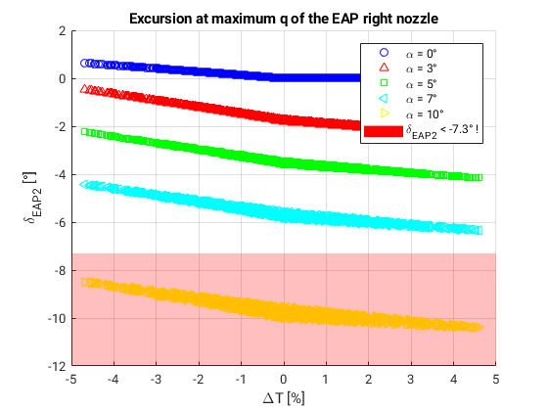
Introduction
Conceptual Design
Results and
Conclusions
Requirements and
Specifications
CASE 2: MAXIMUM DYNAMIC PRESSURE

Slide 20
Introduction
Conceptual Design
Results and
Conclusions
Requirements and
Specifications
THANKS FOR YOUR ATTENTION

