Slide 1
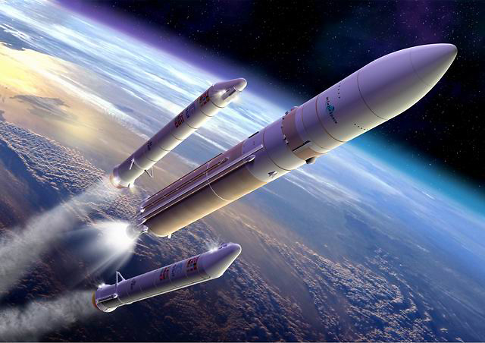
THRUST
IMBALANCE
ANALYSIS
Nicolò Bramani
Alessandro Maria Masserini
Alessio Negri
Pierfrancesco Pansini
Marcello Scalera
Alberto Sedini

Slide 2
Thrust Imbalance
Boosting Phase
Simulation
TVC
Introduction
Conceptual Design
Results and
Conclusions
Requirements and
Specifications
Analysis of the possible scenarios in case of imbalance between the twin external rockets operating as boost stage
Ariane 5 ECA

Slide 3


Introduction
Conceptual Design
Results and
Conclusions
Requirements and
Specifications
Customer requirements [weight over 100%]
Similar-to-target altitude and velocity at boosters’ detachment [30.3%] | Full control of trajectory [24.2%]
High precision attitude control [21.2%] | Lightweight system [6.1%]
Cheap system [6.1%] | Robustness to atmospheric disturbances [12.1%]
Cost
Risk/time
Performance

Slide 4
Introduction
Conceptual Design
Results and
Conclusions
Requirements and
Specifications
Main Functional Requirements
[weight over 100%, Improvement Direction (↑,↔,↓)]
[13.7%, ↔]
Sensor responding time
[10.1%, ↔]
Attitude angular position sensitivity
[10.1%, ↔]
Attitude angular velocity sensitivity
[13.0%, ↑]
TVC angle excursion

Slide 5
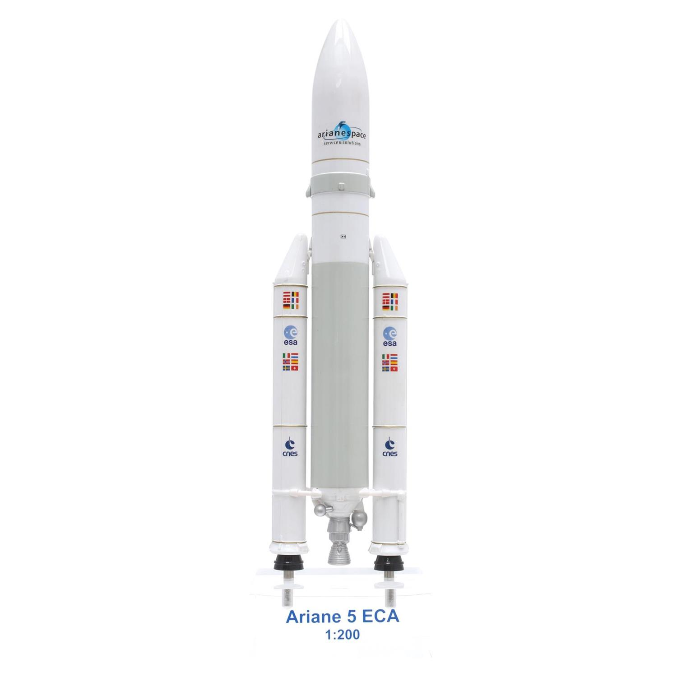
Introduction
Conceptual Design
Results and
Conclusions
Requirements and
Specifications
ESC-A
EPC
EAP
Launch Systems a.y. 2017/2018

Slide 6
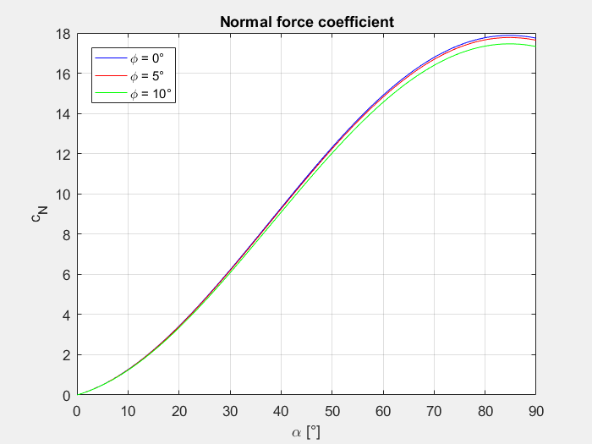
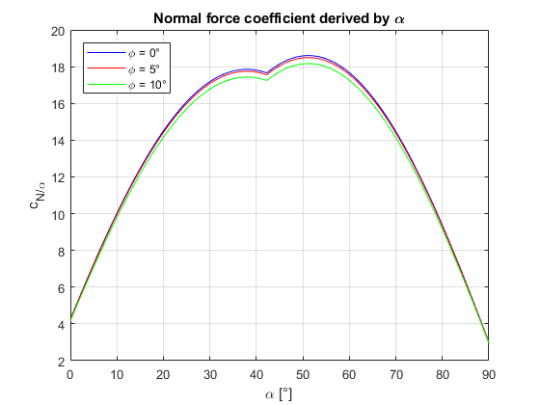
Introduction
Conceptual Design
Results and
Conclusions
Requirements and
Specifications
Cn(α) and $\frac{dCn}{dα}$(α) aerodynamics coefficient evaluation

Slide 7
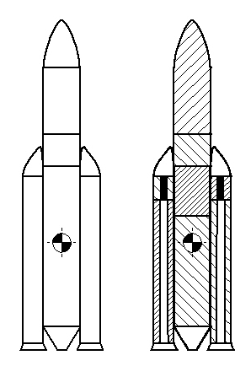
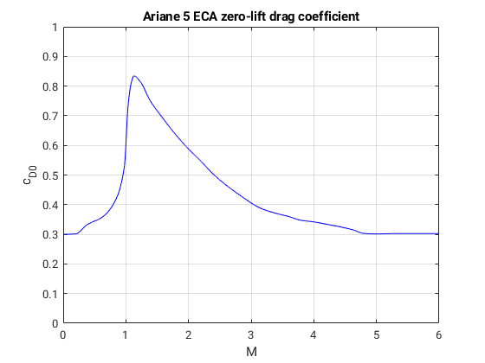



Introduction
Conceptual Design
Results and
Conclusions
Requirements and
Specifications
$C_{d0}$ and $x_{cp}$ of the launcher evaluation
$$X_{cp}=19.28m$$
$$X_{cg}$$

Slide 8
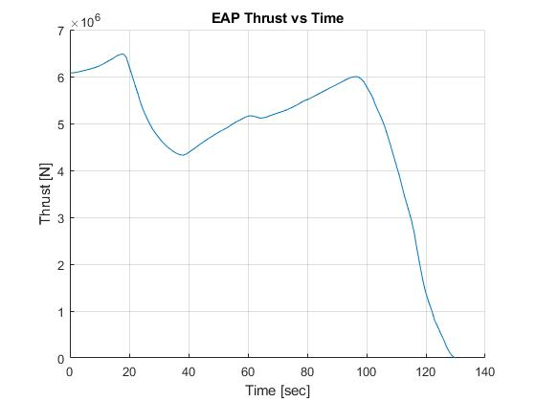
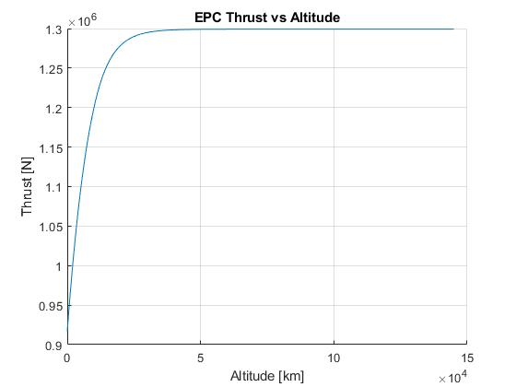
Introduction
Conceptual Design
Results and
Conclusions
Requirements and
Specifications
Real data → Extrapolation → Interpolation
CEA analysis + Mass flow rate → Thrust

Slide 9
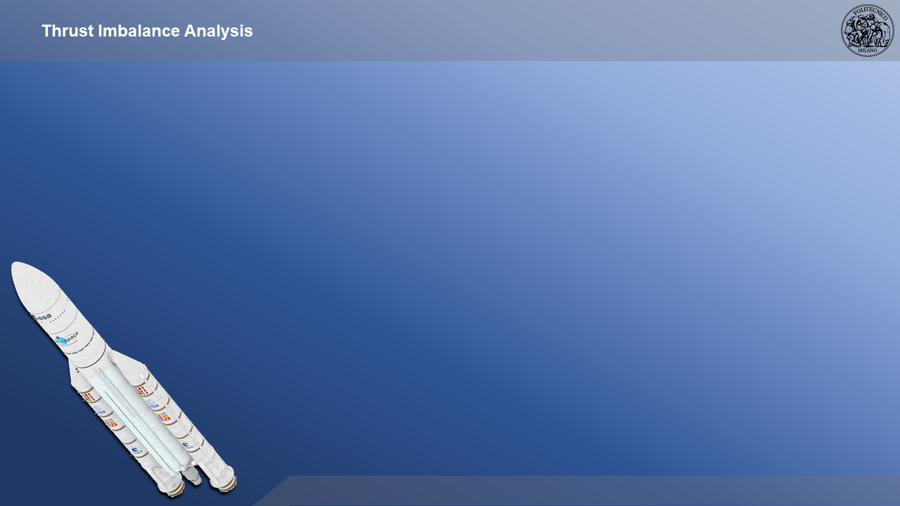






Introduction
Conceptual Design
Results and
Conclusions
Requirements and
Specifications
t = 18s
t = 71s
$$X_{CG}\left(18s\right)=16,23m$$
$$X_{CG}\left(71s\right)=17,38m$$

Slide 10
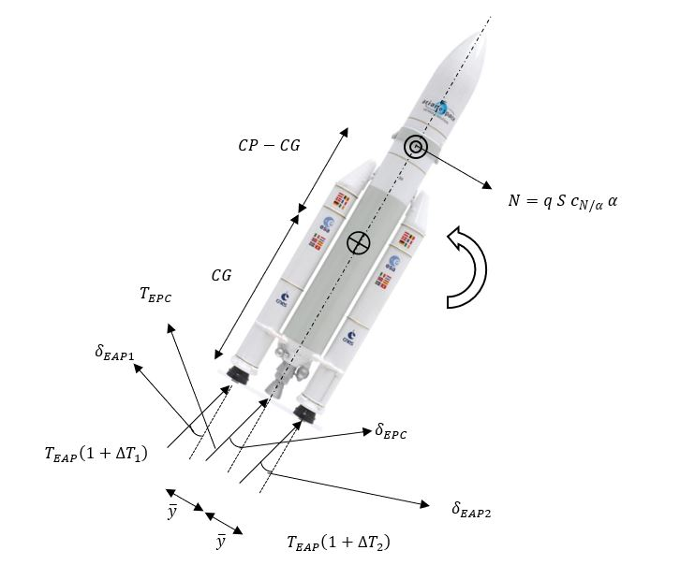
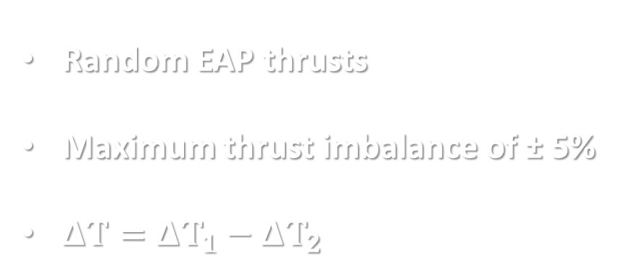
Introduction
Conceptual Design
Results and
Conclusions
Requirements and
Specifications
THRUST VECTOR CONTROL
Random EAP thrusts
Maximum thrust imbalance of ± 5%
$ΔT=ΔT_{1}−ΔT_{2}$

Slide 11
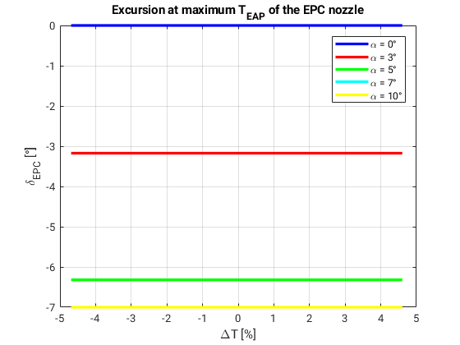
Introduction
Conceptual Design
Results and
Conclusions
Requirements and
Specifications
CASE 1: MAXIMUM EAP THRUST

Slide 12
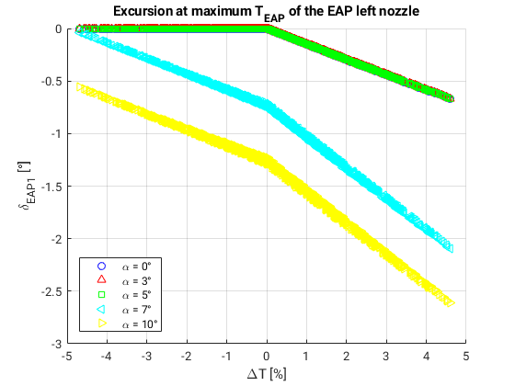
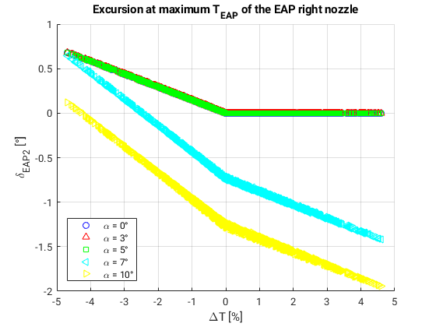
Introduction
Conceptual Design
Results and
Conclusions
Requirements and
Specifications
CASE 1: MAXIMUM EAP THRUST

Slide 13
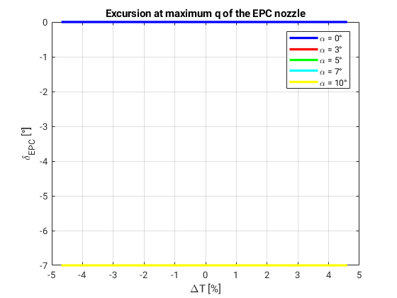
Introduction
Conceptual Design
Results and
Conclusions
Requirements and
Specifications
CASE 2: MAXIMUM DYNAMIC PRESSURE

Slide 14
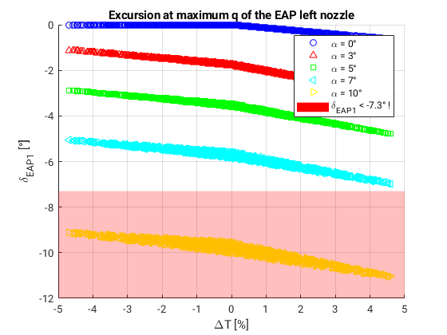
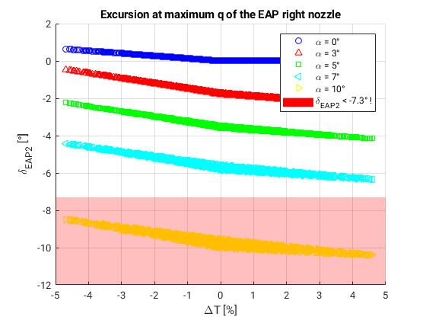
Introduction
Conceptual Design
Results and
Conclusions
Requirements and
Specifications
CASE 2: MAXIMUM DYNAMIC PRESSURE

Slide 15
Introduction
Conceptual Design
Results and
Conclusions
Requirements and
Specifications
THANKS FOR YOUR ATTENTION

