Slide 1

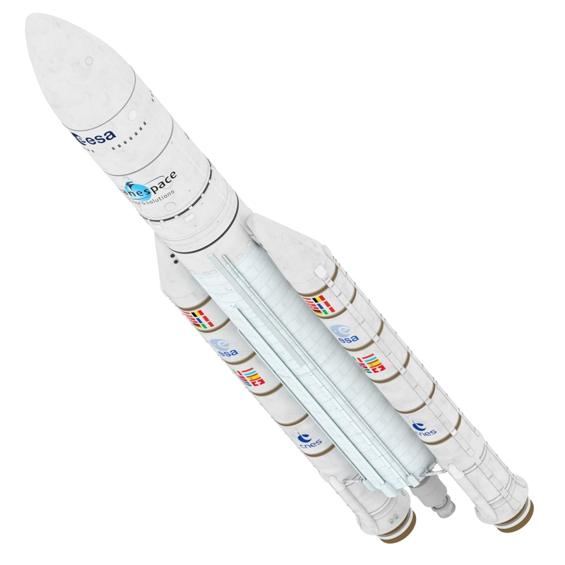
Bramani Nicolò 883811
 | Masserini Maria Alessandro 883251
Negri Alessio 874935
 | Pansini Pierfrancesco 885031
Scalera Marcello 874378
 | Sedini Alberto 883472
THRUST
IMBALANCE
ANALYSIS

Slide 2
Simulation
TVC
Boosting phase
Software
Introduction
Conceptual Design
Results and
Conclusions
Requirements and
Specifications
Analysis of the possible scenarios in case of imbalance between the twin external rockets operating as boost stage
Ariane 5 ECA

Slide 3

Introduction
Conceptual Design
Results and
Conclusions
Requirements and
Specifications
Cost
Customer requirements
Similar-to-target altitude and velocity at boosters’ detachment | Full control of trajectory
High precision attitude control | Lightweight system
Cheap system | Robustness to atmospheric disturbances
Risk/time
Performance

Slide 4

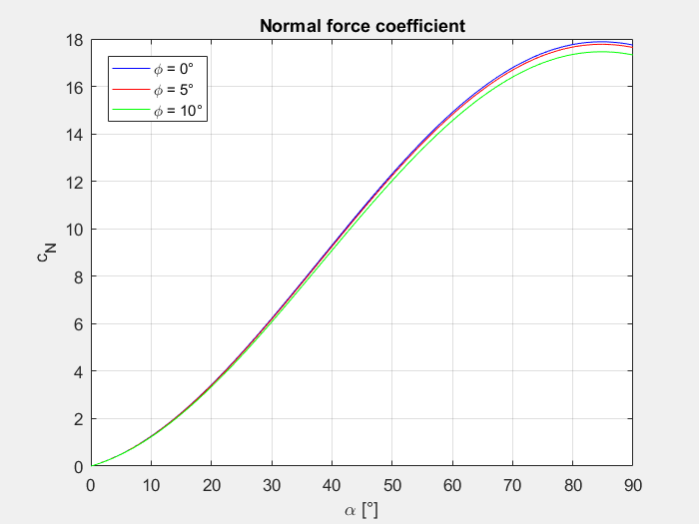
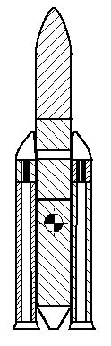
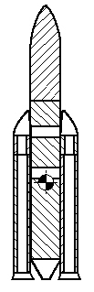
Introduction
Conceptual Design
Results and
Conclusions
Requirements and
Specifications
Drag & Normal force
CG & CPress

Slide 5
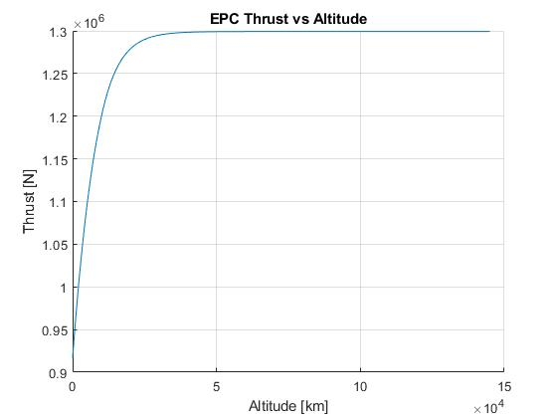
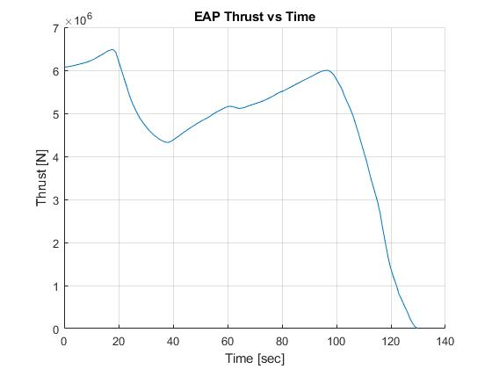
Introduction
Conceptual Design
Results and
Conclusions
Requirements and
Specifications

Slide 6
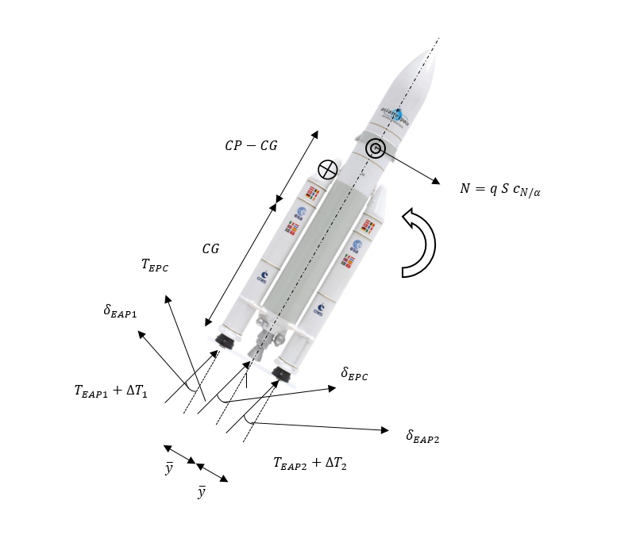
Introduction
Conceptual Design
Results and
Conclusions
Requirements and
Specifications

Slide 7
Introduction
Conceptual Design
Results and
Conclusions
Requirements and
Specifications

