Slide 1
Introduction to dplyr
Series: data wrangling

Slide 2
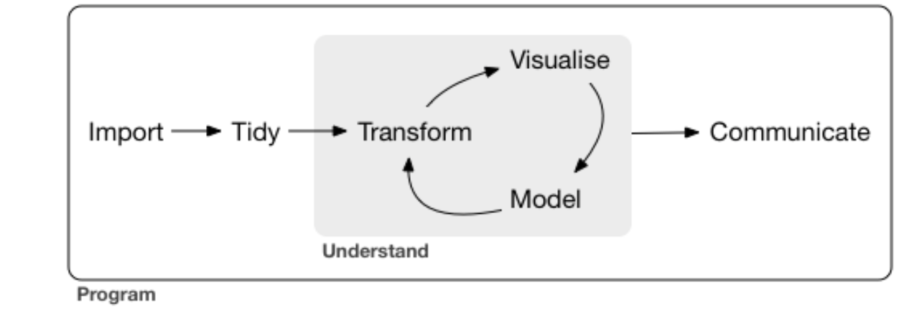
The cycle of data analysis

Slide 3
Dplyr basics
Pick observations by their values (filter()).
Reorder the rows (arrange()).
Pick variables by their names (select()).
Create new variables with functions of existing variables (mutate()).
Collapse many values down to a single summary (summarise()).
group_by() which changes the scope of each function from operating on the entire dataset to operating on it group-by-group

Slide 4
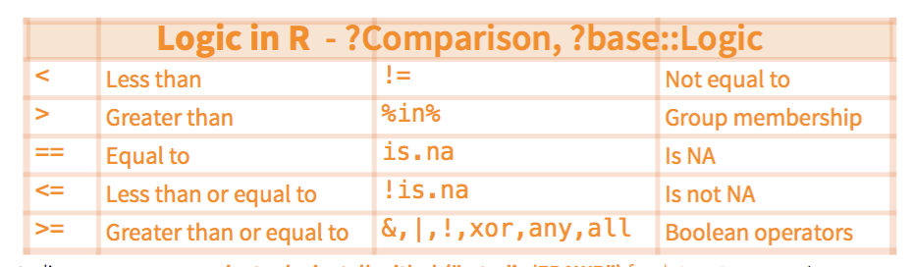
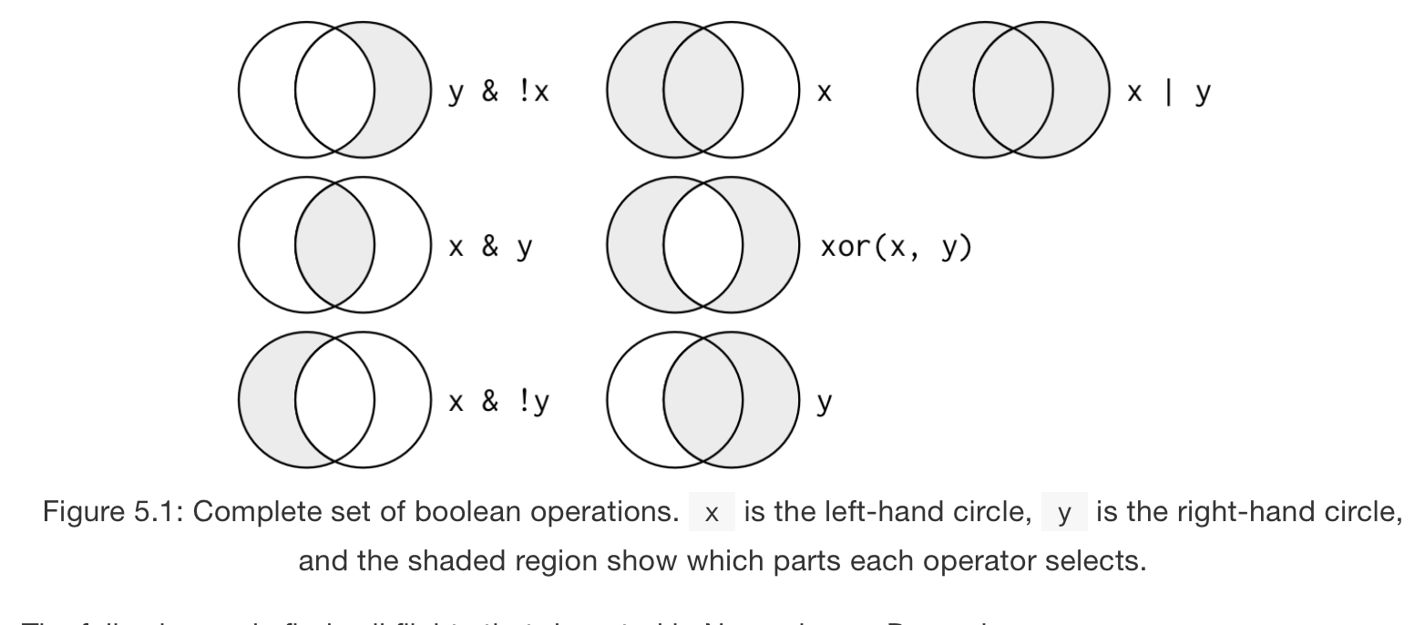
Filter
Extract rows that meet logical criteria

Slide 5
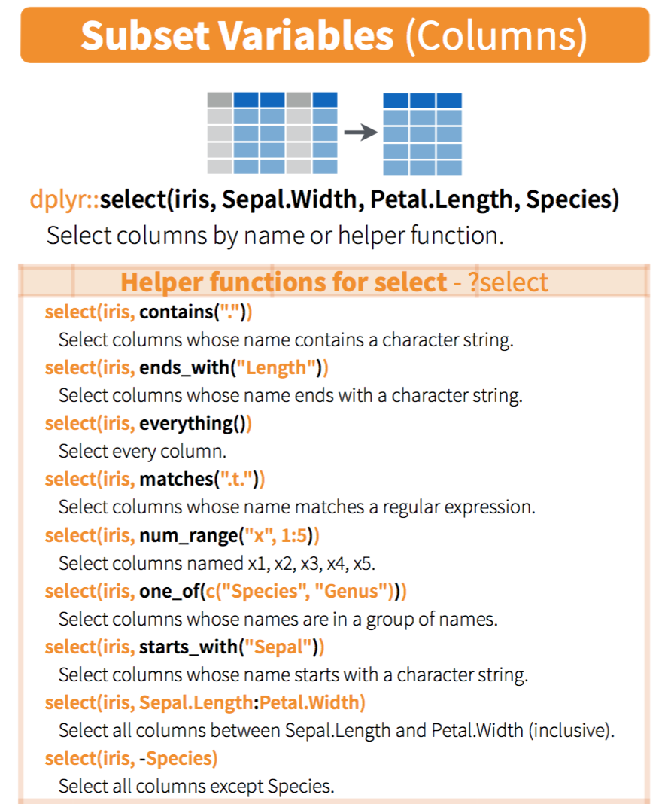
Select

Slide 6
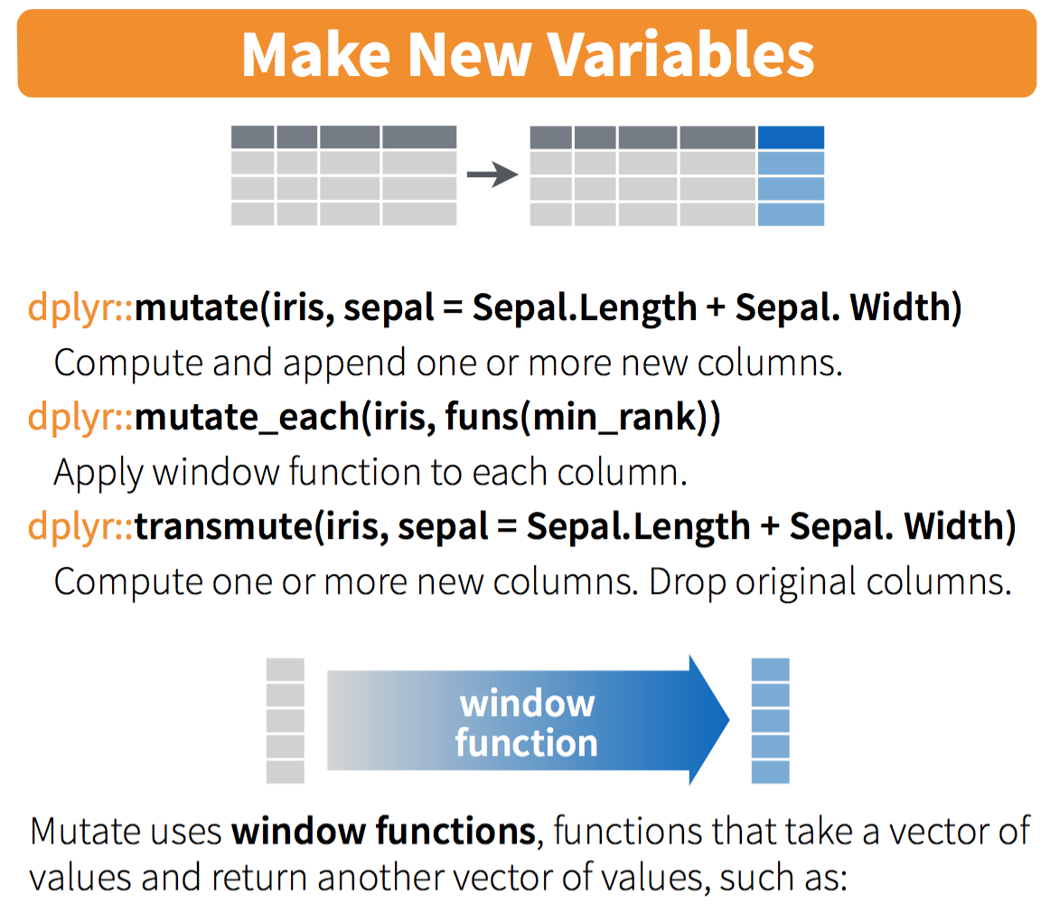
Mutate

Slide 7
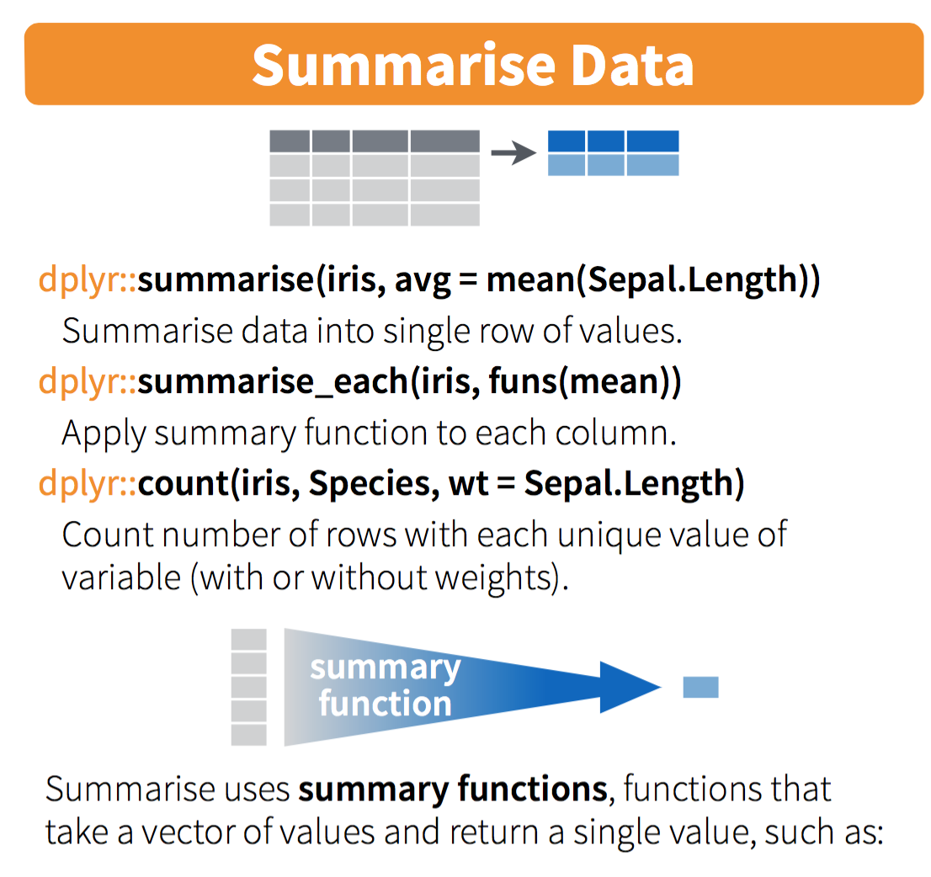
Summarise
Combine with group_by

Slide 8
Pipelines with magrittr
%>% allows you to chain actions

Slide 9
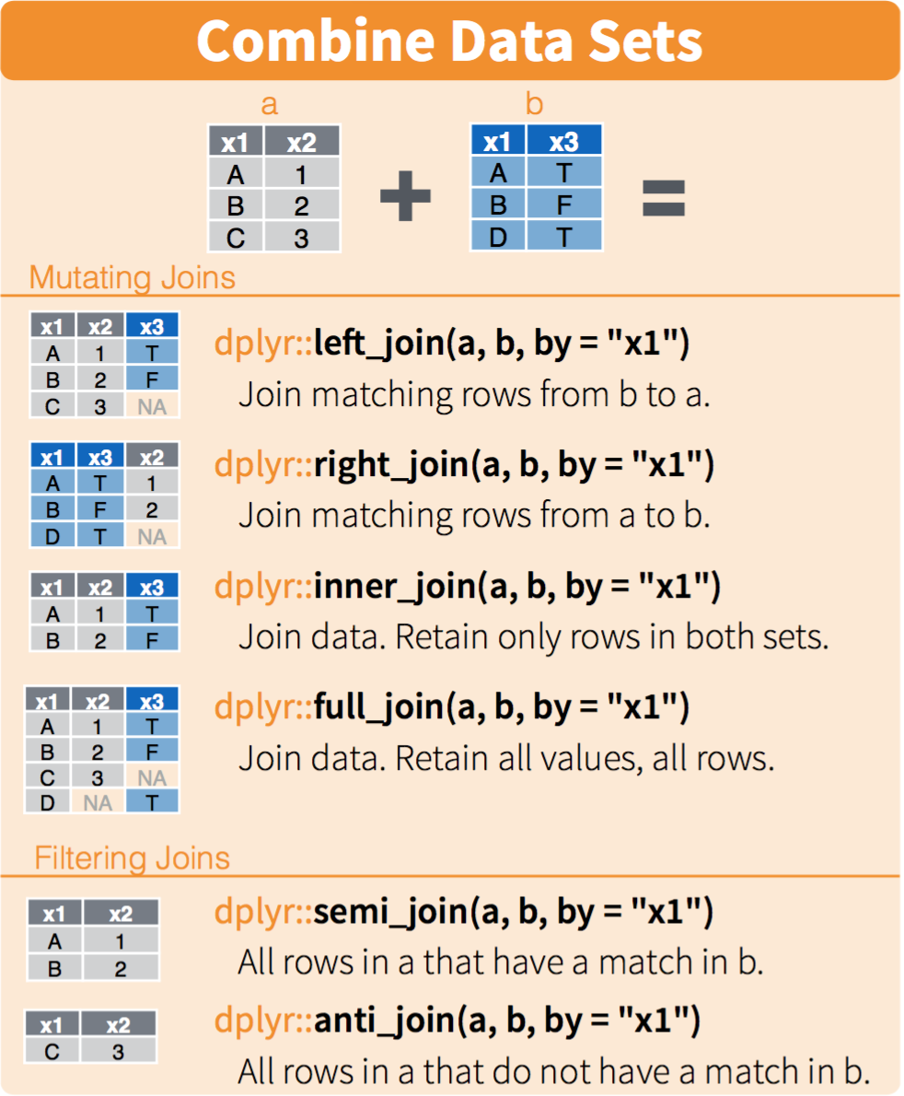
The mighty powers of joins
Useful for combining data sets
(e.g.) combining metanalysis genes with
Bienrich results,
DEGs with annotations

Slide 10
Predicate functions for functions that create new variables
mutate_if
mutate_at
summarize_if
summarize_at

Slide 11
dplyr 0.5 functions
arrange with minus function
top_n with minus function
nth with minus function
Coalesce (replace NA values)
na_if (add NA values)
recode

Slide 12
Tidy data and tidyr

