Slide 1


Government Polytechnic Harakh Barabanki
Presentation on
1 Month Summer Training – 2024-2025
At Student Training Program On Arduino from IIT Bombay
Submitted to
Mrs Sakshi Mishra Mam
Electrical engineering
Govt Polytechnic Harakh
Submitted by
Shambhu Gupta
Electrical engineering
3rd Sem 2nd year

Slide 2
[ Content]
About the Arduino
Arduino Components
Certificate

Slide 3
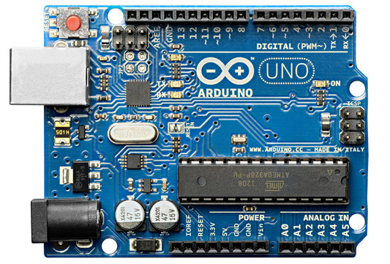
[Arduino Image]

Slide 4
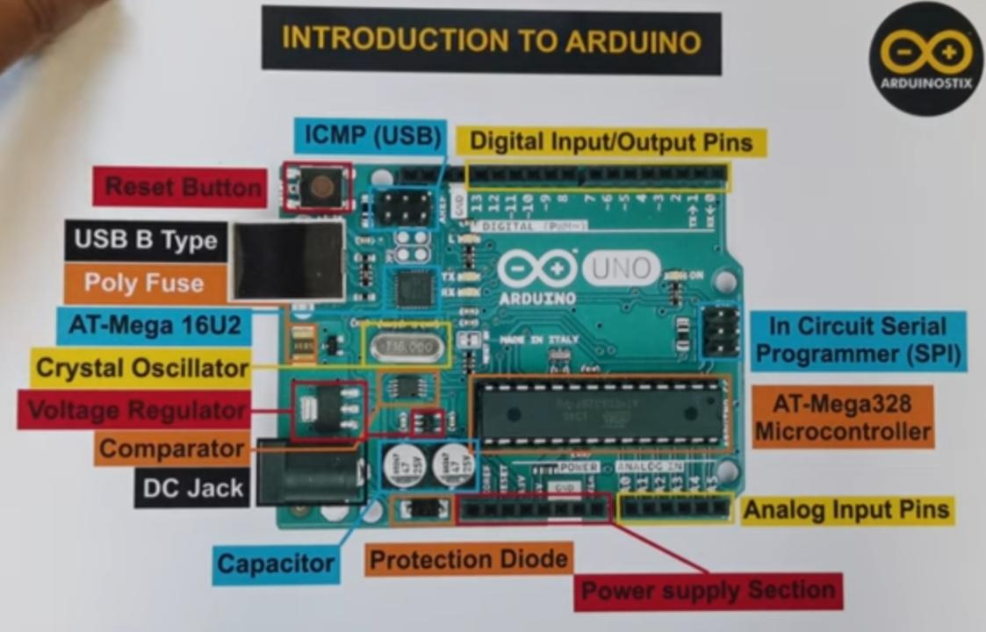

Slide 5
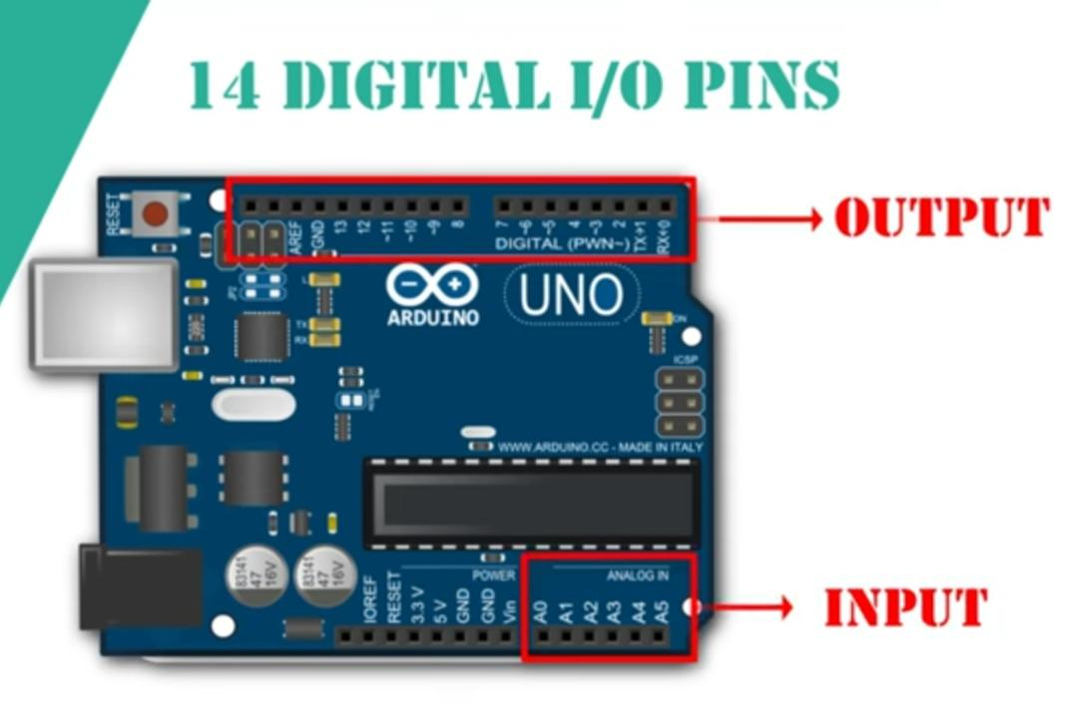

Slide 6
[About the Arduino]
Arduino is an open-source electronics platform based on easy-to-use hardware and software. It uses a microcontroller board (like Arduino Uno) and the Arduino IDE for programming in C/C++. It allows users to connect sensors, motors, LEDs, and other devices to create interactive projects.
1Key Features: Low cost, simple to program, beginner-friendly, cross-platform. *Uses: Robotics, home automation, IoT, and DIY electronics projects.

Slide 7
What is Arduino?
Arduino is an open-source electronics prototyping platform. Consists of hardware (microcontroller board) + software (Arduino IDE). Easy-to-use, ideal for beginners and professionals.

Slide 8
Applications of Arduino Home automation Robotics IOT (Internet of Things) Weather stations LED & motor control projects

Slide 9
Advantages & Limitations Advantages:
Beginner friendly, affordable, flexible.
Limited processing power.
Not suitable for very complex tasks.

Slide 10
Conclusion
Arduino = a simple, powerful tool for innovation.
Best for learning electronics & Codings.
“Start small, build big!”

Slide 11
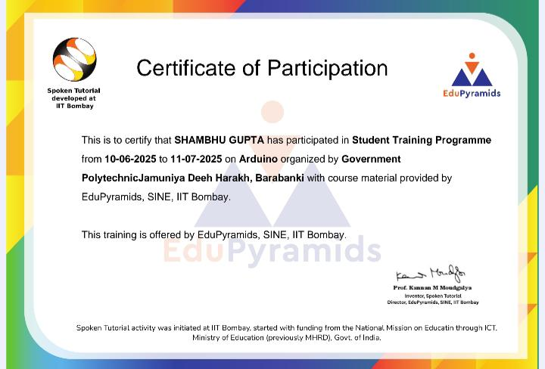
(Certificate of Participation )

Slide 12
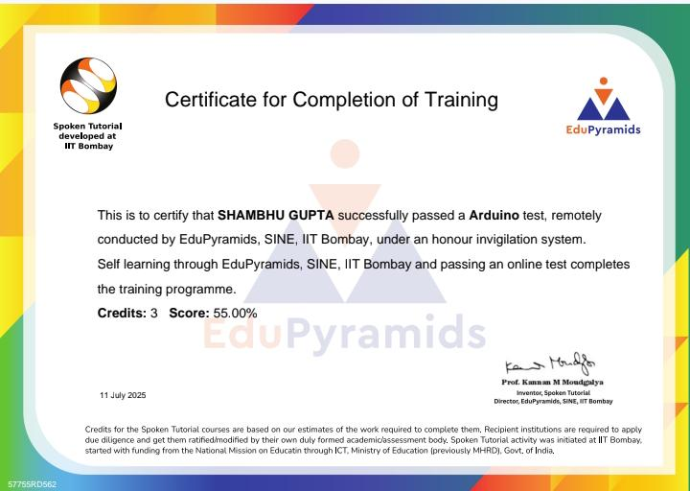
[Certificate]

Slide 13
Thank You 🥰🥰

