Slide 1




Presented by:
Anshuman Maurya
Electrical Engineering 3rd Semester
Government Polytechnic Jamuniya Deeh Harakh, Barabanki
Submitted to:
Sakshi Ma’am
(Lecturer Electrical Engineering)

Slide 2
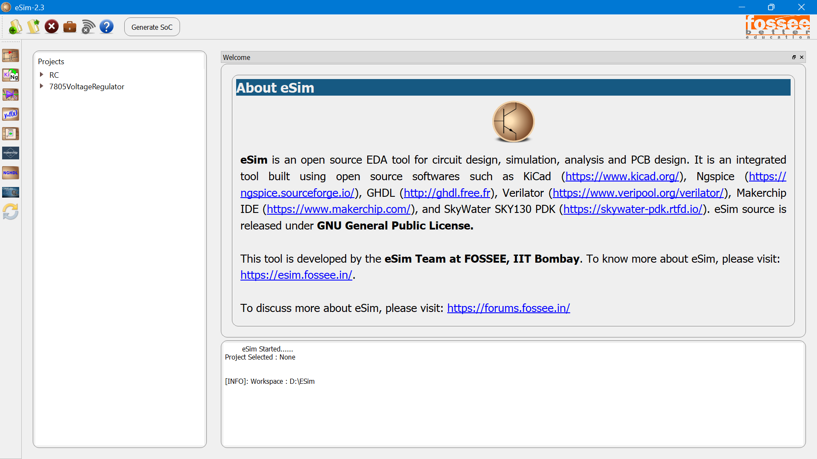
Introduction to eSim
Open-source EDA tool
Circuit Design, Simulation, PCB Design
Developed by FOSSEE, IIT Bombay
Free, under GNU General Public License

Slide 3
My Learning Journey
1.Schematic Creation and Simulation
9.Subcircuit Builder
PCB Design
Duration: 1 Month
Learned from 16 video tutorials
Covered: Schematic, Simulation, PCB, Device Models, Mixed Signals, Makerchip
2.Simulating an Astable Multivibrator
10.Editing a Subcircuit
3.Mapping Components with Footprints
11.Uploading a spice Subcircuit file
4.Setting Parameters for PCB designing
12.Mixed Signal Simulation using NGHDL
5.Laying Tracks on PCB
13.Mixed Signal Simulation using NgVeri
6.PCB Layout for Astable Multivibrator
14.Makerchip IDE
7.Creating a Device Model
15.Advanced NgVeri
8.Uploading a Spice Device Model
16.eSim interface to OpenModelica

Slide 4
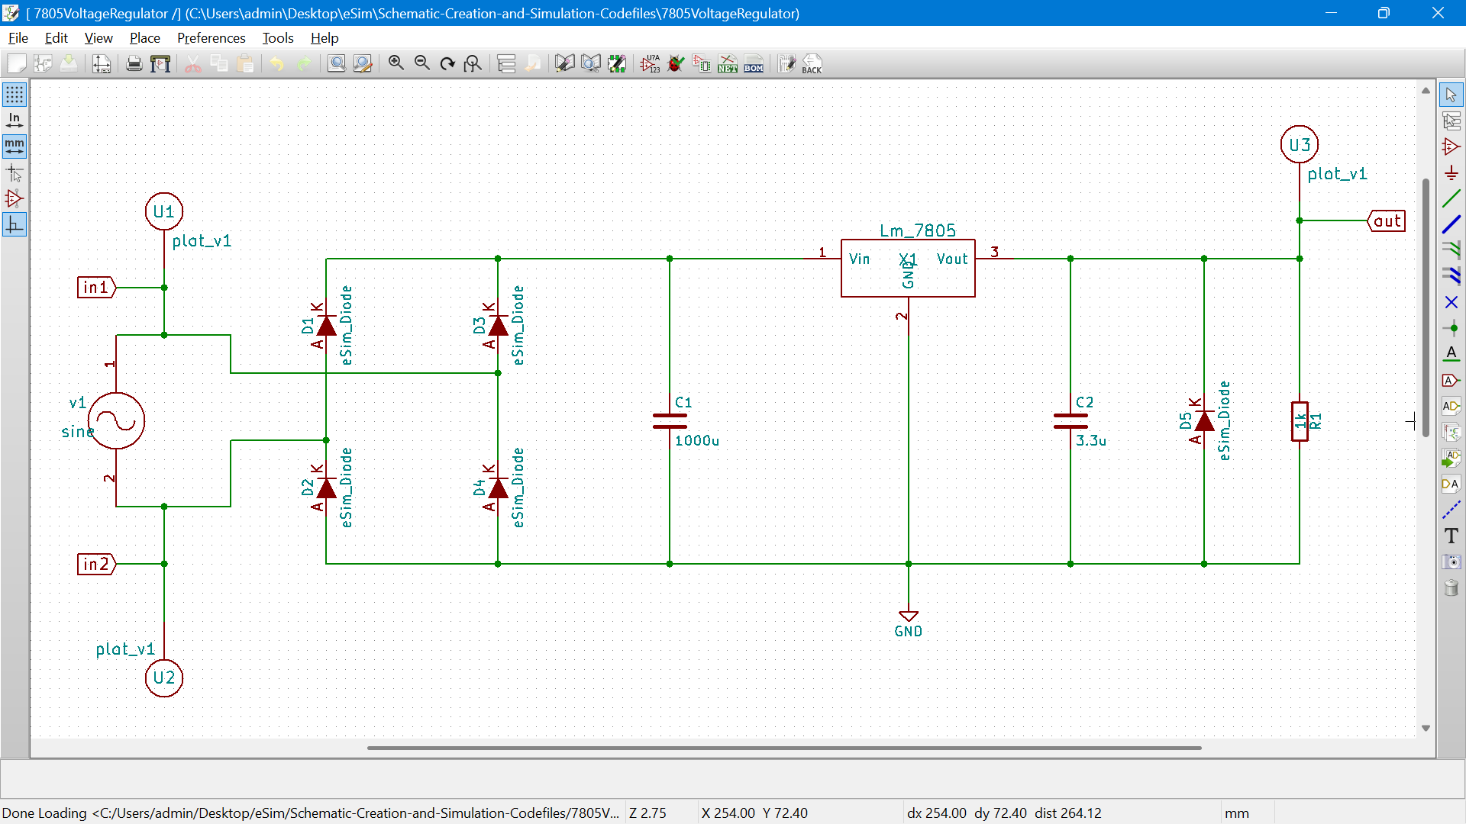
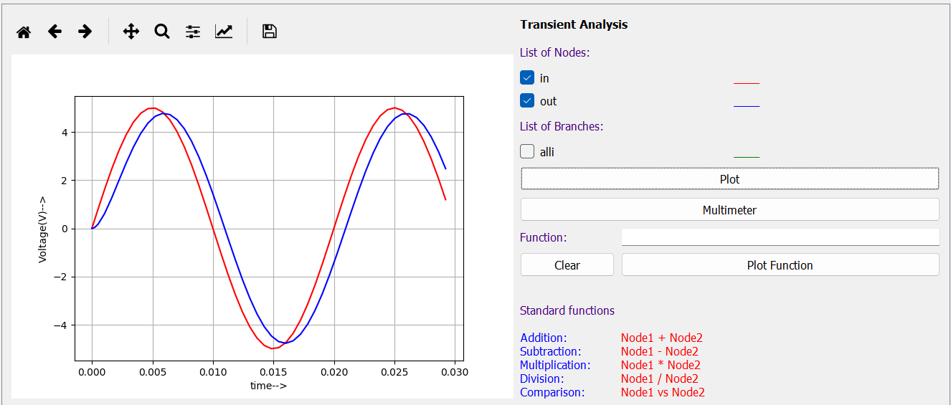
Schematic Creation & Simulation
Basic Design
Creating a circuit schematic
Running simulation
Example circuit
Creating a circuit schematic
Input vs Output Waveform (NgSpice Simulation)

Slide 5
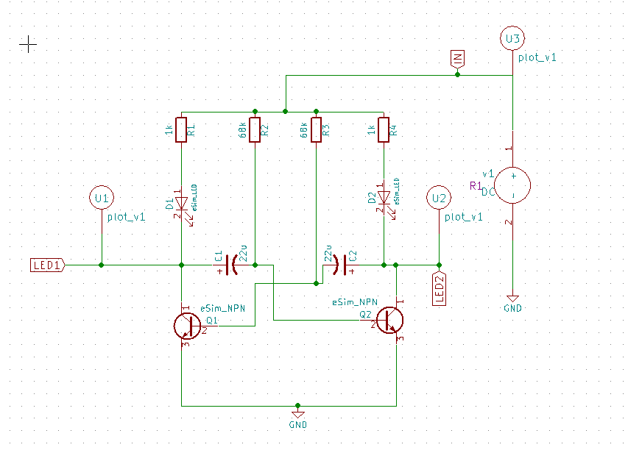
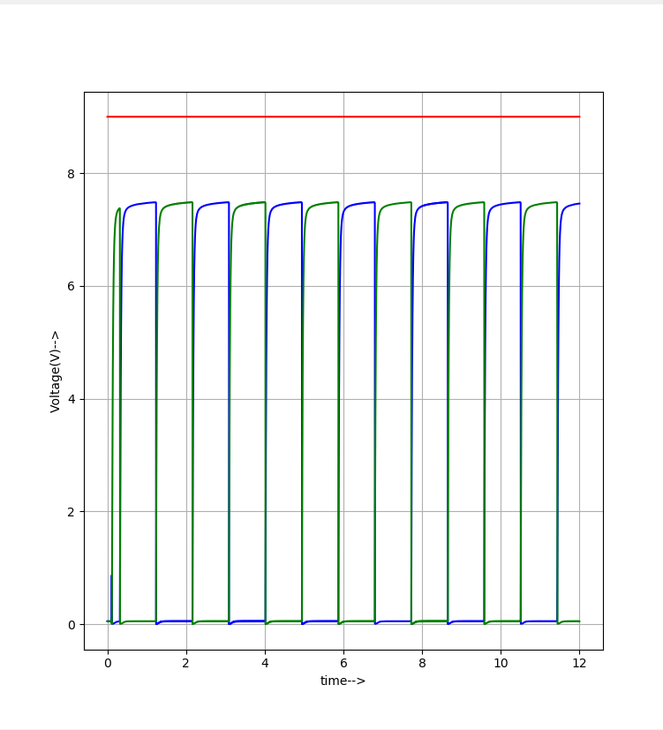

Simulating Astable Multivibrator
Basic Design
Astable multivibrator = Free running oscillator
Generates square wave
Applications: Timer, LED blinker, oscillator
Multivibrator schematic
Square Waveform

Slide 6
PCB Designing (Basics)
Basic Design
Mapping footprints
Setting PCB parameters
Laying tracks
Input vs Output Waveform (NgSpice Simulation)
Creating a circuit schematic

Slide 7
PCB Layout for Multivibrator
Basic Design
Final PCB layout design
Tracks and connections
Input vs Output Waveform (NgSpice Simulation)
Creating a circuit schematic

Slide 8
Device Models & Subcircuits
Basic Design
Creating device models
Uploading SPICE models
Building & editing subcircuits
Input vs Output Waveform (NgSpice Simulation)
Creating a circuit schematic

Slide 9
Mixed Signal Simulation
Basic Design
NGHDL = VHDL + Analog
NgVeri = Verilog + Analog
Digital + Analog together
Input vs Output Waveform (NgSpice Simulation)
Creating a circuit schematic

Slide 10
Makerchip IDE
Basic Design
Online IDE for Verilog
Integrated with eSim
Easy for digital design
Creating a circuit schematic

Slide 11
Advanced Topics
Basic Design
Advanced NgVeri features
OpenModelica interface
Input vs Output Waveform (NgSpice Simulation)

Slide 12
Key Learnings
Basic Design
Circuit design & simulation
PCB designing
Device models & subcircuits
Mixed signal analysis
Makerchip & OpenModelica
Creating a circuit schematic

Slide 13
Applications
Project PCB designing
Testing circuits before hardware
Useful for students, researchers & industries
Input vs Output Waveform (NgSpice Simulation)
Creating a circuit schematic

Slide 14
My Experience & Challenges
⚠️
Problem
Commercial EDA tools (such as OrCAD, PSPICE) are very expensive.
It is difficult for students and researchers to do circuit simulation and PCB design for free.
Challenges: PCB routing, SPICE models
Solutions: Practice, revisiting tutorials
Skills improved: circuit analysis, design
✅
Solution
IIT Bombay (FOSSEE) created eSim – Free Open Source EDA Tool.
Circuit design, Simulation, PCB layout, Verilog/VHDL support on a single platform.
Zero-Cost Learning Platform for Students and Engineers.
💡
Skill
Creating and simulating circuit schematics
Learning PCB Layout Design and Footprint Mapping
Understanding Subcircuits and Mixed-Signal Simulation (Analog + Digital)

Slide 15
My Experience & Challenges
⚠️
Problem
Commercial EDA tools (such as OrCAD, PSPICE) are very expensive.
It is difficult for students and researchers to do circuit simulation and PCB design for free.
Challenges: PCB routing, SPICE models
Solutions: Practice, revisiting tutorials
Skills improved: circuit analysis, design
✅
Solution
IIT Bombay (FOSSEE) created eSim – Free Open Source EDA Tool.
Circuit design, Simulation, PCB layout, Verilog/VHDL support on a single platform.
Zero-Cost Learning Platform for Students and Engineers.
💡
Skill
Creating and simulating circuit schematics
Learning PCB Layout Design and Footprint Mapping
Understanding Subcircuits and Mixed-Signal Simulation (Analog + Digital)

Slide 16
Conclusion & Q/A
eSim = Powerful Free Tool
Learned from basics to advanced in 1 month
Ready to apply in real projects

Slide 17
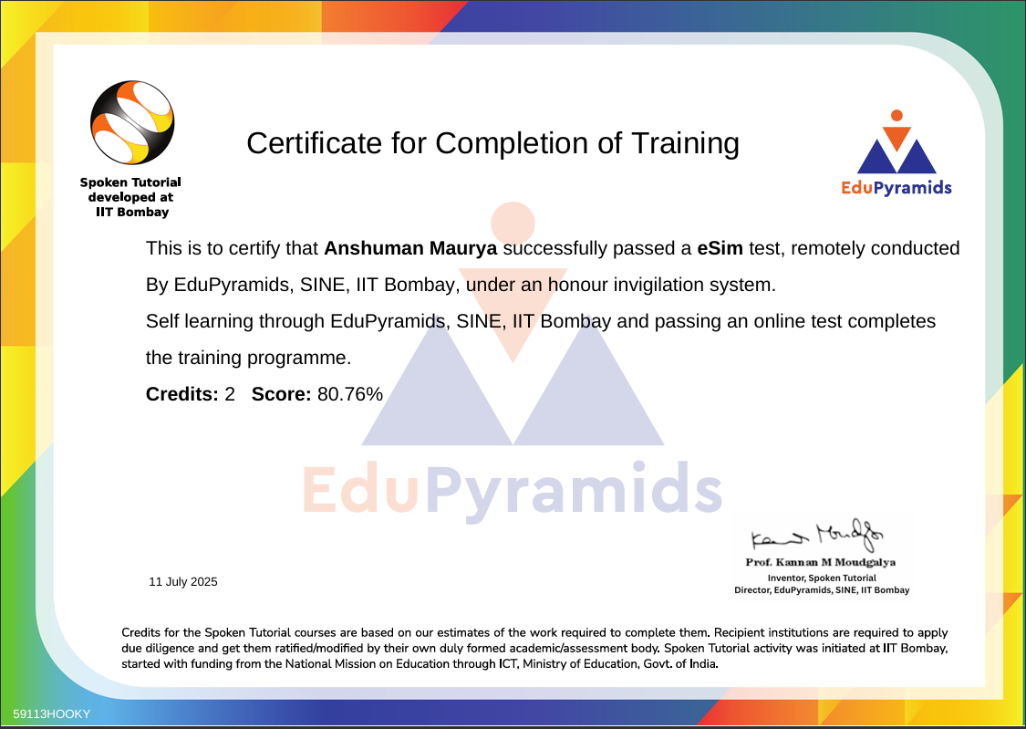

Slide 18
Thank you!

