Slide 1

A POWERPOINT PRESENTATION ON 33/11 KV PATRANGA AYODHYA
A Industrial training 33/11 kv Substation
Submitted by:-
Name:-
Branch :- Electrical Engineering 2nd year
Submitted To:-
(Lecturer Electrical Engineering)

Slide 2
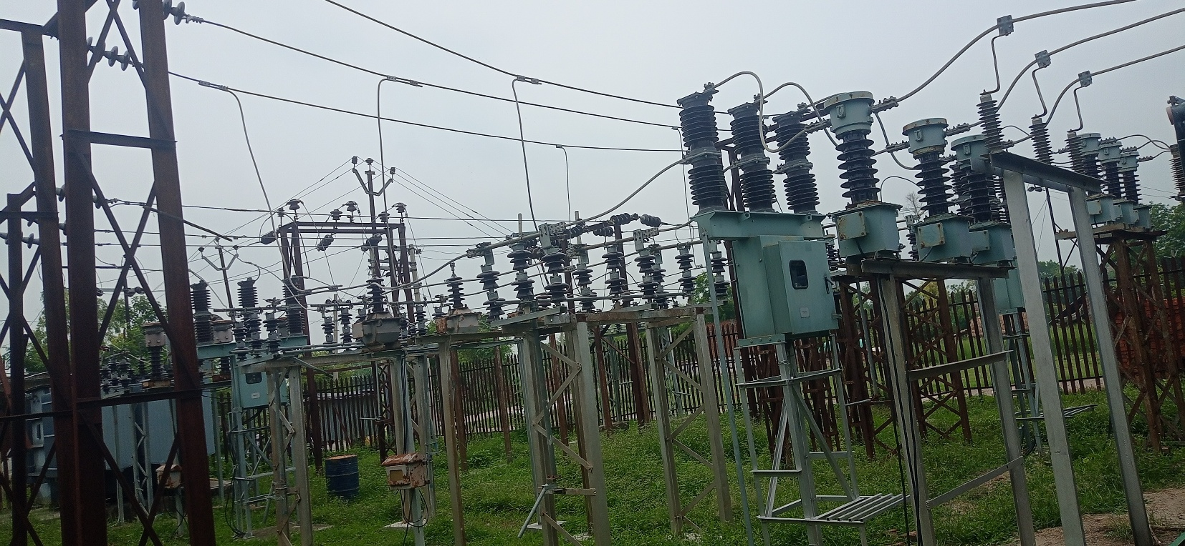
CONTENTS
WHAT IS GRID SUBSTATION
LIGHTNING ARRESTER
BUS BAR
POTENTIAL TRANSFORMER
ISOLATOR
CURRENT TRANSFORMER
PROTECTIVE RELAY
CIRCUIT BREAKER
TRANSFORMER
CONTROL ROOM

Slide 3
WHAT IS GRID SUB STATION (GSS) ?
"A Substation is an assembly by apparatus , which transform the characteristics of electrical energy from one form another Say from one voltage level to another level ,Hence a substation is an intermediate link between the generating station and consumer.
For economic transmission voltage should be high =>step up
Transmitted voltage for distribution =>step-down
For this purpose substations are installed.

Slide 4
INCOMING FEEDERS(33KV)
Ram Sanehi Ghat
OUTGOING FEEDERS(11kv)
Patranga
Mavai
Aliayabad
Bajitpur
Purekamgar
Barhuva

Slide 5
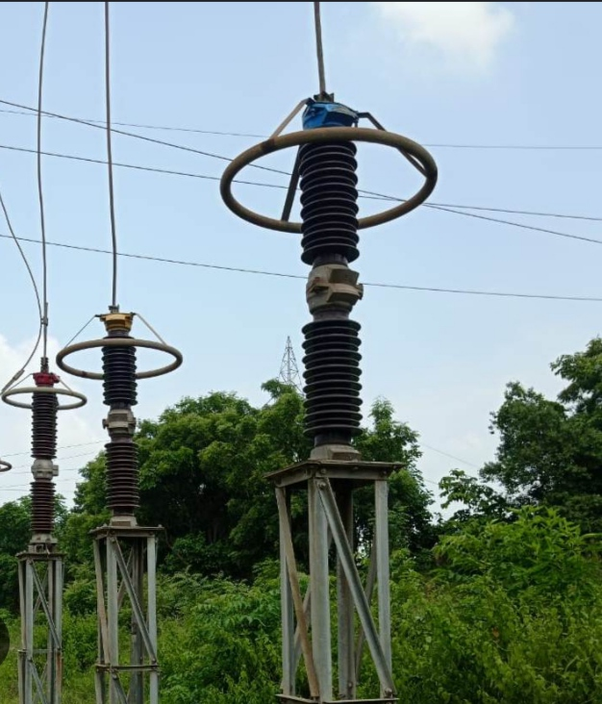
LIGHTNING ARRESTER :-
Lightning arrester is a device used on electric power transmission and telecommunication systems to protect the insulation and conductors of the system from the damaging effects of lightning. The typical lightning arrester has a high-voltage terminal and a ground terminal.

Slide 6
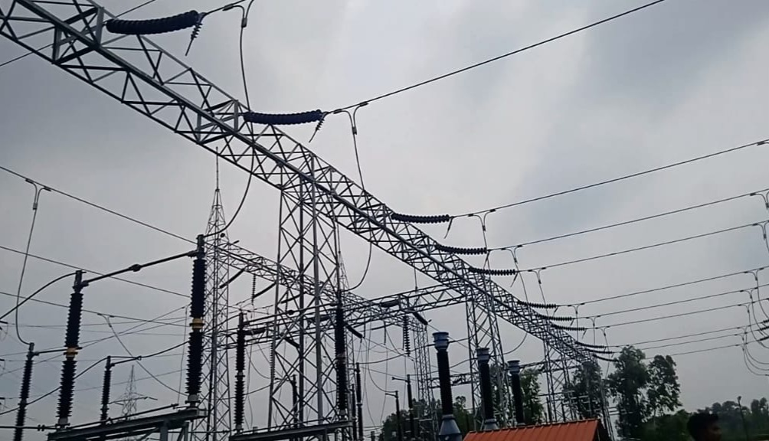
BUSBAR
In a substation, a busbar acts as a central electrical connection point, distributing power from incoming feeders to outgoing circuits. It's a metallic conductor, often a strip or bar, that simplifies complex power distribution by providing a common junction for multiple connections. This allows for efficient and flexible power management within the substation.

Slide 7
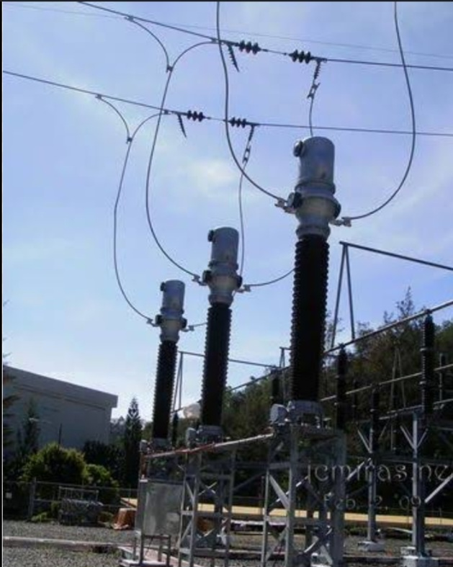
POTENTIAL TRANSFORMER
A Potential Transformer (PT) is an instrument transformer that steps down high system voltages to a safe, standardized value (generally 110 V) for accurate measurement, metering, and protection.

Slide 8
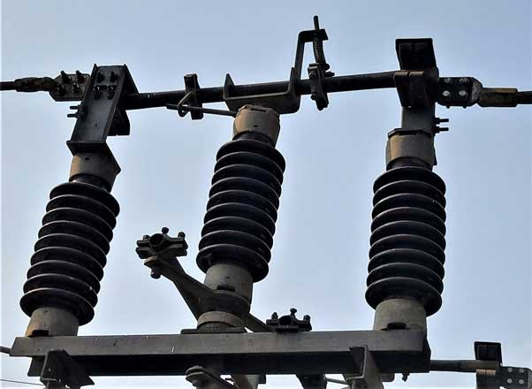
ISOLATOR :-
An Isolator is an off-load device used to disconnect a circuit or equipment from the power supply for maintenance, providing a visible and safe isolation.

Slide 9
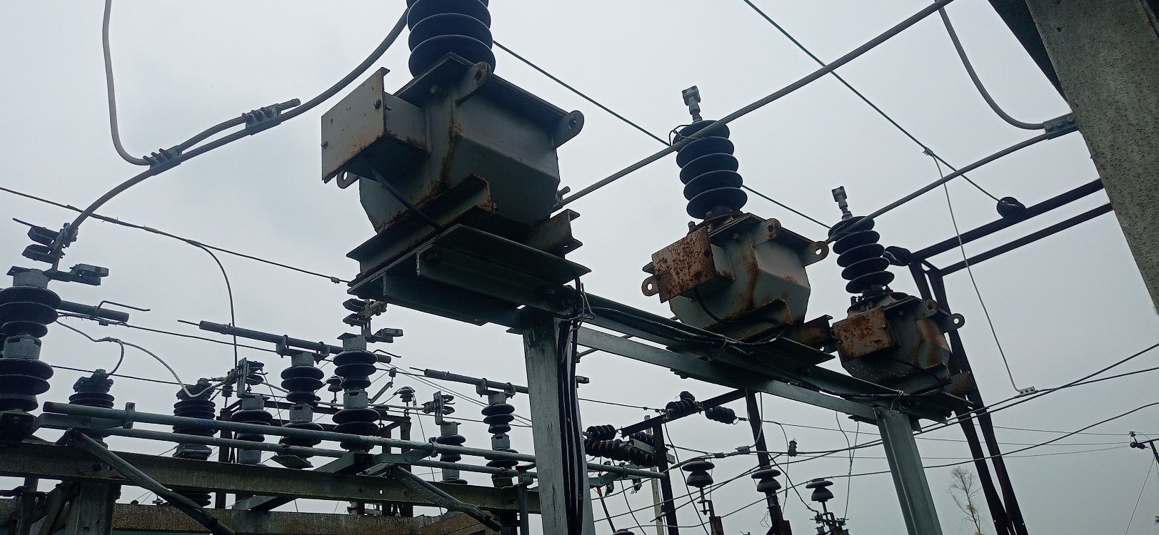
CURRENT TRANSFORMER :-
A Current Transformer (CT) is an instrument transformer that reduces high current to a standard value (5A or 1A) for safe measurement, metering, and protection purposes.

Slide 10
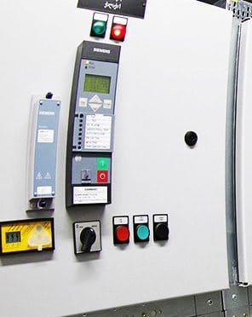
RELAY
A Relay is a protective device that detects abnormal conditions in an electrical circuit and sends a signal to the circuit breaker to disconnect the faulty section.

Slide 11
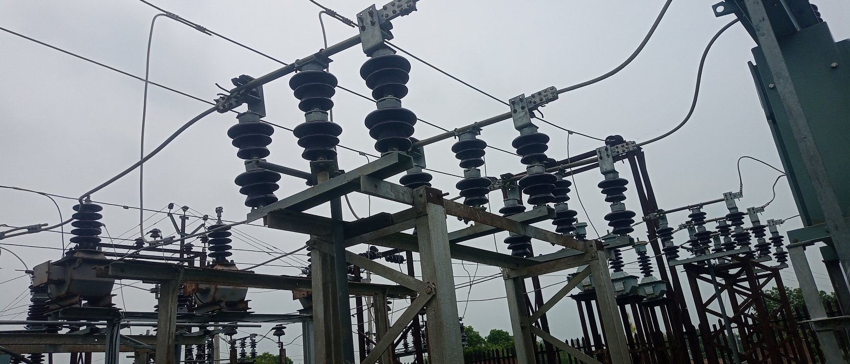
CIRCUIT BREAKER
A Circuit Breaker is an automatic protective device that interrupts normal and fault currents to protect the electrical system from damage.

Slide 12
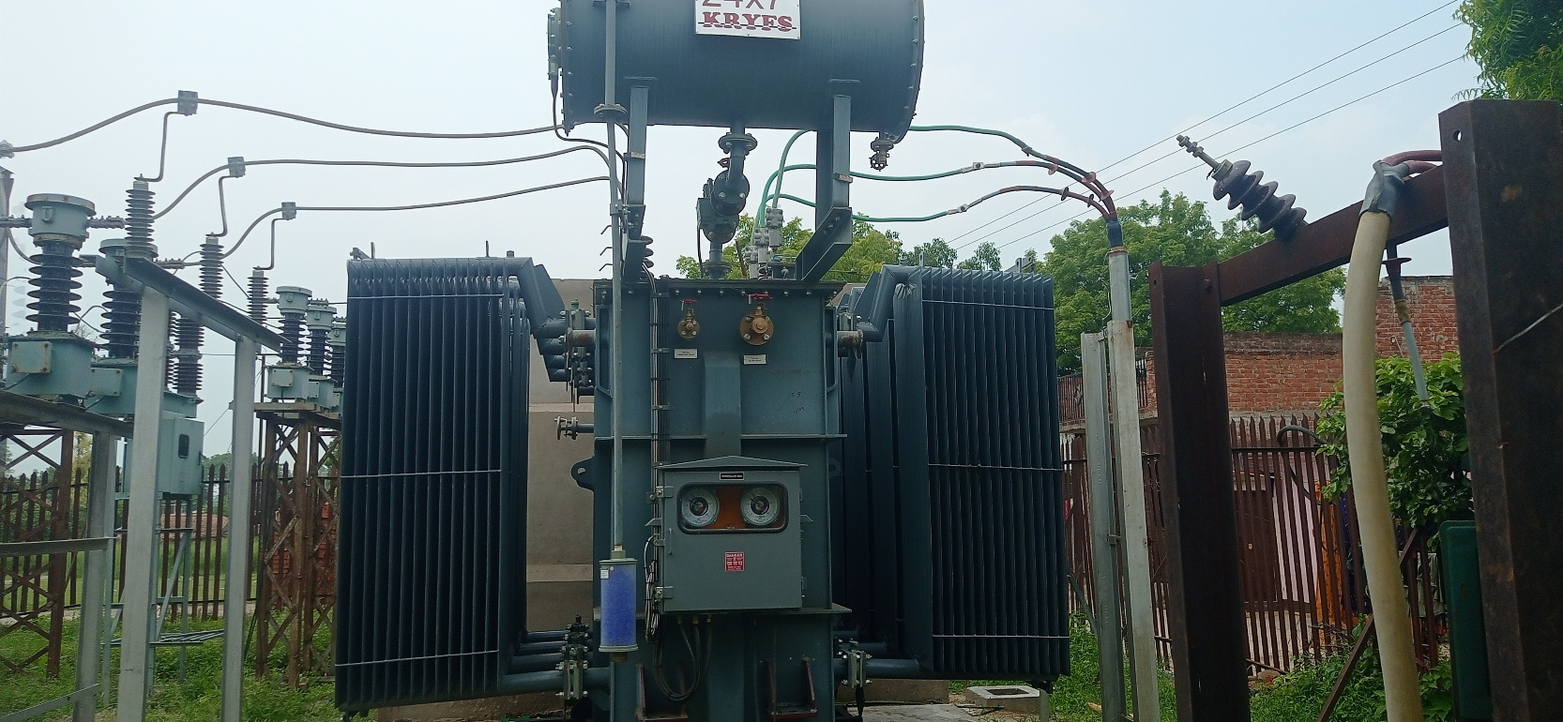
TRANSFORMER
A Transformer is a static device that transfers electrical energy between two circuits at the same frequency, mainly for stepping up or stepping down voltage.

Slide 13
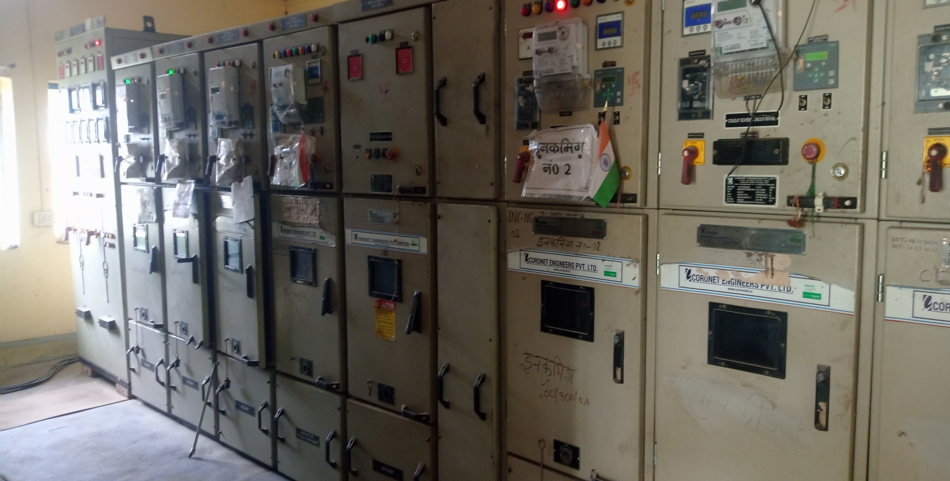
CONTROL ROOM

Slide 14
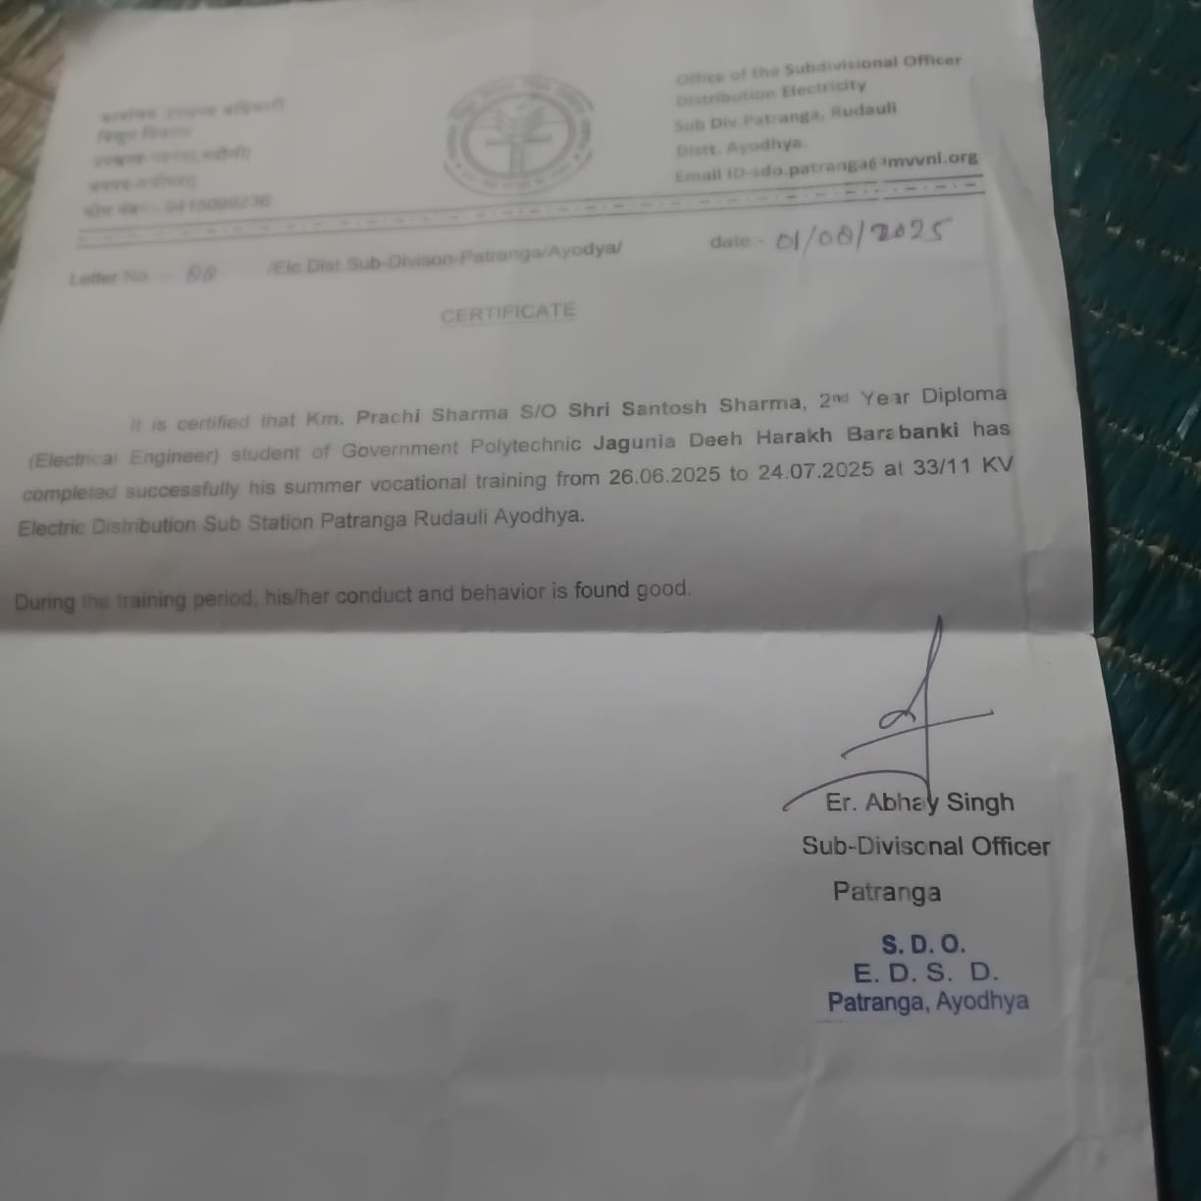

Slide 15
THANK YOU

