Slide 1
Asynchronous Methods
Kyle Kelly
Senior Software Developer
LBA Ware, LLC

Slide 2
Overview
Introduction
What is an Asynchronous Method and why use it
Asynchronous examples
Await
WaitAll
WhenAny
Delay / Repeat
Result / Cancel
Questions

Slide 3
Introduction
Brief description of me
What is Asynchronous Methods (async)
Why use Async
Control flow / don’t block the flow (especially the UI!)
Async vs Threads
Threads have multiple points of control, and some parts are handled by OS
Async - single thread of control, more knowledge of when processes run
Where Async is used
Websites
Backend
Mobile

Slide 4
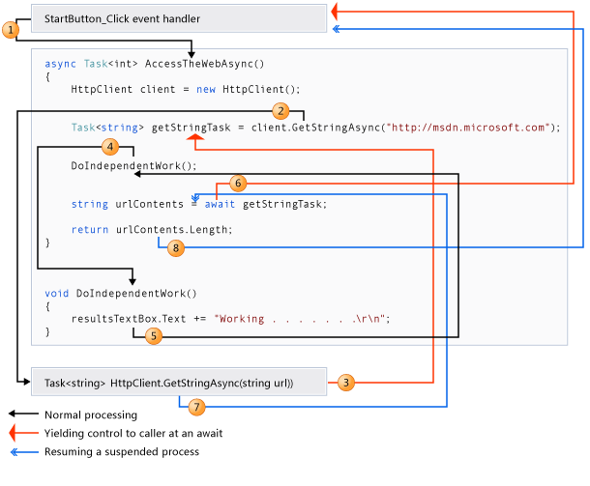
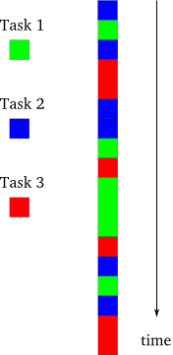
Visualizing Asynchronous Methods

Slide 5
Async AWait
$.ajax({
type: "POST",
contentType: "application/json; charset=utf-8",
url: wsUrl,
data: "{'sUserID': '" + userId + "'"
+ "}",
dataType: "json",
success: function (msg) {
doSomething();
},
failure: function (msg) {
alert('Failure: ' + msg.d[1]);
} });

Slide 6
Async WaitALL
Runs multiple Tasks simultaneously
When all have completed, returns control to caller
List<Task> TaskList = new List<Task>();
var task1 = asyncMethod();
var task2 = asyncMethod();
TaskList.Add(task1);
TaskList.Add(task2);
Task.WaitAll(TaskList.ToArray());

Slide 7
Async WHENANY
Runs multiple Tasks simultaneously
When any have completed, returns control to caller
Repeats as other tasks complete
List<Task> TaskList = new List<Task>();
var task1 = asyncMethod();
var task2 = asyncMethod();
TaskList.Add(task1);
TaskList.Add(task2);
while (condition) {
Task.WhenAny (TaskList.ToArray());
checkCondition();
await task }

Slide 8
Async Delay / repeat
Async delay is used to cancel the request if a set time has been reached
Async repeat is used to repeat the request after a set time
Often used together
var cts = new CancellationTokenSource(TimeSpan.FromSeconds(duration));
RepeatActionEveryTime(Action), TimeSpan.FromSeconds(Time), cts.Token).Wait();
async Task RepeatActionEvery(Action act, TimeSpan inter, CancellationToken canc) {
while (true) {
act();
Task task = Task.Delay(inter, canc);
await task; }}

Slide 9
Result / Cancel
Calling an async method from a non async method
Result
Cancel an async method
Cancellation token
CancelAfter
i = asyncMethod.Result;
cts.Cancel();

Slide 10
Questions
? ? ?

