Slide 1
ResilientCity
Disaster-Resilient Urban Seed Vaults

Slide 2
How This Idea Came to Life?
I would like to share the origin of this idea; thank you for reading. I watched a series where, following a nuclear attack, many people lost their lives, and the survivors had to live in shelters with only canned food. It was striking to see the elders’ longing for foods from the past and the children’s curiosity about them. At first, I wondered, “What could be a solution to this?” — and that’s how the idea of storing seeds in capsules at various locations, to be reusable in the future, was born.
Then I faced another reality: if most people would not survive, what purpose would these capsules serve? This made me rethink the project. How could we minimize loss of life? I examined underground shelters and their implementations in detail. Yes, it was a logical solution, but the cost per person was very high. I then began exploring ways to reduce costs. After many ideas and evaluations, transforming existing structures into emergency shelters and establishing community-based emergency vault networks made the project much more feasible — costs were significantly reduced. This is how I developed my project further. I hope I have conveyed my ideas accurately and effectively.

Slide 3
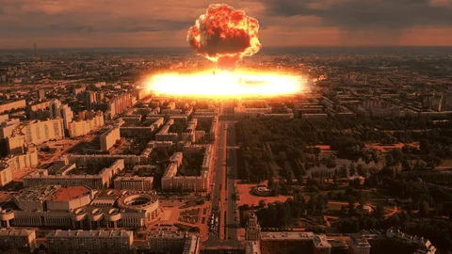
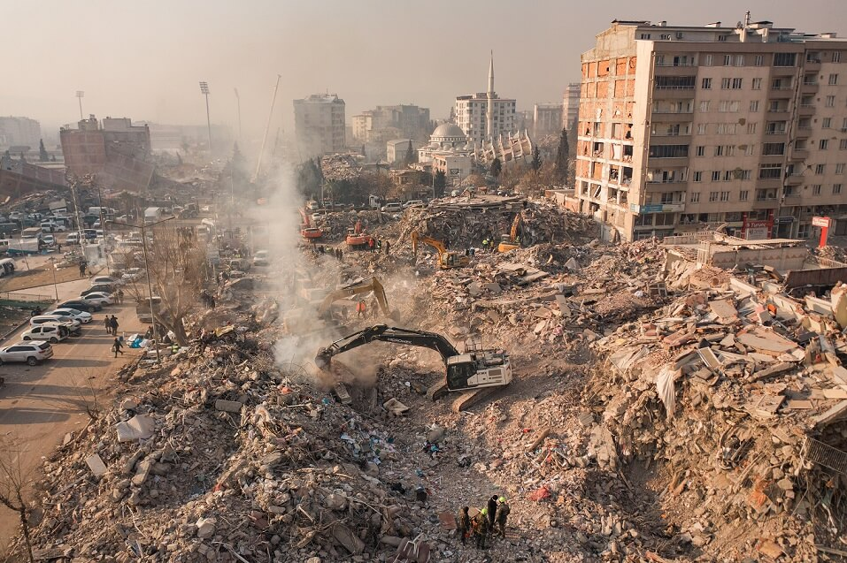
Problem / Background
Cities are increasingly vulnerable to climate change, earthquakes, and other disasters.
Existing infrastructure may fail to ensure community safety during emergencies.
Long-term disasters pose serious risks to food security and continuity of life.

Slide 4
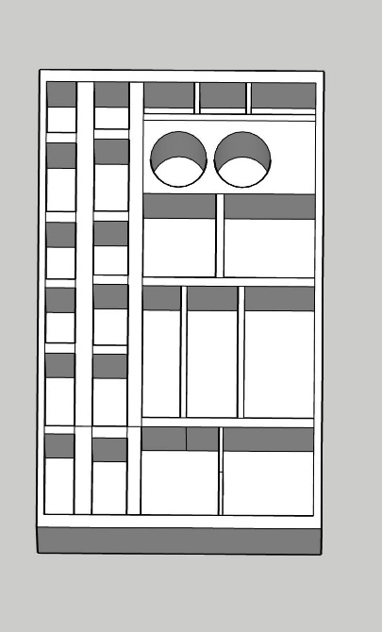
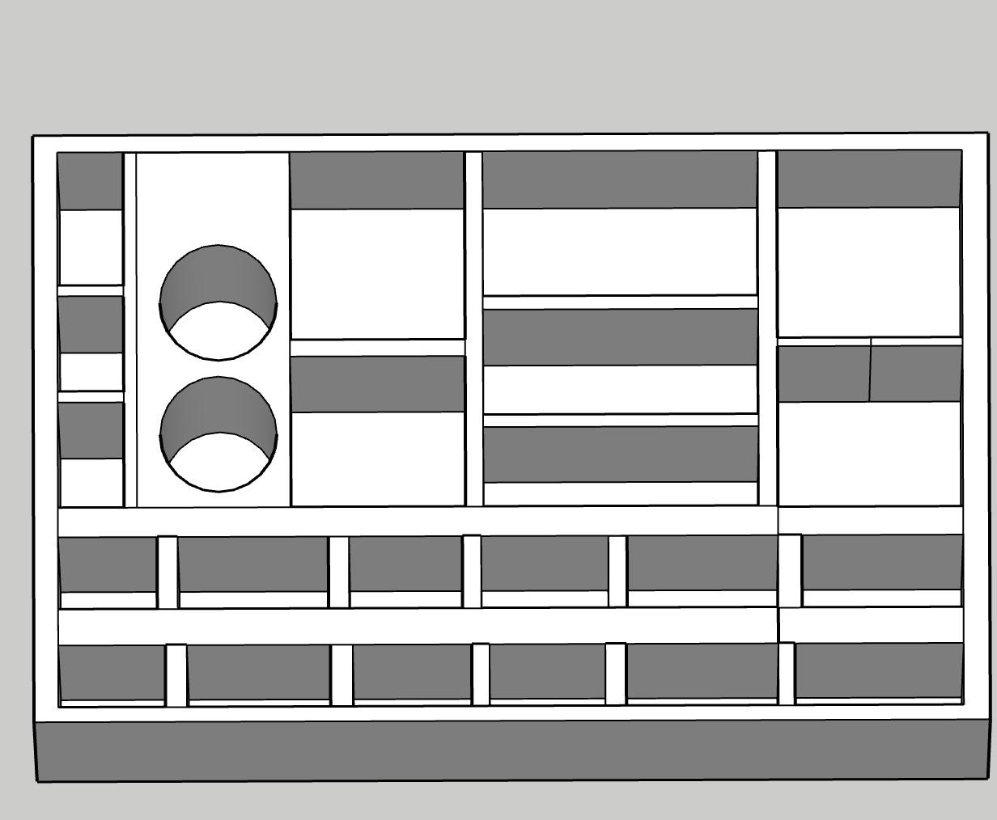
Objective
Design and implement disaster-resilient vaults
and shelter networks in urban areas.
Ensure communities have access to emergency supplies,
food, and seed storage for long-term survival.
🇬🇧 Seed Storage Unit
Designed to ensure safe and long-term preservation of seeds. Its rectangular prism form with two circular compartments maintains humidity balance and allows separate storage of different seed types. The modular structure enhances efficiency in both storage and transport.

Slide 5
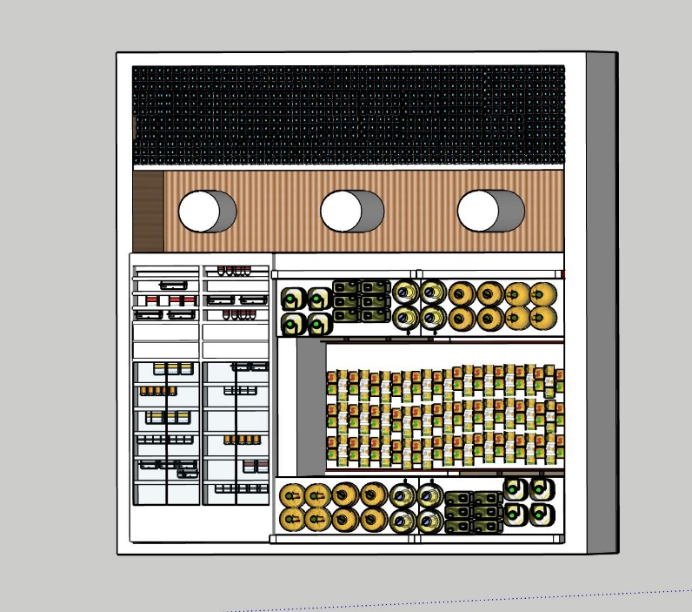
Proposed Solution
Small vaults placed near local facilities
(schools, hospitals, military posts)
for easy access during earthquakes and
other local disasters.
Large vaults designed for long-term survival,
including seed storage, located strategically
for global or severe disasters.
Emergency kits with food, water, and
medical supplies available near small vaults
for immediate use.
🇬🇧 Emergency Survival Kit – Technical Description
The capsule is designed as a modular, durable rectangular prism to enable rapid access to essential supplies after disasters. The interior is optimized to accommodate water, food, first aid supplies, and basic tools in an organized manner. Materials are selected to balance lightweight construction and robustness; the prismatic shape improves stacking and placement efficiency, while offering stability underground and ease of transport. This design aims to provide quick access to life-saving support at critical moments.

Slide 6
Approach
🇬🇧 Description of Reinforced Structure
The model does not visually represent structural reinforcement. However, this concept refers to improving the load-bearing system, adding seismic isolation, and reorganizing emergency zones to enhance the building’s resilience against disasters. This ensures safer evacuation and temporary shelter without collapse risk.
The placement of vaults and shelters is
visualized using 3D modeling.
Existing structures are reinforced
to be disaster-ready.
Features added to the vaults are determined
based on data sources such as climate change,
earthquakes, and radiation.

Slide 7
Expected Impact
🇬🇧 Project Summary
ResilientCity is designed to support survival and reconstruction after disasters. When a city falls, hope can rise again — this project aims to protect both life and nature in the aftermath of disasters. The system combines emergency kits, seed preservation capsules, and reinforced structures to provide communities with safe shelter and sustainable living spaces. Each capsule represents hope, and each structure symbolizes rebirth.
Community safety during disasters is enhanced.
Continuity of life and food security is ensured.
Disaster preparedness and urban resilience
are strengthened.
Provides a sustainable solution considering
cost and feasibility.

