Slide 1
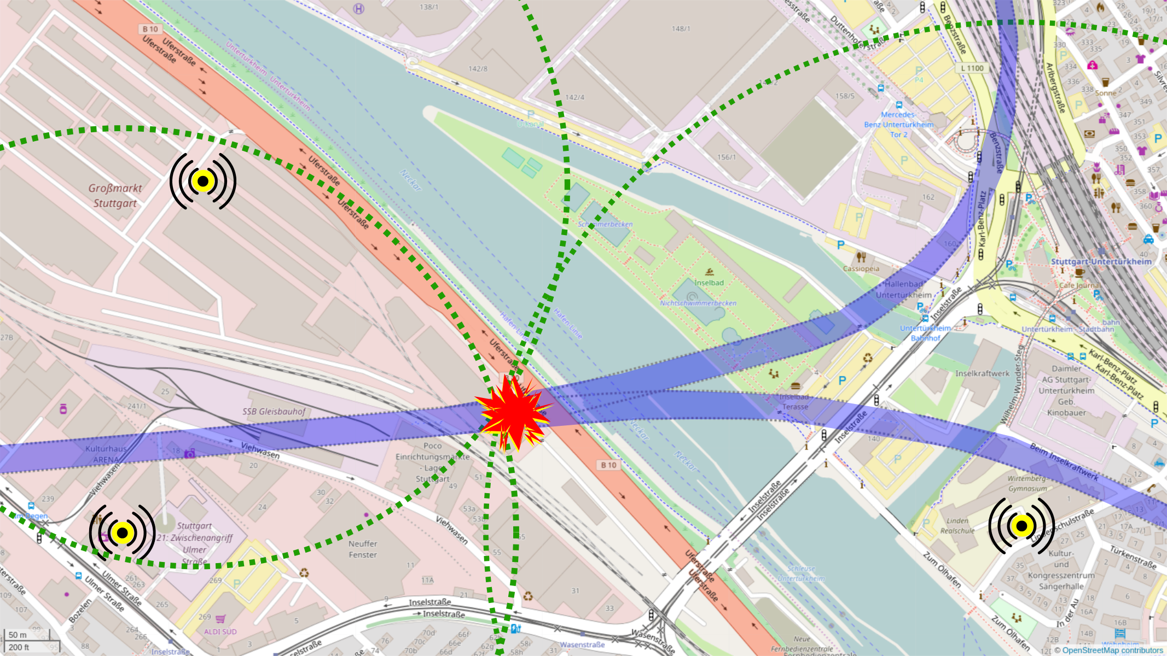
Detecting & Locating of a Seismic Event with Tunnel-God-Detector
by trilateration of a targeted detonation in a tunnel
sensor01
Detonation
S21 tunnel construction site
sensor03
NASA SpaceApps Challenge Stuttgart 2017
in shackspace, Stuttgart
sensor02

