Slide 1
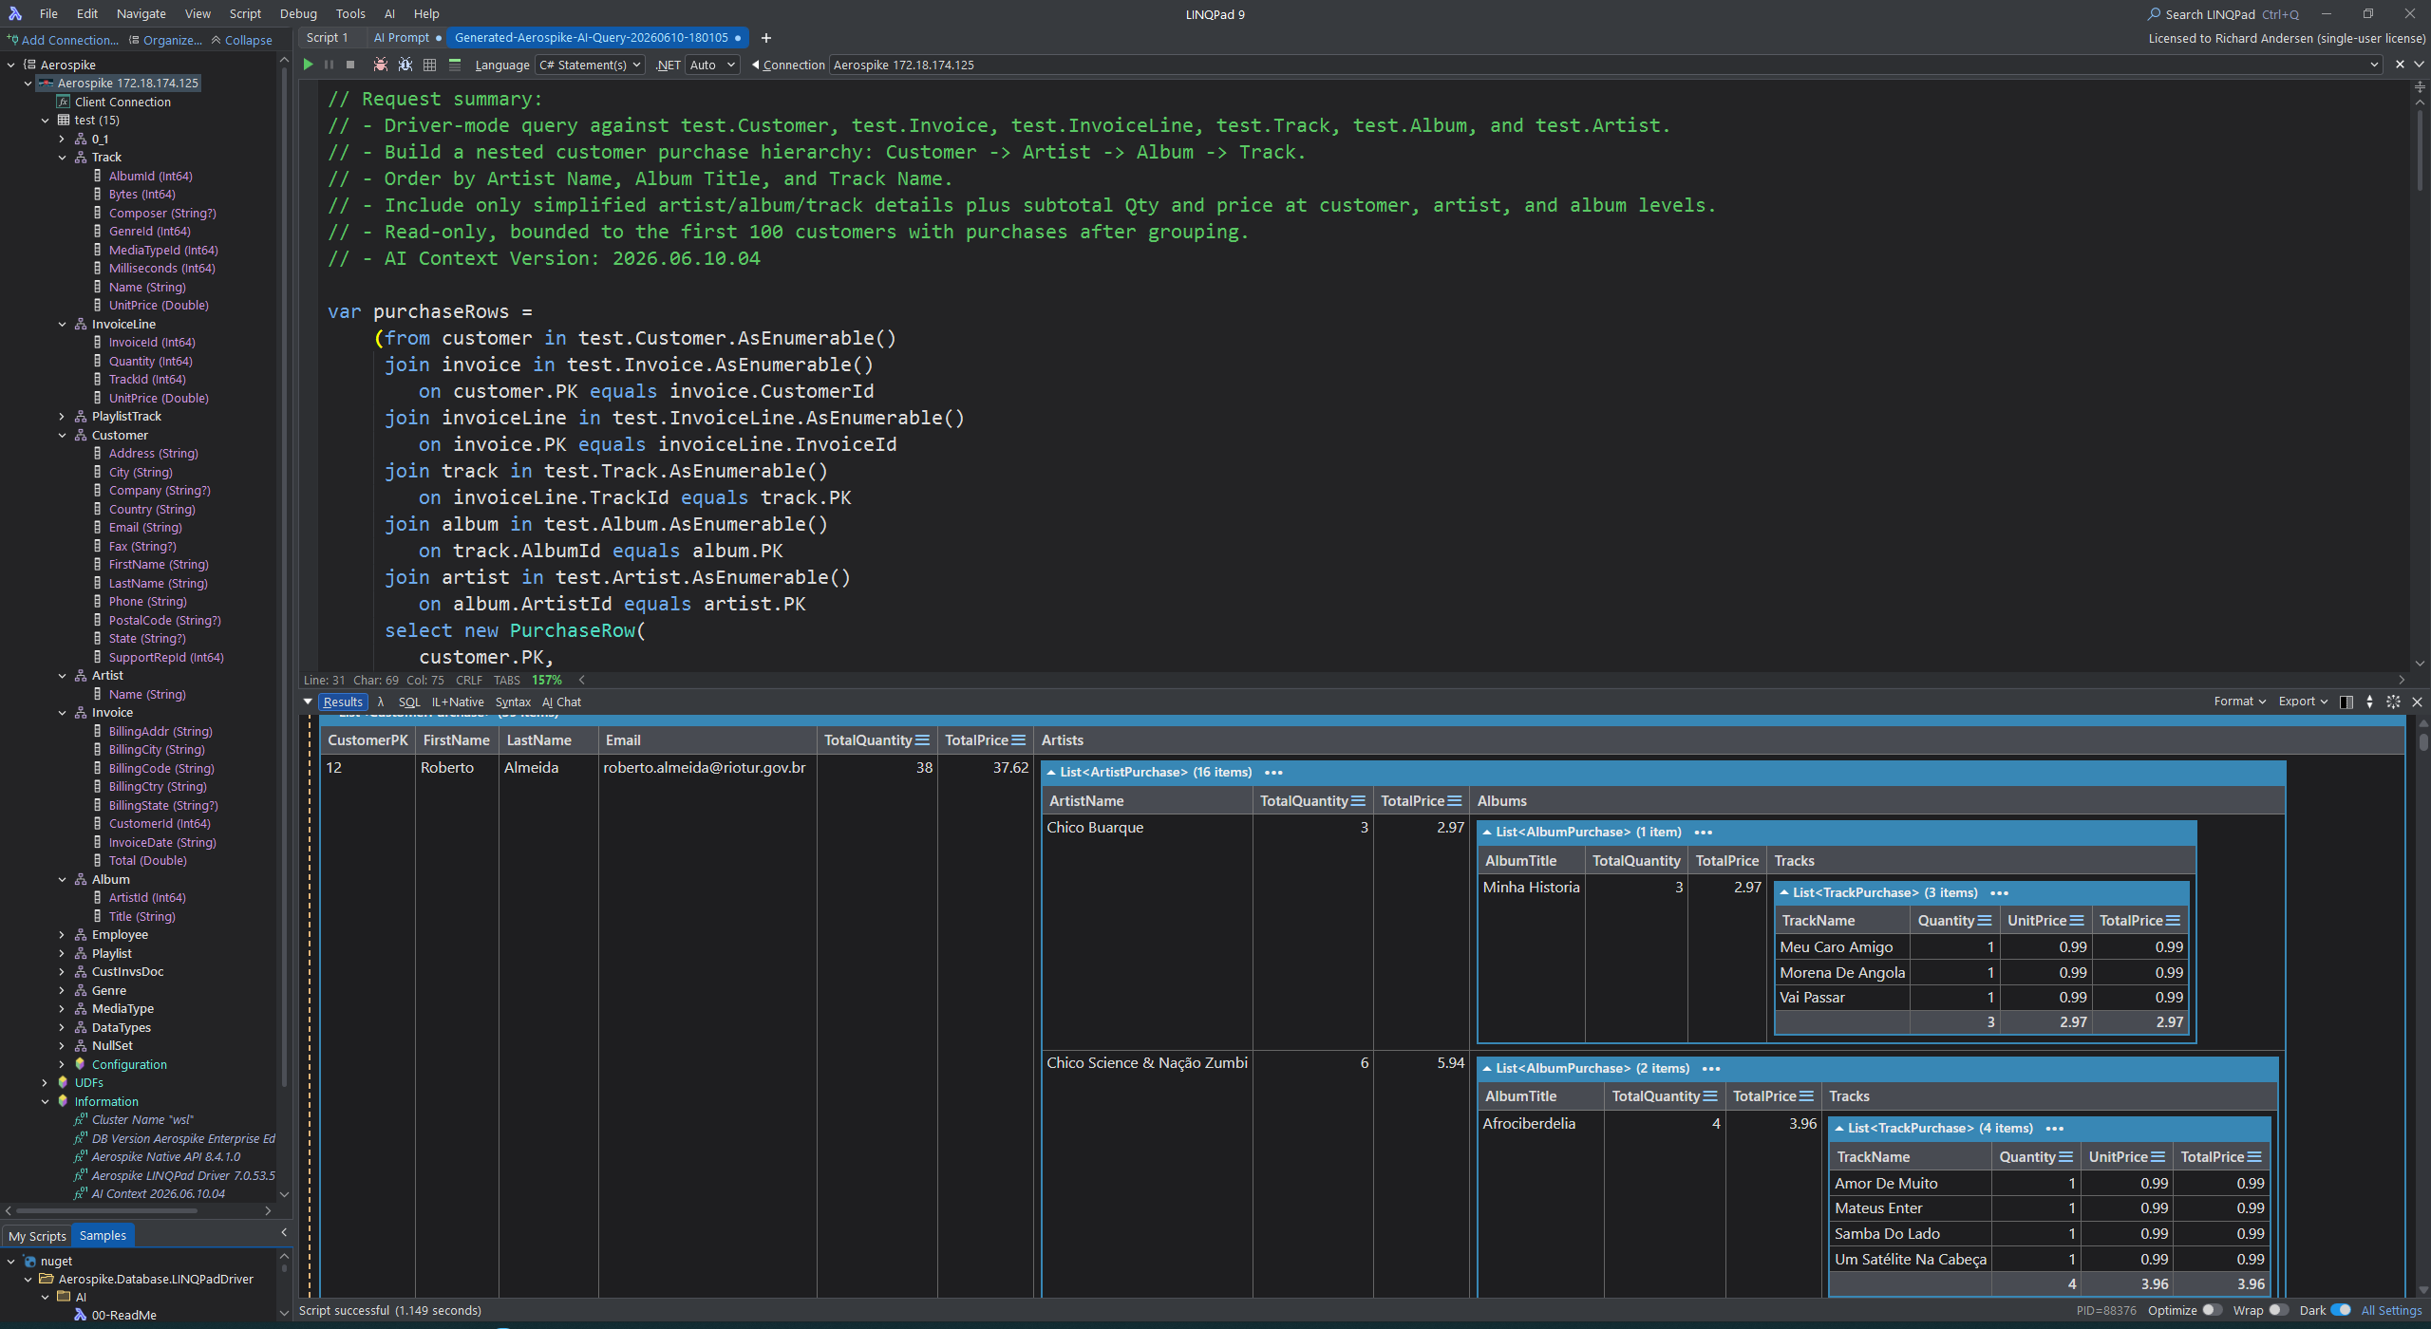
Aerospike LINQPad AI
Schema-aware AI query generation inside LINQPad
Turn natural-language asks into runnable C# Statements queries across LINQPad-driver and native Aerospike API workflows.
LINQPad Driver
AValue-aware
Native C# API
Server expressions
Turn this request into Aerospike C# LINQ Query…
I would like a list of customers purchases.
Please order by Artist Name, Album Title, Track Name with sub-totals.
In one line, turn the above request into Aerospike C# Native API Code by adding:
Use Aerospike Native API.
Aerospike LINQPad AI
Overview deck

Slide 2
What the AI feature does
Natural language becomes safe, bounded LINQPad C# over live Aerospike metadata.
From intent to executable query
Reads current namespace, set, bin, and generated-property context
Chooses LINQPad-driver or native Aerospike API mode In Native API mode; copy/paste ready for Visual Studio/Code
Generates runnable C# Statements with summary comments
Complete CDT and Expression/CTX support with transversal
Opens the generated query with the right LINQPad execution path
The prompt can ask for query syntax, native API code, server-side expressions, or result shaping.
Aerospike LINQPad AI
Overview deck

Slide 3
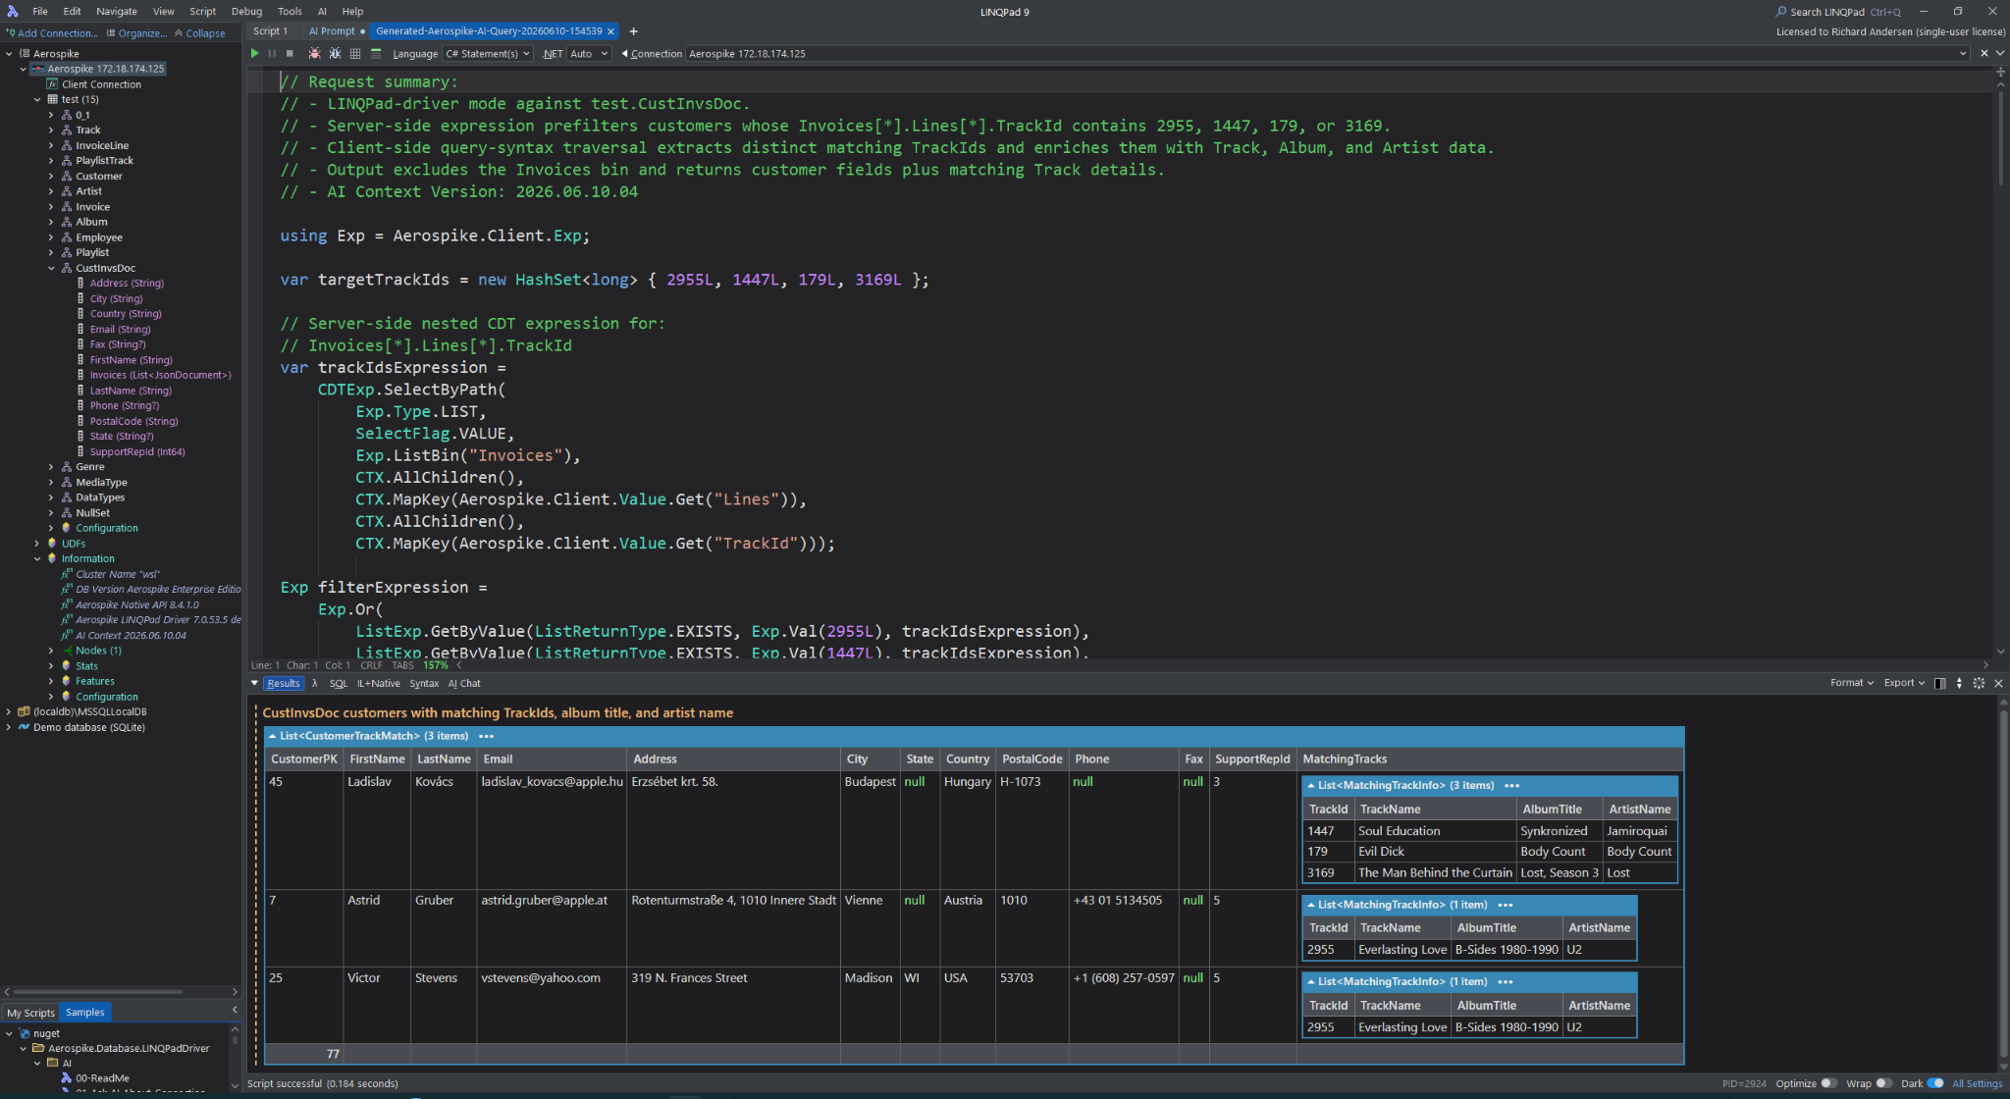
End-to-end workflow
Prompt → AI context → generated script → LINQPad execution → nested result output.
Ask
Context
Generate
Run
Inspect
Natural-language request in LINQPad
Current schema + rules + examples
C# Statements script with summary
LINQPad executes with Dump() output
Nested records, joins, and results
Result shape can include nested invoices, tracks, albums, and artists — without leaving LINQPad.
Aerospike LINQPad AI
Overview deck

Slide 4
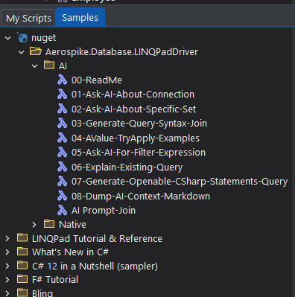
AI samples lower the starting friction
Packaged samples make common AI workflows discoverable inside LINQPad.
Sample coverage
Ask about connection
Explain current cluster and driver context
Ask about a set
Use actual metadata for set-specific queries
Generate joins
Create query syntax or method syntax joins
AValue examples
Show safe conversion and CDT traversal patterns
Filter expressions
Generate server-side expression filters
AI context dump
Inspect what the model receives
The samples are also documentation: they teach the AI where the boundaries are.
Aerospike LINQPad AI
Overview deck

Slide 5
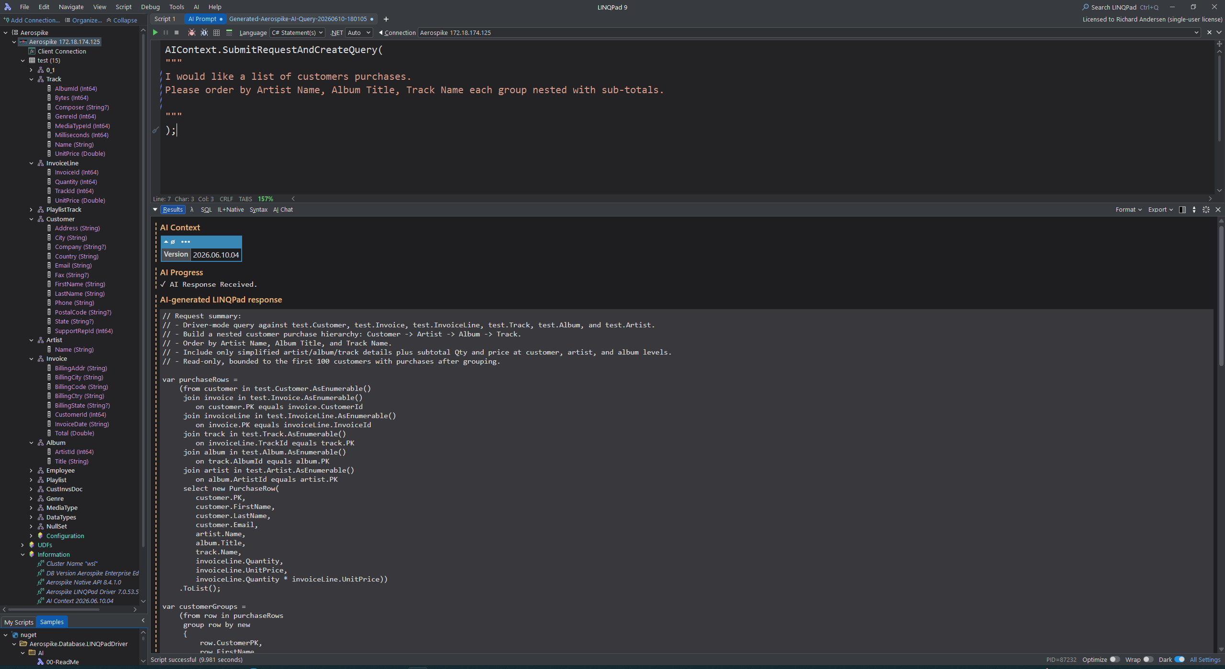
Schema-aware context in the editor
The AI sees the same domain shape you see in LINQPad: sets, bins, generated properties, and cluster metadata.
Context ingredients
Namespace, set, and bin metadata from the active connection
Generated property names and primary-key conventions
Driver rules for AValue / APrimaryKey behavior
Mode-specific examples: LINQPad driver vs native C# client
Versioned AI context so generated scripts show provenance
Result: generated code follows the current connection instead of generic sample assumptions.
Aerospike LINQPad AI
Overview deck

Slide 6
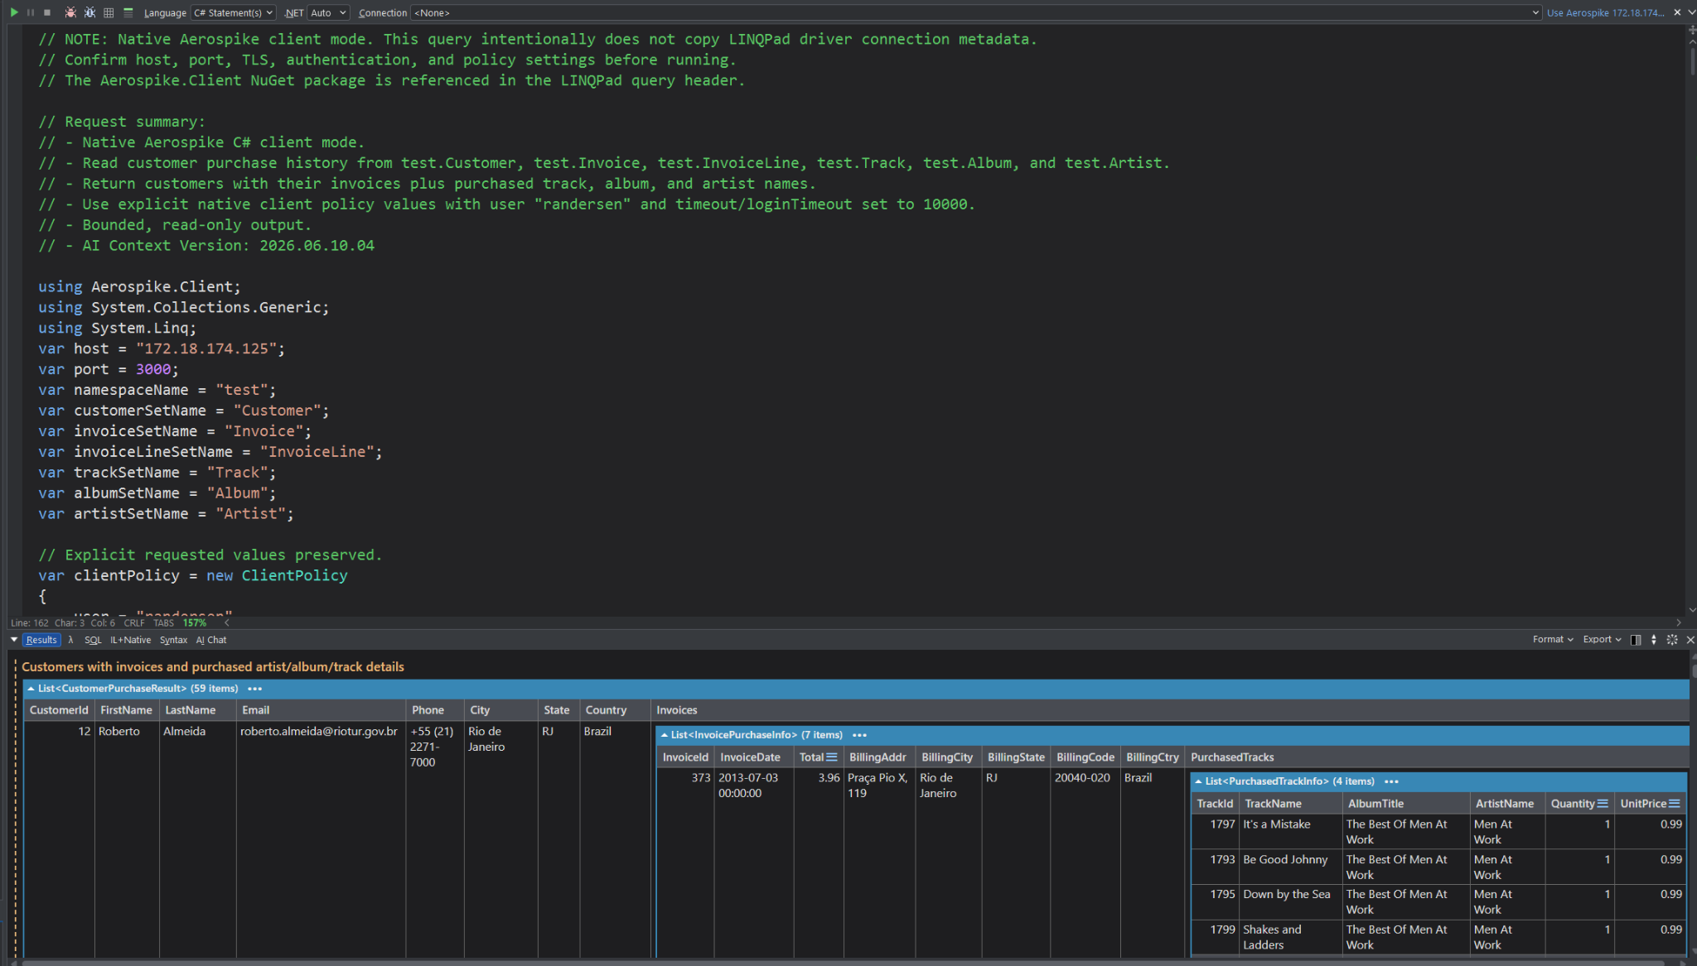
Two execution modes — one workflow
The user can ask for LINQPad-driver code or native Aerospike C# client API code.
LINQPad-driver mode
Native API mode
Generated sets, properties, AValue helpers, and driver expressions.
Explicit AerospikeClient, policies, raw bin names, and native RecordSet/ScanAll/Get/Put. Completly based on the Aerospike Native API.
Aerospike LINQPad AI
Overview deck

Slide 7
Server-side expressions and nested CDT traversal
Expression mode can push filtering to Aerospike while shaping the final result in LINQPad.
Example pattern
CDTExp.SelectByPath(...)
Exp.Or(...) + ListExp.GetByValue(...)
Query(filterExpression)
Client-side enrichment: Track → Album → Artist
Why it matters
Filter large document sets on the server, then return clean customer-shaped results.
Aerospike LINQPad AI
Overview deck

Slide 8
AValue-aware query generation
Generated code respects Aerospike schemaless data, mixed types, and nested document values.
Null-safe CDT traversal
Type-safe conversion or auto-casting
customer.Invoices.ToAValue()
where !invoices.IsEmpty
trackId.CanConvert<long>()
trackId.Convert<long>()
AValue lookup
Output shaping
line.TryGetValue("TrackId", AValue.Empty)
customer fields + MatchingTracks
AValues let the AI generate exploratory LINQPad code without assuming every record has every bin or the same type.
Aerospike LINQPad AI
Overview deck

Slide 9
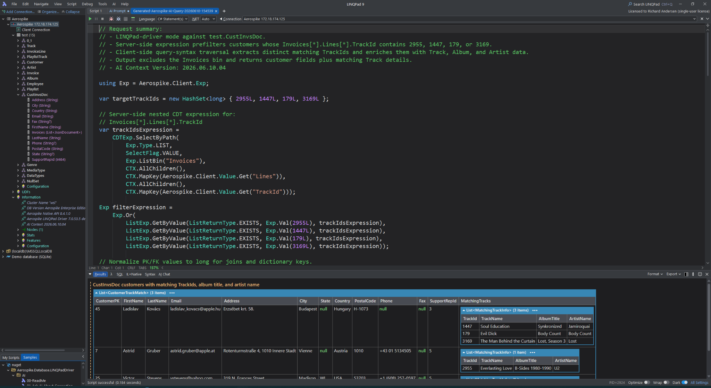
Server-side expressions for nested CDT filtering
Query syntax request: customers whose Invoices[*].Lines[*].TrackId matches 2955, 1447, 179, or 3169
Request shape
Find CustInvsDoc customers by nested TrackId
Path: Invoices → Lines → TrackId
Exclude the Invoices bin from output
Return matching TrackIds with album title and
artist name
Use LINQ query syntax plus server-side expressions
Generated strategy
Build CDTExp.SelectByPath for
Invoices[*].Lines[*].TrackId
Use ListExp.GetByValue(EXISTS, …) per target id
Pass expression to
SetRecords.Query(filterExpression)
Use client-side LINQ only for shaping and enrichment
Why it matters: server-side expression prefilters large nested document/CDTs sets in Aerospike,
then LINQPad shapes clean customer + track/album/artist results.
Aerospike LINQPad AI
Server-side expressions

Slide 10
Why this matters
A practical AI layer for Aerospike exploration inside LINQPad.
Faster exploration
Schema-aware output
Ask for the shape you want and get a runnable query.
Uses current connection metadata instead of generic examples.
Safer code
Deep Aerospike support
Bounded output, read-only defaults, summary comments, and mode-specific guardrails.
AValue, APrimaryKey, CDTs, server-side expressions, and native API mode.
Roadmap: profile-driven AI context, schema-first ordering, truncation warnings, and cleaner rule/example governance.
Aerospike LINQPad AI
Overview deck

